Slide 1

Reproducibility & Replicability survey 2021
School of Geographical sciences, University of Bristol
Contact email: lenka.hasova@bristol.ac.uk
Link to data, graphs and code: Reproducibility Survey Results on Github

Slide 2
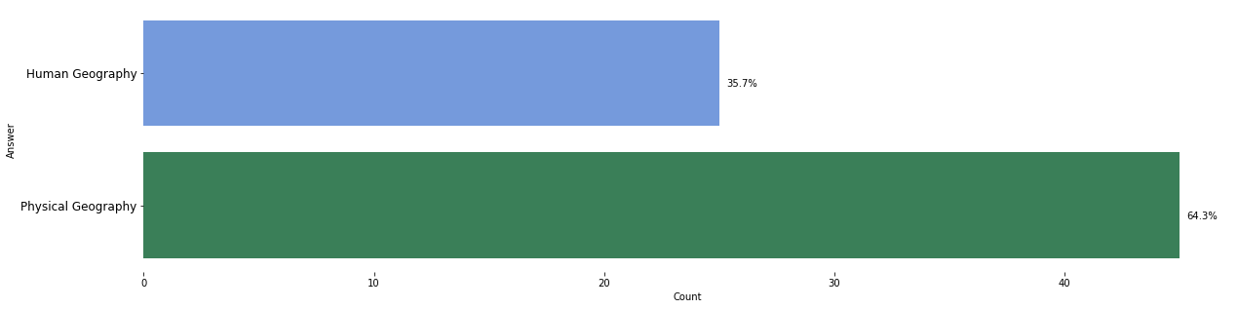
Tell us which Geography Branch do you identify with.
We have collected 70 responses within the school of Geographical sciences. Almost 36% of respondents identify as Human Geographers and 64% as Physical Geographers.

Slide 3
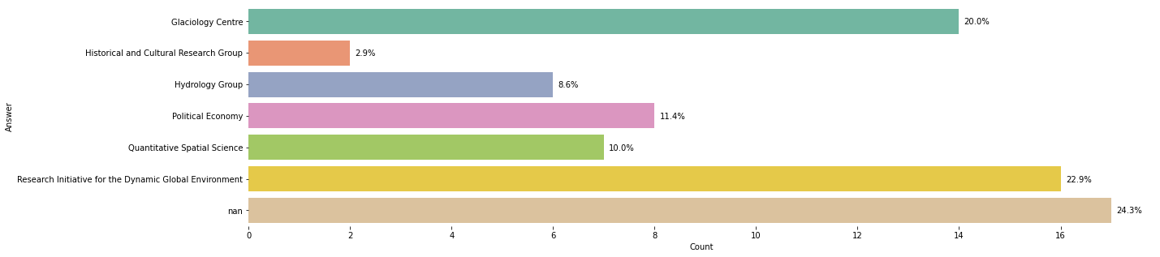
Tell us which Geography Branch do you identify with.
Almost 25% of respondents do not identify themselves with a particular research group or don't want to disclose this information. The rest of the respondents identify predominantly with Glaciology Centre (20%) or Research Initiative for the Dynamic Global Environment (23%).

Slide 4
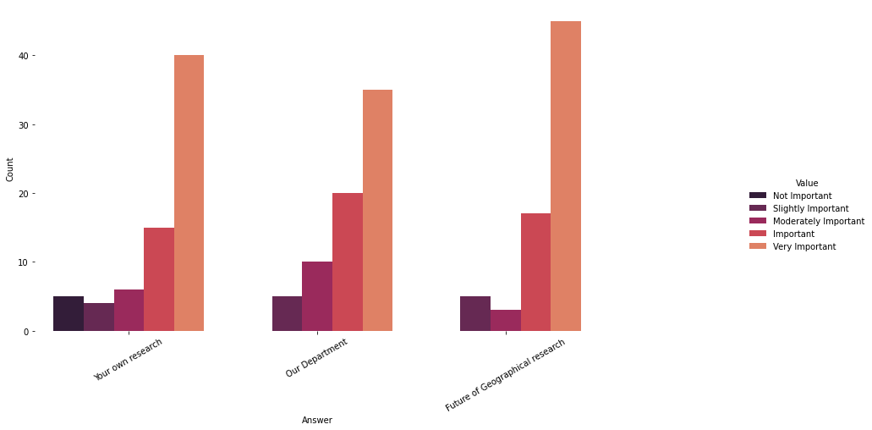
According to you, how important is the Reproducibility and Replicability of Geographical research to ...
In general, respondents feel that this topic is very important to their research as well as to our department and the future of geographical analysis.

Slide 5
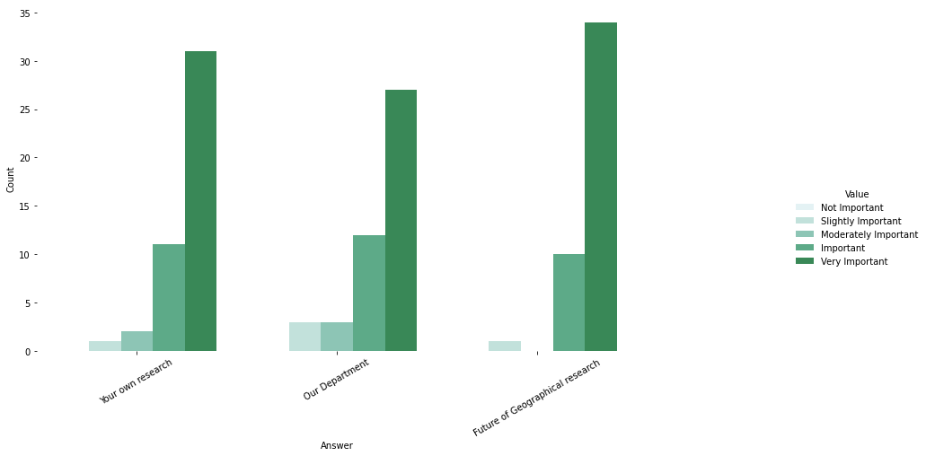
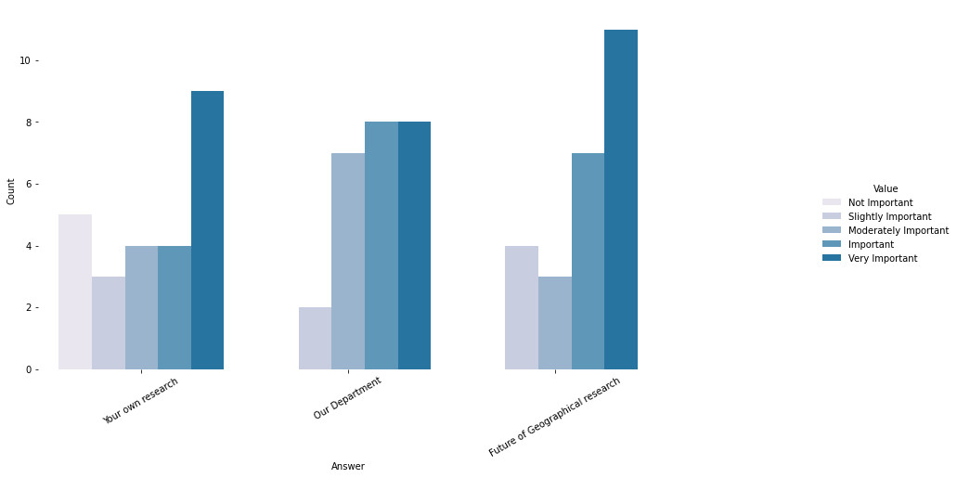
According to you, how important is the Reproducibility and Replicability of Geographical research to ...
However, there is a clear distinction between Human geographers, who feel that R&R is not as important or moderately important for their own research, and Physical geographers, who feel that R&R is much more important for their own research.
Human Geography
Physical Geography

Slide 6
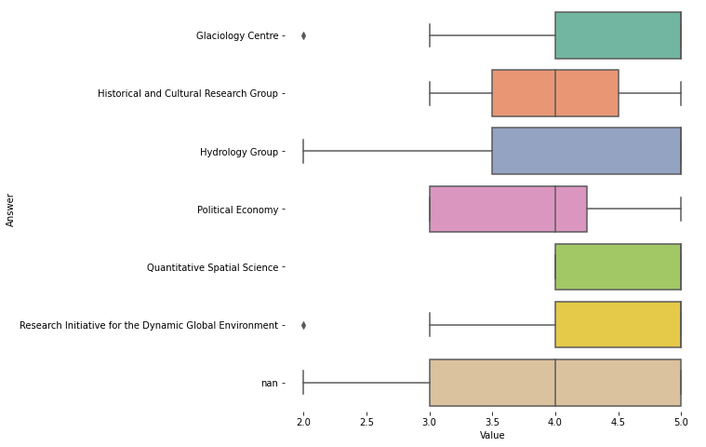
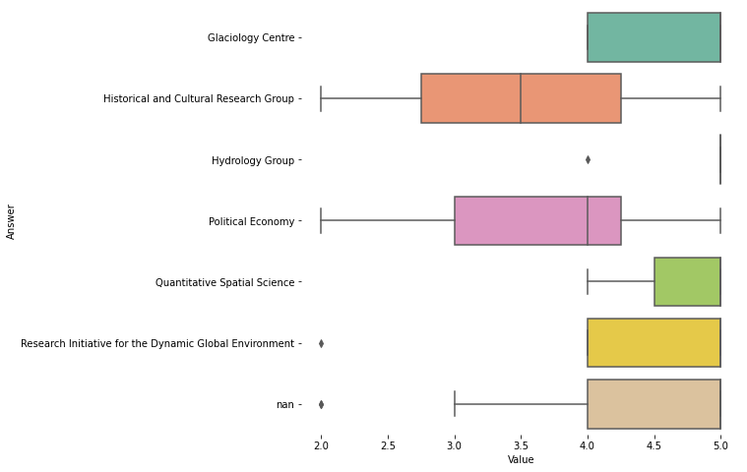
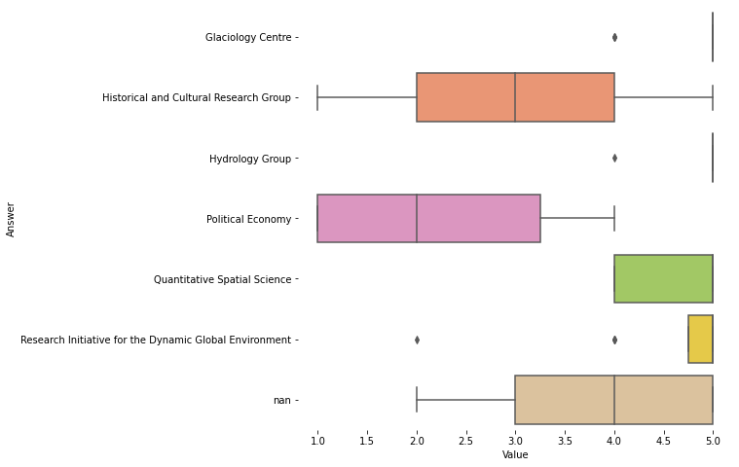
According to you, how important is the Reproducibility and Replicability of Geographical research to ...
Here we can clearly see the differences by each Research Group. While Quantitative Spatial Science and Research Initiative for the Dynamic Global Environment provided more stable answer, where all the domains are important for them, the Historical and Cultural Research Group is the most varied in its responses. For them, the R&R is more important for our department than for their own research.
Your own Research
To Our Department
To future of Geographical Analysis

Slide 7
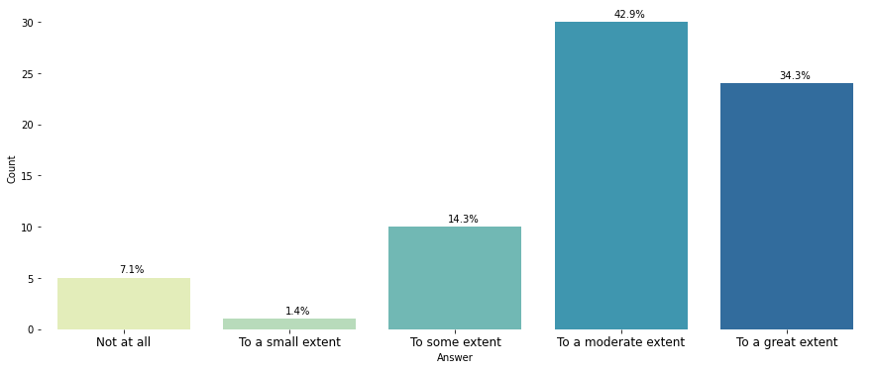
How much do you consider Reproducibility and Replicability in your own research?
Most of the respondents (91%) consider the R&R in their research to some, moderate or great extent, while only 8.5% of respondents is less inclined to R&R in their own research.

Slide 8
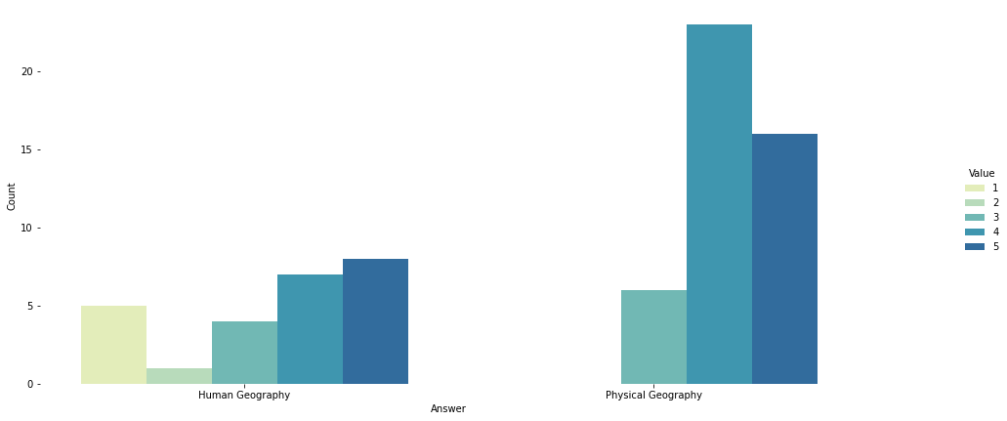
How much do you consider Reproducibility and Replicability in your own research?
We can observe a clear distinction between the Human and Physical geographers. All of the physical geographers consider R&R in their research at least to some extent, while this cannot be said about Human geographers.
Physical Geography
Human Geography

Slide 9
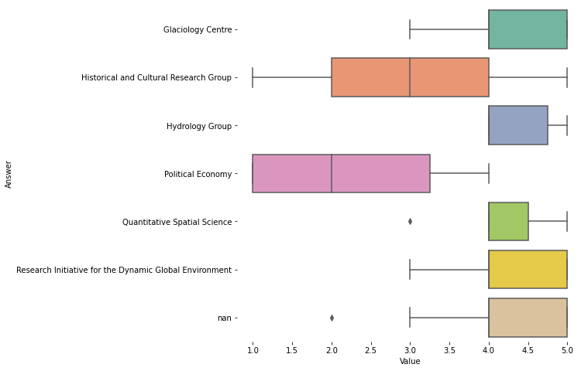
How much do you consider Reproducibility and Replicability in your own research?
This correlates also with the responses grouped by a specific Research group. The respondents identifying with Political Economy and Historical and Cultural Research Group are those who consider R&R the least or not at all.

Slide 10
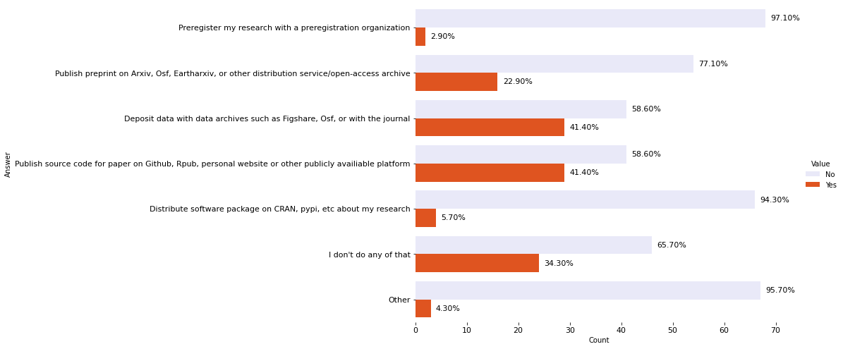
Do you publish your code/data/reproducible examples of your research?
Although there is a big proportion of people who publish their codes, data or preprints, There are quite a few people (34% of all respondents) who does not include open-source practices in their research.

Slide 11
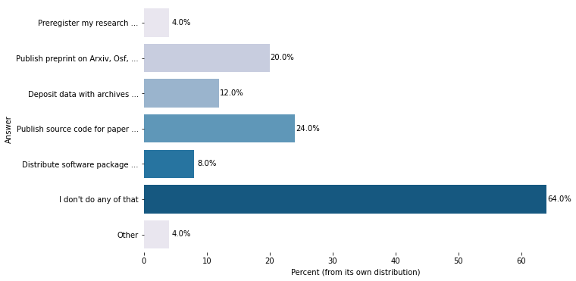
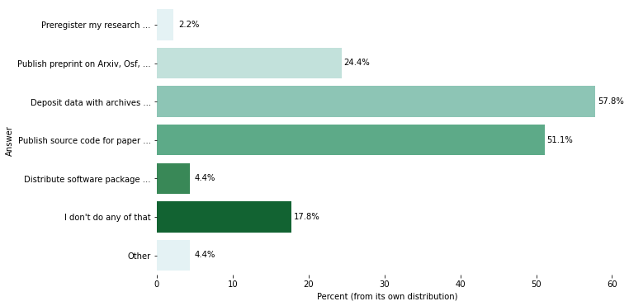
Do you publish your code/data/reproducible examples of your research?
This proportion of respondents that don't include the open-source practices in their research is visibly greater in Human Geography. The general open source publishing practices are much more present within the Physical Geographers.
Human Geography
Physical Geography

Slide 12
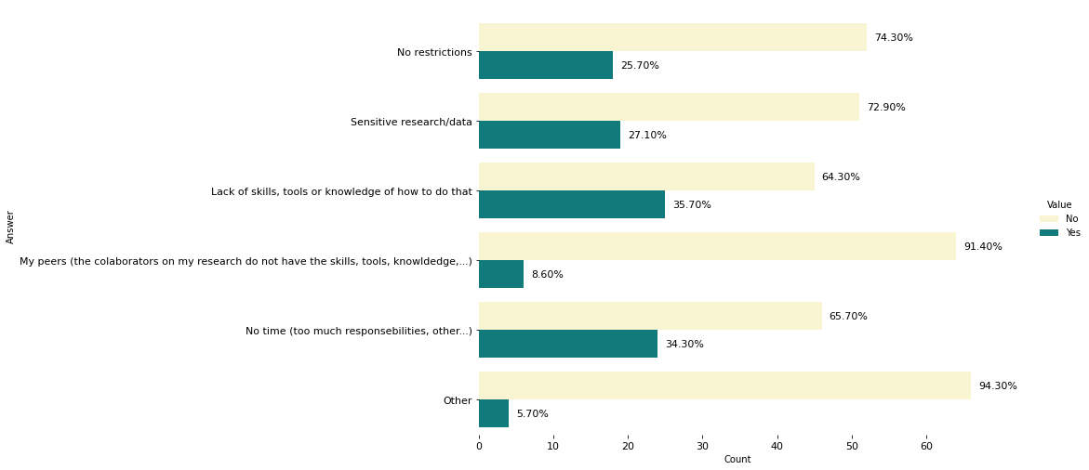
Please tell us what restricts you from publishing your code/data/reproducible examples of your research?
The respondents identified, in general, lack of skills, tools or knowledge and not having enough time as the biggest blockers when it comes to publishing their research.

Slide 13
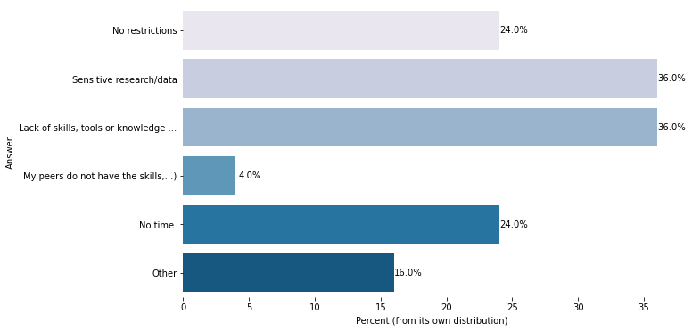
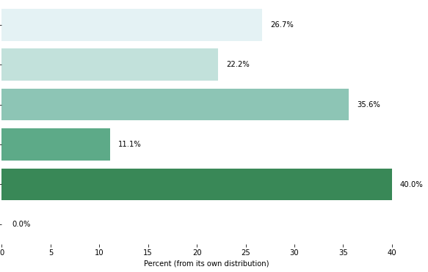
Please tell us what restricts you from publishing your code/data/reproducible examples of your research?
For Human Geographers, however, is also a major problem sensitive data or research. In comparison, Physical Geographers identified 'No time' as a stronger factor than any other.
Human Geography
Physical Geography

Slide 14
Comments
22 respondents commented on this issue. From those, roughly 72% is expressing the importance of R&R and would be happy to attend any courses, seminar or department-wide discussions aiming to increase our knowledge of this topic. Nevertheless, Roughly 20% of respondents that provided comments feel that R&R is not relevant to their research, there is no need for it or it is simply not suitable for some research designs.
Example of some of the comments:
Training on how to do this and what the different options are is needed
Never thought about it in these terms before now and don't deem it of significance to what I research or teach. I can see how it might be relevant to some.
I would be very interested in attending R&R workshops. I don't have much experience of how things are done at Bristol, but I have benefited in the past from established data management infrastructure/staff. This has massively helped in collating and publishing data and the organisation of samples.
I have to say it's the first I've come across the terminology. It seems important, even if greased towards more scientific modes of research. I think human geographers could have a fruitful discussion about what it means for them.
Would be good to have a training course. So far everything has been very learning by doing and trial and error with R&R.
R&R is essential, but seems low on the list of many researchers' and institutions' priorities. There are still many analyses that lack a standardised, scientifically-verified best practice procedure, meaning that it can be difficult to even compare results from different field seasons.\n\nImproving the conditions of the laboratories (e.g. for the instruments to work more reliably) would help to flatten the baseline of analyses, making it easier to trust in technical replicates. It would also make it more logistically feasible to run multiple analyses and hence to verify conclusions through independent methods. Similarly, buying some communal field equipment (e.g. peristaltic pumps) would make it easier to increase sample size in the field, making it easier to trust in-field replicates.
Never thought about it in these terms before now and don't deem it of significance to what I research or teach. I can see how it might be relevant to some.

Slide 15
Relevant literature
Kedron, P., Frazier, A.E., Trgovac, A.B., Nelson, T. and Fotheringham, A.S. (2021), Reproducibility and Replicability in Geographical Analysis. Geogr. Anal., 53: 135-147. Availiable here
Michael F. Goodchild, A. Stewart Fotheringham, Peter Kedron & Wenwen Li (2020), Forum on Reproducibility and Replicability in Geography, Annals of the American Association of Geographers, DOI: 10.1080/24694452.2020.1806030, Availiable here
Gelman, A. and Eric Loken. “The garden of forking paths : Why multiple comparisons can be a problem , even when there is no “ fishing expedition ” or “ p-hacking ” and the research hypothesis was posited ahead of time ∗.” (2019). Availiable here
Huntington-Klein, Nick and Arenas, Andreu and Beam, Emily and Bertoni, Marco and Bloem, Jeffrey and Burli, Pralhad H and Chen, Naibin and Grieco, Paul L.E. and Ekpe, Godwin and Pugatch, Todd and Saavedra, Martin Hugo and Stopnitzky, Yaniv, The Influence of Hidden Researcher Decisions in Applied Microeconomics. IZA Discussion Paper No. 13233, Available at SSRN

