Slide 1
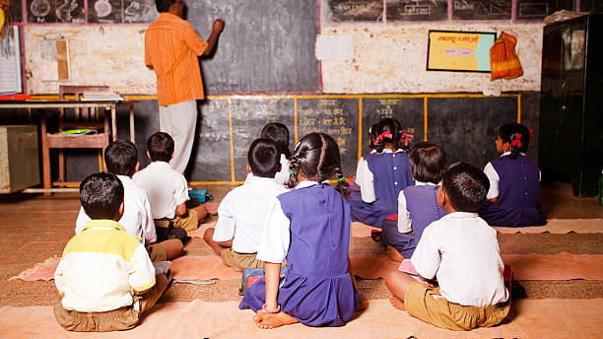
Makers Conclave 2026
AutoMark Rural:
Smart School Attendance System
Leveraging AI and Biometrics to Empower Rural Education
Team Name : E2C (Error To Clear)
Team ID : N25C01A0178
Members :
Ajay R-N25C01A0176
Gokula Krishnan V-N25C01A0096
Santhosh Kumar A-N25C01A0105
College :
CRESCENT UNIVERSITY
Problem ID : MC-11 ( Smart Attendance System )
Team ID: N25C01A0178 | Problem ID: MC-11

Slide 2
The Problem & Proposed Solution
THE CHALLENGE
THE SOLUTION
Manual attendance in rural schools creates significant administrative burdens and data integrity issues.
An offline-first, affordable automated attendance system using AI Face Recognition OR Fingerprint Biometrics.
HIGH TEACHER WORKLOAD
SIGNIFICANT IMPACT
Manual roll calls waste 15-20 minutes of valuable instructional time daily
Reduces attendance time from 15 min to under 2 min (87% reduction)
DATA INACCURACY
COST-EFFECTIVE
Error rates in manual records can be as high as 20%, affecting reporting
Total system cost under ₹10,000 per unit - affordable for rural schools
CONNECTIVITY BARRIERS
OFFLINE ARCHITECTURE
Poor internet precludes standard cloud-based attendance systems
Operates with 100% functionality without an internet connection
System Architecture: Sensor → AI → Output
Camera / Fingerprint Sensor
Raspberry Pi / Arduino
AI Processing (OpenCV)
Local Storage (SD Card)
LCD + GSM Alerts
Success Metric: Reduce attendance time by 87% (15 min → 2 min)
Team ID: N25C01A0178 | Problem ID: MC-11

Slide 3
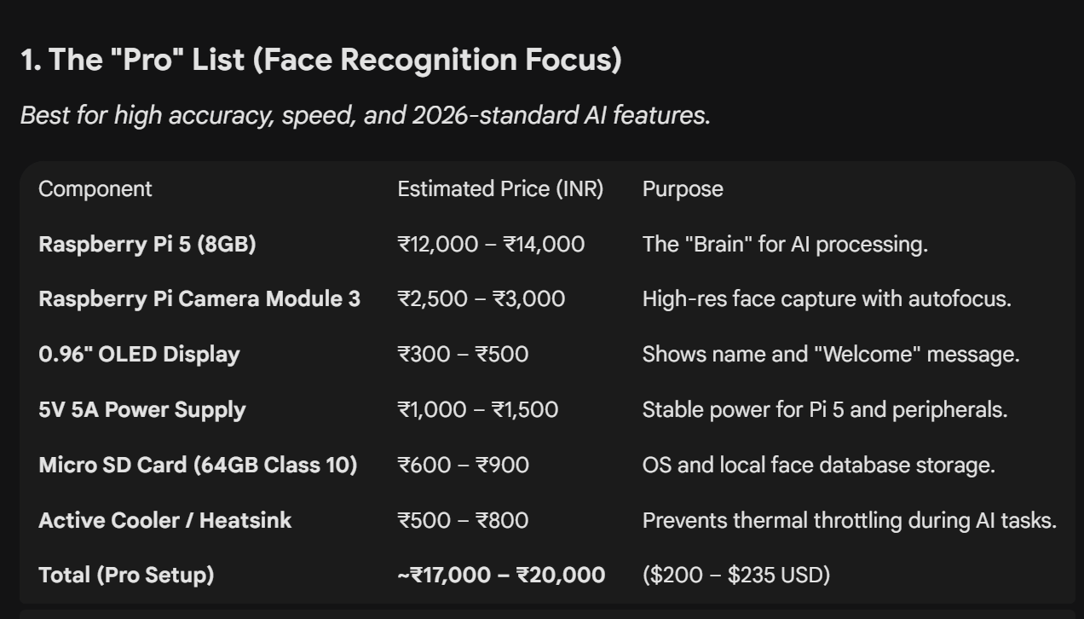
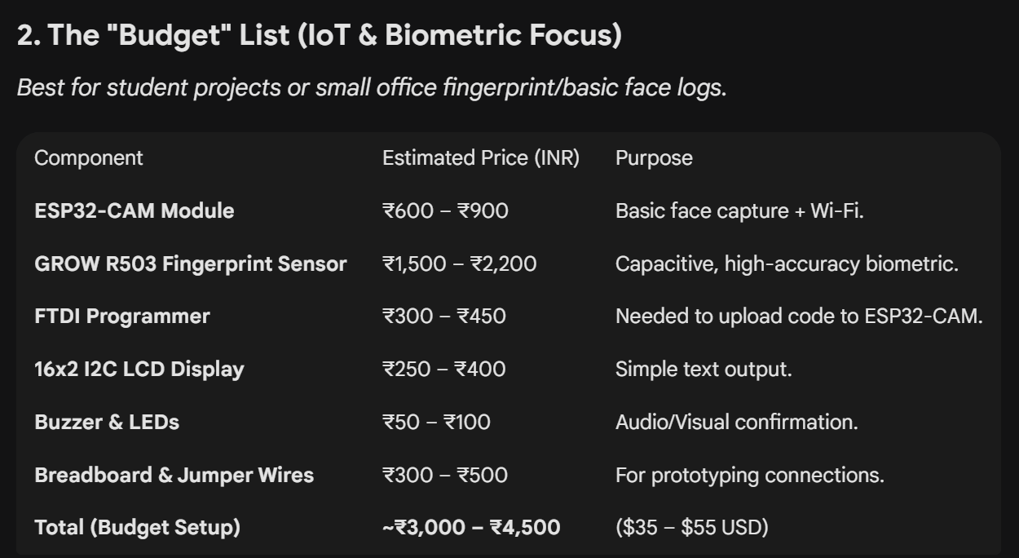
Hardware Inventory
Complete component list with specifications and costs
PRO features using AI
Low Budget Feautures
Two configuration options available: Face Recognition OR Fingerprint
Team ID: N25C01A0178 | Problem ID: MC-11

Slide 4
Implementation Timeline
60-day development roadmap with milestones and deliverables
1
Hardware Sourcing
2
Assembly & Testing
3
Software Development
4
Integration & Deployment
Week 1-2
Week 3-4
Week 5-6
Order Raspberry Pi 4, Camera Module, Fingerprint Sensor
Assemble hardware components on breadboard
Implement face recognition using OpenCV/Dlib
Week 7-8
Integrate hardware and software components
Procure LCD Display, SD Card, GSM Module
Test camera module and image capture quality
Develop fingerprint matching algorithm
Test in real school environment with 50+ students
Source power supply and enclosure materials
Verify fingerprint sensor functionality
Create offline storage system with CSV export
Train teachers on system operation
Test LCD display and user interface
Build bilingual user interface (English + Hindi)
Gather feedback and refine system
Milestone: All components received
Milestone: Hardware operational
Milestone: Software functional
Milestone: Production ready
Risk & Contingency Plan
Risk: Component Delivery Delays
Contingency: Local Vendor Sourcing
International shipping may cause 2-3 week delays for Raspberry Pi and Camera Module
Identify local electronics vendors (Robocraze, Amazon India) with 3-5 day delivery. Maintain 1-week buffer in timeline.
Team ID: N25C01A0178 | Problem ID: MC-11

Slide 5
Impact & Why This Team
WHO BENEFITS
WHY THIS TEAM
Rural Schools in India
Hands-on Hardware Experience
1.5M+
Team members have worked with Arduino, and IoT sensors in previous projects
Based on ASER 2024 data - 1.5+ million government schools can benefit
AI/ML Development Skills
Teachers Save 60+ Hours/Year
Proficient in Python and computer vision algorithms for face recognition
15-20 minutes daily saved = 60+ hours annually for instruction
Access to Test Environment
Network with rural schools through family connections and community outreach
90% Reduction in Errors
Automated system eliminates manual data entry mistakes
Genuine Passion for Impact
Team is committed to solving real problems in rural education, not just building tech
Parent Engagement
SMS alerts keep parents informed about student attendance
PATH FROM PoC TO REAL USE
1
Phase 1: Partner with 5 pilot rural schools for testing.
WHAT'S INNOVATIVE
2
Phase 2: Refine based on teacher and student feedback.
First truly offline-capable biometric attendance system designed specifically for rural constraints. Unlike cloud-based solutions, our system works 100% without internet, runs on affordable hardware under ₹10,000, and features a bilingual interface (English + Regional language) for semi-literate users.
3
Phase 3: Scale to district level through government partnerships.
4
Phase 4: Integrate with government education initiatives (Digital India).
Team ID: N25C01A0178 | Problem ID: MC-11

