Slide 1
2023-Wk05
Working Notes from Lenn

Slide 2
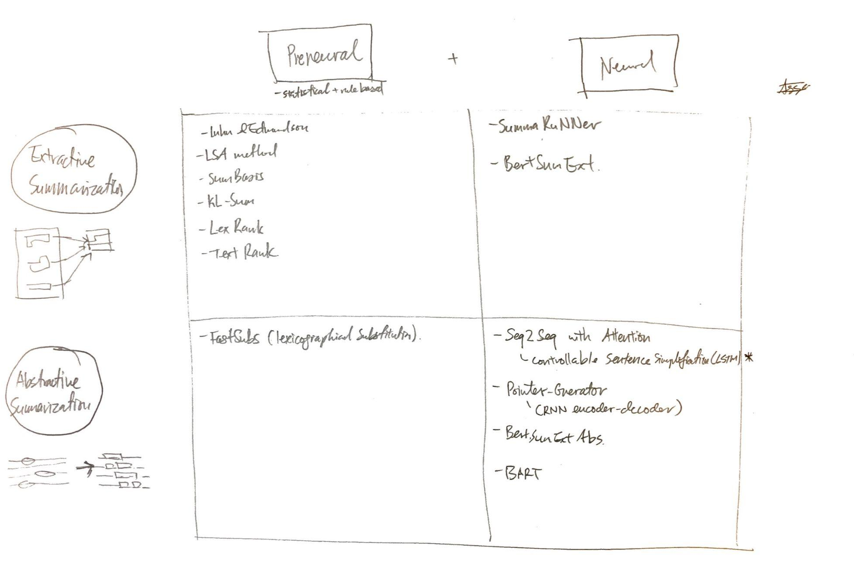
Matrix of Text Summarization Models
“What Have We Achieved” paper does great job of setting up a framework. We talked about “simplification” and “shortening”. They have called it Extractive and Abstractive and laid out various approaches.
The framework has been extended with content from “A Brief Survey”

Slide 3
Overview of Non-Neural Text Summarization Methods
If we decide to avoid seq2seq or other types, these can be our fallbacks
Luhn’s and Edmundson’s approaches:
Summary: Luhn’s approach is a heuristic-based method that involves assigning scores to sentences based on their frequency of occurrence and position within the text. Edmundson’s approach is an extension of Luhn’s method that also takes into account the contextual significance of sentences.
Pros:
Simple and straightforward
Can be easily implemented
Does not require a lot of computational resources
Cons:
Does not always produce high-quality summaries
Does not account for semantic relationships between sentences
Relies heavily on heuristics, which may not always produce accurate results
LSA method:
Summary: Latent Semantic Analysis (LSA) is a method that uses singular value decomposition (SVD) to identify latent topics in a document. The summarization process involves representing the document as a term-document matrix, reducing the dimensionality of the matrix using SVD, and then selecting the most important sentences based on their relevance to the identified topics.
Pros:
Can handle synonymy and polysemy effectively
Can capture relationships between words and phrases
Can be applied to a wide range of text types and domains
Cons:
Requires a large amount of computational resources
Can produce summaries that are dense and difficult to understand
Does not always capture the most important information in the document
SumBasic:
Summary: SumBasic is a greedy method for text summarization that selects sentences based on their importance scores. The scores are generated by combining the position of sentences, frequency of words, and term frequency-inverse document frequency (TF-IDF) values.
Pros:
Simple and easy to implement
Can produce good quality summaries for certain types of documents
Does not require a lot of computational resources
Cons:
Relies heavily on heuristics, which may not always produce accurate results
Does not take into account relationships between sentences or the overall structure of the document
Can produce repetitive or redundant summaries
KL-Sum:
Summary: KL-Sum is a graph-based method for text summarization that uses the Kullback-Leibler (KL) divergence to measure the similarity between sentences. The summarization process involves constructing a sentence graph, where nodes represent sentences and edges represent the similarity between sentences, and then selecting the most important sentences based on their centrality in the graph.
Pros:
Can handle large and complex documents effectively
Can produce coherent and concise summaries
Can take into account relationships between sentences
Cons:
Can be computationally expensive
Can produce summaries that are dense and difficult to understand
May not always produce high-quality summaries
KL-Sum:
Summary: KL-Sum is a graph-based method for text summarization that uses the Kullback-Leibler (KL) divergence to measure the similarity between sentences. The summarization process involves constructing a sentence graph, where nodes represent sentences and edges represent the similarity between sentences, and then selecting the most important sentences based on their centrality in the graph.
Pros:
Can handle large and complex documents effectively
Can produce coherent and concise summaries
Can take into account relationships between sentences
Cons:
Can be computationally expensive
Can produce summaries that are dense and difficult to understand
May not always produce high-quality summaries
LexRank:
Summary: LexRank is a graph-based method for text summarization that uses eigenvector centrality to measure the importance of sentences. The summarization process involves constructing a sentence graph, where nodes represent sentences and edges represent the similarity between sentences, and then selecting the most important sentences based on their centrality in the graph.
Pros:
Can handle large and complex documents effectively
Can produce coherent and concise summaries
Can take into account relationships between sentences
Cons:
Can be computationally expensive
Can produce summaries that are dense and difficult to understand
May not always produce high-quality summaries
Algorithm: TextRank
Summary: TextRank is an unsupervised algorithm that utilizes graph-based ranking to identify the most important sentences in a document and summarize them. The algorithm works by creating a graph of words and sentences, with edges connecting similar words, and then ranking the sentences based on the importance of the words they contain.
Pros:
TextRank is a simple and intuitive algorithm that is easy to implement.
It doesn’t require any labeled data, making it a good choice for text summarization tasks.
TextRank is capable of handling large documents, as it can be easily scaled.
Cons:
TextRank can produce summaries that are too short or too long.
The quality of the summaries produced by TextRank may be influenced by the quality of the text pre-processing.
TextRank can be time-consuming, as it requires multiple iterations to arrive at the final summary.

Slide 4
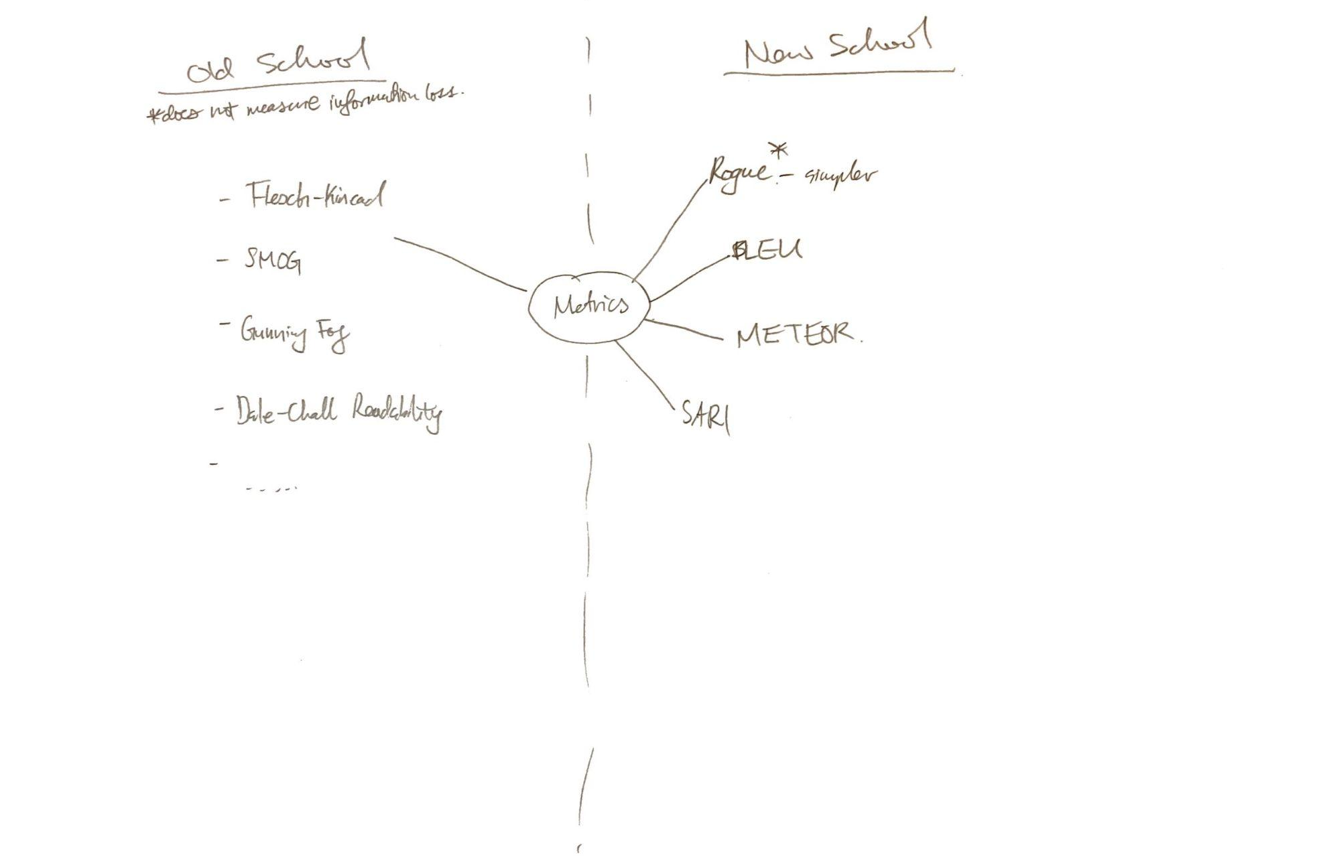
Text Summarization Metrics
Various industry metrics.
Old school metrics generally look for syntactic structure and ignore semantics.
New school is a bit opaque. SARI would be best for meaning preservation, but rogue is good enough (see paper: optimisingStatLearning)
Old School
Flesch Reading Ease: A score that measures the readability of a text based on sentence length and the number of syllables per word.
SMOG (Simple Measure of Gobbledygook): A measure of the readability of a text based on the number of polysyllabic words and sentence length.
Gunning Fog Index: A measure of the readability of a text based on sentence length, the number of words with more than two syllables, and the complexity of the words used.
Coleman-Liau Index: A measure of readability that takes into account characters per word, sentences per 100 words, and the number of words with more than 3 syllables.
Automated Readability Index (ARI): A measure of readability that takes into account the average length of sentences and words in a text.
Dale-Chall Readability Formula: A measure of readability that takes into account the difficulty of words in a text and the length of sentences.
Linsear Write Formula: A measure of readability that takes into account the average number of syllables per word and the average sentence length.
New School
ROUGE measures the similarity between a machine-generated summary and a reference summary. It calculates the overlap between the two summaries in terms of n-grams and provides several different metrics, such as ROUGE-N, ROUGE-L, and ROUGE-W, which evaluate different aspects of the summaries. ROUGE is simple to implement, easy to understand, and provides a clear evaluation of the quality of the machine-generated summaries.
SARI, on the other hand, is a more sophisticated metric that evaluates the content preservation and fluency of the machine-generated summary. It compares the machine-generated summary to the input text and the reference summary, and calculates the preservation of content, fluency, and grammaticality. Unlike ROUGE, SARI takes into account the relevance of the machine-generated summary to the input text, and it provides a more comprehensive evaluation of the quality of the summary.
In terms of the differences, ROUGE provides a simple and straightforward evaluation of the similarity between the machine-generated summary and the reference summary, while SARI provides a more comprehensive evaluation of the content preservation, fluency, and grammaticality of the machine-generated summary. ROUGE is easier to implement and understand, while SARI provides a more sophisticated evaluation of the quality of the summary.

Slide 5
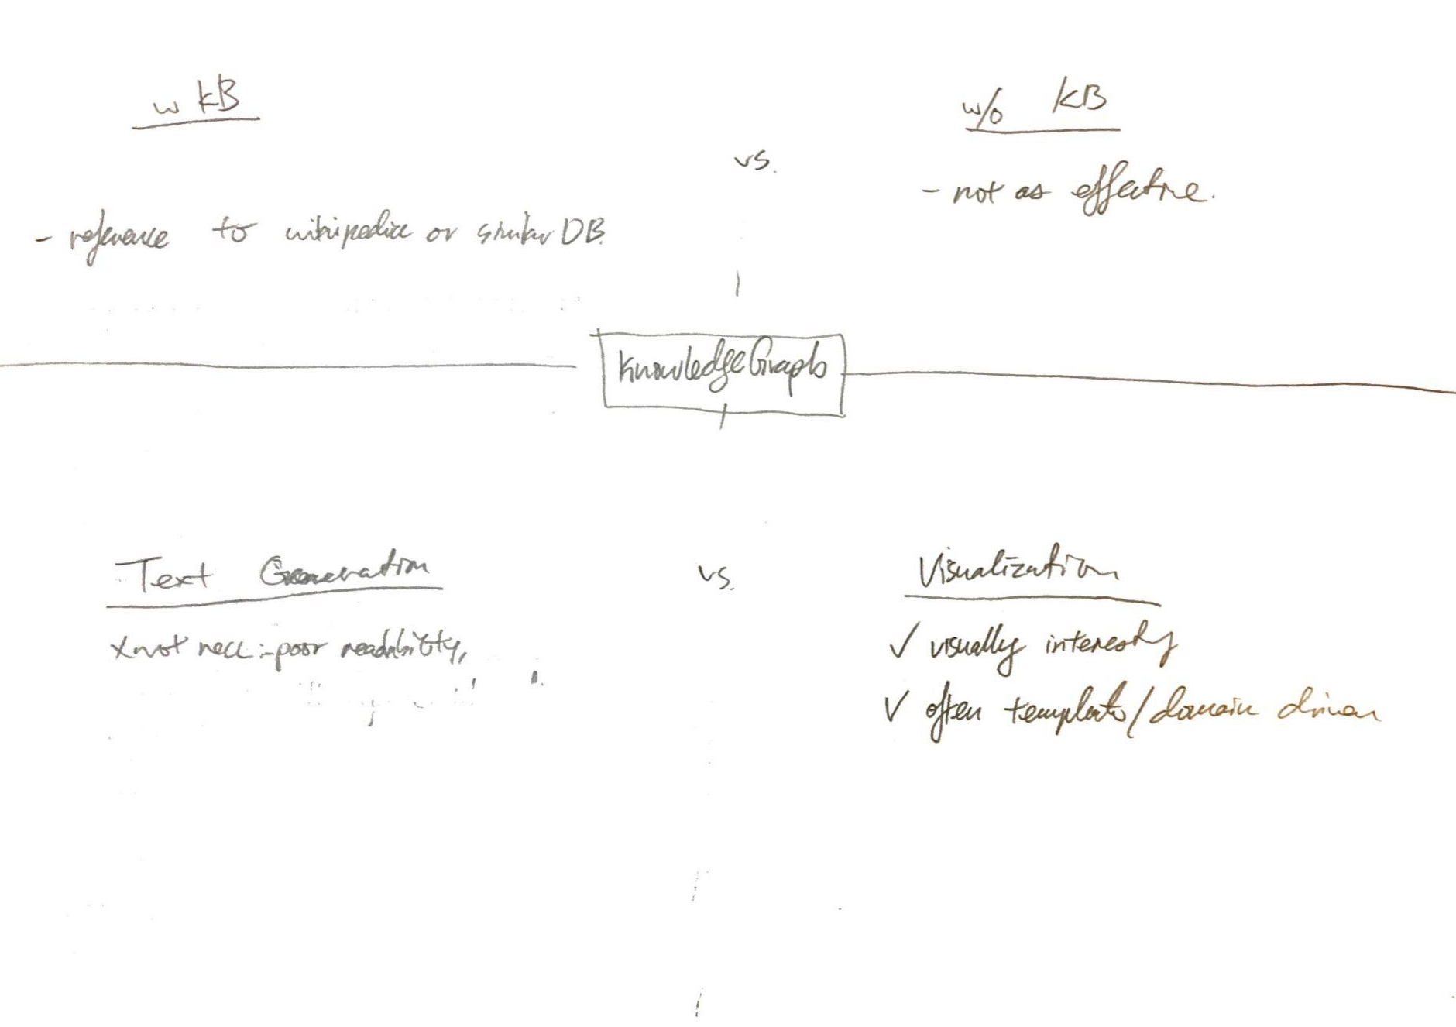

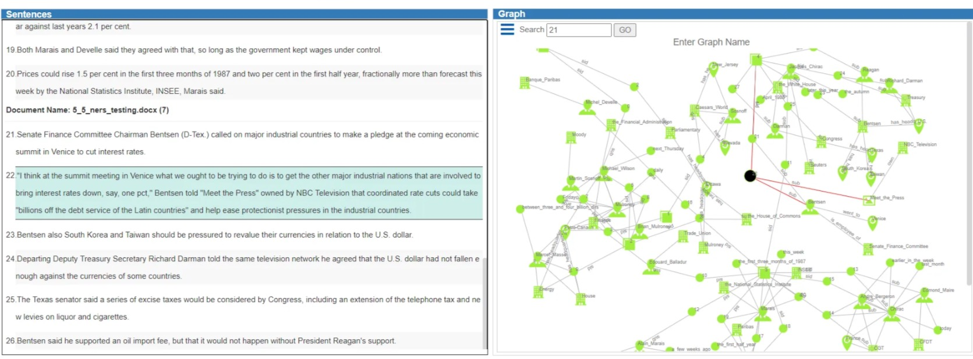
Knowledge Graph Notes
Generally, 2 types: 1x uses a reference Knowledge Base (e.g. wikipedia), 1x builds direct from doc
Text Translation always reads goofy. One paper resorted to “templated” outputs. My sense is if we want to succeed here, topical specialization will help.
Viz… can be nice when filtered or visually designed. If not, it looks really overwhelming and won’t help with learning.

Slide 6
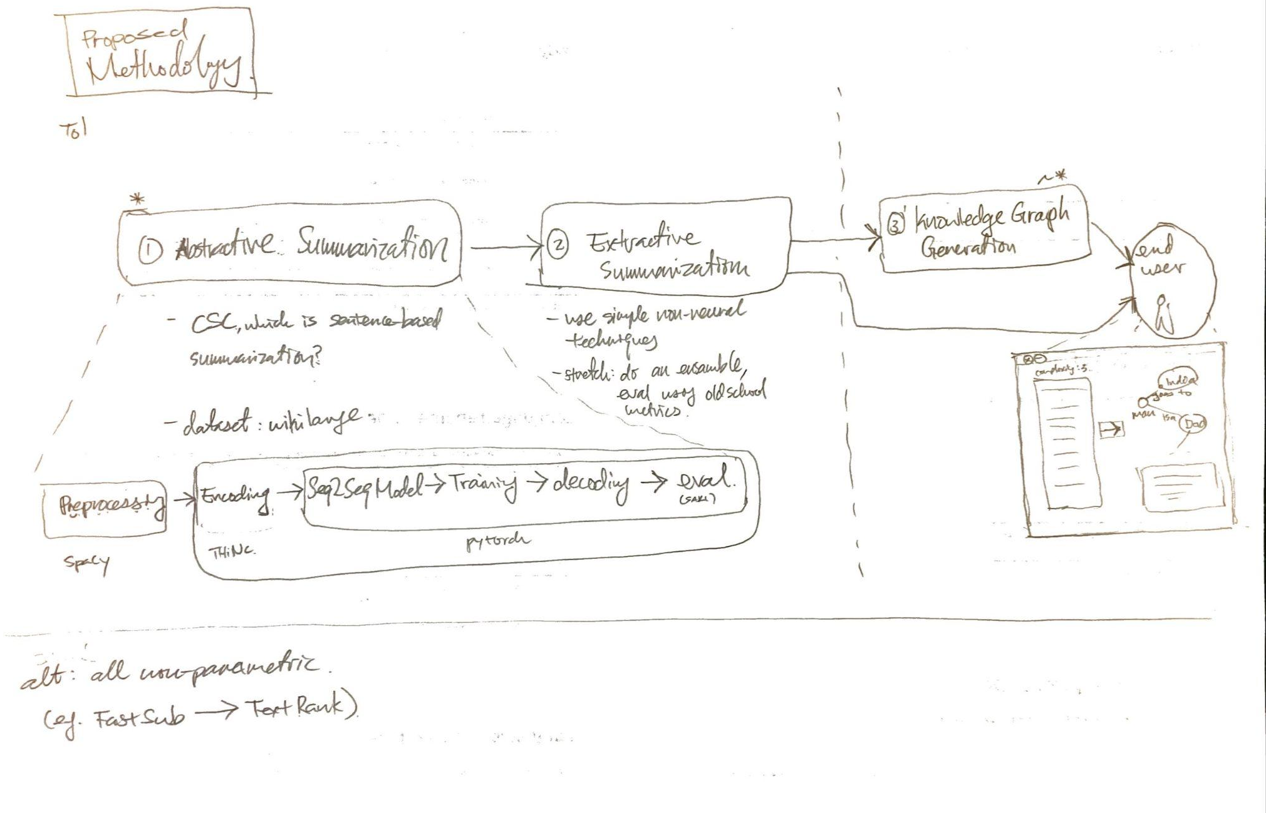
Proposed Methodology
For discussion. Below is a stab at how we can approach the problem in modular parts.
Abstractive: to use neural. Extractive, to use non-neural. Knowledge Graph as a supplement to the summarized text.

Slide 7
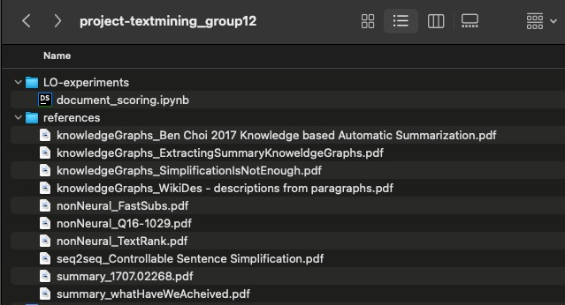
Useful Papers
All “summary_” prefixes are great reads! Easy to digest and will give some overview of the challenges and solutions that lay ahead of us
Some naive implementations attempted… TextRank has been implemented along with a FK scoring mechanism. Check out the Jupyter Notebook
It was eye-opening to skim the KnowledgeGraph papers. It is indeed a challenge. The text output was very poor and graphs had too many irrelevant results.

Slide 8
Web Links
Interactive network graph libraries:
PyVis
Knowledge Graphs:
Text to Knowledge Graph. Knowledge Extraction Pipeline with… | by Prasad Y | The Startup | Medium
leadsemantics: Extracting Knowledge from Text
Knowledge Graphs in Natural Language Processing @ ACL 2020 | by Michael Galkin | Towards Data Science
Build knowledge graph using python | Kaggle,
Generating Knowledge Graphs with Wikipedia | by Jye Sawtell-Rickson | Jan, 2023 | Towards Data Science,
A review: Knowledge reasoning over knowledge graph - ScienceDirect,
An Introduction to Knowledge Graphs | SAIL Blog
Template Oriented Text Summarization via Knowledge Graph | IEEE Conference Publication | IEEE Xplore
Text Summarization:
How to do text summarization with deep learning and Python - ActiveState
Readability index:
Flesch–Kincaid readability tests - Wikipedia
Some points I’m throwing in for our next discussion
Approach - neural or non neural?
Project Parts - what needs to be implemented?
Goals - baseline vs stretch
Team Setup -
divide and conquer?
stick together?
That’s all from me. Have a great week all! 🙌

