Slide 1
Data-Science-Project

Slide 2
TOpics
Research Questions
APIs
Achivements
Upcoming steps
Challenges

Slide 3
Air pollution

Slide 4
Air Pollution – research Questions
1. How do the average yearly values of PM10, PM2.5 and NO₂ change in Germany from 2016-2026?
2.1 How did New Years Eve change the air pollution from 2016 to 2025?
2.2 How did the COVID-19 pandemic affect the air pollution compared to the previous and following years?
3 How much do the annual average values for PM10, PM2.5, and NO_2 differ between the federal states in the period 2016–2026?
4.1 How do the PM10 concentration between urban, suburban and rural areas differ in the period 2016-2026?
4.2 Do the data for urban, suburban, and rural measuring stations differ in terms of the positioning of the stations (background, traffic, industry) in the period 2016-2026?

Slide 5
Air Pollution – Research QUestions
5 How do the PM10 concentrations vary between seasons in the years 2016 to 2026?
6.1 How does daily maximum temperature influence PM10 and PM2.5 concentrations in major German cities between 2016 and 2026?
6.2 How do rainfall patterns relate to changes in PM10 and PM2.5 concentrations in major German cities between 2016 and 2026?
7 What is the impact of summer school holidays in the individual federal states on NO_2 concentrations in the years 2016 to 2026?
8 How does Germany compare to other countries in terms of the daily average concentrations of PM2.5, PM10 and NO2?

Slide 6
Air pollution – our Apis
Bund.DEV air quality API
Umweltbundesamt air data API
Open-Meteo weather API
schulferien-api

Slide 7
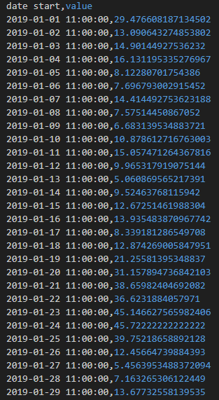
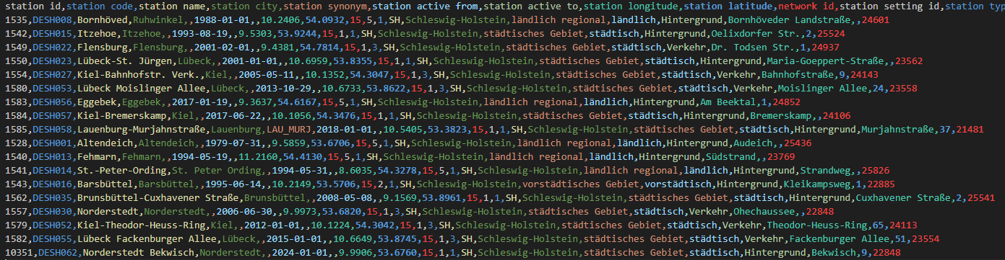
Air pollution - achievements

Slide 8
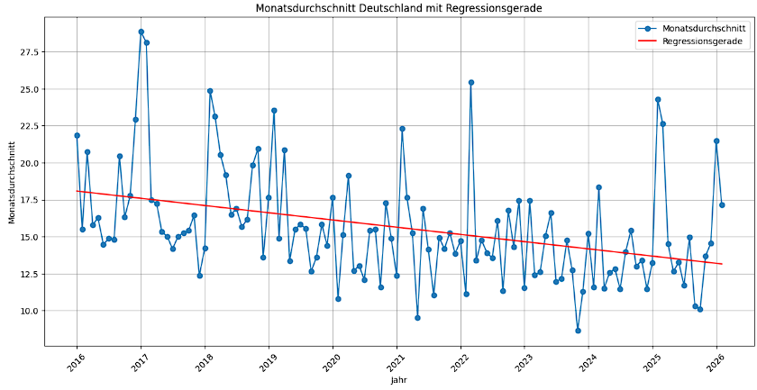
Air pollution – Monthly Average Germany

Slide 9
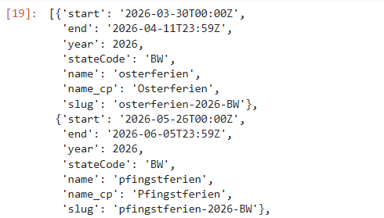
Air Pollution – Api Output Summer Holiday
Using the https://schulferien-api.de/api/v2/2026/ API
Shows School Holidays by year and State

Slide 10
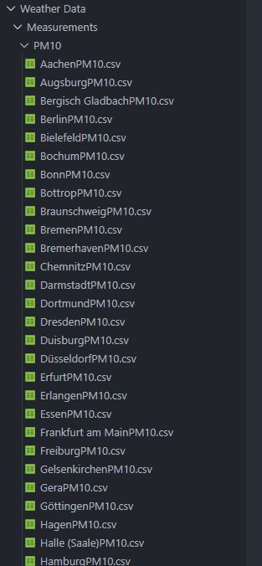
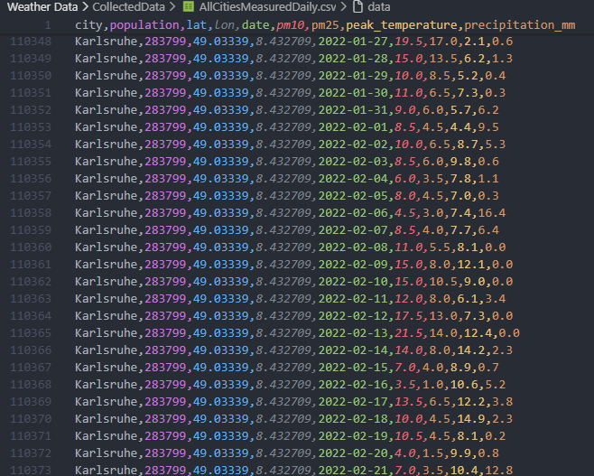
Air Pollution – Weather API

Slide 11


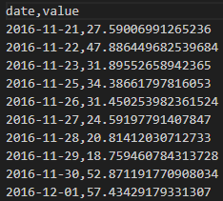
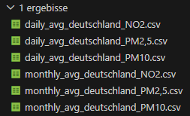
Air Pollution – comparison to other countries
OpenAQ API
e.g. Germany vs. France -> compare daily average concentrations of PM2.5, PM10 and NO2

Slide 12
Air Pollution – Upcoming steps
CSV files with the relevant data for research questions 1 to 5 are already complete
CSV files for questions 6 to 8 are also partially complete, and the rest should be available by the end of the week at the latest
Once everything is available, we can start working on presenting the CSV data in the form of graphics for better visualization. However, we first need to look at how to implement the dynamic display

Slide 13
Air Pollution – Challenges
• with some APIs, you can only make a limited number of requests

Slide 14

Thank you

