Slide 1
Bus and Coach Health and Wellbeing Study How tailored health programs can positively influence productivity, wellbeing and strength of the bus and coach industry
Nikki Brouwers
Managing Director
The Interact Group
Nikki@interactgroup.com.au
0419618868

Slide 2
Background
Together with BIC and APTIA, we developed the Bus and Coach Health and Wellbeing Study to assist the industry in understanding the current landscape of Driver health and wellbeing in an industry faced with common workforce issues such as bullying and harassment and an aging staff demographic.
International research tells us that if employers consider how they can build a healthy workplace, not simply because of Work Health & Safety laws, but because it makes good economic and social sense, that it ultimately delivers benefits to everyone.

Slide 3
An industry ‘first’ – why we did this

Slide 4
A day in the life of a bus driver
We worked with our case study, Forest Coach Lines, to identify the environmental, physical, cognitive and psychological demands of their drivers.
We then used this experience to measure the impact that these demands have on an individual Driver’s health and wellbeing.
Following this was the introduction of a series of tailored health and wellbeing initiatives to Forest Coach Lines Drivers of which the results could be measured.

Slide 5
What we did next
Bully and Harassment Training
96% participation rate – positive response from staff
Employee Assistance Services
24 hour confidential telephone counselling service
Onsite access to Chiropractors
Workplace injury management and prevention
Visible nutritional and dietary guidance
Fresh fruit bowl (100% awareness from staff) and ‘health noticeboard’
Exercise programs
Staff tracked their daily step count using pedometers – this encouraged them to be more active throughout the day to increase their count.

Slide 6
The Results
Strong evidence that tailored health and wellbeing solutions positively influence Driver productivity, health and wellbeing.
Key results from Forest Coach Lines’ participation in the Study include:
Almost all study participants (96%) completed the Interact Group’s bullying and harassment training with 96% of participants indicating that they had not experienced bullying or harassment since the trials (these figures have shown a positive improvement since an initial survey was undertaken by Interact in 2012).
80% of participants indicated a positive relationship with their Supervisor or Manager and 15% indicated average relationship (these figures have shown a positive improvement since an initial survey was undertaken by Interact in 2012).
69% of Study Participants were aware of company policies designed to improve health and wellbeing.
100% of Study Participants were aware of the availability of a fresh fruit bowl to encourage healthy diet choices.
62% of participants were aware of free 24/7 confidential telephone counselling service

Slide 7
Conclusion
Driving a healthy, strong and productive workforce of the future.
The aim of the Bus and Coach Health and Wellbeing Study is to act as a preliminary piece for the industry to ensure continued and improved productivity whilst improving employee health and wellbeing.

Slide 8
The Interact Group Offices Across NSW/ACT
North Sydney Level 16, 201 Miller Street North Sydney NSW 2060 Phone: 02 9460 2444 Fax: 02 9957 1000 | Sydney Level 21, 123 Pitt Street Sydney NSW 2000 Phone: 02 9223 4500 Fax: 02 9230 0600 | Orange Suite 2, 65 Hill Street Orange NSW 2800 Phone: 02 6361 8868 Fax: 02 6362 9623
Tamworth Shop 2, 1 Kable Avenue Tamworth NSW 2340 Phone: 02 6766 6177 Fax: 02 6766 4677 | Newcastle Suite 14, Level 1, 50 Glebe Road The Junction NSW 2291 Phone: 02 4961 5588 Fax: 02 4961 6033 | Port Macquarie 17 Hollingworth Street Port Macquarie NSW 2444 Phone: 02 6583 4844 Fax: 02 6583 2542
Liverpool Level 2, 215-219 George Street Liverpool NSW 2170 Phone: 02 9460 2444 Fax: 02 9957 1000 | Tweed Heads 5/1 Sands Street Tweed Heads NSW 2485 Phone: 02 6622 3466 Fax: 02 6622 3577 | Canberra Level 1, The Realm 18 National Circuit Barton ACT 2600 Phone: 02 9223 4500 Fax: 02 9230 0600
Coffs Harbour 2b, 140 West High Street Coffs Harbour NSW 2450 Phone: 02 6652 8991 Fax: 02 6652 8131 | Lismore Suite 4P, Conway Court, 17 Conway Street Lismore NSW 2480 Phone: 02 6622 3466 Fax: 02 6622 3577

Slide 9
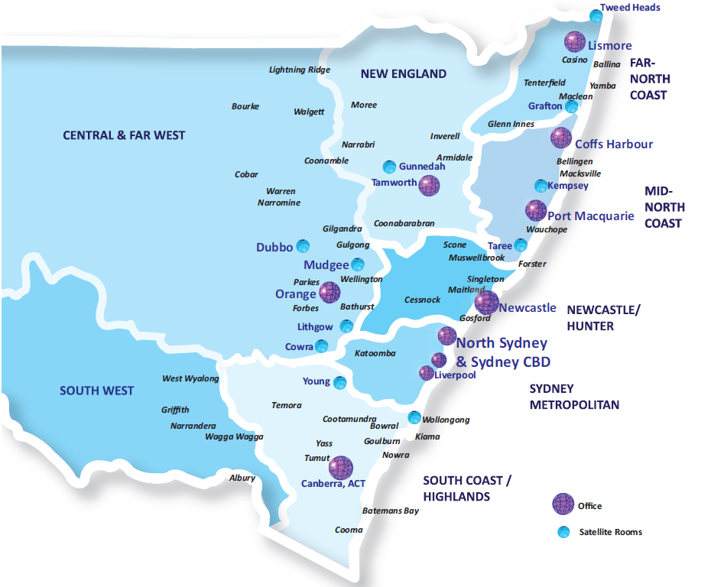

Slide 10
Notes:
You have seen this in your industry news.

Slide 11
Thank you
Nikki Brouwers
Managing Director
The Interact Group
Nikki@interactgroup.com.au
0419618868

