Slide 1
UN Year of Water Cooperation Australian examples of conflicts and their resolution measures. 23 February 2013 Professor Jennifer McKay
Director, Centre for Comparative Water Policies and Laws, Business
School and,
Part time Commissioner for the Environment Resources and Development Court SA

Slide 2
An old conflict
They hang the man and flog the woman
That steal the goose from the common,
But let the greater villain loose
That steal the common from the goose.
English folk poem, 1764
Whiskey is for drinking, water is for fighting about Mark Twain

Slide 3
UN Year of Water Cooperation
Raise awareness on potential for increased cooperation
Challenges facing water, management in the light of increased demand for food (nationally and Australia as food bowl for neighbours) and water
Here I will focus on Australian case studies.

Slide 4
Framework for Australia

Slide 5
Case study approach
pre Water Act 2007
NSW and SA water plans asserting Minister control over volume of use since 1990
Victoria entrenching Ministerial power 2011
Queensland alliance of 3 local govt
SA/VIC Border groundwater sharing agreement and institution
Water Act 2007 preserves State sovereignty implies duty of good faith to negotiation.

Slide 6
State sovereignty
States have sovereignty but recently Water Act 2007 has had an impact on this.
Urban and rural examples of state sovereignty will be given
Prospective thoughts on Water Act

Slide 7
results of our research
Water planners and community perceptions of federal governance of water

Slide 8
SA and Victoria early Political Challenges in Water Allocation between States

Slide 9
commentary on the cartoon
Victoria is the epitome of the frivolous woman of fashion of the day – her dress
elaborately flounced and trimmed, her neckline daringly exposed and her skirts short enough to reveal very high-heeled shoes. She has attached a garden hose to the water tank, once again allowing only an isolated drop to fall into South Australia’s little bucket. The caption reads: ’You see I intend to treat you with sisterly regard in the

Slide 10
commentary on the cartoon
caption was a bitter critique of the ‘family’ of
Federation, in which the smaller states languished
at the mercy of the larger

Slide 11
Victoria v SA water
The caption reads: ’You see I intend to treat you with sisterly regard in the matter.
You will observe that the droppings I allow to go to you absolutely without condition’. The caption was a bitter critique of the ‘family’ of Federation, in which the smaller states languished at the mercy of the larger.

Slide 12
Appeals to Prime Minister Deakin
South Australia is appealing to the
Commonwealth, shown in the figure of the dapper
Prime Minister Alfred Deakin, also of course a
Victorian. ‘Here Deakin’, he says, ‘make him turn
off the tap. Look at the dribble he’s leaving me.’

Slide 13
Early Days
South Australia is appealing to the
Commonwealth, shown in the figure of the dapper Prime Minister Alfred Deakin, also of course a
Victorian. ‘Here Deakin’, he says, ‘make him turn
off the tap. Look at the dribble he’s leaving me.’

Slide 14
previous documents
Courtesy Margaret Anderson
Director, History Trust of South Australia

Slide 15
SA THE ROLE OF THE VICTIM
From the 1880s each of the colonies had also conducted a number of official enquiries into the use of the waters of the Murray. At first New South Wales and Victoria refused to include South Australia in their deliberations.

Slide 16
Constitution
Left water to States section 100.
this has become entrenched in the national psyche

Slide 17
Section 100
The Water Act is based on suite of Commonwealth powers s .51(i), (ii), (viii), (xi), (xv), (xx), (xxix) (xxxvii), (xxxix), s122 notably the referral of power under section 51(xxxvii).
There are specific attempts in many sections to read down provisions so as not to infringe section 100. (s.11) to create Commonwealth water legislation (s.14).

Slide 18
Universal metering- Unique Australian context

Slide 19
The Present-Water Act 2007 copyright UniSA Copyright unisa

Slide 20
Australia up to 2007
McKay J, Fresh water
New perspectives on Water in Australia 2007
Melbourne University Press

Slide 21
Instrument - state level water plan and Basin Plan
The Water Act requires these to be done and accredited as in the national interest
The accreditation process has not happened yet as the community are unhappy. 3 ATTEMPTS TO BALANCE ESD. Problem perception of unfairness and loss of State sovereignty
Philosophical issue can regional plans be amalgamated? Several regional interest plans do not make a whole.

Slide 22
Decisions of Australian courts on regional water allocation and water plans
water plans interpreted strictly no discretion in Minister to vary a plan
ESD used to reduce water allocations by up to 50%
pro-rata reductions seen as fair
normal administrative law rules apply so there must be procedural fairness.
Recently, Harvey used immediate past use

Slide 23
State plans since 1990
1 the construction of the ESD obligation in the relevant State act.
2 the type of body drafting the plans also derived from the Act,
3 the type of review power in the relevant act setting up the court, and
4 these are only persuasive on each other

Slide 24
Principal water management agencies and laws applicable to each state and territory
State or territory | Lead jurisdictional body for water management / Principal legislation | Name of the Plan | No of plans as on 30 June 2010
Australian Capital Territory | Environment ACT/ Water Resources Act 1998 | Water Resources Management Plan | 1
New South Wales | Department of Natural Resources/Water Management Act 2000; Water Act 1912 | Water sharing plan | 54
Northern Territory | Department of Natural Resources, Environment and the Arts/Water Act 1992 | Water allocation plan | 3
Queensland | Department of Natural Resources, Mines and Water / Water Act 2000; Wild Rivers Act 2005;Integrated Planning Act 1997 | Water resource plan | 21
South Australia | Department of Water/Natural Resources Management Act 2004; Groundwater (Border Agreement) Act 1985 | Water allocation plans | 15
Tasmania | Department of Primary Industries and Water/ Water Management Act 1999 | Water management plans | 6
Victoria | Department of Sustainability and Environment /Water Act 1989;Groundwater (Border Agreement) Act 1985 | Regional sustainable water strategies | 2
Western Australia | Department of Water /Rights in Water and Irrigation Act 1914 | Water management plans/Water Allocation Plans | 11

Slide 25
Are Statutory Water Plans the right way to approach sustainable water policy? (water planners responses)
YES - 61.5%
But also pointed out some concerns:
unfairness in the processes for public consultation,
lack of knowledge of local,
cost of development and implementation of water plans, and
uncertainties in the science.

Slide 26
Corporatisation who is sovereign?
Victoria has chosen to entrench in its Constitution act a requirement that delivery of water services shall be by a body that reports to a Minister.
Other States do this but not in their Constitutions and not entrenched
Constitution Act 1975 as amended sections 18(2) h and Part V11

Slide 27
Delivery of Water Services
Constitution Act 1975 - SECT 18
Power for Parliament to alter this Act
18. Power for Parliament to alter this Act
three-fifths majority of all of the members of both the Legislative Council and the Legislative Assembly before it can be submitted for royal assent

Slide 28
Hansard Vic
Mr BRACKS (Premier) - I move:
That this bill be now read a second time.
Honourable members will agree that the provision of water services, at reasonable cost, is a matter of primary importance to our community. It was for this reason that, at the last election, this government made a commitment to ensure that our water authorities remain publicly owned and directly accountable to the people of Victoria. To secure the public control of water services, an amendment to Victoria's constitution was proposed to entrench the public ownership of our water authorities.

Slide 29
allows public private partnerships but ..
A new part VII will be added to the constitution to require public ownership of water authorities. If a public authority has the responsibility for ensuring the delivery of a water service, that responsibility must be carried on by that authority or another public authority. This does not exclude public-private partnership arrangements whereby the private sector provides infrastructure or performs services under contract with a water authority. This bill makes it clear that a public authority may enter arrangements with the private sector for the provision of water services but cannot abdicate its ultimate responsibility for ensuring the delivery of water services under these arrangements or have that responsibility removed from it.

Slide 30
Queensland- water supply sovereignty
Allconnex a consortium of three local governments was dis-established in June 2012

Slide 32
The current share (Groundwater licence entitlements along the SA/Vic border)
South Australia 172 GL | Victoria 53 GL

Slide 33
Border groundwater

Slide 35
Border groundwater
5 people from each State decide water allocation in the zones.
huge reduction in allocations in the zones to achieve ESD
for example11A from 12000Gl to 1823 Gl
pressure on this agreement due to SA Govt initiative on regulating Forestry use unique

Slide 36
1985
PAV (ML/yr) | Zone | Zone | PAV (ML/yr)
12000 | 11A | 11B | 12000
6000 | 10A | 10B | 6000
6000 | 9A | 9B | 6000
3500 | 8A | 8B | 3500
4500 | 7A | 7B | 4500
5500 | 6A | 6B | 5500
11500 | 5A | 5B | 11500
11000 | 4A | 4B | 11000
16500 | 3A | 3B | 16500
25000 | 2A | 2B | 25000
71000 | 1A | 1B | 71000

Slide 37
2010
PAV (ML/yr) | Zone | Zone | PAV (ML/yr)
3700 | 11A | 11B | 1823
14000 | 10A | 10B | 6720
11206 | 9A | 9B | 5960
6309 | 8A | 8B | 6760
10270 | 7A | 7B | 6600
8850 | 6A | 6B | 9838
18943 | 5A | 5B | 11949
22102 | 4A | 4B | 14000
24054 | 3A | 3B | 16500
25000 | 2A | 2B | 25000
31812 | 1A | 1B | 45720

Slide 38
Issues with the macro plan for the MDBA
Two million people
14% of Australian land area
40% of the gross value of agricultural output using over 50% of water
94% of rainfall evaporates
4% runs off
2% groundwater recharge
Mean annual runoff 23,850 GL presently 11,200 GL

Slide 39
Water act 2007
It requires State water plans to have certain content (s. 22 and s. 55) be accredited (s. 56) by the Commonwealth or adopted (s.57).
It aims for the new Murray-Darling Basin Authority (MDBA) to create a Basin plan (for MDB waters only). And this must be designed to achieve ESD

Slide 40
Volumes allocated- consumptive vs Environment
PM Gilliard has announced a 3200GL back to the river which is an extra 450 billion litres from 2019 also pledged $1.7 billion $ over a decade from 2014.
This will achieve some ecological goals
Goundwater is connected and this will help it survive.

Slide 41
Water Act 2007
It leaves the water laws in the competence of the States but provides protocols as the content of instruments such as water plans (s. 19, 20, and 22)[3] created under State laws

Slide 42
Water Act 2007
It makes the basin plan a legislative instrument (s 33) and this means that any State law to the contrary is invalid s109
allows review by courts exercising federal jurisdiction and specifically mentions the Federal Magistrates Court (s139) and the AAT and the High Court.

Slide 43
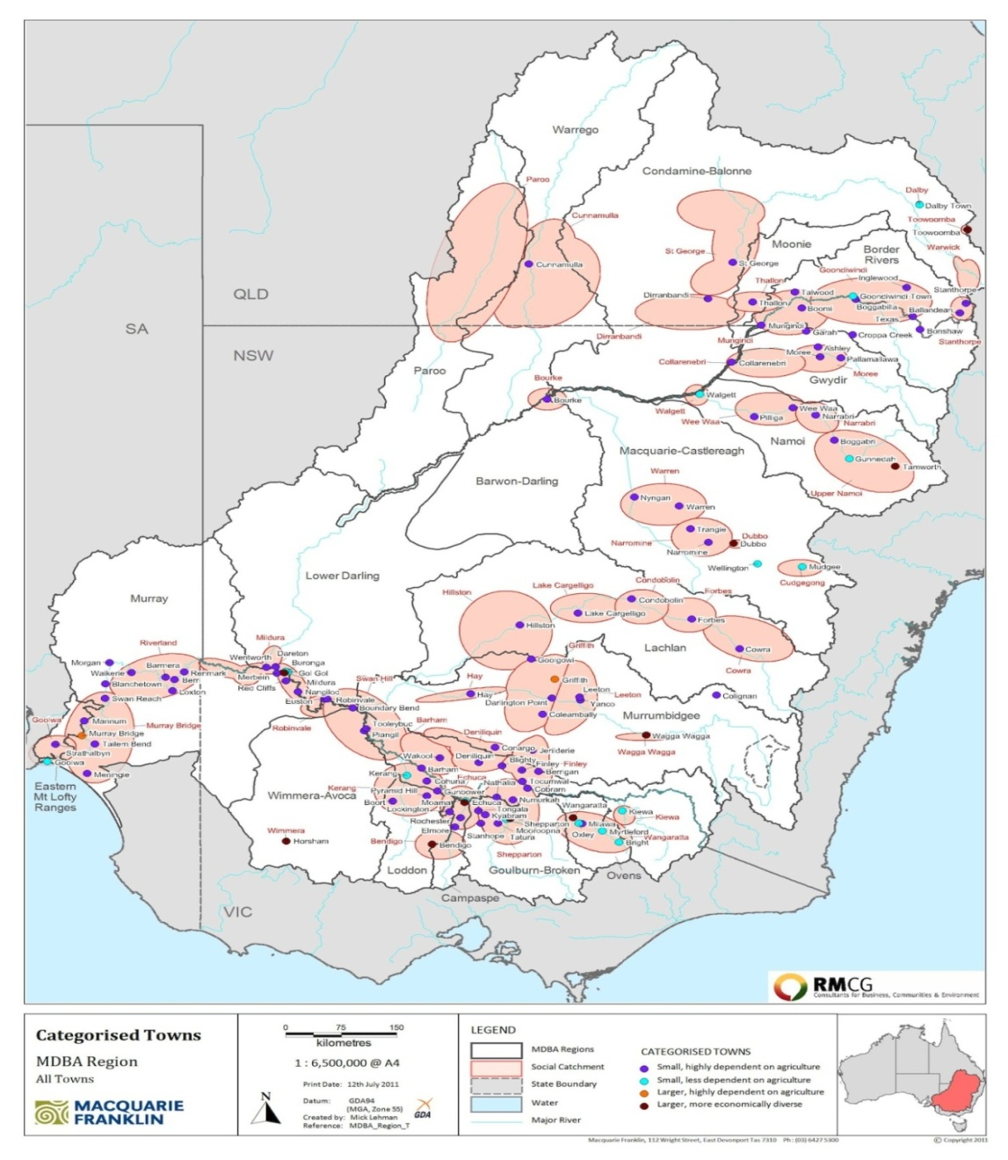
Agriculture and specific towns identified as more sensitive to changes in water availability
Source: EBC, RMCG et al (2011a) MDBA website

Slide 44
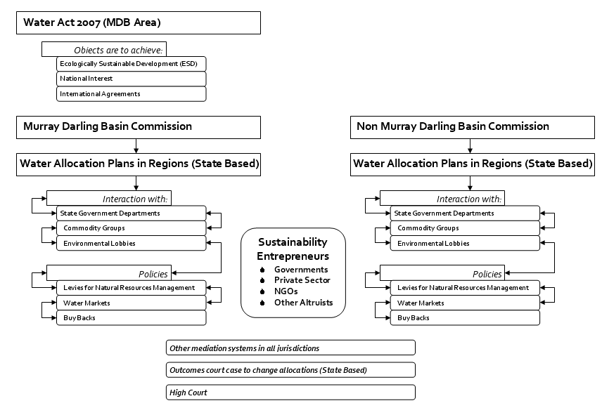
Solution 1 to deliver water justice- Apply Water Act to the entire nation

Slide 45
Solution 2 have this structure for Water supply businesses
Model of water business enterprise. Source: McKay J (2003) & McKay J, Water Policy (2005) 1-20
Craft this type of special organisational form which will better balance the economic, environmental and community interests.
Use this type of body in all regions

Slide 46
next 4 epochs Australian of water law
Epoch 6 NOW attempted implementation of federal power thwarted by interest groups and conflicts at rural urban, and other levels
Epoch 7 Future Extensive rights based claims indigenous people and others
Epoch 8 Future foreign investment issues deeper regulation.
Solutions- new water supplier form and more Federal intervention

Slide 47
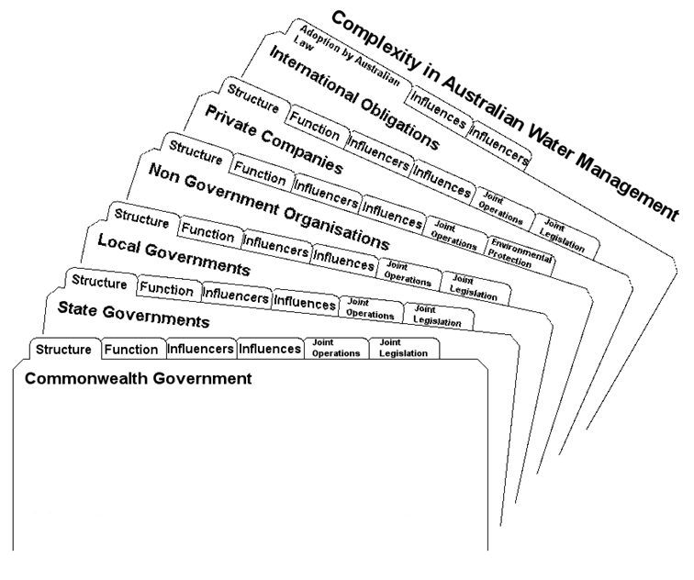
Complexity

Slide 48
Summary
Co-operation does exist in Australia but it is limited.
There are increased pressures on existing schemes which could undo past cooperative processes

Slide 49
Thank You

Slide 50
Early Epochs of water laws
Epoch 1 1788-1901- Only State colonial laws and these were highly introspective to the particular colony.
Epoch 2 Federation1901 to 1983- fiscal federalism (CCAC) sections 96 and section 100 prohibition on Commonwealth powers.
Policy narrative- man can control nature and State paramountcy

Slide 51
mid 2 Epochs of water laws
Epoch 3 Treaties power 1983- 1994- (CCAC) enhanced Federal intervention Tasmanian dam’s case, MDBC agreement (weak) and ESD principles.
Epoch 4 1994- 2007 state power but federal incentives Council of Australian Governments reforms, ESD and competition law reforms hence enhanced section 51 (xx) Trade Practices powers State litigation on State water plans and allocation reductions. Regional delivery, NWI federal control

Slide 52
Epoch 4 Four elements of water justice
Sustainable use.
Inter-generational equity.
Equitable use or intra-generational equity, and
Integration principle integration of environmental concerns into development decisions.
Rio 1992 and various Australian government publications and State laws such as the NWI State laws and international treaties
now resilience policy narrative no longer man can control nature and more Federal control

Slide 53
Epoch 5 2008 ++
water markets but also Commonwealth and State intervention in the water market
buybacks for environmental purposes State and Federal
reinstatement of federal subsidization of irrigation infrastructure but also private infrastructure facilitated
use of PPP and alliance processes for infrastructure in cities especially desalination plants

Slide 54
Water Act 2007
Commonwealth (under multiple powers in section 51, including the referral of powers from the States) enacts the Water Act to apply to M D Basin
Arose out of frustration of Howard Government with States on water reforms in NWI and non implementation of water allocation plans
Commonwealth accreditation of all State Water Plans which must aim to achieve ESD ,gives a role to Australian competition and Consumer Commission to regulate process and enhances the Commonwealth environmental water holder. Buy backs of land and water start.

Slide 55
Entrenching..
(2) It shall not be lawful to present to the Governor for Her Majesty's assent
any Bill by which-
may be repealed, altered or varied or any Bill by which-
(h) responsibility for ensuring the delivery of a water service (within the meaning of Part VII) may be transferred to a person or body that

Slide 56
Entrenching..
is not a public authority (within the meaning of that Part) or the
accountability to a responsible Minister of the Crown of such an
authority for ensuring the delivery of such a service may be removed-
unless the third reading of the Bill is passed by a special majority.

Slide 57
Entrenching..
is not a public authority (within the meaning of that Part) or the
accountability to a responsible Minister of the Crown of such an
authority for ensuring the delivery of such a service may be removed-
unless the third reading of the Bill is passed by a special majority.

Slide 58
Entrenching..but allowing contracts
6) Subsection (2) does not apply to any Bill to-
(a) enable a public authority (within the meaning of Part VII) to enter into an arrangement of any kind with a person or body (including an independent contractor) relating to the delivery of a water service(within the meaning of that Part); or

Slide 59
Entrenching..but allowing contracts
(b) alter the structure, composition or membership of a public authority
(within the meaning of Part VII) that has responsibility for ensuring
the delivery of a water service (within the meaning of that Part) if

Slide 60
Entrenching..but allowing contracts
the alteration does not affect its status or the status of a successor
body as such a public authority accountable to a responsible Minister
of the Crown for ensuring the delivery of that service.

Slide 61
Entrenching..but allowing contracts
b) alter the structure, composition or membership of a public authority
(within the meaning of Part VII) that has responsibility for ensuring the delivery of a water service (within the meaning of that Part) if the alteration does not affect its status or the status of a successor body as such a public authority accountable to a responsible Minister of the Crown for ensuring the delivery of that service

Slide 62
Public Authority Vic s96-97cont.
In this Part- public authority means-
(a) a public statutory authority; or
(b) a Council within the meaning of the Local Government Act 1989; or
(c) a company (within the meaning of the Corporations Act) all the shares in which are held by or on behalf of the State; or
(d) an Agency Head within the meaning of the Public Sector Management and Employment Act 1998 who is a corporation sole;
public statutory

Slide 63
Public Authority Vic s96-97cont.
public statutory means a body, whether corporate or unincorporate, that is established by or under an Act for a public purpose but does not include a company (within the meaning of the Corporations Act) in which all the shares are not held by or on behalf of the State
Water legislation means the Water Act 1989, the Water Industry Act 1994 or the Melbourne and Metropolitan Board of Works Act 1958

Slide 64
Public Authority Vic s96-97cont.
water service means a service relating to-
(a) water supply; or
(b) sewerage; or
(c) irrigation; or
(d) water collection and storage; or
(e) sewage treatment- for ensuring the delivery of which a public

Slide 65
Public Authority Vic s96-97cont.
authority has responsibility under water legislation, including under
a licence issued under water legislation.

Slide 66
Water service Vic
water service means a service relating to-
(a) water supply; or
(b) sewerage; or
(c) irrigation; or
(d) water collection and storage; or
(e) sewage treatment- for ensuring the delivery of which a public authority has responsibility under water legislation, including under legislation.

Slide 67
Human rights charter VIC
S36 A public authority must consider relevant human rights

Slide 68
S 97 Vic. Delivery of water services
(1) If at any time on or after the commencement of section 5 of the
Constitution (Water Authorities) Act 2003 a public authority has responsibility for ensuring the delivery of a water service, that or another public authority must continue to have that responsibility.

Slide 69
S 97 delivery
(2) A public authority that, at any time on or after the commencement of
section 5 of the Constitution (Water Authorities) Act 2003, has responsibility
for ensuring the delivery of a water service must, while it has that
responsibility, be accountable to a responsible Minister of the Crown for
ensuring the delivery of that service.

Slide 70
S 97 form of public authority
(3) Nothing in this section prevents a public authority that has responsibility for ensuring the delivery of a water service entering into an arrangement of any kind with a person or body (including an independent contractor) relating to the delivery of that service while itself retaining that responsibility and remaining accountable to a responsible Minister of the Crown for ensuring the delivery of that service

Slide 71
S 97 form of public authority cont.
that responsibility and remaining accountable to a responsible Minister of the
Crown for ensuring the delivery of that service

Slide 72
S 97 form of public authority
(4) Nothing in this section prevents the making of an alteration to the structure, composition or membership of a public authority that has responsibility for ensuring the delivery of a water service if the alteration does not affect its status or the status of a successor body as a public
authority accountable to a responsible Minister of the Crown for ensuring the
delivery of that service.

Slide 73
Further reforms-sovereignty
WATER AMENDMENT (GOVERNANCE AND OTHER REFORMS) BILL 2012
, with respect to our water authorities the special status that they enjoy and the special responsibility that any government has to provide a safe, secure and reliable water supply for its citizens are such that we deem that this business, this activity, needs to remain in public hands. I am very pleased that as a community there is a consensus around that question

Slide 74
Privatisation the spectre of the past
... At the same time as the Water Industry Act 1994 was being introduced into this Parliament to establish the Melbourne metropolitan water retailers as corporations under the Corporations Law, senior ministers, other commentators and other members of the then coalition government were either actively contemplating direct privatisation or refusing to rule it out. They were using language which made it very clear that it was only in the very near future that the question of private ownership was not going to arise; in the longer term they had no problem with stimulating a debate around the private ownership of Victoria's water resources

Slide 75
Water Amendment ( Governance and other reforms) Bill 2012
This bill, insofar as it is a continuation of a process that was put in place by the former government, is to deal with the transitions these water corporations, these Corporations Law companies, from the ambit of the Corporations Law to becoming statutory authorities
Harmonises customer obligations too so identical between water suppliers.

Slide 76
Governance types 2008 (McKay)

Slide 77
Institutional arrangements diverse
Local Govt Public:
issues: - Role of national governments - Degree of fiscal Isolation - NOW Level of private participation
Corporatized Public:
issues: - Legal structure of the entity - Access to private finance - Composition of board

Slide 78
Institutional arrangements
Delegated to Private Sector:
BOO or other Assets publicly owned
issues: - Nature and sophistication of contracting authority - Financial arrangement
Fully Private: assets private
Private corporation with publicly traded shares
issues: - Evolutionary context for full privatization - Regulatory environment

Slide 79
Principal water management agencies and laws applicable to each state and territory
State or territory | Lead jurisdictional body for water management / Principal legislation | Name of the Plan | No of plans as on 30 June 2010
Australian Capital Territory | Environment ACT/ Water Resources Act 1998 | Water Resources Management Plan | 1
New South Wales | Department of Natural Resources/Water Management Act 2000; Water Act 1912 | Water sharing plan | 54
Northern Territory | Department of Natural Resources, Environment and the Arts/Water Act 1992 | Water allocation plan | 3
Queensland | Department of Natural Resources, Mines and Water / Water Act 2000; Wild Rivers Act 2005;Integrated Planning Act 1997 | Water resource plan | 21
South Australia | Department of Water/Natural Resources Management Act 2004; Groundwater (Border Agreement) Act 1985 | Water allocation plans | 15
Tasmania | Department of Primary Industries and Water/ Water Management Act 1999 | Water management plans | 6
Victoria | Department of Sustainability and Environment /Water Act 1989;Groundwater (Border Agreement) Act 1985 | Regional sustainable water strategies | 2
Western Australia | Department of Water /Rights in Water and Irrigation Act 1914 | Water management plans/Water Allocation Plans | 11

Slide 80
Are Statutory Water Plans the right way to approach sustainable water policy? (water planners responses)
YES - 61.5%
But also pointed out some concerns:
unfairness in the processes for public consultation,
lack of knowledge of local,
cost of development and implementation of water plans, and
uncertainties in the science.

Slide 81
State Court interpretations of Water Plans
Water Plans interpreted strictly: no discretion in Minister or court to vary a Plan.
ESD used to reduce water allocations by up to 50%.
Pro-rata reductions seen as fair.
Normal administrative law rules apply, so there must be procedural fairness.

Slide 82
Water Governance Issues
Constitutional
Water law Water Act
Institutional structures
Basin plan and regional water plans
Policy responses licensing and water trading.
Community adoption of sustainable development changing to collectivity in rights and obligations

Slide 83
Solution 2 have this structure for Water supply businesses
Model of water business enterprise. Source: McKay J (2003) & McKay J, Water Policy (2005) 1-20
Craft this type of special organisational form which will better balance the economic, environmental and community interests.
Use this type of body in all regions

Slide 84
Complexity

Slide 85
Thank You

