Slide 1
Words about Water in our World: a literature focus
Katie Silva
Teacher Librarian, Wilderness School
And SASOSE Council President

Slide 2
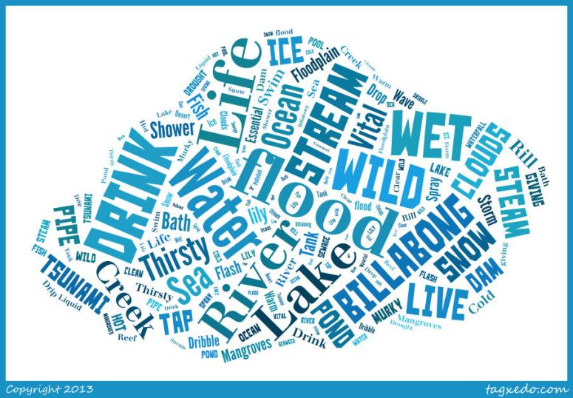
My words…
Notes:
If online, link to tagxedo and explore words
Get participants to share other ideas and record them to add during or later

Slide 3
What about your words?
http://www.tagxedo.com

Slide 4
In this session…
Words about Water - ours
Inspirational works
Making connections with the curriculum
Aboriginal & Torres Straight Islander
Asia and Australia’s engagement with Asia
Sustainability
General Capabilities
Let’s make some links

Slide 5

Perfect planet pie
Toft, K 2012, Recipe for Perfect Planet Pie, Silkim Books, Ballina, NSW.
Notes:
What’s so special about water? Read and show. Start making connections

Slide 6
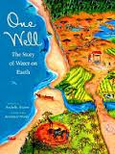
One Well: the Story of Water on Earth
Notes:
Words of wisdom and big picture info. One source, link to concept of sharing, taking books out for temporary use and putting them back into the cycle. Faster than the actual water cycle!

Slide 7
Responding to the theme…
In the Australian Curriculum – water appears mostly in Science
Important in History – particularly Yr 5 patterns of settlement
Will be very important in Geographyhttp://www.acara.edu.au/verve/_resources/2._Draft_F-12_Australian_Curriculum_-_Geography.pdf
Looking forward to Civics and Citizenship http://www.acara.edu.au/verve/_resources/Shape_of_the_Australian_Curriculum__Civics_and_Citizenship_251012.pdf
Notes:
Civics and Citizenship draft http://www.acara.edu.au/verve/_resources/Shape_of_the_Australian_Curriculum__Civics_and_Citizenship_251012.pdf

Slide 8
What about…?
Cross-Curriculum Priorities
General Capabilities
Aboriginal and Torres Strait histories and cultures
Asia and Australia’s engagement with Asia
Sustainability
Literacy
Numeracy
ICT capability
Critical and creative thinking
Personal and social capability
Ethical understanding
Intercultural understanding

Slide 9
Aboriginal and Torres Strait Islander histories and cultures
“Dust Echoes” http://www.abc.net.au/dustechoes/dustEchoesFlash.htm Water stories reflect place and culture. Always watch before using. Idea of Moeity from Arnhem Land. Dhuwa (water) people (in glossary).
‘Yellow-Eye’
‘Big Rain Coming’

Slide 10
Asia and Australia’s engagement with Asia
Crossing water to get to Asia
Tsunami – ‘The Day of the Elephant’
Water facts: water and culture 2011, Australian Broadcasting Commission, accessed 22 February 2013, <http://www.abc.net.au/water/stories/s1598082.htm>.
WaterBridge Project: intention to release booklist re water – not yet (17/2/13) http://papertigers.org/ptOutreach/index.html

Slide 11
Asia and Australia’s engagement with Asia
Discussion point: would water in Asia be different to any other part of the world?
?

Slide 12
Sustainability
The obvious connection with water
Go back to the word bank and identify key words and concepts to connect and build on
When sharing and discussing stories, identify sustainability elements
Respond to the text suggesting ways that water can be used differently
Can develop rules for using water
Creative ways of expressing ideas including ICTs
Notes:
Jelly

Slide 13
Useful water
Dangerous water
Playful water
Sharing water
Water as a character
Water as setting
Water as a haven
Different kinds of water – place, state, quality
Issues

Slide 14
How can we use others words?
http://www.ted.com/talks/ludwick_marishane_a_bath_without_water.html

Slide 15
Please create your own words about water and add them to the well
This resource is available on the SASOSE website http://sasose.asn.au.
If you are willing to share what you have done, please email sasoseonline@gmail.com
Thank you

