Slide 1
CASE STUDY
Melbourne 2006 Commonwealth Games GOODWILL PARTNERSHIP

Slide 2
Goodwill Partnership Case Study
Agenda
Background
Initiatives
Events
Marketing
Workforce
Outcomes
Recommendations

Slide 3
Goodwill Partnership – Background
The Opportunity
Commonwealth Games Federation - 71 nations, 53 developing (90% population)
Melbourne 2006 - creating lasting legacy for Commonwealth
Celebrate Commonwealth Games values – Humanity, Equality, Destiny
First-ever Goodwill Partnership
Request For Tender released – April 2005
Plan officially selected as Goodwill Partner in August 05
Melbourne2006 & Plan announce Goodwill Partnership in September 05

Slide 4
Goodwill Partnership – Background
Why Plan as the Goodwill Partner?
Plan works with communities in 13 developing Commonwealth Countries
Plan is Australia’s only non religious, non political international development and child sponsorship organisation working in 46 countries
Child centredness is Plan’s core philosophy
Children are seen as agent of change in community development

Slide 5
Goodwill Partnership – Background
Goodwill Partnership Objectives
Raise awareness of issues affecting children in the Commonwealth
Encourage Australians to sponsor a child or support a project in the Commonwealth
Educate people about Plan’s child focused philosophy
Create a lasting legacy for the Melbourne 2006 Commonwealth Games
Celebrate the values of the Commonwealth Games – humanity, equality, destiny

Slide 6
Goodwill Partnership – Background
Key Performance Indicators
To directly benefit children of developing Commonwealth countries through:
Child Sponsorship – sponsoring a child in one of 13 Plan-assisted Commonwealth countries
Donations – fundraising activity to support one of the priority projects in the Commonwealth for the Games which include:
Africa – HIV/AIDS
Bangladesh – Community Learning Support Program
India – Early Childhood Care & Development
Fiji – HIV/AIDS Youth Education

Slide 7
Goodwill Partnership Initiatives
Youth Media Program
Goodwill Ambassadors
M2006 Family Initiative

Slide 8
Goodwill Partnership Initiatives
1. Youth Media Program
Overview
9 Youth Reporters Ghana, India & Pakistan in Melb to report on Games
Training & reporting on Games & Festival 2006 events in film & print
Visiting regional Victoria (Adopt-a-Second Team), attending Games & Festival 2006 events
Cultural exchanges organised at Games & other events
Representatives of 4 media groups from Victoria
6 Plan Cultural Ambassadors (through Age competition)

Slide 9
Goodwill Partnership Initiatives
1. Youth Media Program
Adopt-a-second-team
OCGC Initiative
Ghana, India, Pakistan & Uganda
Monash, Melbourne, Strathbogie & Ballarat
Media pieces created & exchanged
Three day Youth Media regional visit
Film pieces played at Plan Showcase @ Interact
Significant Engagement
Cultural discourse & life-changing experiences
Empowerment of young people

Slide 10
Goodwill Partnership Initiatives
1. Youth Media Program
Goodwill Cultural Ambassadors
Six Victorian students (aged 13 to 17)
Competition in The Education Age
Two days with Youth Media Reporters at the Games
Cultural dialogue and exchange – built lasting friendships
Potential for continuing Cultural Ambassadors Program

Slide 11
Goodwill Partnership Initiatives
1. Youth Media Program
Media Reports
3 days regional Victoria tour – Adopt-a-Second-team activities & workshops
5 days intensive media training
5 days Games & Festival Reporting
10 Film & 5 Print stories (published on NineMSN)
Theme – Humanity, Equality, Destiny

Slide 12
Goodwill Partnership Initiatives
1. Youth Media Program
Media Reports
Ghana
Rugby 7’s – vox pops with Spectators
Golden Boy – interview with Ghanaian gold medal long jumper – Ignisious Gaisah
Sing for Water (Festival 2006) interview with Paul Kelly & Valinga Khaza
Luminarium (Festival 2006)

Slide 13
Goodwill Partnership Initiatives
1. Youth Media Program
Media Reports
India
Indian Athletes with disabilities story. Interviews with team officials & athletes
Artplay (Festival 2006) interviews with organisers & children
Tanzanian Golden Pride Children’s Choir (Festival 2006)

Slide 14
Goodwill Partnership Initiatives
1. Youth Media Program
Media Reports
Pakistan
Pakistan Badminton Team – interviews with Team Manager & athletes
Hockey (Pakistan vs India) – vox pops & inteviews with Team Managers & captain
W-11 Karachi to Melbourne (Festival 2006) – story on the Pakistani decorated tram, vox pops and interview with organisers

Slide 15
Goodwill Partnership Initiatives
1. Youth Media Program
Media Highlights
Media stories/ interviews with Youth Media included:
Ch 7 Sunrise – interview with Harry White, Enoch Mahama (Ghana) & Huma Khursid (Pakistan)
Ch 7 Today Tonight – interview with Enoch Mahama & Fatima Bolly (Ghana) – program repeated
Ch 9/WIN News – Youth Media visit to Ballarat
BBC World News – Youth Media Reporters story & interview with Ghana reporters at Luminarium

Slide 16
Goodwill Partnership Initiatives
1. Youth Media Program
Media Highlights
Media stories/ interviews with Youth Media included:
Herald Sun (Sat 18 Mar) – 2 page feature
The Age – 2 page feature
Hindustan Times (New Delhi) – interview with Indian Youth Reporters
ABC News Online – Fatima Bolly (Ghana) and Mudassar Hussain (Pakistan)

Slide 17
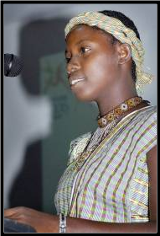
Goodwill Partnership Initiatives
1. Youth Media Program

Slide 18
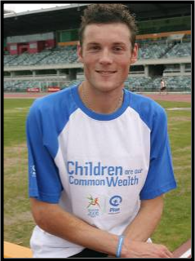
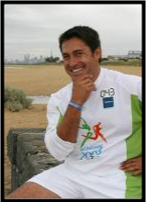
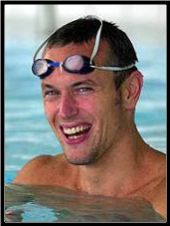
Goodwill Partnership Initiatives
2. Goodwill Ambassadors
Jamie Durie TV Personality
Mark Foster English Swimming Champion
Craig Mottram Australian 5000m Running Champion Silver Medalist Melbourne 2006

Slide 19
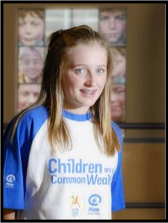
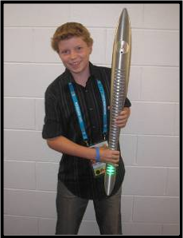

Goodwill Partnership Initiatives
2. Goodwill Ambassadors
Youth Ambassadors
Alice Barlow & Harry White

Slide 20
Goodwill Partnership Initiatives
2. Goodwill Ambassadors
Ambassador Highlights
Harry White addressing HRM Queen Elizabeth - Opening Ceremony
Craig Mottram promotes the ‘Children are Our Commonwealth’ wristband
Jamie Durie - Queens Baton Relay
Harry White & Jamie Durie Ch 9’s Today show

Slide 21
Goodwill Partnership Initiatives
3. M2006 Family Initiative
M2006 Family
Child sponsorship promotion
Goodwill Champions – M2006 Family staff
Presentations & Promotions
M2006 Sponsors
Telstra – QBR support
Qantas – Frequent Flier Promotion
APCS – Youth Media support
VISA – TVC online promotion & donation
Cadbury Schweppes – Youth Media support
Microsoft – Plan’s Goodwill Volunteers support
M2006 Licensees – promotion & proceeds of carry bag merchandise

Slide 22
Goodwill Partnership Events
Goodwill Partnership Launch
Warm Up to the Games
World AIDS Day Breakfast
Queens Baton Relay
Plan Showcase at Interact
Games Time

Slide 23
Goodwill Partnership Events
1. Goodwill Partnership Launch
8 September 2006 – MCG
Officiated by:
Minister for Commonwealth Games, Justin Madden MP
Chairman, Melbourne 2006 Commonwealth Games, Ron Walker AO
Attended by:
Jamie Durie – Plan Goodwill Ambassador
Harry White – Plan Youth Ambassador

Slide 24
Goodwill Partnership Events
2. Warm Up to the Games
3. World AIDS Day Breakfast

Slide 25
Goodwill Partnership Events
4. Queens Baton Relay
Partnership with Telstra – Principal Sponsor QBR
Evening Ceremony Sites
Marquee attended by Plan staff & direct dialogue teams
Grant Hackett ‘gold coin donation’ promotion

Slide 26
Goodwill Partnership Events
5. Plan Showcase at Interact
An African-themed 18m x 18m marquee (Mud Huts)
Highlight – Interact Launch with Tanzanian Golden Pride Children’s Choir
Showcase educated the public about Plan through:
Youth Media Cinema
Interactive Development Education displays
Multi-media stations
Face to face education
Face to face sponsor sign up

Slide 27
Goodwill Partnership Events
6. Games Time
Plan staff & Volunteers
Wristband Sales
Inform public about Plan and issues facing children
Direct Dialoguers – child sponsorship
Sidney Myer Music Bowl
Rod Laver Arena
Alexandra Gardens
Yarra Park (MCG)

Slide 28
Goodwill Partnership Events
6. Games Time
Luminarium (Festival 2006)
Gold Coin Donation entry
Workforce by Plan Goodwill Volunteers

Slide 29
Goodwill Partnership Marketing Campaign
Advertising
Merchandising
Direct Marketing
Promotion
Publicity

Slide 30
Goodwill Partner Marketing
1. Advertising
TVC – child sponsor message
Advertising Ch 9 & SBS TV

Slide 31
Goodwill Partner Marketing
1. Advertising
SMS Direct Response Campaign
Melbourne 2006 in-venue big screens & Live Sites
Animated ad with ‘Donation’ call-to-action
Follow up with Child Sponsorship SMS
Print Advertising
Excl. 8-page Herald Sun ‘Goodwill’ lift out
Herald Sun - Games Time advertising
The Age – occasional & Games Time
Regional & Local Papers – Jan–Mar 06 (QBR)
Women’s Day (support 4 page feature re: Jamie in Uganda) – December 05
Big Issue – March 06

Slide 32
Goodwill Partner Marketing
1. Advertising
Online
Plan Website – 70% Increase
NineMSN – advertising
NineMSN – Youth Media Reporters mini-site
Radio Advertising
3AW
SBS Radio
3FOX & 3MMM
Outdoor Signage
Billboards in Metro Melb – Nov 05–Apr 06
Ambient advtsg in professional suites

Slide 33
Goodwill Partner Marketing
1. Advertising
Media Partnerships –
over $2million in advertising & promotional support
Channel 9
SBS TV
SBS Radio
Herald Sun
3AW
3FOX
IOM Outdoor Signage

Slide 34
Goodwill Partner Marketing
2. Merchandise Program
Merchandise Program –
‘Children are Our Common Wealth’ Wristbands
Promoted by Craig Mottram, Jamie Durie & Harry White
Sold for $3ea (or 2 for $5)
Distributed through:
Goodwill Volunteers during Games
CWG Athletes Village through CGCE
Commonwealth Games Superstore (Swanston St)
Offices of Plan board members & supporters
Plan Website

Slide 35
Goodwill Partner Marketing
3. Direct Marketing
Face-to-face
Telemarketing - SMS & Woman’s Day Comp
Direct Mail (Jan 06 and Apr 06)
Post Games mail piece

Slide 36
Goodwill Partner Marketing
4. Promotions
Promotional items inc:
Avant Card (inc. distribution campaign)
Posters (public & M2006 Family)
Banners & Flags
Pocket-sized brochure (supporting wristbands)
Goodwill Pin
Plan Showbags
Bookmarks, Stickers, Lollypops
Commemorative Sponsor Welcome Kit with fridge magnet

Slide 37
Goodwill Partner Marketing
5. Publicity
PR Consultancies
CPR Communications – Plan Tender & Goodwill Partner Launch
Hootville – QBR, Plan Youth Media Launch, Interact Launch, Youth Media, Goodwill Partnership
Communications Consultant (Michelle Rice)
Issues based news
Opinion pieces
Plan Media Team
Goodwill Partnership
Youth Media
Issues

Slide 38

Goodwill Partner Marketing
5. Publicity
Media Launches
Goodwill Partner Launch
Youth Media Launch
Interact Launch
Media Coverage
64+ Print Stories (local, national & international)
14+ Television News & Current Affairs stories (inc BBC Asia, Ch 9, Ch 7, ABC, SBS & WIN)
20+ Radio stories & interviews (national, state & regional radio)

Slide 39
The Goodwill Partnership Workforce
Workforce Structure
Management Structure
Games Time Job Roles
Volunteer Strategy
Workforce Facts

Slide 40

Goodwill Partner Workforce
1. Workforce Structure
Games Team (10 FTEs)
Games Taskforce (20 FTEs)
Plan Goodwill Volunteers (170)
Plan Games Time Workforce (40)

Slide 41
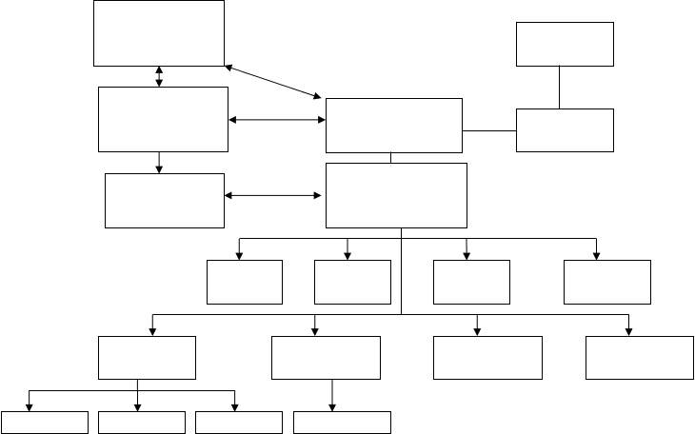
Goodwill Partner Workforce
2. Management Structure
OCGC
ANO Board
M2006
ANO SMT
Project Director
Games Project Committee
Goodwill Partner Manager
Project Leader
Volunteer Co-ord
Operations Manager
DM Co-ord
Marketing Co-ord
Media/Comms Mgr
Corporate Relations Mgr
Special Projects Co-ord
CCCD Co-ord
E-Comms Cord
Media Officer
Comms Officer
Corp Reltns Co-ord

Slide 42

Goodwill Partner Workforce
3. Games Time Job Roles
Site Manager
Volunteer Co-ordinator
Team Leaders
Team Support Staff
Collateral Control
CCCD Advisors (development education)
Mobile Cash Collection Team Leader
Mobile Cash Collection Support
Cash Collection – office based
Supporter Services – office based
Youth Media Co-ordinators
Youth Media Assistants
Youth Media Chaperones
Youth Media Advisor
Media Relations Consultants

Slide 43

Goodwill Partner Workforce
4. Volunteer Strategy
Online Volunteer registration
Advertising in press, Games website, Plan website
200 registered
170 Volunteers deployed
Half-day training workshops
5. Workforce Facts
Workforce of over 200
1985 hours of operation over 12 days
Oldest volunteer 70 years
22% volunteers under 18 years
100 volunteers attended Opening Ceremony rehearsals (Microsoft Support)

Slide 44
The Goodwill Partnership
OUTCOMES

Slide 45

Goodwill Partner Outcomes
Objective 1 Raise awareness of issues facing children in developing countries
Commemorative 8-page ‘Goodwill Guide’ in Herald Sun
HIV/AIDS in Africa, Education in Bangladesh, Healthcare in India, HIV/AIDS youth education in Fiji
Plan Showcase at Interact
Focus on 4 Pillars of UNCRC
Right to Education, Protection (child labour), Participate (Youth Meda program), Survival (Water)
Publicity
National Television / online
Extensive major metro and regional print

Slide 46

Goodwill Partner Outcomes
Objective 2 Encourage Australian’s to be a part of the solution to end child poverty by sponsoring a child or supporting a project in the Commonwealth
Financial Outcomes
2660 Child Sponsorships directly attributed to Goodwill Partnership
Increase of over 3000 new child sponsorships Nov 05 – Apr 06
$?? Raised through public donations and fundraising
$?? Raised through corporate donations and fundraising

Slide 47

Goodwill Partner Outcomes
Objective 2 Encourage Australian’s to be a part of the solution to end child poverty by sponsoring a child or supporting a project in the Commonwealth
Strategy for Child Sponsorship
DM campaign
TVC advertising (child sponsor message)
Advertising Campaign (child sponsor message)
Child Sponsor profile publicity during QBR
Direct Dialoguers deployed through QBR
Direct Dialoguers deployed Plan locations at Games Time
M2006 Team Unite – child sponsorship exhibit
Showcase at Interact
Publicity Campaign – raising awareness of child sponsorship
Marketing & Merchandising Collateral – child sponsorship call-to-action

Slide 48

Goodwill Partner Outcomes
Objective 2 Encourage Australian’s to be a part of the solution to end child poverty by sponsoring a child or supporting a project in the Commonwealth
Strategy for Donations
Grant Hackett gold coin donation promotion at QBR
Wristband Sales through Volunteers at Games Time (fundraising)
SMS Campaign on big screens at M2006 Venues & Live Sites
Gold coin donation entry to Luminarium (Festival 2006)
Proceeds from sale of M2006 merchandise bags
M2006 Sponsor donations & fundraising
Showcase at Interact
Publicity Campaign – donation message
Commemorative Goodwill Guide – donation call-to-action
Marketing & Merchandising Collateral – child sponsorship call-to-action

Slide 49

Goodwill Partner Outcomes
Objective 3 Educate people about Plan’s child-centred development work & its relevance in creating a lasting legacy for the Melbourne 2006 Games
Results
65% increase in awareness of Plan (from 15-25%) between Sept 05 & Apr 06 (source: Newspoll Market Research)
Increase in media approaching Plan for comment on development related issues (anecdotal)

Slide 50
Goodwill Partner Outcomes
Objective 3 Educate people about Plan’s child-centred development work & its relevance in creating a lasting legacy for the Melbourne 2006 Games
Initiatives include:
Goodwill Ambassador Program
Media & event exposure through celebrity & youth ambassadors
1.5 billion watched Harry White address HRM Queen Elizabeth at Opening Ceremony
Ch 9 Today Show – Jamie Durie & Harry White talk Goodwill Partnership, child sponsorship & wristbands
Ambassador Profiles in Commemorative 8pg Goodwill Guide in Herald Sun (circ??)
Ch 7 Sunrise – Interview with Harry White
Ch 7 Today Tonight – Interview with Harry White
Ch 9 National News – Interview with Jamie Durie
ABC News Victoria – Interview with Harry White

Slide 51

Goodwill Partner Outcomes
Objective 3 Educate people about Plan’s child-centred development work & its relevance in creating a lasting legacy for the Melbourne 2006 Games
Initiatives Include:
Publicity Program
Opinion Piece by Plan National Executive Director in The Age (Editorial)
Interviews with Plan National Executive Director on radio & press
Plan National Executive director contacted by media for comment re: HIV/AIDS, Queens Speech to Commonwealth, Sierra Leone defection
Plan Showcase at Interact
Games Time Activities (Volunteers & Direct Dialogue teams)
QBR Activities

Slide 52

Goodwill Partner Outcomes
Objective 3 Educate people about Plan’s child-centred development work & its relevance in creating a lasting legacy for the Melbourne 2006 Games
Initiatives Include:
Youth Media Program
Equipping reporters with media skills
Providing reporters with experience that will enrich their lives / communities
Give reporters a voice for having their voices heard re: issues for children in the Commonwealth
Provide opportunity for cross cultural dialogue with other youths and opportunity for new life-long friendships
Adopt a Second Team
Opportunity for cultural exchange and fostering cross cultural friendships
Enabling youths to produce media pieces through film and writing
Provided platform for understanding of different types of disadvantage
Opportunity for better understanding of Rights and build personal empowerment

Slide 53

Goodwill Partner Outcomes
Objective 4 Create long-term tangible benefits for children of the Commonwealth
Initiatives Include:
Cultural Youth Ambassadors
Youth Ambassadors Program
Child Sponsorship/Children First
2660 Child Sponsorships
64 Children First supporters
Publicity

Slide 54

Goodwill Partner Outcomes
Objective 5 Celebrate the values of the Commonwealth Games – Humanity, Equality, Destiny
Goodwill Partner philosophy
Youth Media Reporters – ‘Humanity, Equality, Destiny’ theme required in all stories
Promotion of Games values in marketing and promotion
Promotion of Games values in publicity and media relations (eg. Opinion Piece)
Initiatives including:
Youth Media & Adopt a Second Team activities
Youth Media & Cultural Ambassador activities
Interact launch and dinner with Tanzanian Golden Pride Children’s Choir (Festival2006), Youth Media & Adopt a Second team members

Slide 55
Goodwill Partner Recommendations

Slide 56

Goodwill Partner Recommendations
Governance Structure
Opportunity for future strategic growth for Goodwill Partnership
Create Goodwill Partnership Agreement – eg. 3 Games (12 year)
Position Goodwill Partnership strategically with Commonwealth Games Federation (& Plan International HQ)
Make Goodwill Partnership part of CGF constitution
Implementation of Goodwill Partnership managed by Host City Governing Body and Host City Games Corporation
Position Goodwill Partnership in Games Corporation Executive – implement through sponsorship & event departments
Strategy development and Implementation of Goodwill Partnership in Host City office of Goodwill Partner
Games Corporation appoint Goodwill Partner Manager

Slide 57
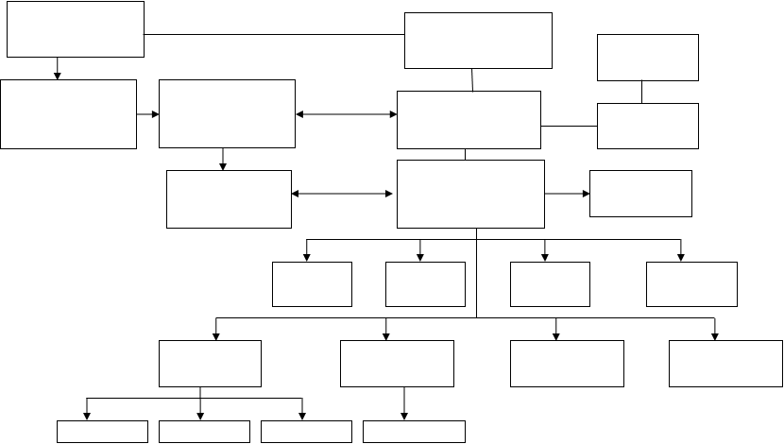
Goodwill Partner Recommendations
Management Structure
Commonwealth Games Federation
Plan International HQ
NO Board
Host City Gov Body
Host City – Games Corporation – Executive
Plan Host City NO
Games Project Committee
Goodwill Partner Manager
Project Leader
Admin Assistant
Volunteer Co-ord
Operations Manager
DM Co-ord
Marketing Co-ord
Media/Comms Mgr
Corporate Relations Mgr
Special Projects Co-ord
CCCD Co-ord
E-Comms Cord
Media Officer
Comms Officer
Corp Reltns Co-ord

Slide 58

Goodwill Partner Recommendations
Potential Scope for Goodwill Partnership
Program and Marketing initiative
Include Goodwill Partnership in broadcasting & sponsorship negotiations
Ongoing Partnership outside Games Time
Represent and champion teams from developing Cwlth nations
Raise awareness & seek support for teams from developing Cwlth nations
Sporting initiatives in developing Commonwealth nations
Youth Media program (close association with CWG)
Marketing/Advertising Campaign
Event presence and promotion QBR & Games Time
Fundraising activities QBR & Games Time

