Slide 1
Super Resolution
Lennie Araki
23-Apr-2020
02/26/2019
Seek Confidential
1

Slide 2
Based on OpenCV 2.4
Original code
https://github.com/zhangxiaoya/FB
Forked + tweaked
https://github.com/lenniea/FB
Added command line options
To test 2x (instead of 4x) super resolution
Originally running on Mac with gcc
Difficulty getting cmake to recognize brew installed OpenCV 2.4
Further Tweaks to run on Windows 10 with Vstudio 2013
Change filenames to not include ‘*’
Change to static linking
Use cmake to generate Vstudio 2013

Slide 3















“eia” Sample
16 PNG Images: 90 x 90

Slide 4
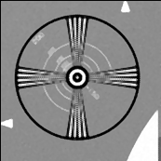
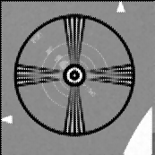
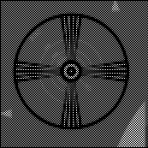
“eia” Sample
2x Super Resolution
Images 0-15
Images 0-7
Images 8-15

Slide 5






























“text” Sample
30 PNG Images: 49x57

Slide 6



“text” Sample
2x Super Resolution
Images 0-30
Images 0-14
Images 15-30

Slide 7

































“seek decimated” Sample
32 BMP Images: 103x78

Slide 8
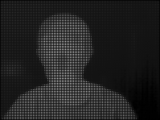
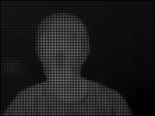
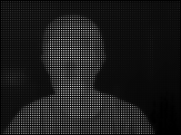
“seek decimated” Sample
2x Super Resolution
Images 0-31
Images 0-15
Images 16-31

Slide 9
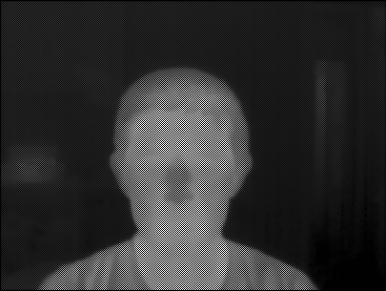
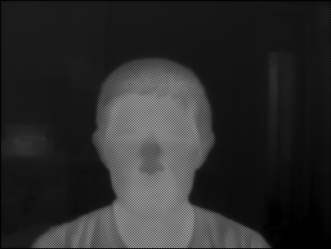

“seek 32k” Sample
2x Super Resolution

Slide 10
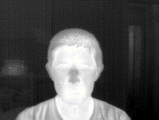
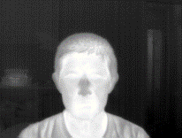
8k vs 32k
8k (300% size)
32k (150% size)

