Slide 1
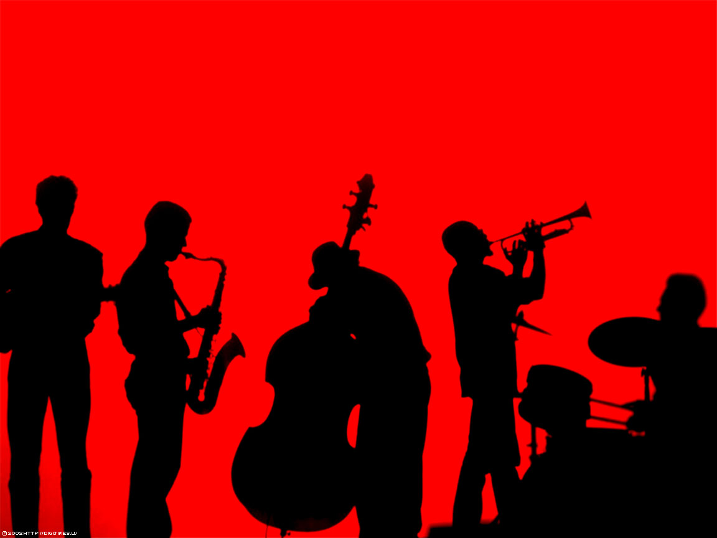
Utilizing a GAN to generate simple Jazz sequences
17.12.2021
Lennart Kieschnik – Deep Learning Course Project

Slide 2
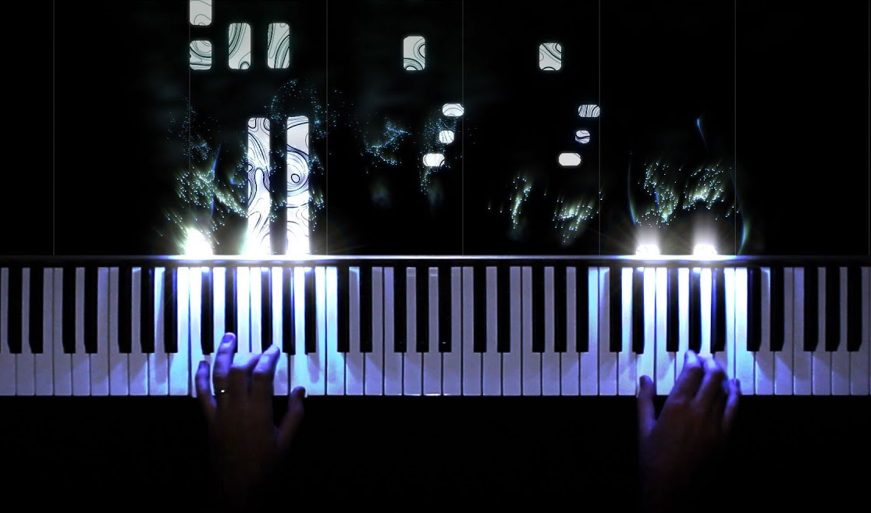
Intro
Data
Preprocessing
Model
Results
1
Basic Idea was to imagine the musical compositions as piano rolls
As piano rolls, they can be imagined as 2D information
The sequence and order of notes would be given by one dimention (0), and the pitch by another (1)
In a way, they can be even seen as images that can be processed by convolution in GAN
0
17.12.2021
Lennart Kieschnik – Creating Jazz with GAN
1

Slide 3
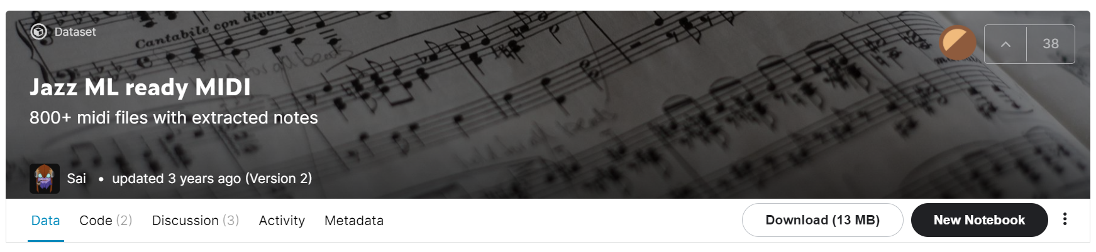
Intro
Data
Preprocessing
Model
Results
https://www.kaggle.com/saikayala/jazz-ml-ready-midi
936 Midi-files containing Jazz music of different length
Different number of tracks (dimensions) per file, meaning different number of instruments
Different in tempo and volume
--> For the matter of this project and the time given I had to simplify the data. The goal was to create a believable Jazz tune, so volume and instrument were of less importance
17.12.2021
Lennart Kieschnik – Creating Jazz with GAN
2

Slide 4


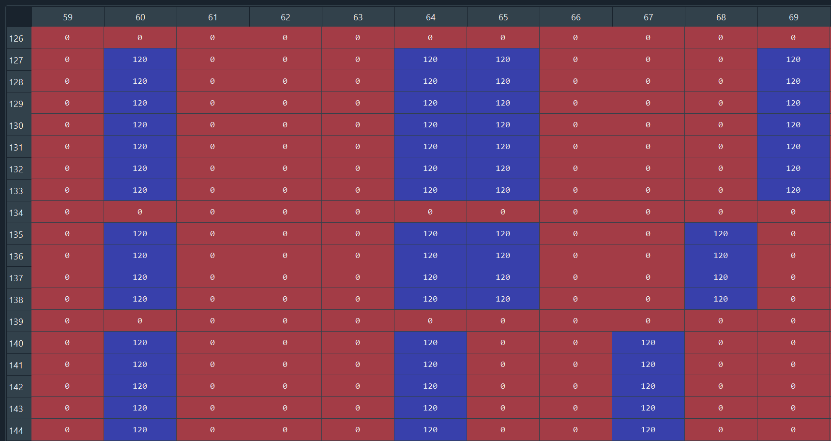
Intro
Data
Preprocessing
Model
Results
https://github.com/qsdfo/midi_to_numpy
???
Music!
Output of read_midi.py class
17.12.2021
Lennart Kieschnik – Creating Jazz with GAN
3

Slide 5
Intro
Data
Preprocessing
Model
Results
https://github.com/qsdfo/midi_to_numpy
936 Midi-files
936 dictionaries
{ „key“ : [np.array]}
936 2D np.arrays with different sequence length (X rows, 128 columns)
Function that finds the dimension (track) with the highest note count
936 3D np.arrays
Function that finds the area in the array with highest density of notes
906 2D np.arrays with the same shape (200 x 128), ~ 30 sec of music depending on set tempo
Function that unifies volume value and normalization
Model
17.12.2021
Lennart Kieschnik – Creating Jazz with GAN
4

Slide 6
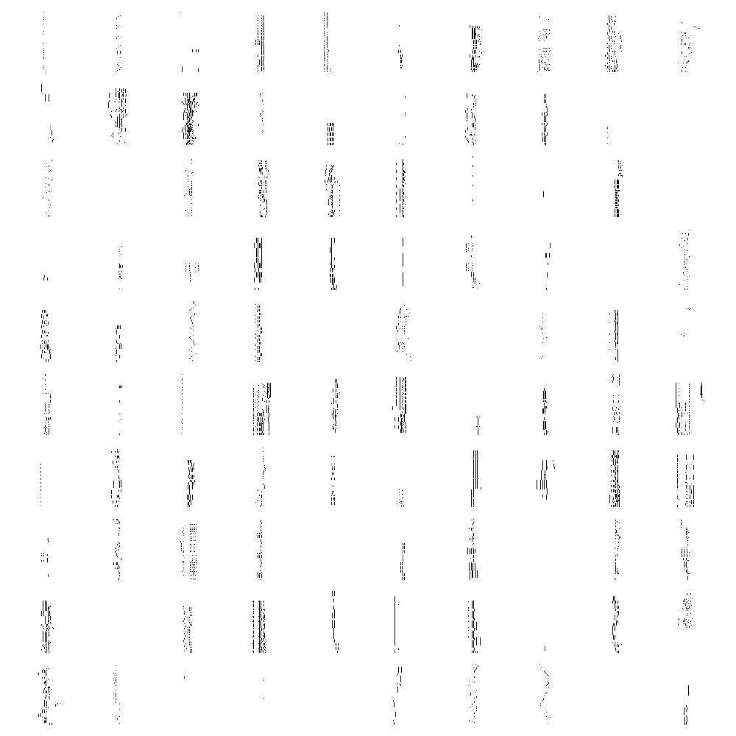
Intro
Data
Preprocessing
Model
Results
17.12.2021
Lennart Kieschnik – Creating Jazz with GAN
5

Slide 7
Intro
Data
Preprocessing
Model
Results
# Optimizer
optimizer= RMSprop(lr=0.0008, clipvalue=1.0, decay=1e-8)
# dropout
dropout_rate = 0.2
# LeakyReLu
leaky_faktor = 0.2
# Normalization
data = data.astype('float32') / max(np.unique(data)) * 2 -1
# Number of random numbers
z_size = 30
# loss
loss='binary_crossentropy'
# epochs and batch size
epochs = 90
batch_size = 100
batch_count = data.shape[0] / batch_size
17.12.2021
Lennart Kieschnik – Creating Jazz with GAN
5

Slide 8
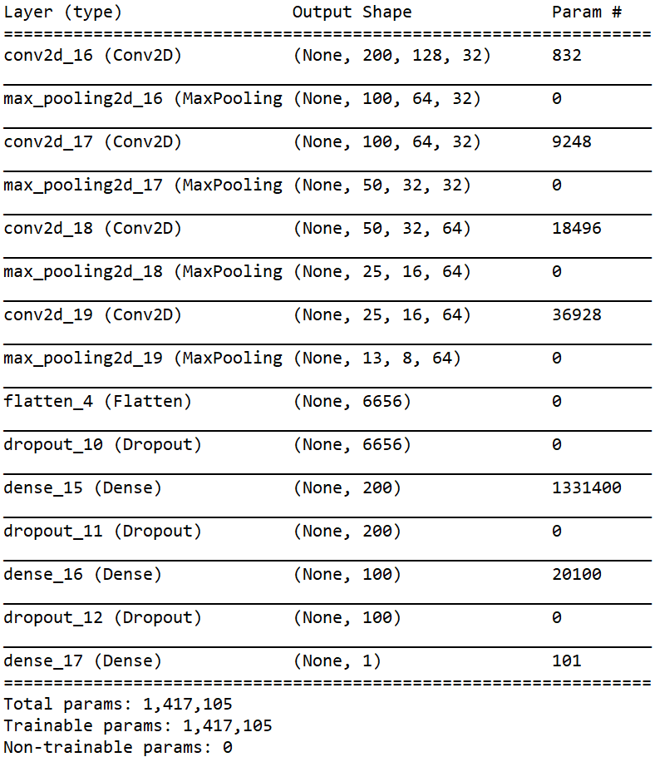
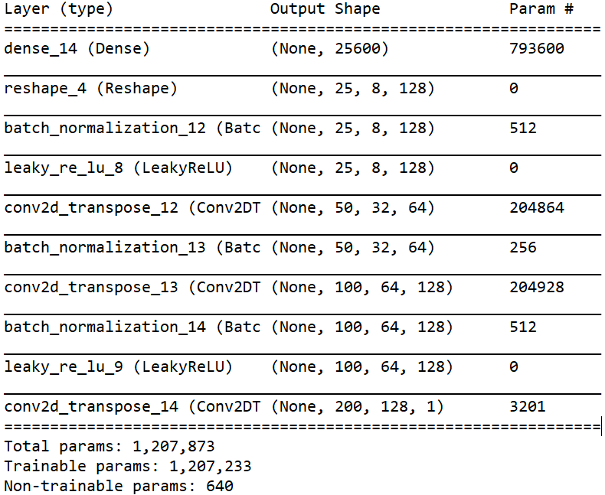
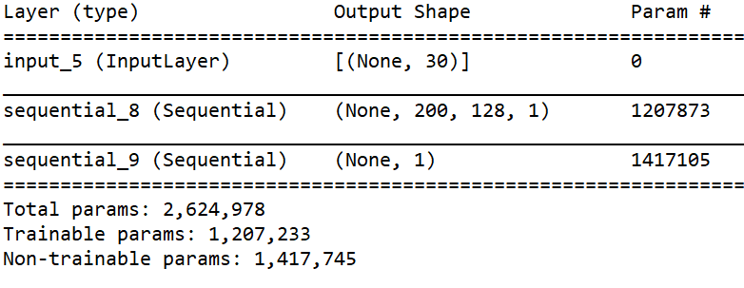
Intro
Data
Preprocessing
Model
Results
17.12.2021
Lennart Kieschnik – Creating Jazz with GAN
6

Slide 9
Intro
Data
Preprocessing
Model
Results
# Optimizer
optimizer= RMSprop(lr=0.0008, clipvalue=1.0, decay=1e-8)
# dropout
dropout_rate = 0.2
# LeakyReLu
leaky_faktor = 0.2
# Normalization
data = data.astype('float32') / max(np.unique(data)) * 2 -1
# Number of random numbers
z_size = 30
# loss
loss='binary_crossentropy'
# epochs and batch size
epochs = 90
batch_size = 30
batch_count = data.shape[0] / batch_size
17.12.2021
Lennart Kieschnik – Creating Jazz with GAN
7

Slide 10
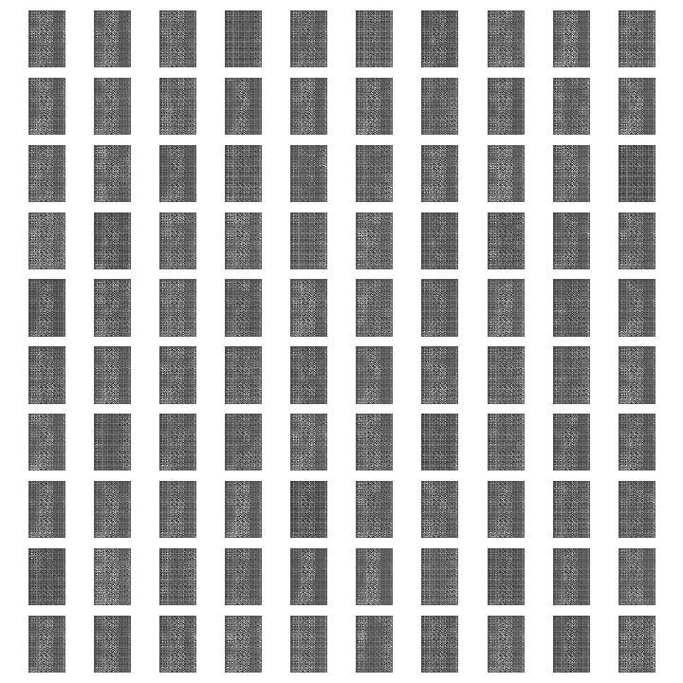
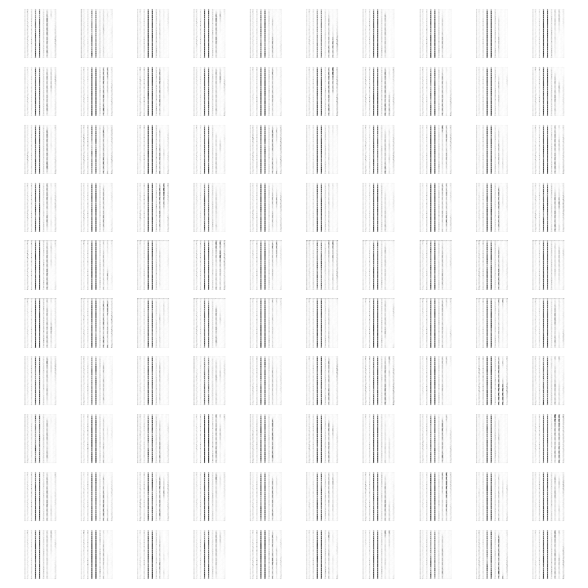
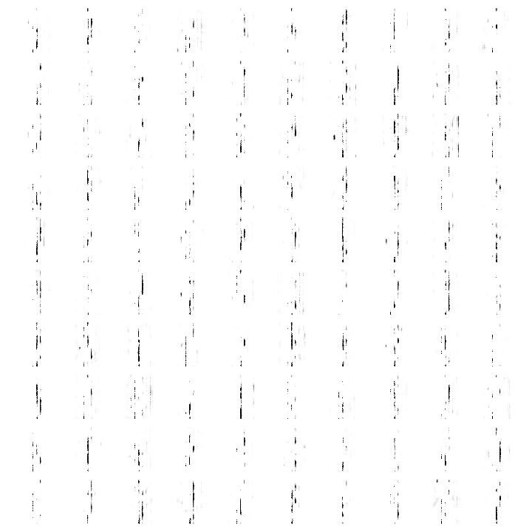
Intro
Data
Preprocessing
Model
Results
3rd epoche
5th epoche
20th epoche
17.12.2021
Lennart Kieschnik – Creating Jazz with GAN
8

Slide 11
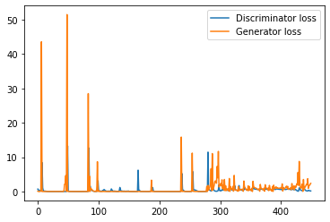
Intro
Data
Preprocessing
Model
Results
17.12.2021
Lennart Kieschnik – Creating Jazz with GAN
9

Slide 12
Intro
Data
Preprocessing
Model
Results
Since the data was generated from different midi files with different complexity in terms of track count, the preprocessing was likely not sufficient for generating suitable trainings data
Some track contained a melody, some containe just chords and some both
The large number of zeros in the array might have been the reason for the GAN to eventually only create empty arrays if epochs proceeded to higher numbers
Nonetheless, the GAN produced compositions that where not uniform, not random, and had some kind of internal logic in melodic theme and rythm
However, there were still random single base notes or dissonances in the compositions, and it sounded not really jazzy often
17.12.2021
Lennart Kieschnik – Creating Jazz with GAN
10

