Slide 1
HPML Final Project - Spring 2026
Benchmarking High-Throughput LLM Serving Frameworks
vLLM and SGLang improve concurrency-16 throughput by up to 39.1x over a HuggingFace baseline on shared-prefix prompts.
LLM Serving Benchmark
Yimeng Ye - yy3608
Can Yang - cy2811
Yuxuan Wang - yw4609
Jiawei Wang - jw4807
Zhijing Wu - zw3155
GitHub: https://github.com/lennonYe/6998_project
Tracking: https://wandb.ai/shvpz8ctzd-1/llm-serving-benchmark

Slide 2
Motivation & Problem
Why LLM serving needs systems optimization.
Why this matters
Problem statement
Interactive LLM products need low latency while serving many concurrent users.
Naive generation underutilizes GPU capacity and repeats expensive prefill work.
KV-cache memory management and request scheduling dominate serving efficiency.
Compare HuggingFace, vLLM, and SGLang for autoregressive inference under controlled concurrent workloads.
Goal: Measure TTFT, throughput, latency, and GPU memory across concurrency levels and prompt structures.
HPML - Spring 2026
2 / 14

Slide 3
Technical Approach - Model & Data
Controlled serving benchmark across models, prompts, and concurrency levels.
Models
Workload
Hardware
Qwen2.5-1.5B-Instruct, Qwen2.5-3B-Instruct, Llama-3.2-1B-Instruct, Qwen2.5-1.5B-AWQ-INT4.
Synthetic short Q&A prompts plus shared-prefix code-analysis prompts; 16 prompts per set to avoid cycling at max concurrency.
NVIDIA L4 24 GB rerun; earlier mid-report numbers used NVIDIA L40S 48 GB.
HPML - Spring 2026
3 / 14

Slide 4
Technical Approach - Optimizations Applied
We compare serving systems rather than changing model architecture.
1.
vLLM / PagedAttention
Paged KV-cache management enables high-throughput continuous batching under concurrent requests.
2.
SGLang / RadixAttention
RadixCache reuses shared prompt prefixes, reducing repeated prefill work for similar requests.
3.
AWQ INT4 quantized serving
Lower-precision weights reduce model memory footprint and test serving behavior under quantization.
HPML - Spring 2026
4 / 14

Slide 5
Profiling Methodology
Common metrics and comparable request patterns across all frameworks.
Tools
Metrics captured
PyTorch Profiler for HuggingFace baseline generation path
vLLM and SGLang server logs
nvidia-smi for GPU memory snapshots
Weights & Biases for run-level tracking
TTFT and end-to-end latency
Total output-token throughput
Peak / serving GPU memory
Short prompts vs shared-prefix prompts
Concurrency sweep: 1, 2, 4, 8, 16
HPML - Spring 2026
5 / 14

Slide 6
Results - Headline Numbers
Qwen2.5-1.5B-FP16, concurrency 16, NVIDIA L4.
39.1x
4.4x
20.6x
higher throughput
lower short-prompt latency
higher short-prompt throughput
28.34 -> 1108.39 tok/s on shared-prefix prompts
8999 ms -> 2045 ms with vLLM
28.45 -> 585.90 tok/s with vLLM
Measurements use deterministic generation, max_new_tokens=256, and concurrency levels 1-16.
HPML - Spring 2026
6 / 14

Slide 7
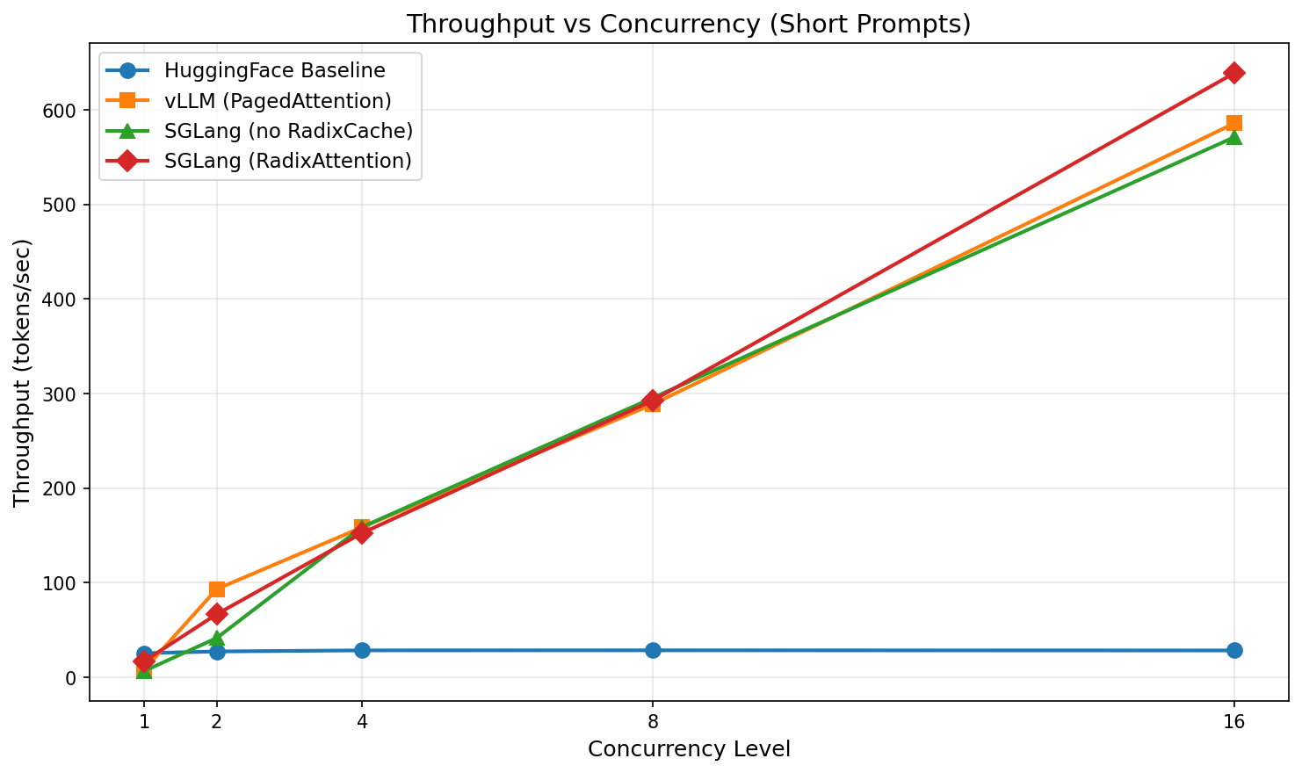
Results - Before vs. After
Throughput scales dramatically once requests are served by optimized runtimes.
Takeaway
HuggingFace baseline remains sequential and flat under concurrent load.
vLLM and SGLang exploit serving-time batching and KV-cache management.
SGLang is strongest when requests share long prompt prefixes.
HPML - Spring 2026
7 / 14

Slide 8
Profiler Evidence
PyTorch profiler isolates where baseline generation spends GPU time.
Top kernels: aten::mm, GEMV kernels, aten::addmm, FlashAttention forward, elementwise ops.
What to point at
Baseline generation pays repeated matrix multiply and token-by-token decode costs.
Serving frameworks reduce overhead through batching and cache-aware scheduling.
Shared-prefix prompts reveal the benefit of prefix reuse in SGLang.
GPU memory increases because serving frameworks reserve KV-cache space.
HPML - Spring 2026
8 / 14

Slide 9
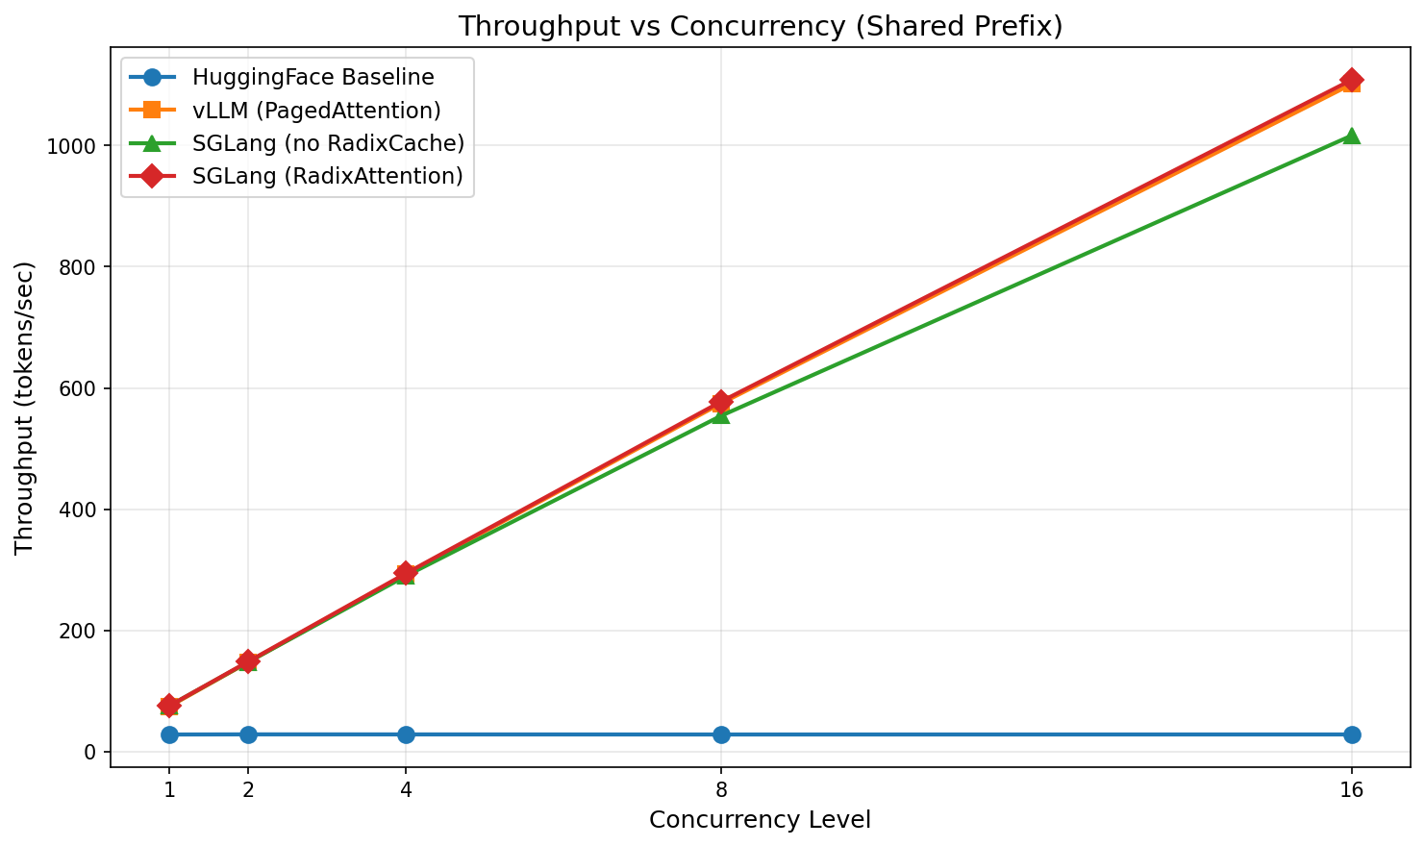
Demo / Visualization
Static fallback: generated figures from existing benchmark JSON files.
Shared-prefix throughput
Use README commands to regenerate figures without rerunning GPU benchmarks.
The visualization script also uploads figures and per-concurrency metrics to WandB.
Narrate the gap between sequential baseline and optimized serving as concurrency rises.
HPML - Spring 2026
9 / 14

Slide 10
Lessons Learned
The highest gains came from serving-time systems design rather than model changes.
What worked
What didn't work
Continuous batching made vLLM and SGLang much faster than the sequential baseline.
Shared-prefix prompts clearly exposed RadixAttention benefits.
Separate environments avoided dependency conflicts across frameworks.
One shared Python environment was brittle because serving frameworks pin different Torch stacks.
Profiling server internals directly was more invasive than profiling the baseline path.
Raw throughput alone was insufficient; TTFT and memory were needed to explain tradeoffs.
HPML - Spring 2026
10 / 14

Slide 11
Next Steps
Extend the benchmark to longer contexts and more realistic request traces.
Measure GPU utilization and queueing behavior over longer steady-state windows.
Add TensorRT-LLM / TGI comparisons and larger models when more GPU memory is available.
Evaluate quality and cost tradeoffs for quantized serving beyond AWQ INT4.
HPML - Spring 2026
11 / 14

Slide 12
Teamwork & Contributions
Team responsibilities and artifacts.
Member | Primary contributions | Tools / artifacts
Yimeng Ye | Benchmarking pipeline, experiment execution | scripts/run_all*.sh, results JSON
Can Yang | Serving framework integration, README and submission organization | src/bench_vllm.py, src/bench_sglang.py, README
Yuxuan Wang | Profiling and visualization | src/bench_profile.py, src/visualize.py
Jiawei Wang | Model/configuration sweep and result validation | configs/config.py, multi-model results
Zhijing Wu
Report, experiment tracking, documentation
WandB dashboard, deliverables/report.pdf

Slide 13
Thank you
Questions?
GitHub: https://github.com/lennonYe/6998_project
Tracking: https://wandb.ai/shvpz8ctzd-1/llm-serving-benchmark
HPML - Spring 2026
13 / 14

Slide 14
Backup - Experimental Setup
Experiment settings used for the reported L4 rerun.
Setting | Baseline | Optimized
Serving stack | HuggingFace Transformers | vLLM / SGLang
Precision | FP16 | FP16 and AWQ INT4
Concurrency | Sequential simulation: 1, 2, 4, 8, 16 | Concurrent HTTP requests: 1, 2, 4, 8, 16
Prompt sets | Short Q&A + shared-prefix code analysis | Same prompt sets
Max new tokens | 256 | 256
Hardware | 1x NVIDIA L4 24 GB | 1x NVIDIA L4 24 GB
Software stack | PyTorch 2.6, Transformers 4.51 | vLLM 0.8.4, SGLang 0.4.6
HPML - Spring 2026
14 / 14

