Slide 1




Slide 2
Day 1

Slide 3
Ember.js
Framework to develop web applications
AUTO-UPDATING HANDLEBARS TEMPLATES Ember makes Handlebars templates even better, by ensuring your HTML stays up-to-date when the underlying model changes. To get started, you don't even need to write any JavaScript.
COMPONENTS Experience the future of the web platform today with Ember's components. Components allow you to create your own application-specific HTML tags, using Handlebars to describe their markup and JavaScript to implement custom behavior.
ROUTING Build JavaScript apps that don't break the web! Ember.js makes it downright simple to create sophisticated, multi-page JavaScript applications with great URL support, in a fraction of the code you'd write in other frameworks.
CONVENTION OVER CONFIGURATION

Slide 4
Core concepts
TEMPLATES Handlebars templates. {{title}} {{#if isAdmin}}30 people have viewed your blog today.{{/if}}
COMPONENTS {{}} for now, <> very soon
CONTROLLERS About to be deprecated in favor of components. Components can not be route to for now but will be soon.
MODELS Models represent persistent state.
ROUTES Load a controller and a template and can load model data to “back” the controller and template.
ROUTER maps URL to a route.

Slide 5
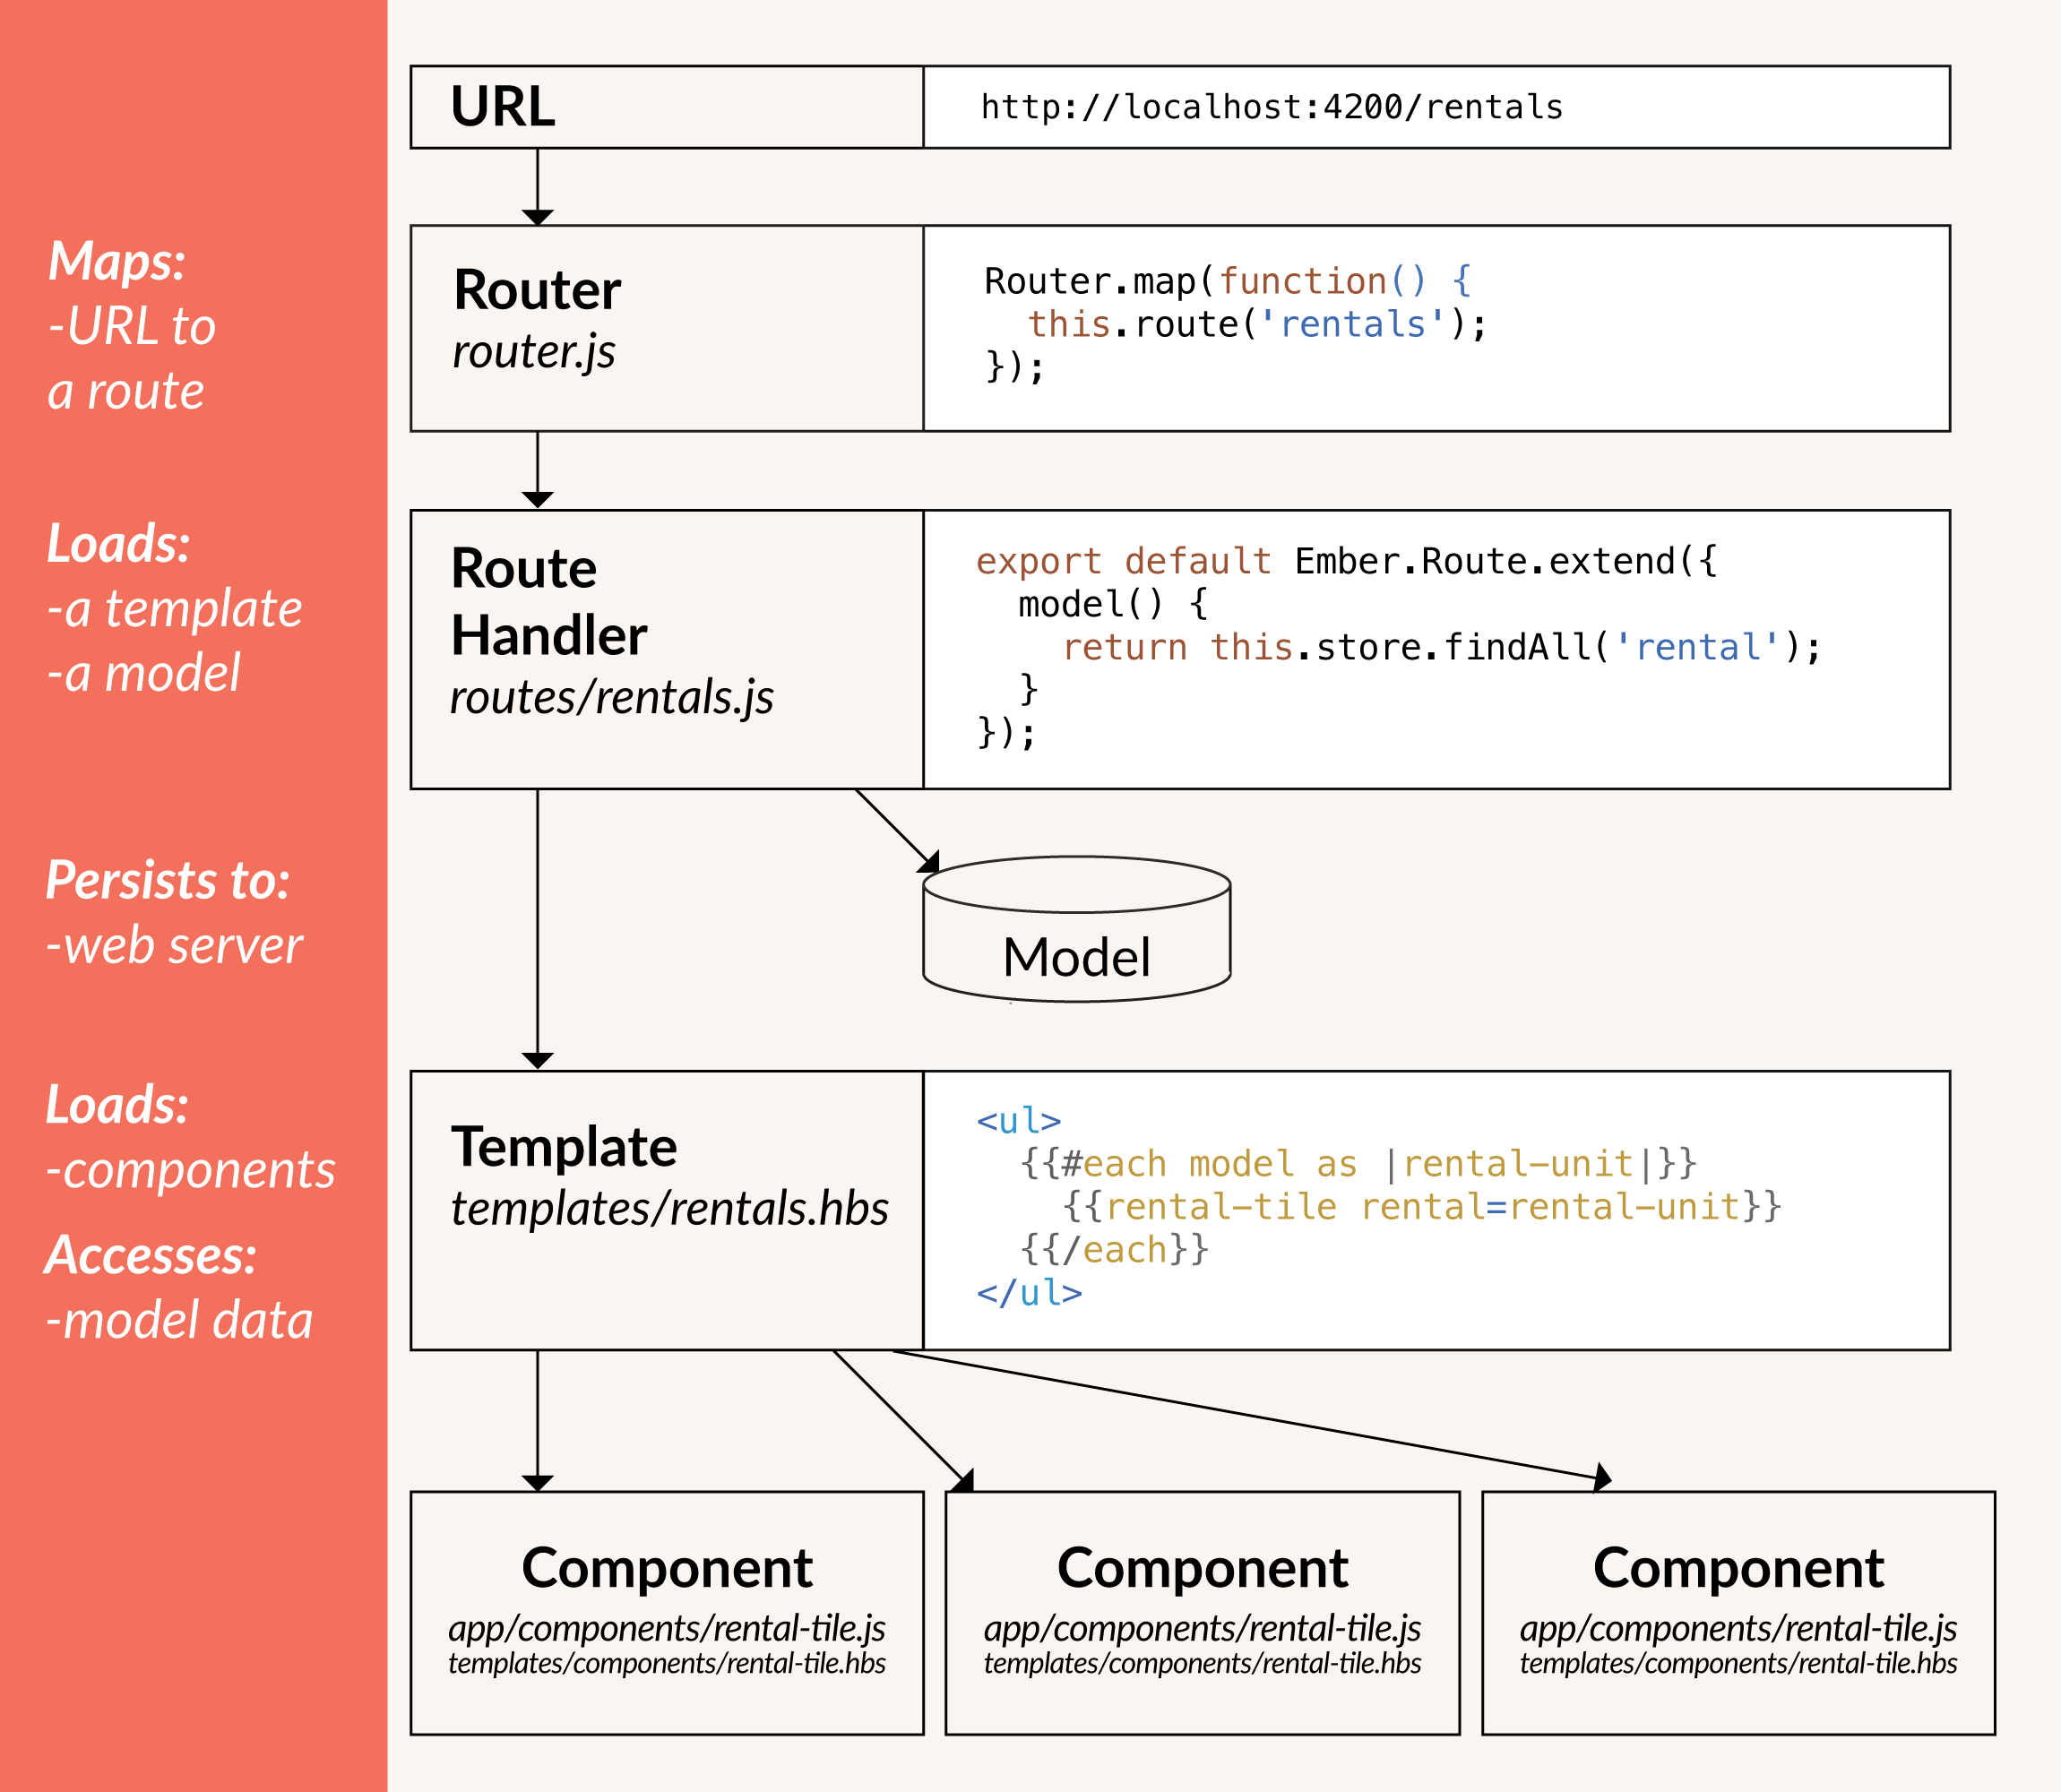
Core concepts

Slide 6
Core concepts - Router

Slide 7
Router
WHEN
The user loads the app for the first time.
The user changes the URL manually, such as by clicking the back button or by editing the address bar.
The user clicks a link within the app.
Some other event in the app causes the URL to change.
THEN
It renders a template.
It loads a model.

Slide 8
Router
// app/router.js
Router.map(function() { this.route('about', { path: '/about' }); this.route('favorites', { path: '/favs' }); });

Slide 9
Core concepts - Route Handler

Slide 10
Route Handler
Model hook
Returns data so it’s available to controller / template as a “model” variable.
Usually an ember data record, but can be any promise object plain JS object or array.
Ajax call or EmberData call.

Slide 11
Route handler
// app/routes/favorite-posts.js
import Ember from 'ember'; export default Ember.Route.extend({ model() { return [Array of favorites here]; } });

Slide 12
Core concepts - Template

Slide 13
Templates
Ember uses handlebars (http://handlebarsjs.com/)
“hbs” templates with static HTML along with dynamic content in double curly braces {{}}
Dynamic content is rendered using data-binding
No more double binding
“Data down, action up” pattern
Conditionals (#if), loops (#each), helpers (#link-to, #input, ...)

Slide 14
Template
// app/templates/favorite-posts.hbs
{{#each model as |favorite|}} <article class="blog-post"> <h3>{{favorite.title}}</h3> <div>{{favorite.body}}</div> </article> {{/each}}

Slide 15
Core concepts - Components

Slide 16
Components
Two parts: a handlebars template and a source JS file that defines behavior.
Components in ember must have a “-”.
Components receives properties (data down)
Components trigger actions (action up)

Slide 17
Components - template
// app/templates/components/blog-post.hbs
<article class="blog-post"> <h1>{{title}}</h1> <p>{{body}}</p> </article>

Slide 18
Template now with component
// app/templates/favorite-posts.hbs
{{#each model as |favorite|}} {{blog-post title=favorite.title body=favorite.body}} {{/each}}

Slide 19

Proyecto Nasa Image search
As an User I want to search for an image on NASA.
As an User I want to see a list of images that match the search term.
As an User I want to see information about one image.

Slide 20
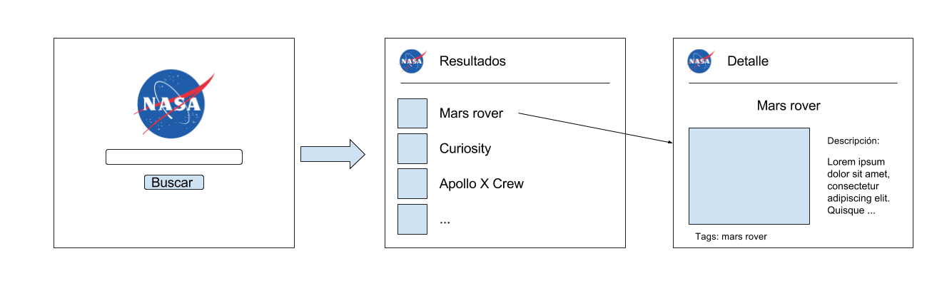
Proyecto Nasa Image search - screen flow

Slide 21


Slide 22

Install node
https://nodejs.org/

Slide 23
Install ember and create an app
npm install -g ember-cli
ember new nasa
cd nasa
ember serve

Slide 24
Out of the box features
A development server.
Template compilation.
JavaScript and CSS minification.
ES2015 (ES6)* features via Babel.
*Officially, the name is "ECMAScript 2015 Language" and it's the 6th Edition of the ECMA-262 standard.

Slide 25
Install bootstrap and ajax library
ember install ember-ajax
ember install ember-bootstrap
Docs:
http://www.ember-bootstrap.com/
https://github.com/ember-cli/ember-ajax

Slide 26
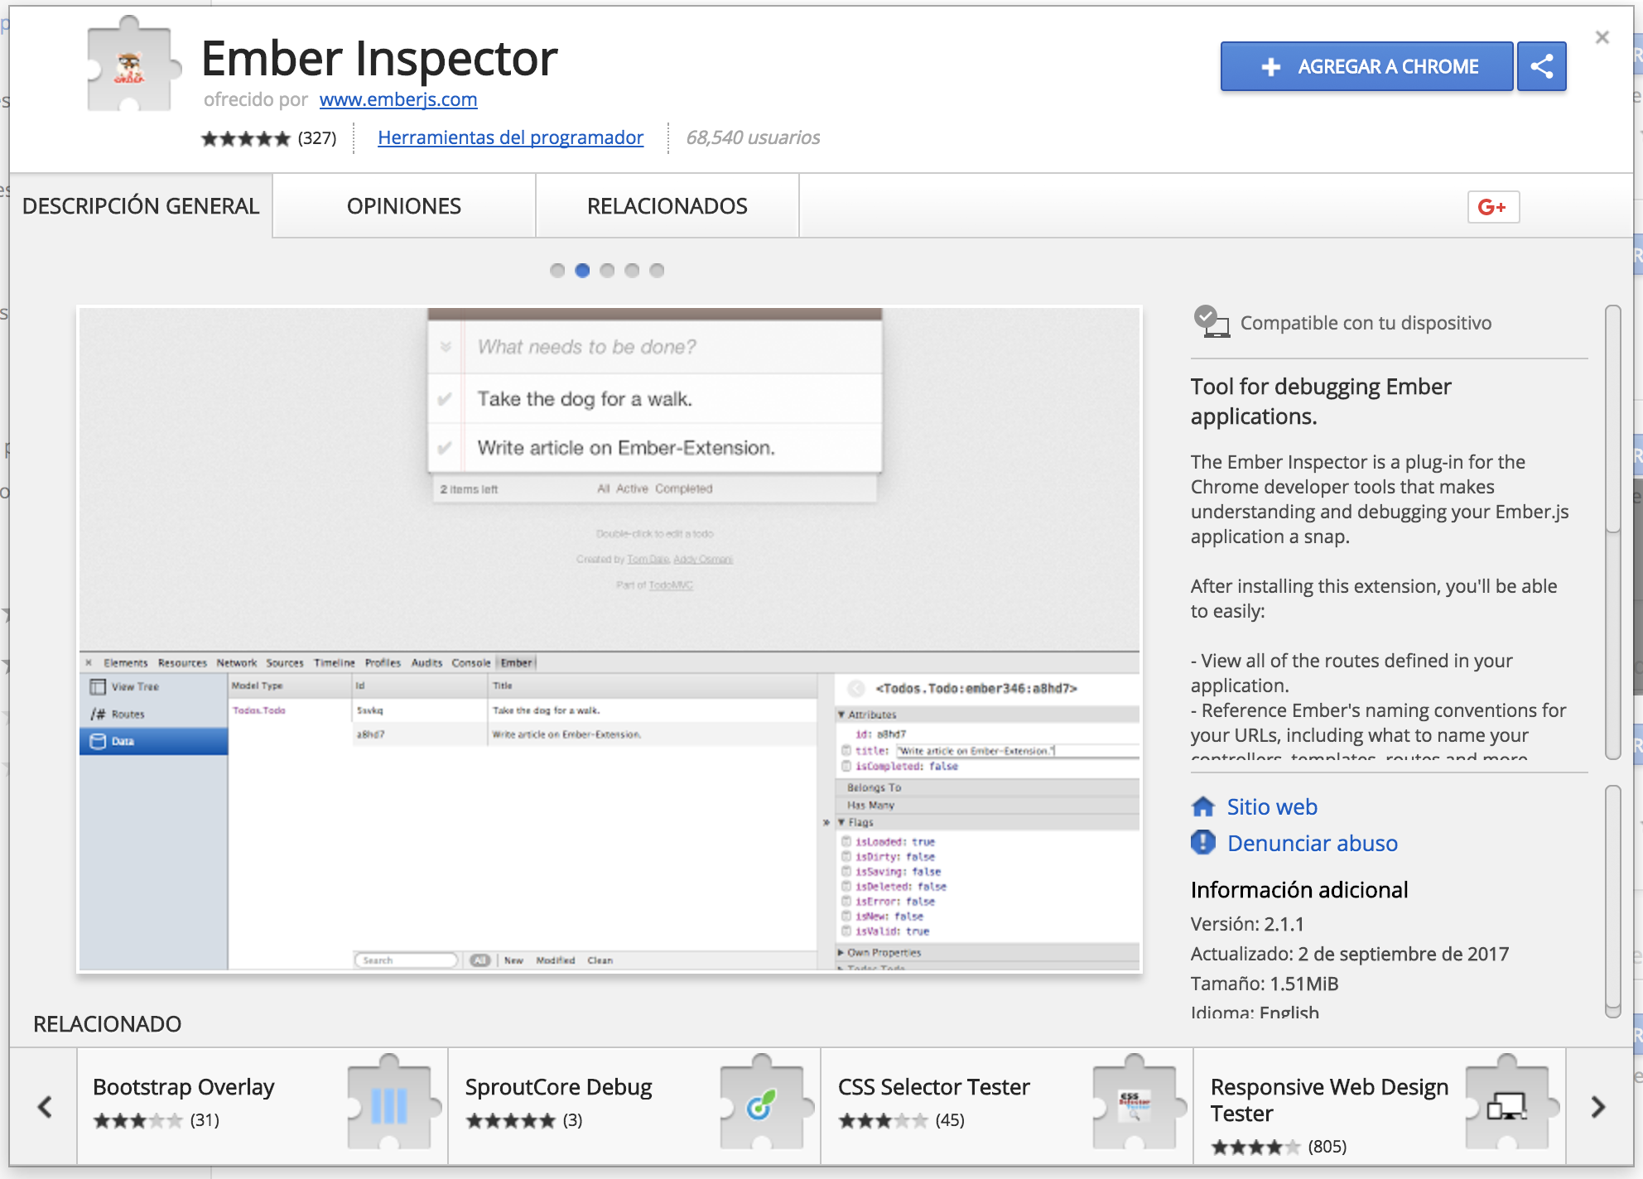
Install chrome extension
https://chrome.google.com/webstore

Slide 27
Day 2

Slide 28
Data binding
{{input value=searchTerm type='text'}}
<h1>{{searchTerm}}</h1>

Slide 29
Let’s create a route

Slide 30
Route and route handlers
WHEN
The user loads the app for the first time.
The user changes the URL manually, such as by clicking the back button or by editing the address bar.
The user clicks a link within the app.
Some other event in the app causes the URL to change.
THEN
It renders a template.
It loads a model.

Slide 31
Install ember and create an app
ember generate route search

Slide 32
Let’s work
Add a link-to helper to navigate from “/” to “/search”
{{#link-to ‘route-name’}} Link name {{/link-to}}
Add a link to do the inverse navigation.
Add a button with an action.
Add an input to the search page and bind it to a route variable.

Slide 33
Actions (hbs)
<button {{action "doSearch"}}>Buscar</button>

Slide 34
Actions (route)
import Ember from 'ember';
export default Ember.Route.extend({
actions: {
doSearch() {
console.log("Llego");
}
}
});
import Route from '@ember/routing/route';

Slide 35
Action parameters (hbs)
{{input value=searchTerm type='text'}}
<button {{action "search" searchTerm}}>Buscar</button>

Slide 36
Action parameters (route)
import Ember from 'ember';
export default Ember.Route.extend({
actions: {
search(searchTerm) {
console.log(searchTerm);
}
}
});

Slide 37
Install ember and create an app
ember g route images

Slide 38
Let’s work
Return an array of strings in the model hook.
Loop through the array and display each string in the template.
Make the button on ‘/search’ transition to ‘/images’.
Hint: use this.transitionTo(‘route-name’)
Now replace the array of string for array of objects and refactor
[{name: ‘...’, description:’...’}, {name: ‘...’, description:’...’}]

Slide 39
Refactor - creating a component
ember g component image-item

Slide 40
Refactor - replace template code for component
Put the static html in the component hbs
Replace the html code in the template for a component
¿Do we need parameters?

Slide 41
Day 3

Slide 42
Proyecto Nasa Image search - screen flow

Slide 43
Search results
We need to pass data from the ‘/’ page to the ‘/search’ page.
Query params:
Parameter in the url

Slide 44
Query params
this.transitionTo('images',{ queryParams: { q: searchTerm }});

Slide 45
Query params
For query params to work, we need to define them in the controller.
import Ember from 'ember';
export default Ember.Controller.extend({
queryParams: ['q']
});

Slide 46
Get transition data from route
model(params, transition) {
console.log(transition.queryParams['q']);
}

Slide 47
Query params
Advantages:
We can bookmark the url.
We can directly type the url to perform a specific search.

Slide 48
Request and response flow
Request (from the browser to the server)
Response (in reaction to a request)
Async calls from the browser to the server (non blocking and response will be handled as a ‘callback’)

Slide 49
Ajax call
Ajax call to: https://images-api.nasa.gov/search?media_type=image&q=
Service injection (ajax library)
ajax: Ember.inject.service(),
model(params, transition) {
this.get('ajax').request(....);
}

Slide 50
Emberfire
ember install emberfire

Slide 51
Create an emberfire account
https://firebase.google.com/

Slide 52
Create and list your favorites
Create two inputs and a button.
Async calls from the browser to the server (non blocking and response will be handled as a ‘callback’)

Slide 53
Day 4

Slide 54
Services
A Service is an Ember object that lives for the duration of the application, and can be made available in different parts of your application.

Slide 55
Services
ember g service bookmarks

Slide 56
Services
Service only stores state during app execution (not persistent).
Add and remove images to our bookmarked list.

Slide 57
Dynamic segments
this.route('favorite', { path: '/favorites/:favorite_id' });
Get param in the model hook and load the favorite by id.
Add a link to each favorite.
Do the same for a single nasa image.

Slide 58
Component actions
Create a component action to show / hide the image of the result list.

Slide 59
Day 5

Slide 61
Servicio web-unicen
Vamos a usar un servicio que creamos desde la cátedra.
URL: web-unicen.herokuapp.com
Este servicio:
Guarda información con el siguiente formato:
Id: Es autogenerado (no se pasa al crearlo).
Group: Número de grupo.
Thing: Un objeto JSON.

Slide 62
Servicio web-unicen
¿Cómo consulto la información?
Consulta por ID
Método: GET
URL: http://web-unicen.herokuapp.com/api/thing/ + id
Consulta por grupo
Método: GET
URL: http://web-unicen.herokuapp.com/api/thing/group/ + group id

