Slide 1
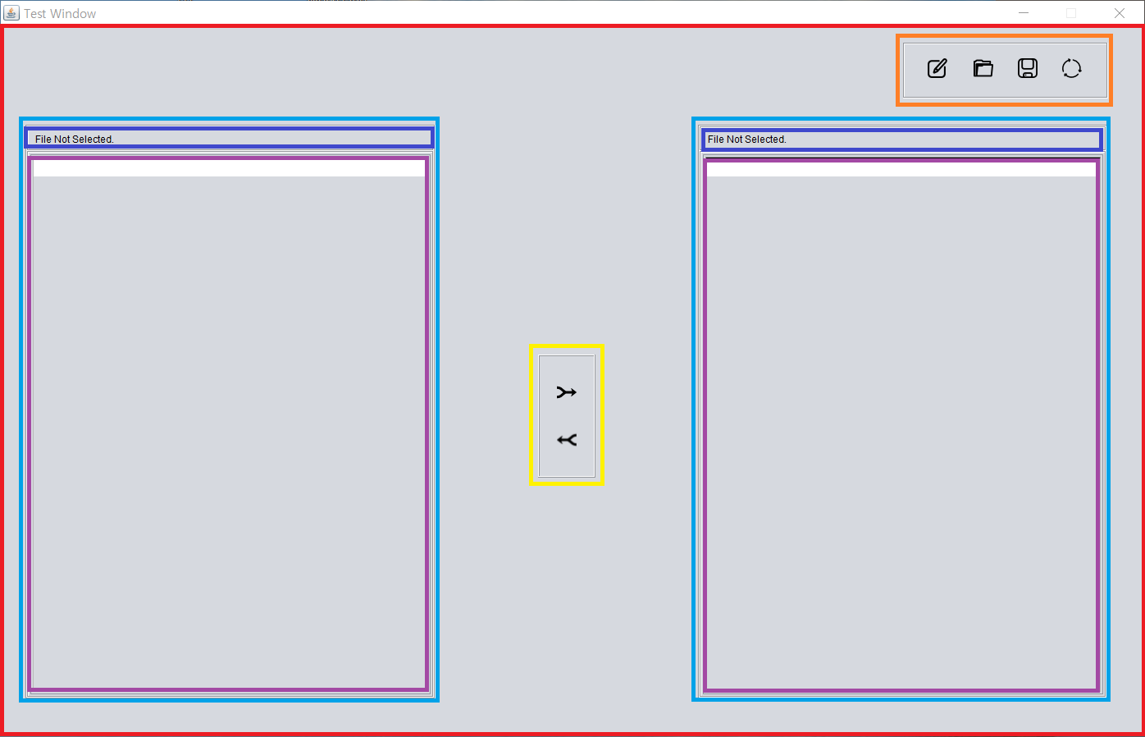
MainFrame
Top_menu_panel
Filepath_panel
Button_text_panel
Merge_button_panel
Text_panel

Slide 2
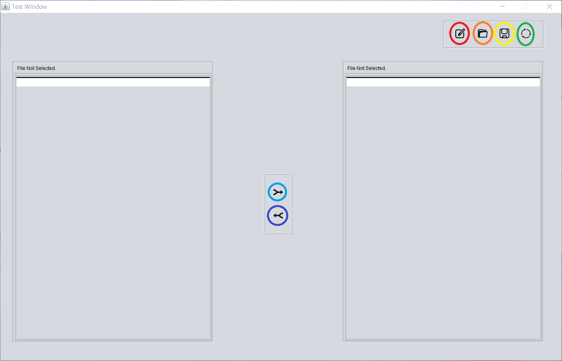
Load button
Edit button
Refresh button
Save button
LRmerge button
RLmerge button

Slide 3
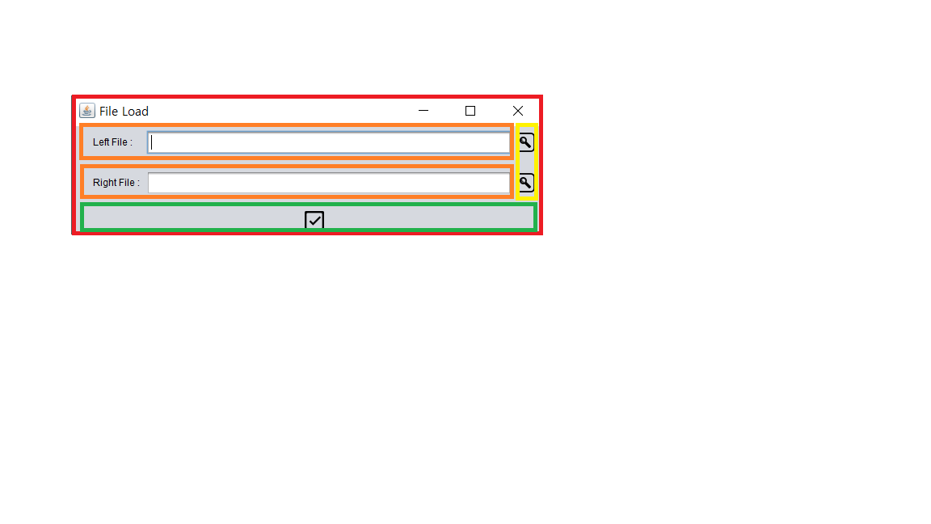
Load_Frame
Load_file_panel
Find_button
Load_ok_button
Load_ok_button_panel

