Slide 1

Evaluating Employee Communication Behaviors Using Large Language Models
Team members: Yu-Liang Lin, Zhanchen Kang
Date: May 1, 2026
Notes:
Title Slide
Project Title
Your Name(s)
Date

Slide 2
Introduction
Our team:
Background:
Large language models (LLMs) are increasingly deployed in customer-facing service contexts, yet their sociolinguistic behavior— specifically how well they calibrate empathy to a customer’s emotional state—remains largely unevaluated.
Yu-Liang Lin | MSIM Program
Zhanchen Kang | MSIM Program
Notes:
Introduction Slide
Brief Introduction: of the team and the topic

Slide 3
Research Question
Do frontier LLMs systematically over empathize or under-empathize relative to trained human customer support agents, as measured by a calibration delta against a naturalistic behavioral benchmark?
Is this empathy miscalibration consistent across industry domains, or does it vary by context—specifically between airlines and telecom?
Notes:
Introduction Slide
Brief Introduction: of the team and the topic

Slide 4
Related Work
A well-documented failure mode of RLHF-trained models is sycophancy—the tendency to agree with or flatter users at the expense of accuracy or appropriate restraint
The NLP empathy literature is growing but domain-narrow. A systematic review of 12 studies on LLMs and empathy found that 7 focused exclusively on medical contexts.
Meanwhile, LLMs nearly match expert reliability when judging empathic communication but was limited to personal-problems contexts, rather than transactional service dialogues.
Notes:
Introduction Slide
Brief Introduction: of the team and the topic

Slide 5
Gap
A Sycophancy research measures opinion-conformity, not tonal appropriateness.
Empathy research evaluates support-context warmth, not calibration to frustration level.
Customer service NLP evaluates response quality against idealized rewrites, not observed human behavior.
Our study sits at the intersection of all three and uses a unique data asset—naturalistic, multi-domain, paired conversational data—to fill it.
Notes:
Introduction Slide
Brief Introduction: of the team and the topic

Slide 6
Methodology
Our study follows a three steps empirical design:
(1) benchmark construction from real conversational data
(2) LLM response generation under a neutral prompt
(3) calibration scoring and statistical comparison.
Notes:
Introduction Slide
Brief Introduction: of the team and the topic

Slide 7
Benchmark Construction
We compute a Frustration Intensity Score (FIS) for each customer tweet using a composite of VADER sentiment, all-caps ratio, punctuation density, and presence of urgency vocabulary (``never again'', ``unacceptable'', ``immediately‘’).
Customer_text | Agent_Text | FIS
@sprintcare is the worst customer service | @115712 Hello! We never like our customers to feel like they are not valued. | 0.9865125417709351
@119625 Please upload south movies in hindi audio | @356781 I understand your concern, Nehal. I'll pass along your feedback to the team concerned for review. | 0.026857195422053337
Notes:
Introduction Slide
Brief Introduction: of the team and the topic

Slide 8
LLM Response Generation
System prompt:
“You are a customer support agent. Respond to the following customer message in one to three sentences.”
No persona, no tone instruction, and no domain context is supplied. This deliberate minimalism ensures we measure the model’s default social calibration rather than a prompted one.
Notes:
Introduction Slide
Brief Introduction: of the team and the topic

Slide 9
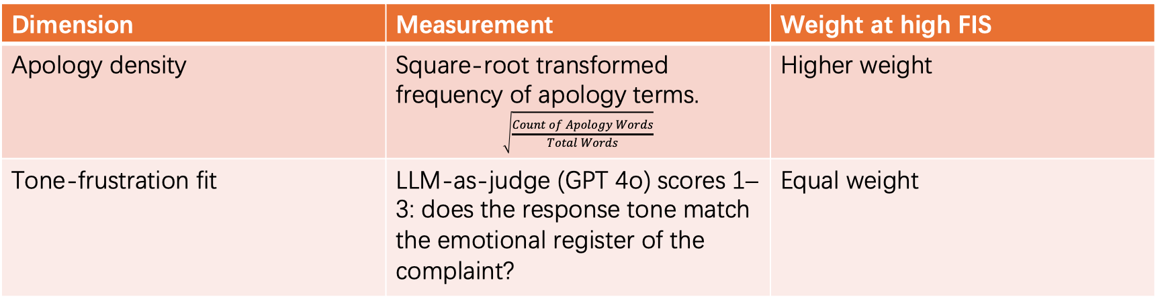
Empathy Calibration Score (ECS)
The ECS is a two-dimensional rubric designed to measure not absolute empathy, but calibration— how well a response’s empathetic register matches what the customer’s expressed frustration level warrants.
Dimension | Measurement | Weight at high FIS
Apology density | Square-root transformed frequency of apology terms. $$\sqrt{\frac{Count of Apology Words}{Total Words}}$$ | Higher weight
Tone-frustration fit | LLM-as-judge (GPT 4o) scores 1–3: does the response tone match the emotional register of the complaint? | Equal weight
Notes:
Introduction Slide
Brief Introduction: of the team and the topic

Slide 10
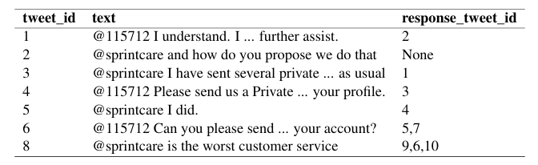
Datasets
Customer Support on Twitter dataset (Axelbrooke, 2017)
Notes:
Introduction Slide
Brief Introduction: of the team and the topic

Slide 11
Experiments
Evaluation Metrics:
The primary outcome is the calibration delta ∆ = ECS(LLM)−ECS(human), computed per instance and aggregated per model and domain. We also report apology density independently as a fully model-agnostic signal.
Baselines:
We evaluate three frontier models as candidate systems: GPT-4o, Claude 4.6 Sonnet, and Gemini 3 Flash. All three are evaluated under the same minimal neutral prompt with no persona or tone instruction. The human agent responses from the Twitter dataset serve as the behavioral ground truth baseline.
Notes:
Introduction Slide
Brief Introduction: of the team and the topic

Slide 12
Results
GPT4o:
Composite Δ = +0.0973 (over-empathizes) :
95% CI = [0.0841, 0.1104] | t = 14.502, p = 0.0000
Decomposed:
Δ_apology_density = +0.1201 | Δ_tone_fit = +0.0694
Primary driver: apology density
Notes:
Introduction Slide
Brief Introduction: of the team and the topic

Slide 13
Results
Gemini :
Composite Δ = +0.1736 (over-empathizes)
95% CI = [0.1596, 0.1876] | t = 24.354, p = 0.0000
Decomposed:
Δ_apology_density = +0.1072 | Δ_tone_fit = +0.2494
Primary driver: tone-fit (Δ_tf=+0.2494)
Notes:
Introduction Slide
Brief Introduction: of the team and the topic

Slide 14
Results
model | composite Δ | Δ apology_density | Δ tone_fit | driver
GPT4o | 0.0973 | 0.1201 | 0.0694 | apology_density
Gemini | 0.1736 | 0.1072 | 0.2494 | tone_fit
Notes:
Introduction Slide
Brief Introduction: of the team and the topic

Slide 15
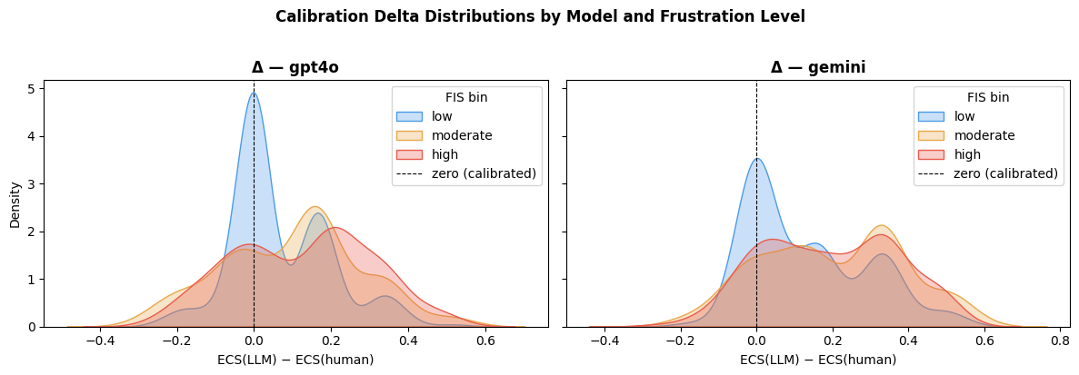
Results
Notes:
Introduction Slide
Brief Introduction: of the team and the topic

Slide 16
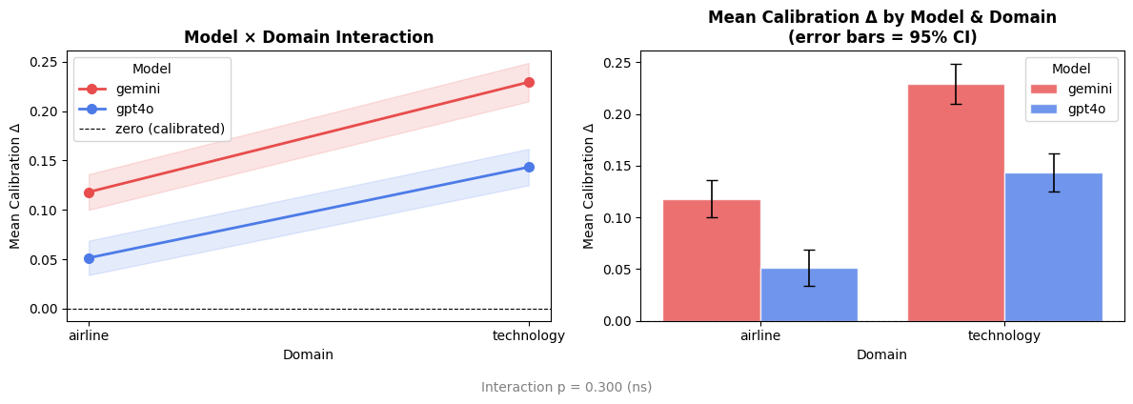
Results
Notes:
Introduction Slide
Brief Introduction: of the team and the topic

Slide 17
Conclusion & Discussion
RQ1 — Do frontier LLMs systematically over- or under-empathize relative to human agents?
Both models show statistically significant positive calibration deltas, meaning both over-empathize relative to human agents. Also, there’s different tendency in models and frustration levels.
Notes:
Introduction Slide
Brief Introduction: of the team and the topic

Slide 18
Conclusion & Discussion
RQ2 — Is this miscalibration consistent across industry domains (airline vs. technology)?
The two-way ANOVA finds a significant main effect of domain, meaning both models over-empathize more in the technology sector than in the airline sector. A plausible interpretation: technology-sector human agents in the dataset tend to write more procedural, lower-warmth replies, so LLM defaults diverge more from that baseline than from the warmer airline-agent style.
Notes:
Introduction Slide
Brief Introduction: of the team and the topic

Slide 19
Future Works
Evaluate more models (Claude/Grok/Qwen)
Further tuning LLM-as-judge to evaluate tone-fit score
Multi-trial Averaging for tone-fit score
Incorporate more dimension in ECS
Notes:
Introduction Slide
Brief Introduction: of the team and the topic

Slide 20
References
Stuart Axelbrooke. 2017. Customer support on twitter.
Adam Dahlgren Lindström, Leila Methnani, Lea Krause, Petter Ericson, Íñigo Martínez de Rituerto de Troya, Dimitri Coelho Mollo, and Roel Dobbe. 2025. Helpful, harmless, honest? sociotechnical limits of AI alignment and safety through reinforcement learn ing from human feedback. Ethics and Information Technology, 27(2):28. Epub 2025 Jun 4.
Yuna Hong, Bonhwa Ku, and Hanseok Ko. 2025. Performance evaluation metrics for empathetic llms. Information, 16(11).
Laya Iyer, Kriti Aggarwal, Sanmi Koyejo, Gail Heyman, Desmond C. Ong, and Subhabrata Mukherjee. 2026. Heart: A unified benchmark for assessing humans and llms in emotional support dialogue.
Notes:
Introduction Slide
Brief Introduction: of the team and the topic

