Slide 1


Main Title
Subtitle
11/2020

Slide 2

Rule Based Fraud Detection
Current Rule Book
New Rules – persistent, general
New Rules – persistent, employees
New Rules – transactional

Slide 3
Rule based fraud detection
System with a set of predefined rules aimed to identify fraudulent accounts and transactions.
IF <condition> THEN <action>
3 possible actions:
Block the account/transaction
Accept the account/transaction
Refer it to manual analysis

Slide 4
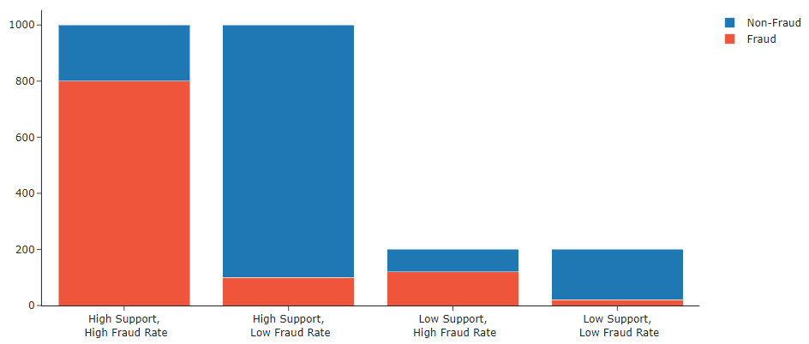
Rule based fraud detection
Rules’ performance evaluated with two metrics:
Support - Total number of cases tagged by the rule.
Fraud Rate - Percentage of tagged cases corresponding to actual fraudsters.

Slide 5
Rule based fraud detection
Four different kinds of rules:
Onboard: Applied only during the onboarding of the client.
e.g.: block account if the e-mail’s domain is suspicious
2. Login: Applied every time a user logs into his account.
e.g.: block account if the user’s device is suspicious
3. Persistent: Applied at fixed timesteps to all active accounts.
e.g.: block account if the user receives more than 50 referral bonus rewards
4. Transactional: Applied to all individual transactions
e.g.: block transaction if it is a Boleto Payment consisting of 100% of the account’s balance.

