Slide 1
Restaurant Location Analysis IBM Applied Data Science Capstone
By: Luanluan Xu
July, 2019

Slide 2
1. Introduction
In the modern society, More and more people choose to eat out or increase the frequency of eating out. Especially in modern metropolises like New York City, restaurants are everywhere, opening and closing every day. But why some restaurants after opening can be filled with customers and make a lot of money, while others have slow bussiness. Location is one of the important factors.

Slide 3
1. Introduction
1.1 Bussiness Problem
So how to decide a location-selection?
Based on the data of 2,698 restaurants in five Boroughs of New York City, this project aims to study the influence of household income level, population density, existing competitors and other factors on the location-selection, and find out the patterns.
1.2 Targeted Audiences
owners or investors who want to open a restaurant.

Slide 4
2. Data Section
Tools used for data collection/cleaning/analysis.
Foursquare API
Web scraping
Python
Machine Learning(K-means)
Folium

Slide 5
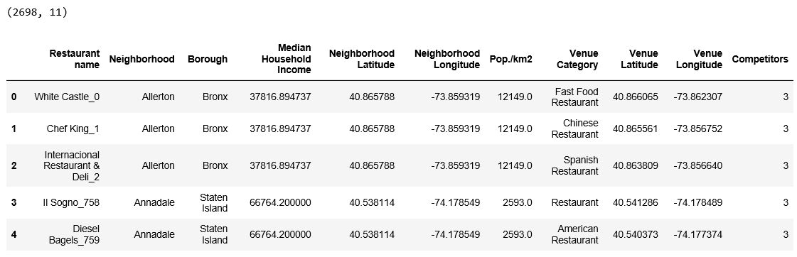
2. Data Section
Data from all sources are combined into one table.
There are 2698 restaurant samples and 11 features.

Slide 6
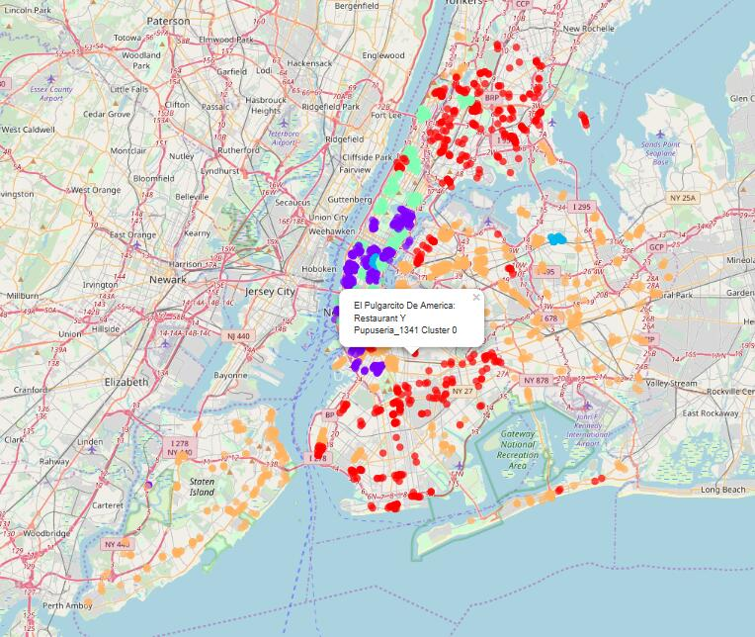
3.1 Using k-means for Restaurants Segmentation
I create a new dataframe which only contains 4 features:
'Restaurant name',
'Median Household Income',
'Pop./km2' (Population density)
'Competitors'.
I run k-means to cluster the restaurants into 5 clusters, and visualize all restaurants in NYC in a map using Folium.

Slide 7
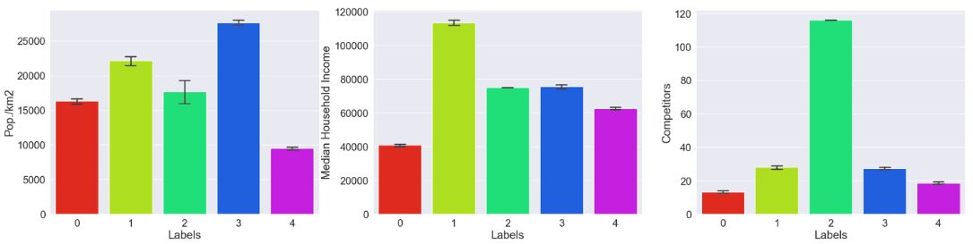
4.2 Analyzing Individual Feature Patterns using Visualization
From the figures, cluser 5('Lables'==4) have the lowest population density, and cluser 1 ('Lables'==0) have the lowest Median Household Income, they have less Competiors too. what's the relationships between Median Household Income, Population density and Competitors.

Slide 8
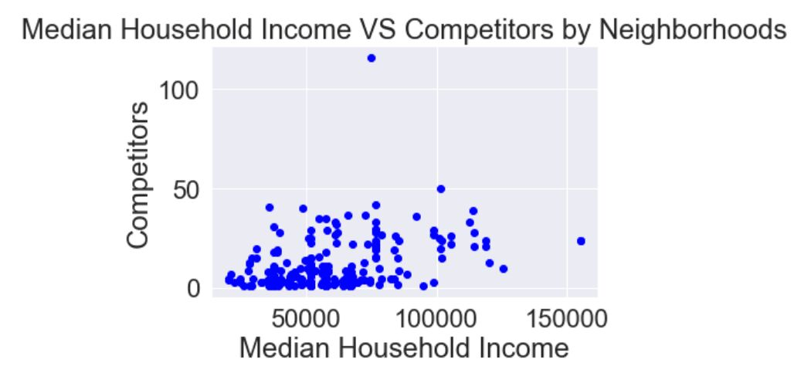
3.3 Neighborhoods analysis
The Pearson Correlation Coefficient is *r* = 0.353 with a P-value of P = 3.116e-09.
Since the p-value is << 0.001, the correlation between Median Household Income and Competitors is statistically significant, although the linear relationship isn't extremely strong (~0.35).
From the 2D Scater-plot, we can see that when the neighborhood tends to have more competitors with a higher Median Household Income.

Slide 9
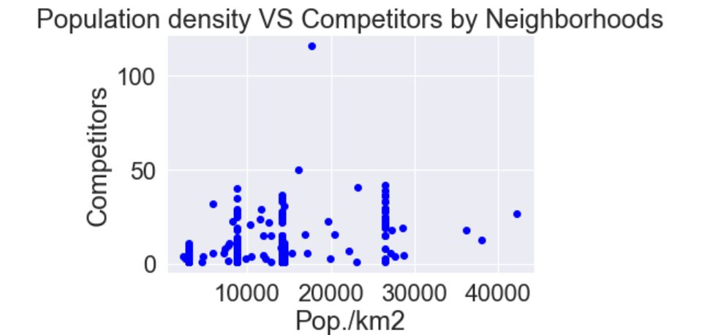
3.3 Neighborhoods analysis
The Pearson Correlation Coefficient is r = 0.406 with a P-value of P = 5.953e-12.
Since the p-value is << 0.001, the correlation between Population density and Competitors is statistically significant, although the linear relationship isn't extremely strong (~0.41).
From the plot, less obviously with noise which is caused by the missing information, competitors tend to rise as the population density increases.

Slide 10
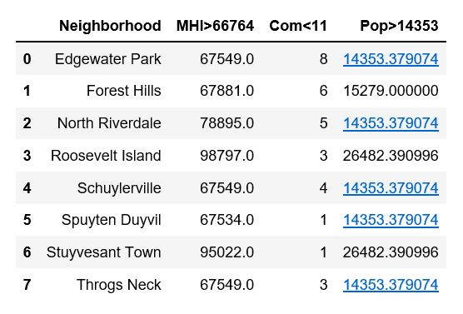
4. Results
Based on the patterns, Let's find the neighborhoods :
Median Household Income > 66764(75%)
Population density > 14353(75%)
Competitor < 11(mean=10.18).

Slide 11
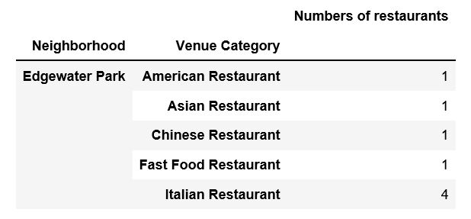
5. Discussion
There are many other factors to be considered while deciding a location selection. For example, if the owner wants to open a Italian restaurant. Edgewater Park is not a good choice.
Because there have been 4 Italian Restaurants in this area. If he does so, the new restaurant may spend too much time on marketing because of the abundance of competitors around neighborhood. It's better to choose a location from the rest.

Slide 12
6. Conclusion
Overall, location selection is a very complicated process. There are many considerations that should be made in the selection.
According to this report, 8 out of 306 neighborhoods are recommended to owners or investors who want to open a restaurant. Although it can't give the exact location, it helps to narrow it down!

Slide 13
Data Sources & Reference
1) Neighborhoods in New York City Coursera-Course 9
2) Restaurants in New York City Foursquare API
3) Population density by Neighborhoods
Wikipedia page
("https://en.wikipedia.org/wiki/Neighborhoods_in_New_York_City ")
4) Median Household Income by Neighborhoods
web page
(https://ny.curbed.com/2017/8/4/16099252/new-york-neighborhood-affordability)

Slide 14
Thank you!

