Slide 1

REPUBLIC OF CAMEROON | AGILE PROJECT MANAGEMENT | MR KUATE
Expense Tracker
Two-Sprint Review
Sprint 1: Account, Session & Admin Foundation | Sprint 2: Standalone Expense & Income Tracking
Delivered over two three-week Scrum sprints, 19 September to 9 October 2026, with a daily stand-up every school day at 10:00 for ten minutes.
Presented by Biloa Ekassi Lena, Tagne Fadhil, Djou Ningaye Simon, Nguma Kelimbom and Yuhnekeh Sidney Brown.
Track. Understand. Improve.
FinFlow | Expense Tracker | Agile Project Management
1
Notes:
Good morning. We are the five-member Scrum team behind Expense Tracker, branded FinFlow, and this review covers the two three-week sprints we have just completed: Sprint 1 on the Account, Session and Admin Foundation, and Sprint 2 on Standalone Expense and Income Tracking.
Everything in this deck comes from our own project artefacts: the product vision and backlog documents, the Trello board, and the GitHub repository where the work was merged. The presentation takes about fifteen minutes and we are happy to take questions at the end.

Slide 2
WHAT WE WILL COVER
Agenda
Team & sprint cadence
Daily stand-up practice
Trello & GitHub workflow
1
2
3
Who we are, how long each sprint ran, and the rhythm we worked to.
Ten minutes, every school day at 10:00, three questions each.
How a story moved from a card to a reviewed merge on develop.
Product vision update
Sprint 1 outcome
Sprint 2 outcome
4
5
6
The corrections we folded into the vision and the backlog in Sprint 1.
Account, session and admin foundation: US01 to US11.
Standalone expense and income tracking: US12 to US26.
FinFlow | Expense Tracker | Agile Project Management
2
Notes:
Here is the shape of the next fifteen minutes. We start with who we are and the cadence we committed to, then the two things the brief asks us to summarise: our daily stand-up practice and the Trello and GitHub workflow we set up.
After that we walk through the product vision update and take each sprint in turn, covering the goal, the user stories it carried and what the sprint actually produced. We finish with our Definition of Done and what Sprint 3 will pick up.

Slide 3
WHO WE ARE
Team, Roles & Sprint Cadence
MEMBER
ROLE
RESPONSIBILITY
3 weeks
Yuhnekeh Sidney Brown
Product Owner
Owns and orders the backlog; writes user stories and acceptance criteria; accepts or rejects work at sprint review.
per sprint
Tagne Fadhil
Scrum Master
Runs sprint planning, the daily stand-up, review and retrospective; removes blockers; guards the Definition of Done.
19 Sep - 9 Oct
Biloa Ekassi Lena
Developer
Implements and tests the stories assigned each sprint; reviews pull requests before merge.
2026
Nguma Kelimbom
Developer
Implements and tests the stories assigned each sprint; reviews pull requests before merge.
5 members
Djou Ningaye Simon
Developer
Implements and tests the stories assigned each sprint; reviews pull requests before merge.
all developers
Two sprints delivered
- Sprint 1 - weeks 1 to 3
- Sprint 2 - weeks 4 to 6
FinFlow | Expense Tracker | Agile Project Management
3
Notes:
Five of us, and everyone writes code. Two of us carry a Scrum role on top of development. Sidney is our Product Owner: he owns the backlog and its order, writes the user stories and acceptance criteria, and accepts or rejects work at the end of each sprint. Fadhil is our Scrum Master: he runs sprint planning, the daily stand-up, the review and the retrospective, and his main job is clearing blockers.
Lena, myself and Simon are developers, implementing and testing the stories assigned each sprint and reviewing each other's pull requests.
Both sprints ran three weeks, covering 19 September to 9 October 2026.

Slide 4
HOW WE STAYED IN SYNC
The Daily Stand-up
Every school day at 10:00, ten minutes, three questions each. Nothing else was allowed into the meeting.
1
2
3
What did I do yesterday?
What am I doing today?
What is blocking me?
Each developer reported what they finished the previous day and how it moved the Sprint Goal forward.
The work planned for the present day of the sprint, so the team always knew what was in flight and who held it.
Any blocker was raised out loud and picked up immediately by the Scrum Master rather than left to fester.
10 minutes
Every school day
3 questions
Blockers owned
Hard cap, every day
Mon to Fri, 10:00am
Each developer answers
SM picks them up live
Ten minutes was the rule we actually kept. Longer problems went to a separate conversation straight after, so the stand-up never turned into a design meeting.
FinFlow | Expense Tracker | Agile Project Management
4
Notes:
Our daily stand-up was the single most important ritual of both sprints. It ran every school day at ten in the morning and was capped at ten minutes.
Each developer answered three questions: what I finished yesterday, what I am doing today, and what is blocking me. The third question is the one that earned its place - blockers were captured in the meeting and the Scrum Master took them away immediately instead of us discovering them at the end of the sprint.
As Scrum Master, Fadhil protected the ten minutes. If a topic needed real discussion we took it offline right after, which is why the stand-up stayed short every single day.

Slide 5
TRELLO MEETS GITHUB
How the Work Actually Flowed
BACKLOG
ISSUE
BRANCH
BUILD
PULL REQUEST
REVIEW & MERGE
A user story exists as a Trello card with its acceptance criteria as a checklist and a P0 to P3 priority label.
The card maps to exactly one GitHub Issue, so the story has a single home and a single tracking number.
A branch is cut from develop, named for the story. Nothing is ever committed straight to develop or main.
The developer implements and tests the story on that branch against the acceptance criteria.
A PR is opened against develop and linked back to the issue it closes.
Another developer reviews the PR before it merges. The card then moves to done on the board.
>
>
>
>
>
Trello board
GitHub repository
Engineering work is visible too
- One board, lists running Sprint 0 through Sprint 8, so the board itself shows the build order. Every story is a card: acceptance criteria as a checklist, priority as a P0 to P3 label.
- One shared repo with main and develop. Every feature branches off develop, opens a pull request back into develop, and is reviewed by another developer before it merges.
- Technical setup tasks such as CI/CD, the database schema and seeded categories got their own cards, keeping product work clearly separate from groundwork.
Branch naming in practice, from our own repository:
US17_create_an_expense_category
US09_manage_default_categories US10_monitor_platform_health US01_create_account US07_admin_authentication
FinFlow | Expense Tracker | Agile Project Management
5
Notes:
This is the part of the brief that asks how Trello and GitHub connect, so let us be concrete.
Trello was our single board of record. The lists ran left to right as Sprint 0 through Sprint 8, which meant the board itself showed the build order rather than hiding it in a spreadsheet. Each user story was a card with its acceptance criteria as a checklist and a priority label from P0 to P3. Technical setup work, such as CI/CD and the database schema, got its own cards so it was obvious what was product work and what was engineering groundwork.
GitHub held one shared repository with main and develop. Every story got its own branch off develop, named by story number and feature. Nobody committed directly to develop or main - you branched, built, opened a pull request back into develop, and another developer reviewed it before it merged.
The connector between the two was the GitHub Issue: one story, one Trello card, one issue, one branch, one pull request. When the review passed and the merge landed, the card moved to done.
The honest status: the branch naming convention and the GitHub half are the parts we have genuinely exercised so far. You can see the real branch names on this slide straight from our repository. Writing the sprint backlog out as one GitHub Issue per story is the piece we are still finishing.

Slide 6
SPRINT 1 ALSO CORRECTED OUR FOUNDATIONS
Product Vision, Updated
The vision statement
What the review changed
- "To provide a simple and intelligent personal financial platform that helps users record their income and expenses with minimal friction, optionally plan and track spending goals, understand their financial activity, and improve their ability to save money."
- We had stated the product as a planning tool. The correction re-centred it on tracking first, with budgeting as an optional layer the user can add whenever they choose.
Tracking is always on
Budgeting is a goal, not a gate
Overspending is allowed
- Income and expense tracking works from account creation, with no setup barrier and no budget required first.
- A budget is an optional goal layer, like a personal streak. It never blocks, pauses or gates recording income or expenses.
- Once a budget is validated the system never prevents spending. Overspending surfaces as a negative balance.
The financial cycle the vision now fixes: TRACK (always on) > PLAN (optional) > MONITOR (never blocks) > UNDERSTAND (savings or debt)
Total income
Savings
Debt
sum of all valid income records in the period
total income - total actual expenses
total actual expenses - total income, carried into the next period
Savings and debt are calculated from real income and real expenses, so they work whether or not the user ever sets a budget.
FinFlow | Expense Tracker | Agile Project Management
6
Notes:
Sprint 1 was not only code. The corrections we received on our first submission were folded back into the Product Vision document, and two things changed materially.
First, the vision statement itself. We had framed Expense Tracker as a planning product. The corrected vision centres it on recording income and expenses with minimal friction, and treats planning as something the user may optionally add. That reads as a small wording change but it reordered our whole backlog.
Second, three product principles became non-negotiable. Tracking is always on from account creation. Budgeting is a goal, not a gate, so it can never block a transaction. And overspending is a legitimate outcome of a goal you missed, not an error the system prevents.
Everything else follows from the order on the blue strip: track, optionally plan, monitor without blocking, then understand whether the user saved or fell into debt.

Slide 7
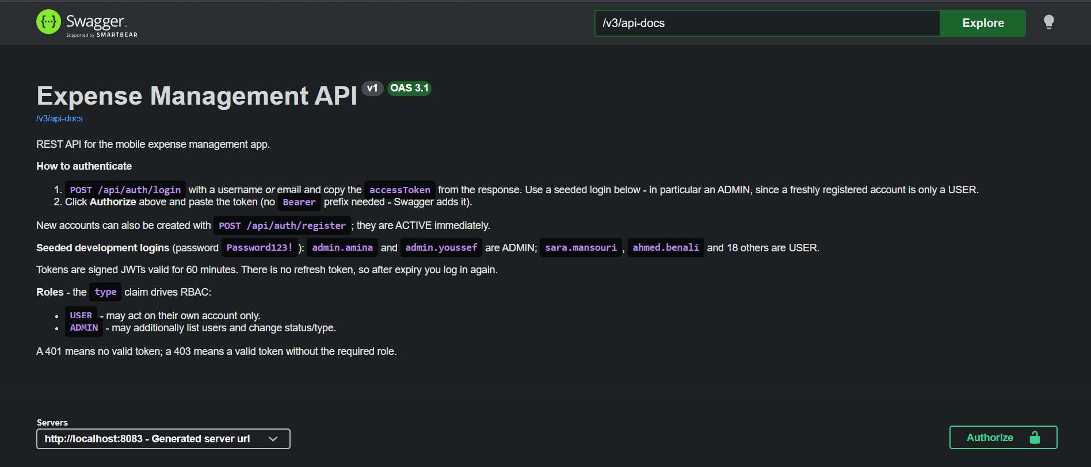
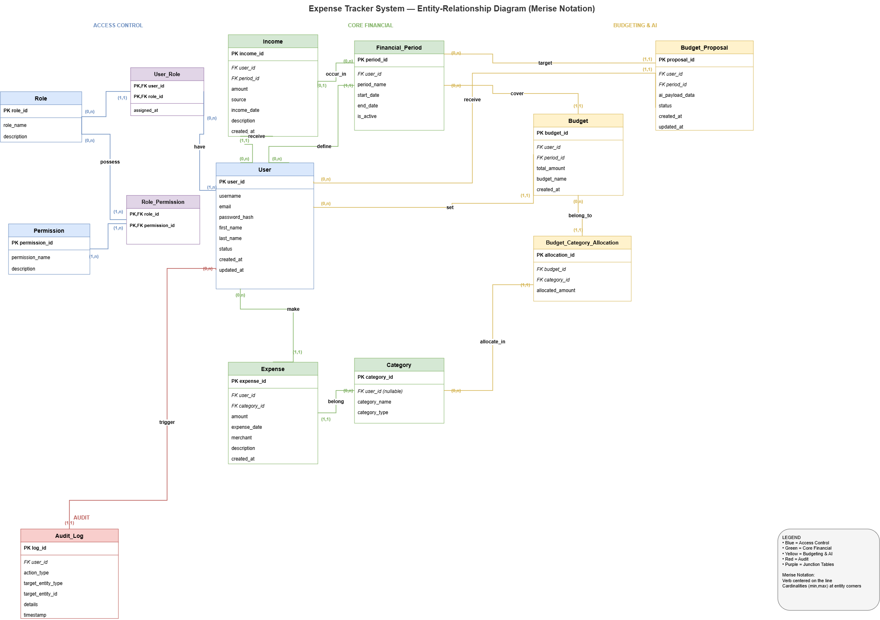
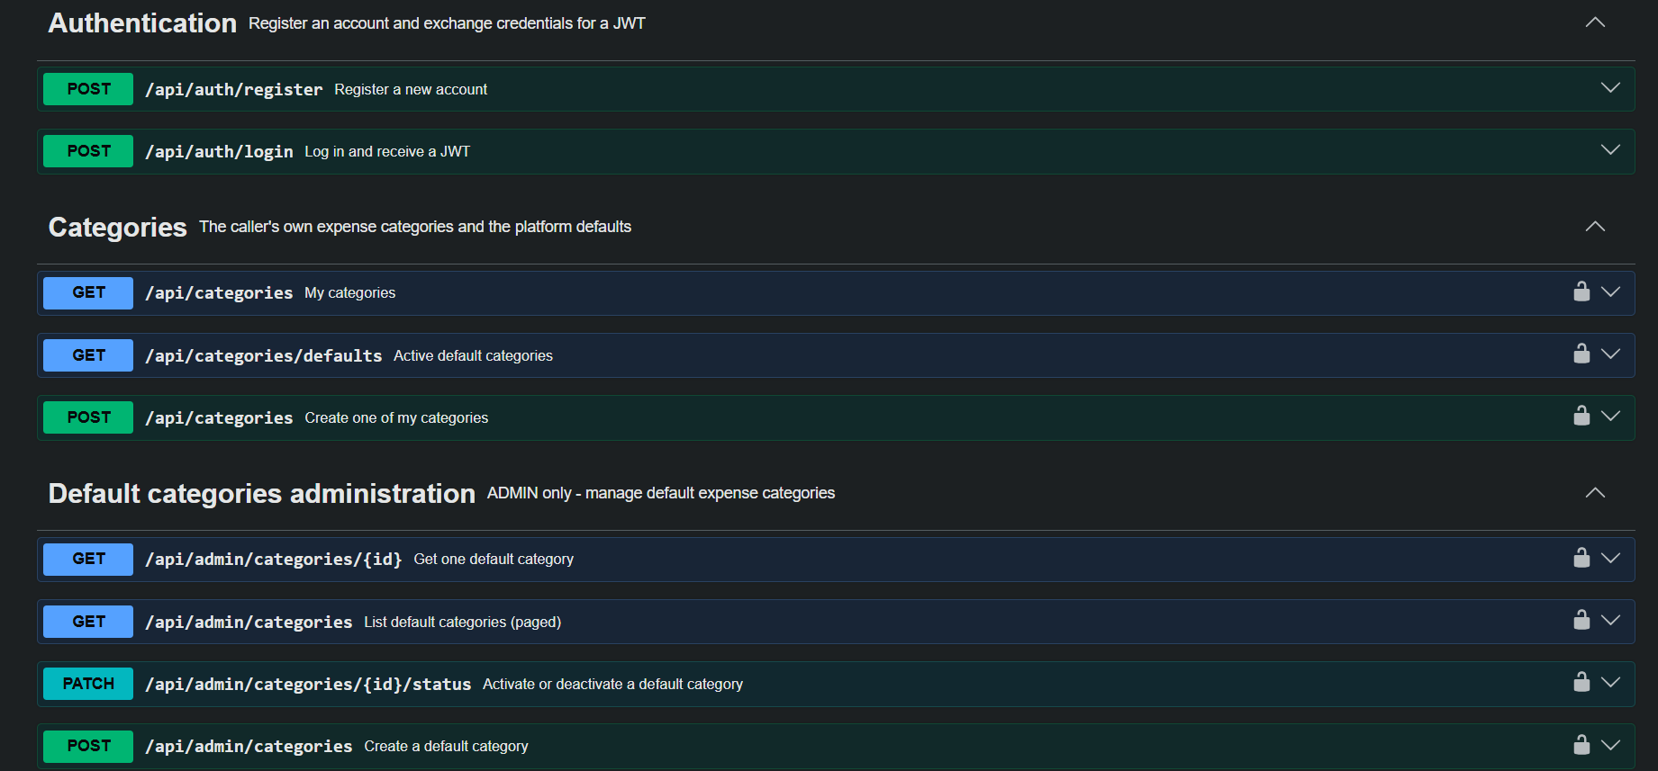
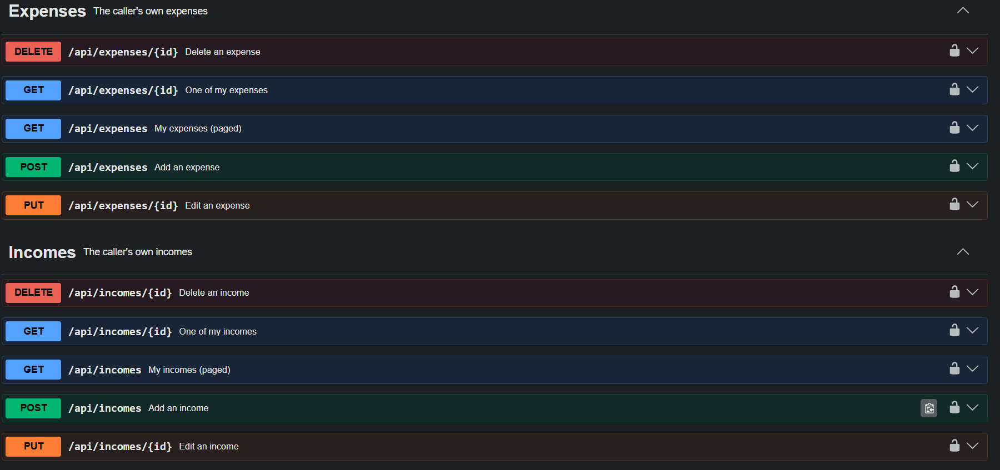
WHAT SITS UNDERNEATH BOTH SPRINTS
Technical Foundation
REST API surface, documented in Swagger
Entity relationship model
Every endpoint the mobile client calls is described and testable from the Swagger UI.
Users, accounts, categories, income and expenses, designed before feature work started.
Backend
Mobile
Testing
Java 17, Spring Boot, PostgreSQL persistence through Hibernate ORM.
React Native and TypeScript, styled from a single tokenised design system.
JUnit controller tests; Testcontainers for integration coverage.
FinFlow | Expense Tracker | Agile Project Management
7
Notes:
Before either sprint could deliver a story, we needed a foundation, and most of that came out of Sprint 0.
On the left is our entity relationship model. It was designed up front because every story in both sprints sits on it: users and their account state, the category tables, and the income and expense records.
On the right are three screenshots of our live Swagger documentation. Having the API described before the screens were built meant the mobile side and the backend side could work in parallel instead of blocking each other, and it gave us a contract to test against.
The stack: Java and Spring Boot with PostgreSQL behind Hibernate on the backend, React Native with TypeScript on the client, and JUnit plus Testcontainers for tests.

Slide 8
SPRINT 1 | WEEKS 1 TO 3
Sprint 1: Account, Session & Admin Foundation
Sprint Goal: a user can create an account and securely access the application, and the platform can be administered separately from user accounts.
Account & session
Administration
The hard rule
- US01 Create a personal account
- US02 Log in with credentials
- US03 Log out securely
- US04 Secure session handling
- US05 View and edit profile
- US06 Reset a forgotten password
- US07 Separate admin authentication
- US08 Manage user account status
- US09 Manage default categories
- US10 Monitor platform health and errors
- US11 An administrator must be technically prevented from reaching any user's income, expenses, budgets, savings, debt or reports.
-
- Enforced at the access control layer of the API, not merely hidden in the interface.
3 weeks
11
P0 and P1
6 + 5
sprint length
user stories US01 to US11
priority mix
account stories + admin stories
FinFlow | Expense Tracker | Agile Project Management
8
Notes:
Sprint 1 ran the first three weeks and its theme was identity: proving who a user is, and proving what an administrator is not allowed to do.
The Sprint Goal was that a user can create an account and securely access the application, while the platform can be administered separately from user accounts.
It carried eleven stories. On the left, the account and session work - creating an account, logging in and out, keeping the session secure, editing a profile and recovering a forgotten password. In the middle, the administration stories - a separate admin login, managing user account status, managing the default expense categories that new users start with, and monitoring platform health.
The story on the right is the one I would single out. US11 is not a feature, it is a constraint: an administrator must be technically prevented from reaching any user's financial data. We treated it as an architectural requirement from the first day of the sprint, because a privacy rule that only exists in the user interface is not a privacy rule.

Slide 9
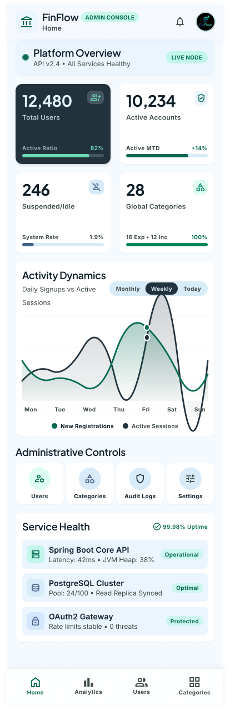
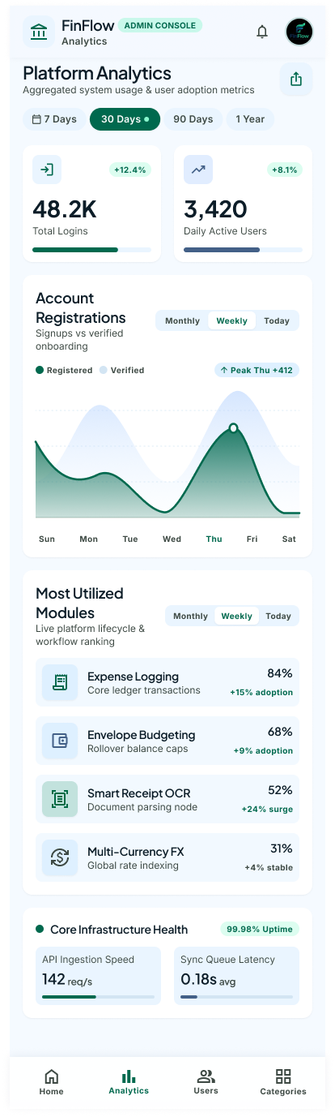
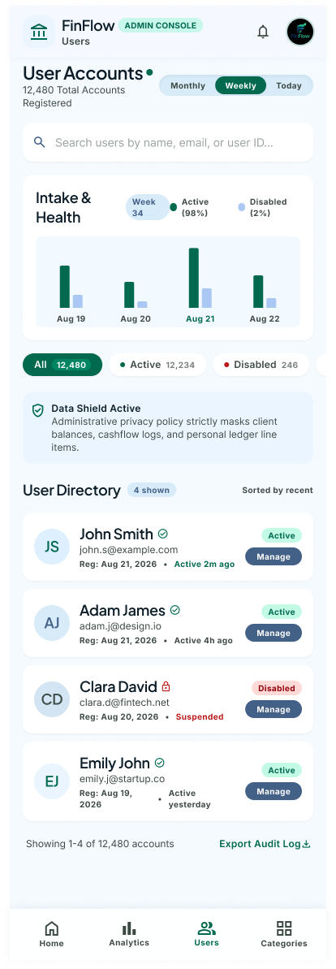
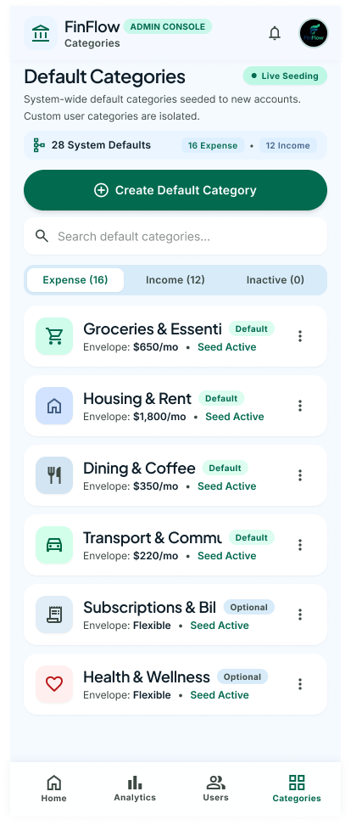
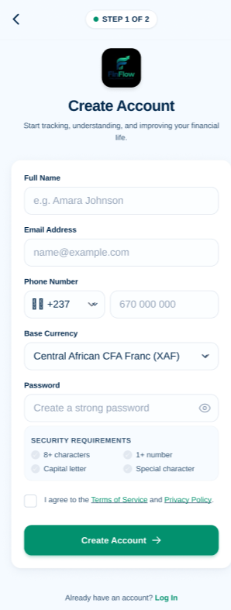
SPRINT 1 | THE SCREENS
Admin Console & Account Creation
Sign-up and secure account creation
- Required-field validation with a live password checklist, so a user cannot submit an account that will fail to be created.
- Registration links straight into the backend: a created account can immediately proceed to log in.
- An existing identifier such as an email or phone number is rejected rather than silently duplicated.
- The sign-up flow and the admin console are visually distinct, because they are two different entry points into two different permission levels.
Admin Home
Admin Analytics
Admin Users
Admin Categories
Platform status, live health and error counts, with no route into user finances.
Technical and platform-level metrics only.
Account status management: activate, suspend, review.
The default category set new accounts are seeded from.
Security measures carried by this sprint: hashed credentials, token expiry and invalidation on logout, and admin role separation enforced at the API layer rather than in the UI.
FinFlow | Expense Tracker | Agile Project Management
9
Notes:
These are the Sprint 1 screens, taken from our Figma file, and they are all on the administrative and account side of the product.
Across the top are the four admin console screens: Admin Home with live platform status and error counts, Admin Analytics, Admin Users for account status management, and Admin Categories where the default category set is maintained.
Notice what is absent. There is no screen, and no route, that lets an administrator look at a person's income, expenses or budget. That is US11 made visible in the design rather than only asserted in a document.
On the right is the sign-up screen. Validation happens before submission - the password checklist is live, and a duplicate email or phone number is refused. That maps directly onto the acceptance criteria for US01.

Slide 10
SPRINT 2 | WEEKS 4 TO 6
Sprint 2: Standalone Expense & Income Tracking
Sprint Goal: a user can track income and expenses from day one, with no budget required first. The product becomes genuinely usable at the end of this sprint.
Income | US12 to US16
Categories | US17 to US19
Expenses | US20 to US26
- US12 Add an income record: amount, source, date
- US13 View income records
- US14 Edit an income record
- US15 Delete an incorrect income entry
- US16 Calculate total income for the period
- US17 Create an expense category
- US18 Edit a category
- US19 Delete an unused category
-
- Categories are created without a budget existing, and new accounts are seeded with a sensible default set.
- US20 Record an expense manually
- US21 View expense history
- US22 View expense details
- US23 Edit an expense
- US24 Delete an expense
- US25 Filter by category and date
- US26 Search expenses
3 weeks
15
15 of 15
0
sprint length
user stories US12 to US26
tracking stories
budgets required to use it
US20 records an expense whether or not a budget exists, and never blocks it because of budget status. US17 creates a category with no budget present.
FinFlow | Expense Tracker | Agile Project Management
10
Notes:
Sprint 2 covered the second three weeks and is the sprint where the product became actually usable.
The Sprint Goal was that a user can track income and expenses from day one with no budget required first. We deliberately wrote fifteen stories with zero dependency on budgeting, because that is the corrected product principle in code rather than in prose.
Three families of stories. Income, US12 to US16: recording an income with an amount, source and date, then viewing, editing, deleting and totalling it. Categories, US17 to US19: creating a category, editing it, deleting an unused one, with new accounts seeded from the default set the admin maintains. And expenses, US20 to US26: recording an expense manually, then the whole history journey - viewing, opening details, editing, deleting, filtering by category and date, and searching for a specific transaction.
The zero on the right-hand stat is the point of the sprint. A user could complete every one of these fifteen stories without ever creating a budget.

Slide 11
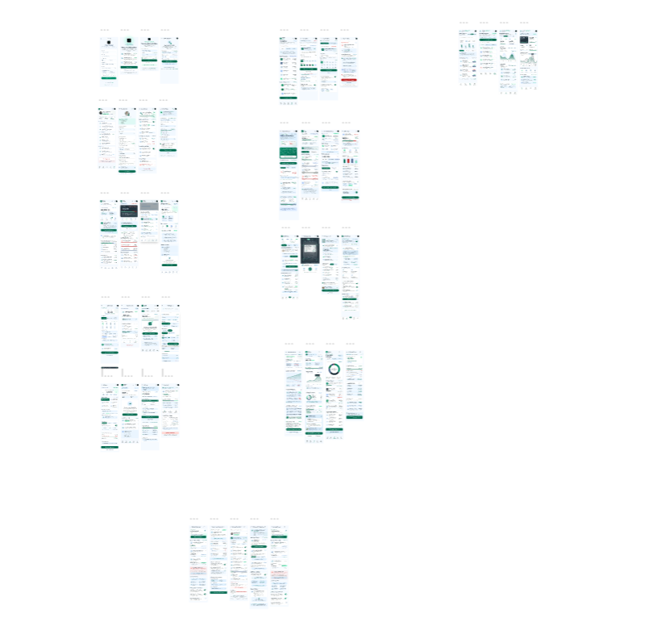
SPRINT 2 | THE SCREENS
Tracking Screens & API
Expense and income endpoints in Swagger
Wired flows across both sprints
The mobile tracking screens are built against these documented, testable endpoints.
Technical work that sat behind the stories
Default categories pre-seeded on account creation, and expense and income CRUD endpoints wired to their screens.
FinFlow | Expense Tracker | Agile Project Management
11
Notes:
This slide pairs the tracking screens with the API they were built against.
On the left is our general Figma design file, which holds the wired flows for the tracking journey: recording an expense, browsing the history, filtering, and the income screens alongside them.
On the right, the same Swagger documentation as before, now showing the income, expense and category endpoints that Sprint 2's screens consume. Building the screens against a documented contract is what let us see the endpoints rendered correctly in the API explorer before the mobile work was finished.
At the bottom, the technical work behind the stories that never appears as a card the user sees: default categories seeded onto every new account, and the CRUD endpoints that back the tracking screens.

Slide 12
WHERE BOTH SPRINTS LANDED
Sprint Outcomes
Sprint 1 | closed
Sprint 2 | delivered
- US01 to US11 closed, all eleven stories.
- Account creation, login, logout and secure sessions.
- Profile management and password reset.
- Separate admin authentication.
- User account status and default category management.
- Platform health and error monitoring.
- US11: no admin route to user financial data.
- US17 closed: users create their own expense categories.
- Default categories seeded onto every new account.
- Income and expense CRUD endpoints delivered.
- Expense and income screens linked to the API.
- Admin dashboard and sign-up flow linked end to end.
Sprint 2 | in progress
Carried into Sprint 3
- US12 to US16 income management is in progress.
- US18 to US26 on the expense history journey are in progress.
- Filtering, searching, editing and deleting expenses are next.
- These carry into Sprint 3 as the first commitment.
- Close out the remaining Sprint 2 tracking stories.
- Then open the optional budgeting layer:
- US27 to US33, budgeting as a goal layer.
- A financial period of at least one week.
- Overall budget, category allocations and validation.
Shown honestly: Sprint 1 closed in full, and Sprint 2 delivered its category and API foundation with the remaining tracking stories still open.
FinFlow | Expense Tracker | Agile Project Management
12
Notes:
Let us be straight about where the work actually stands, because a sprint review is worth nothing if it overstates.
Sprint 1 closed in full. All eleven stories were done: account creation, login, logout, secure sessions, profile management, password reset, separate admin authentication, user account status management, default category management and platform health monitoring. US11, the privacy constraint, was honoured by never exposing a route from the admin area to user financial data.
Sprint 2, the second three weeks, delivered its foundation. US17 landed - users can create their own expense categories - and the technical work went in behind it: default categories seeded onto every new account, and the income and expense CRUD endpoints wired through to the screens. The admin dashboard and the sign-up flow are now linked end to end.
What remains open is the rest of the expense and income journey: US12 to US16 on income management, and US18 to US26 on the expense history. That is the honest picture, and those stories are the first commitment we take into Sprint 3.

Slide 13
VERIFIABLE IN THE REPOSITORY
Evidence from Our Own Tooling
29
5
19 Sep - 9 Oct
29
commits across the repository
pull requests merged to develop
from first commit to latest merge
Java source files in the backend
Work merged into develop, in order
Also in the repository
US09 add admin management of default expense categories
- 6 controller test classes covering admin categories, user category provisioning, expenses, income and monitoring
- Swagger configuration documenting every public endpoint
- Seed data provisioning default categories and user accounts
- Global exception handling with a consistent error shape
- Architecture documents, UML diagrams and the ER model
✓
US10 add admin platform health and error log monitoring
✓
S2-TECH-1 give new accounts their own copy of the default categories
✓
S2-TECH-2 expense and income CRUD endpoints and screens
✓
US17 let users create their own expense categories
✓
FEATURE login and user type redirection
✓
FEATURE sign-up page linked to the corresponding backend
✓
Every item above can be checked directly in the shared repository: the same branches, pull requests and tests the workflow on slide 5 describes.
FinFlow | Expense Tracker | Agile Project Management
13
Notes:
None of this needs to be taken on trust, so here is where to check it.
The repository holds twenty-nine commits and five pull requests merged into develop. The most recent five got there through the exact branch-and-review flow we described: US09 for default categories, US10 for platform health, the two Sprint 2 technical branches for seeded categories and the CRUD endpoints, and US17 for user-created categories.
On the right is the supporting evidence: six controller test classes covering admin categories, user category provisioning, expenses, income and monitoring, plus Swagger configuration, seed data and consistent exception handling.
One thing I want to flag honestly: writing the backlog out as one GitHub Issue per story is not finished. That is the one part of the plan that is more intention than execution today, and it is what we will close out next.

Slide 14
THE BAR WE HELD OURSELVES TO
Definition of Done
A story was only counted as done when every one of these held. It is what let us claim Sprint 1 as closed rather than nearly closed.
1
2
3
4
Implemented as written
Acceptance criteria pass
Validation and error handling
Tests pass
The functionality exists and matches the story, with no half-built screens.
Every Given / When / Then criterion is verified, not assumed.
Required fields, invalid values and failures are handled with a clear message.
Relevant unit, integration and acceptance tests are green before review.
5
6
7
Reviewed by someone else
No critical defect
Product Owner accepts
At least one other developer reviews the pull request before it merges.
Nothing known is blocking normal use of the feature.
The PO checks the result against the acceptance criteria and accepts or rejects it.
FinFlow | Expense Tracker | Agile Project Management
14
Notes:
Two slides to go, and this one is about how we decided whether work was finished.
Our Definition of Done had seven conditions, and a story had to satisfy all of them. It had to be implemented as written, with every acceptance criterion verified. Validation and error handling had to be present, tests had to be green, and another developer had to review the pull request before it merged. Nothing knowingly broken could be left in, and finally the Product Owner checked the result against the criteria and accepted it.
The reason this matters to a review is that it is why we can say Sprint 1 closed in full. We were not counting stories that were nearly there. And it is also why Sprint 2 is reported as partly delivered rather than complete - the same bar applies to us when the news is less good.

Slide 15
WHAT HAPPENS NEXT
Next Steps & Retrospective
Sprint 3 opens the optional budgeting layer, built on the tracking foundation that already works.
Close out Sprint 2
Sprint 3: budgeting as a goal layer
- US12 to US16 and US18 to US26: the remaining income and expense tracking stories are the first commitment of Sprint 3.
- US27 to US33. A user-defined financial period of at least one week, an overall budget, category allocations, validation that warns without blocking, and the edit window that locks the budget.
RETROSPECTIVE | what we would keep and what we would change
Keep
Change
Watch
- The ten-minute stand-up at 10:00 every school day. Short, fixed and never allowed to expand.
- Branch off develop and review before merge. It kept a shared repository clean with five people in it.
- Convert the sprint backlog into one GitHub Issue per story, so every branch and pull request traces to a story automatically.
- Report story status on the Trello board daily rather than at the end of the sprint, so the board never drifts from reality.
- Sprint 4 combines receipt capture and mobile money parsing, two different technical problems in one sprint.
- Sprint 7, the AI assistant, is the sprint to trim first if the calendar tightens.
FinFlow | Expense Tracker | Agile Project Management
15
Notes:
To close, the immediate plan and what the two sprints taught us.
Sprint 3 has two commitments. First, close out the remaining Sprint 2 tracking stories so the tracking layer is complete. Second, and only then, open the budgeting layer as a goal rather than a gate: US27 to US33, covering a financial period of at least one week that the user defines, an overall budget, allocations to categories, validation that warns without blocking, and the edit window that locks the budget after the first six percent of the period or a small number of edits.
The retrospective is on the bottom row. We would keep the ten-minute stand-up exactly as it was - it was short, fixed, and never grew into a design meeting - and we would keep the rule that nothing reaches develop without a review.
We would change two things. The backlog needs to become one GitHub Issue per story so traceability is automatic, and we need to move cards on the Trello board daily rather than letting the board drift from what is actually merged.
And we are watching two risks: Sprint 4 bundles receipt OCR and mobile money parsing into one sprint, and the AI assistant in Sprint 7 is the first thing we would drop if the calendar tightens.
Thank you - we are happy to take questions.

Slide 16
THANK YOU
Questions & Discussion
Two three-week sprints, a daily stand-up every school day at 10:00, and a Trello and GitHub workflow that got real work merged into develop.
Sprint 1 closed in full; Sprint 2 delivered the tracking foundation and continues into Sprint 3.
Notes:
Thank you. To summarise in two sentences: we completed two three-week sprints with a ten-minute stand-up every school day at ten o'clock, and we ran the work through a Trello board and a GitHub repository where nothing reached develop without a review.
Sprint 1 closed in full on the account, session and admin foundation. Sprint 2 delivered the standalone tracking foundation - user-created categories, seeded defaults and the income and expense API wired to its screens - with the remaining expense and income stories continuing into Sprint 3.
Happy to take questions on the workflow, the stories, or the decisions behind them.

