Slide 1
Phoenix Park Main Findings
Student number: C24383676
Name: Allen Lapitan
Module: STAT2012 Statistics

Slide 2
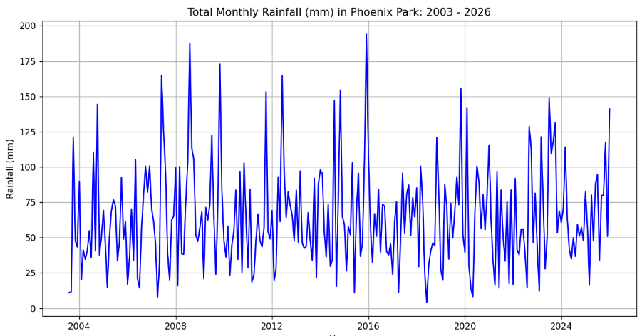
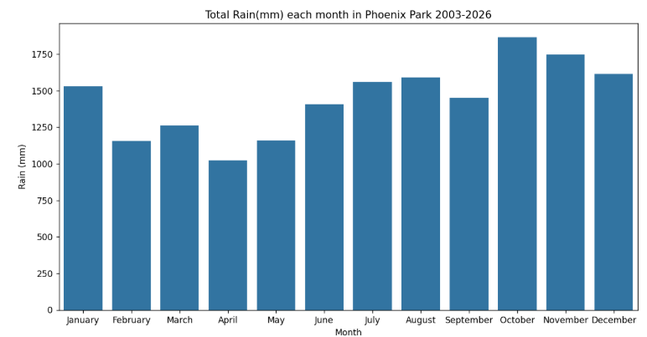
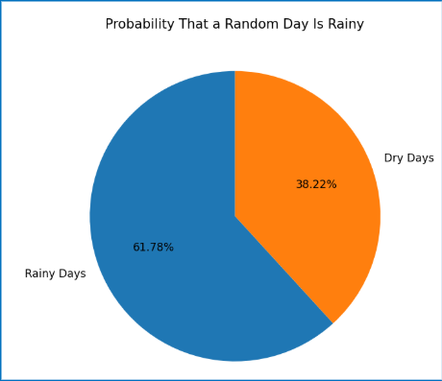
Precipitation
Through my analysis of the Phoenix Park dataset, I found that:
October, November, and December were the months with the highest amount of precipitation in Phoenix Park.
The driest months were April, May, and February.
The chances of it raining on any given day is 61.78%.

Slide 3
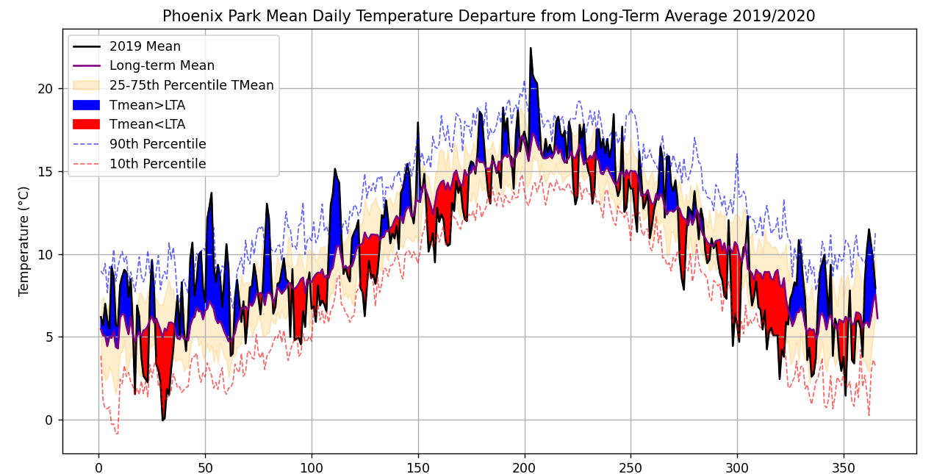
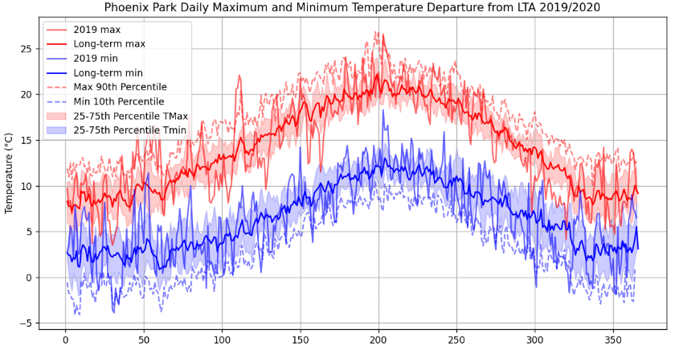
Temperature
Through my analysis of the dataset:
During mid-year around August, it is hottest and by December and January it is coldest.
The mean, maximum and minimum temperatures rarely exceed the 90th or 10th percentile.
When the mean temperatures exceed the 90th or 10th percentiles it is by a large margin.

Slide 4
Conclusion
The analysis of the Phoenix Park dataset displays clear patterns in rain and temperature. My findings paint a picture of Phoenix Park being a wet and cold place during winter but damp and warm during summer. I think that my findings show that temperature and rain at phoenix park are overall predictable, due to the temperature rarely being above or below the 90 or 10th percentile.

