Slide 1
Unified representation of tractography and diffusion-weighted mri data using sparse multidimensional arrays cesar caiafa – olaf sporns – Andrew saykin – franco pestilli
Lê Nữ Tố Khuê – 15110066
Đỗ Văn Long – 15110072

Slide 2
Content
Introduction
Linear methods based on convex optimization
The connectome encoding method
The approximated tensor decomposed model
Experimental results
Demo

Slide 3
Content
Introduction
Linear methods based on convex optimization
The connectome encoding method
The approximated tensor decomposed model
Experimental results
Conclusions

Slide 4
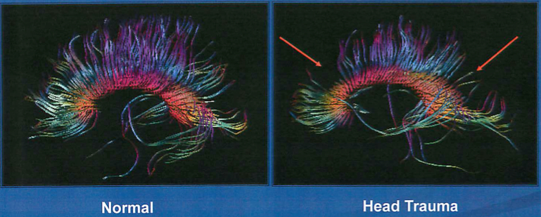
Introduction
Diffusion-weighted MRI (dMRI) allows estimating structural brain connections in-vivo by measuring the diffusion of water molecules at different spatial directions.

Slide 5
Introduction
“In neuroscience, tractography is a 3D modeling technique used to visually represent nerve tracts using data collected by dMRI.”[1]
[1]:https://en.wikipedia.org/wiki/Tractography

Slide 6
Introduction
Tractography and dMRI are the primary methods for mapping structural brain networks and white matter tissue properties in living human brains.
Connectome evaluation:
In recent years, a large variety of tractography algorithms have been proposed and tested.
But, difficult to trust a single algorithm for all applications, and calls for routine statistical evaluation methods of brain connectomes.
Linear methods based on convex optimization. [Part 2]
And, the connectome encoding method in multidimensional arrays.

Slide 7
Content
Introduction
Linear methods based on convex optimization
The connectome encoding method
The approximated tensor decomposed model
Experimental results
Conclusions

Slide 8
2. Linear methods based on convex optimization
The Linear Fascicle Evaluation (LiFE) method:
Computed the statistical error in predicting the measured.
Input: the set of fascicles generated by using tractography methods.
Output: the subset of fascicles that best predict the measured dMRI signal.

Slide 9
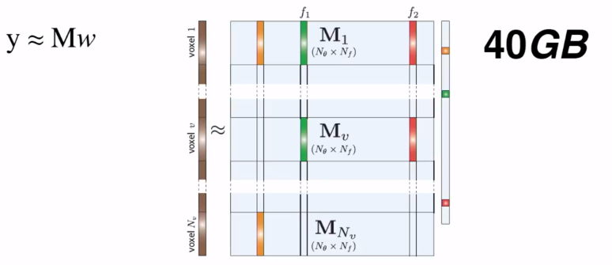
2. Linear methods based on convex optimization
** The size of matrix M very large (tens of gigabytes).
➔ The ENCODE method: to implement a sparse tensor decomposition of matrix M.

Slide 10
Content
Introduction
Linear methods based on convex optimization
The connectome encoding method
The approximated tensor decomposed model
Experimental results
Conclusions

Slide 11
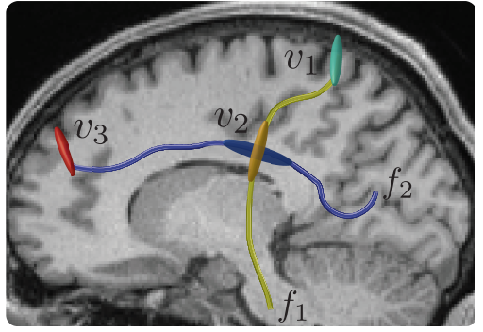
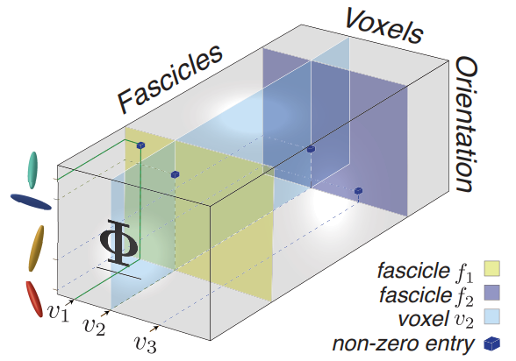
3. Linear methods based on convex optimization
The ENCODE method: mapping structural connectomes from natural brain space to tensor space.

Slide 12
Content
Introduction
Linear methods based on convex optimization
The connectome encoding method
The approximated tensor decomposed model
Experimental results
Conclusions

Slide 13
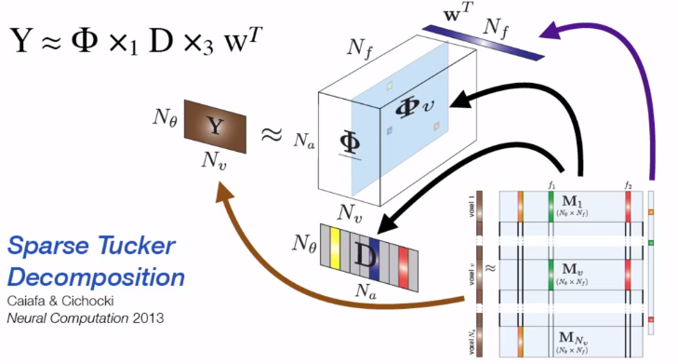


4. The approximated tensor decomposed model
tensor Sparse Decomposed LiFE model (${LiFE}_{SD}$)
The ${LiFE}_{SD}$ approximated tensor model:

Slide 14
Content
Introduction
Linear methods based on convex optimization
The connectome encoding method
The approximated tensor decomposed model
Experimental results
Conclusions

Slide 15
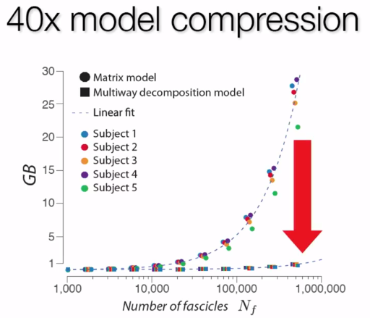
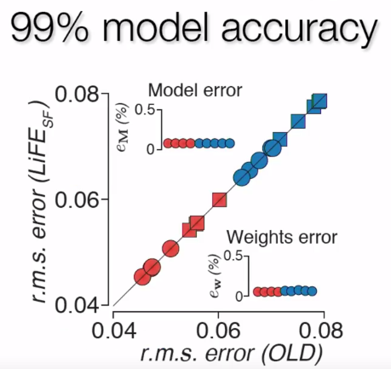
5. Experimental results

Slide 16
Content
Introduction
Linear methods based on convex optimization
The connectome encoding method
The approximated tensor decomposed model
Experimental results
Conclusions

Slide 17
5. conclustions
Multidimensional tensors and decomposition methods have been used to help investigators make sense of large multimodal datasets.
A few applications in neuroscience, such as performing multi-subject, clustering and electroencephalography analyses.
Decomposition methods have been used to find compact representations of complex data by estimating the combination of a limited number of common meaningful factors that best fit the data.

