Slide 1
GitHub
Agentic Workflows
Repository automation powered by AI agents
with enterprise-grade security guardrails
Innovate 2026

Slide 2
The Shift: From Deterministic to Judgment
Traditional GitHub Actions
Agentic Workflows
Deterministic: if X → do Y
Every scenario must be pre-coded
Complex YAML configurations
Rigid — can't handle nuance
Bug triage, doc updates, arch reviews
still need humans
"Productive Ambiguity"
AI agents that exercise judgment
Write in plain markdown
Flexible — adapts to context
Inherits Actions ecosystem:
logs, secrets, permissions
→
GitHub Next + Microsoft Research — "Continuous AI" vision
Innovate 2026 · ADO/GitHub with Microsoft
2 / 11

Slide 3
How It Works: Markdown → Agent
1
Write Markdown
2
Compile
3
Agent Runs
---on: pull_request:permissions: read-allsafe-outputs: add-comment:---# Big-O AuditorAnalyze code foralgorithmic complexity.Suggest optimizations.
Run:
On PR / Issue / Schedule:✓ Reads code & context✓ Exercises judgment✓ Suggests improvements✓ Posts PR commentAll in GitHub ActionsTeam-visible logs & audit
$ gh aw compile
→
→
Generates hardened.lock.yml workflowSanitized, auditable,minimal permissions
Innovate 2026 · ADO/GitHub with Microsoft
3 / 11

Slide 4
Security: 5-Layer Defense-in-Depth
Intelligence of an agent + guardrails of CI/CD
1
Read-Only Tokens
Agent gets read-only GitHub token.
Cannot push, create PRs, or delete.
2
Zero Secrets
Write tokens exist only in isolated
post-agent jobs. Nothing to steal.
3
Container + Firewall
Isolated container. AWF proxy enforces
domain allowlist. Non-allowed = dropped.
4
Safe Outputs
Agent produces structured artifact.
Gated write job applies only permitted ops.
5
Threat Detection
AI-powered scan: prompt injection,
leaked creds, malicious code. Fail = halt.
Event → Agent (read-only) → Artifact → Threat Scan → Write Job (scoped) → GitHub API
CBRE Innovate 2026 · ADO/GitHub with Microsoft
4 / 11

Slide 5
Demo: Big-O Auditor
An agent that reviews PRs for algorithmic complexity — written in natural language
1
2
3
4
5
Create
agent.md
Natural
Language
gh aw
compile
Open a
Pull Request
Agent
Reviews
›
›
›
›
YAML header:
permissions, triggers,
AI provider (Copilot)
"Analyze code for
Big-O complexity.
Suggest optimization."
Generates hardened
.lock.yml workflow
automatically
Push O(n²) code.
Agent activates
on PR trigger.
Finds inefficiency.
Suggests O(n) fix.
Shows perf impact.
~3 minutes to execute · Results posted as PR comment with formatted table
Innovate 2026 · ADO/GitHub with Microsoft
5 / 11

Slide 6
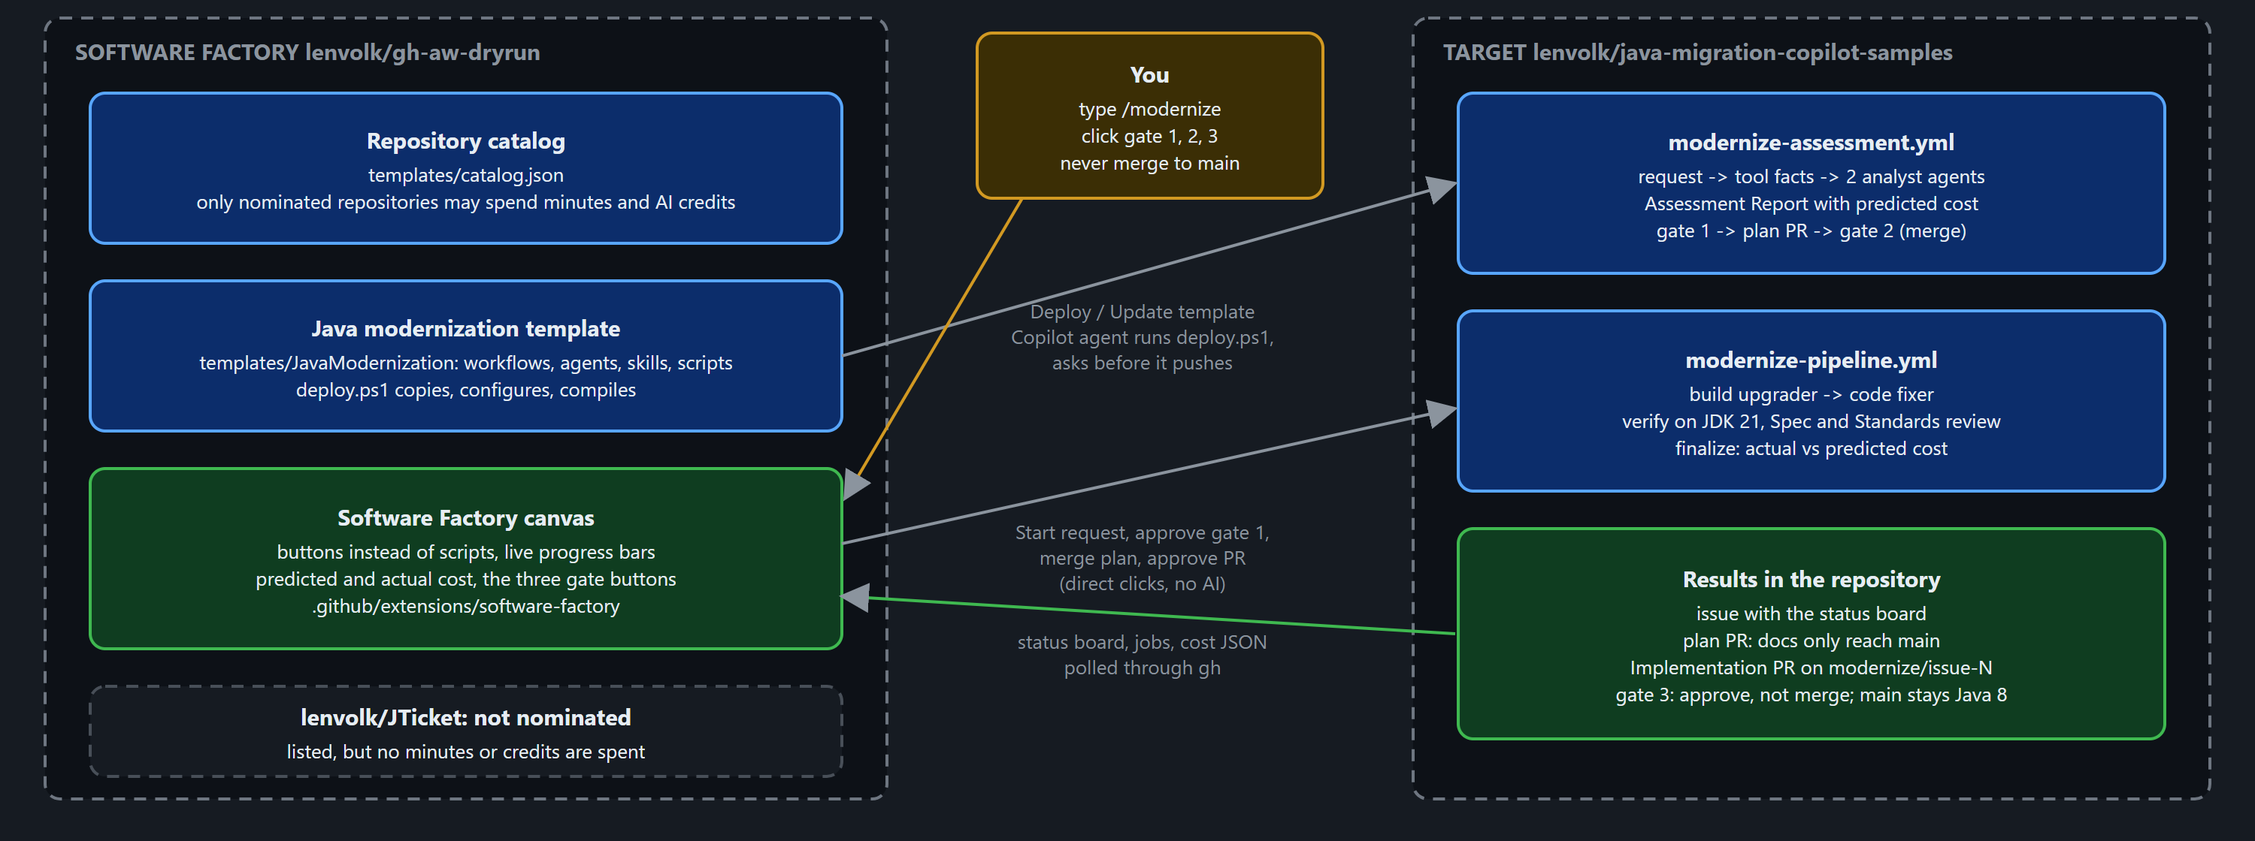
Demo: The Software Factory
Beat 4 — one repository acts as the team and modernizes Java in the repos it nominates
Factory = catalog + template + canvas · Target: Asset Manager, Java 8 / Spring Boot 2.7 → Java 21
Innovate 2026 · ADO/GitHub with Microsoft
6 / 11
Notes:
Beat 4 is standalone; it does not need Beats 1-3.
The factory (lenvolk/gh-aw-dryrun) holds three things: the repository catalog (templates/catalog.json), the Java modernization template (gh-aw agent workflows, orchestrator workflows, custom agents, skills, scripts, deploy.ps1) and the Software Factory canvas in the GitHub Copilot app.
Deploy copies the template into the nominated target (lenvolk/java-migration-copilot-samples). The workflows run there, in its GitHub Actions; the canvas monitors them with live progress bars, like one dashboard over many pipelines.
Only nominated repositories may spend minutes and AI credits: JTicket is listed but not nominated, so it is greyed out.

Slide 7
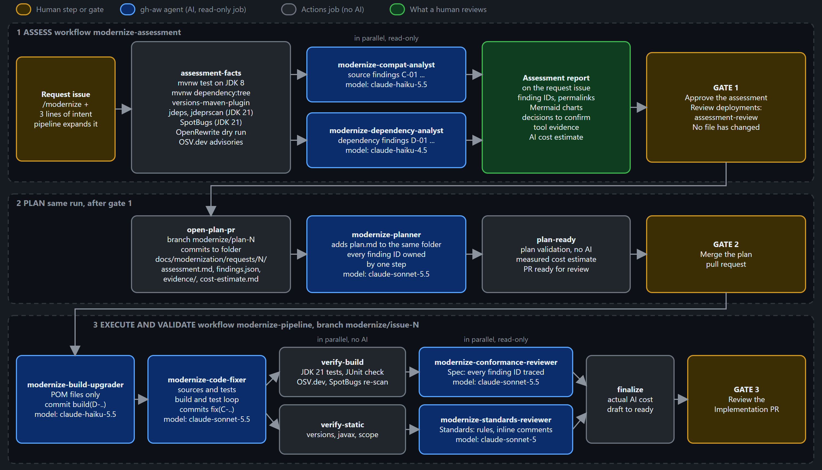
Assess → Plan → Execute → Validate
Tools measure the facts, gh-aw agents do the judgment work, a human approves each step
1
GATE 1
Approve the report
Findings and predicted cost. No file has changed.
2
GATE 2
Merge the plan
Only Markdown and evidence reach main.
3
GATE 3
Approve, don’t merge
Review only; main stays on Java 8.
Innovate 2026 · ADO/GitHub with Microsoft
7 / 11
Notes:
Same order as GitHub Copilot app modernization (assess, plan, execute, validate), built with our own gh-aw agents and standard Java tools. It does not run that product and is not a supported product feature.
Assess: a /modernize issue starts it. Tools only, no AI: tests on JDK 8, dependency tree, jdeps/jdeprscan, SpotBugs, OpenRewrite dry run, OSV.dev. Two read-only analyst agents turn the facts into findings with stable IDs. Gate 1: a human approves the Assessment Report, including the predicted cost per stage.
Plan: a planner agent writes plan.md in a plan PR; a deterministic check confirms every finding ID is owned by a step. Gate 2: a human merges the plan. Only Markdown and evidence land in main.
Execute and validate: build-upgrader then code-fixer (one writer at a time), verify on JDK 21 (no AI), Spec and Standards reviewers in parallel, finalize posts actual vs predicted cost. Gate 3: a human approves the Implementation PR with a review, without merging, so the demo can repeat.

Slide 8
One Canvas: Buttons, Not Scripts
The Software Factory canvas drives the run and shows live progress and cost
Direct clicks — never through AI
Prompts to the Copilot agent
✓ Save the Copilot token
✓ Start the /modernize request
✓ Approve gate 1, merge the plan (gate 2)
✓ Approve the Implementation PR (gate 3)
› Deploy the template to a nominated repo
› Update the template (asks before it pushes)
› Explain the Assessment Report
› Troubleshoot a failed job
~200
~85 min
Est. → Actual
AI credits per full run
GitHub Actions runner time
cost of every stage
about $2, incl. gh-aw threat detection
free on a public repo; $0.006/min if private
estimated at gate 1, compared before gate 3
A demo built with gh-aw, not a product feature · same lifecycle order as GitHub Copilot app modernization
Innovate 2026 · ADO/GitHub with Microsoft
8 / 11
Notes:
In the canvas, the token and the three gates are direct human clicks that never pass through AI. Deploy, Update template, Explain the report and Troubleshoot send a prompt to the Copilot agent in the session, which does the work in the chat and asks before it pushes anything.
Progress is real: bars count completed jobs and steps from the GitHub Actions API.
Cost: plan for about 200 AI credits (about $2) per full run; threat detection is about 30% of it. Runner time is about 85 minutes, free on a public fork, $0.006 per minute on a private repository. The Assessment Report predicts the cost of every stage before gate 1; finalize posts actual vs predicted before gate 3.
Because the full run takes about an hour, pre-run it before the meeting and replay it with Open an existing request.

Slide 9
What Can Your Teams Build?
18 design patterns · Ready-made examples at github.com/githubnext/agentics
⚡
Issue & PR
Management
📄
Continuous
Documentation
🔍
Code Quality
& Testing
Auto-triage, labeling,
project coordination
Auto-update docs
when code changes
CI failure diagnosis,
test improvements
📊
Metrics &
Analytics
🔄
Continuous
Improvement
🌐
Multi-Repo
Operations
Daily reports, trend
analysis, health monitoring
Daily code simplification
& refactoring
Feature sync across
repositories
Innovate 2026 · ADO/GitHub with Microsoft
9 / 11

Slide 10
Innovate × Agentic Workflows
How gh-aw maps to your hackathon themes
Innovate Theme | Ideas | gh-aw Fit | Example Workflow
Agentic AI & Multi-Agent | 113 | ✅ Direct | Agent per repo task, orchestrated via dispatch
DevOps / SDLC Automation | 35 | ✅ Direct | PR review, test gen, pipeline quality gates
Document Intelligence | 89 | ⚡ Partial | Auto-generate docs from code changes
RAG & Knowledge Retrieval | 59+ | ⚡ Partial | Knowledge-grounded PR review via MCP Gateway
IaC & Cloud Automation | 30 | ✅ Direct | Terraform linting, infra validation on push
gh-aw directly addresses 178+ of CBRE's 500+ innovation ideas
💡 Teams can fork examples from github.com/githubnext/agentics and start building today
Innovate 2026 · ADO/GitHub with Microsoft
10 / 11

Slide 11
Get Started
Wizard to create AW
Gallery
Docs
github.github.com/gh-aw/
Quick Start
github.github.com/gh-aw/setup/quick-start/
Examples
github.com/githubnext/agentics
Blog
github.blog/ai-and-ml/automate-repository-tasks-with-github-agentic-workflows/
Let's discuss follow-up sessions for your other Innovate themes
Agentic AI (113 ideas) · Voice AI (22 ideas) · Document Intelligence (89 ideas)
Thank You

