Slide 1
Large Eddy Simulation of Heat Transfer on Wing surfaces in 3D
Stefan Lengauer
Presentation given at
FH JOANNEUM University of Applied Sciences,
Graz, Austria
16 March 2015

Slide 2
Contents
Project objectives
Basics of Large Eddy Simulation
Heat Transfer
Mesh generation
Simulation setup in Ansys CFX
Results of heat transfer
Comparison LES and RANS equations
References

Slide 3
Basics of Large Eddy Simulation

Slide 4
Mesh Generation

Slide 5
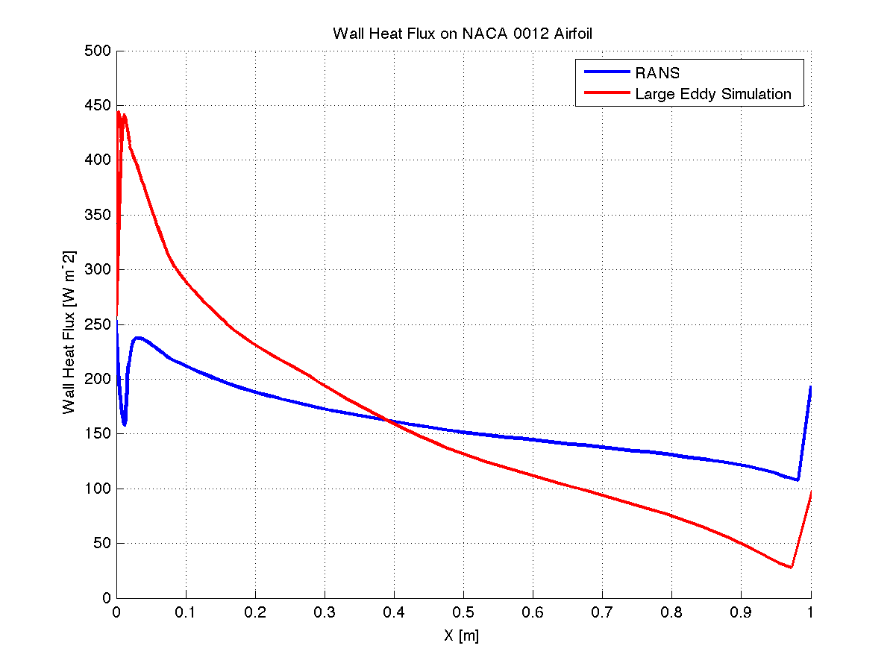
Results of heat transfer

Slide 6
Comparison LES – RANS equations
RANS equations
Large Eddy Simulation
+ 2D mesh
- requires a lot of modeling
- Heat transfer tends to be inaccurate
- 3D mesh
- High demand on resources
+ requires few modeling
+ good heat transfer prediction

Slide 7
References
Versteeg, H.K., and Malalasekera, W., An Introduction to COMPUTATIONAL FLUID DYNAMICS: The Finite Volume Method, 2nd ed., Pearson Education Limited, Harlow, England, 2007.
Fröhlich, J., Large Eddy Simulation turbulenter Strö̈mungen, 1st ed., Teubner Ver- lag, Wiesbaden, 2006.
Cerbe, G., and Wilhelms, G., Technische Thermodynamik: Theoretische Grundlagen und praktische Anwendungen, 15th ed., Carl Hanser Verlag, Mu ̈nchen, 2008
Schwarzer,R,CFD-Modellierung:GrundlagenundAnwendungenbeiStrömungsprozessen, Springer-Verlag, Berlin, Heidelberg, 2013
Ochoa, J.S., and Fueyo, N., “Large Eddy Simulation of the flow past a square cylinder”, Zaragoza, Spain.
Anderson, D., and Tsao, J., “Evaluation and Validation of the Messinger Freezing Fraction,” Ohio Aerospace Institute, Brook Park, Ohio, 2003.

