Slide 1
Large Eddy Simulation of Heat Transfer on Wing surfaces in 3D
Stefan Lengauer
Presentation given at
FH JOANNEUM University of Applied Sciences,
Graz, Austria
16 March 2015

Slide 2
Contents
Project objectives
Basics of turbulence
Basics of Large Eddy Simulation
Mesh generation
Simulation setup in Ansys CFX
Results of heat transfer
Comparison LES and RANS equations
References

Slide 3
Project objectives
Execution of a high-resolution simulation of the heat transfer on a wing surface
Given geometry: NACA 0012 airfoil
Software tool for CFD simulation: Ansys CFX
Comparison of the results with a similar RANS simulation
Evaluation of the applicability of LES simulation

Slide 4
Basics of turbulence
All natural flows turbulent
Three-dimensional, spacial character
Three different approaches
RANS equations
Large Eddy Simulation
DNS (Direct Numerical Simulation)

Slide 5
Basics of Large Eddy Simulation
“Compromise” between RANS equations and DNS
Larger eddies simulated with time dependent simulation
Smaller eddies represented by models

Slide 6
Mesh generation
Two-dimensional mesh provided by Dr. Hassler
For LES extension in third direction necessary
Very fine grid in vicinity of the wall required
Physical dimensions: 7m by 5m by 0.3m
2.2 Million elements

Slide 7
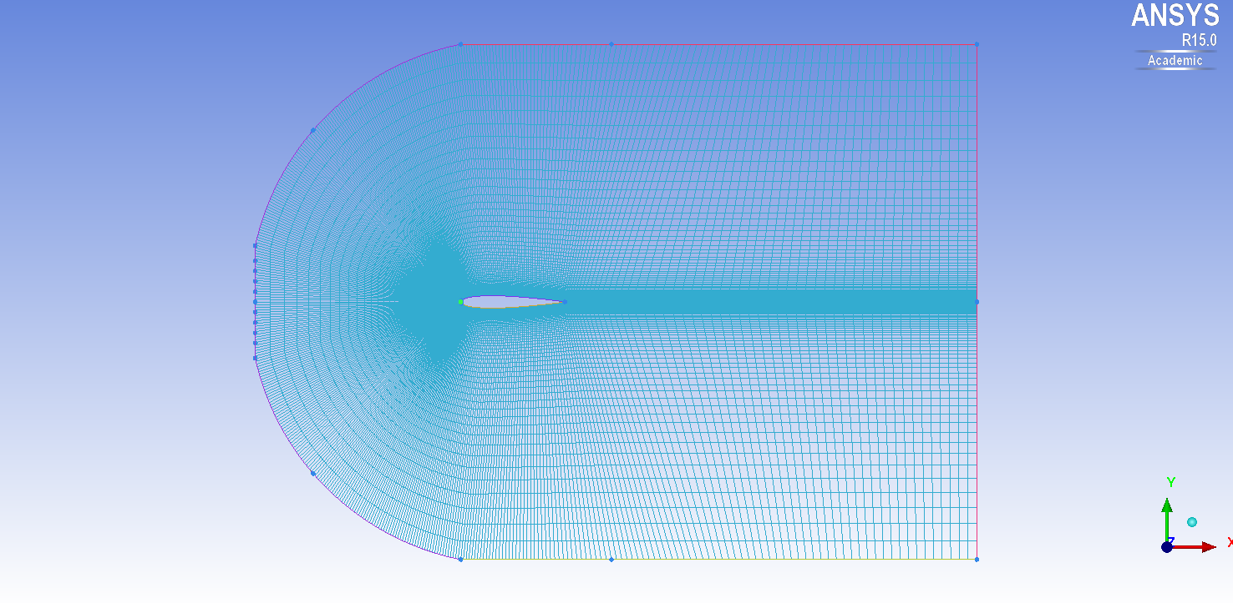
Mesh generation
Figure 1: Initial mesh with the airfoil in the center

Slide 8
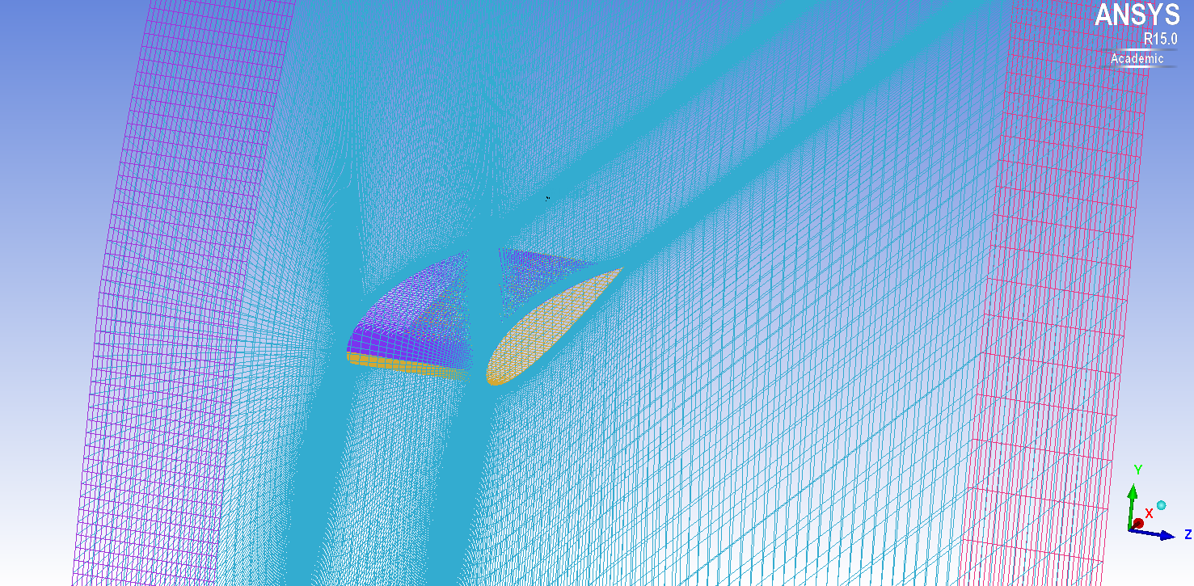
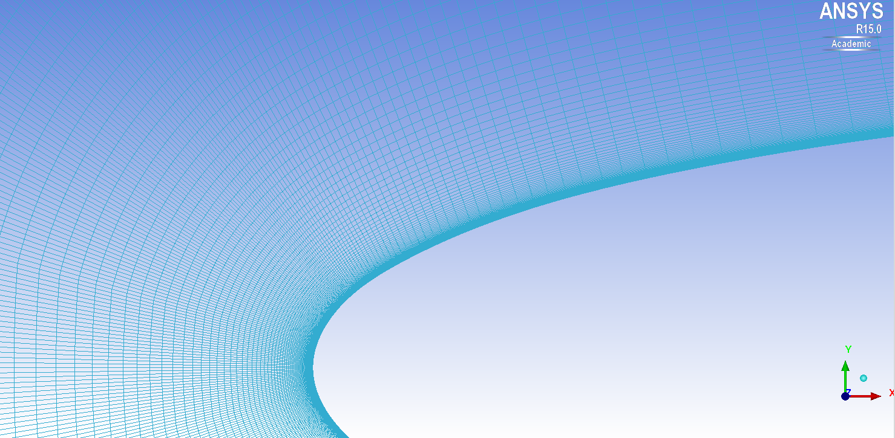
Mesh generation
Figure 2: Isotropic view of the airfoil
Figure 3: Close-up on the airfoil surface

Slide 9
Simulation setup in Ansys CFX
Two simulations
Stationary RANS simulation
Transient LES simulation
Long computation time of the transient simulation
Data export from Ansys CFX-Post

Slide 10
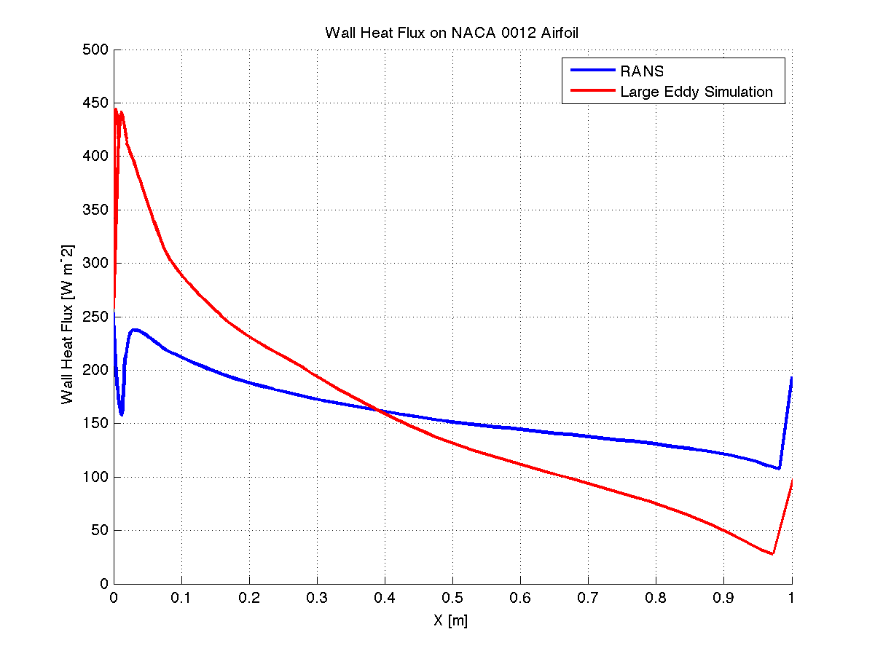
Results of heat transfer
Figure 4: Distribution of the Wall Heat Flux

Slide 11
Comparison LES – RANS equations
RANS equations
Large Eddy Simulation
+ 2D mesh
- Requires a lot of modeling
- Heat transfer tends to be inaccurate
- 3D mesh
- High demand on resources
- Long computation durations
+ Requires few modeling
+ Good heat transfer prediction

Slide 12
References
Versteeg, H.K., and Malalasekera, W., An Introduction to COMPUTATIONAL FLUID DYNAMICS: The Finite Volume Method, 2nd ed., Pearson Education Limited, Harlow, England, 2007.
Fröhlich, J., Large Eddy Simulation turbulenter Strö̈mungen, 1st ed., Teubner Ver- lag, Wiesbaden, 2006.
Cerbe, G., and Wilhelms, G., Technische Thermodynamik: Theoretische Grundlagen und praktische Anwendungen, 15th ed., Carl Hanser Verlag, Mu ̈nchen, 2008
Schwarzer,R,CFD-Modellierung:GrundlagenundAnwendungenbeiStrömungsprozessen, Springer-Verlag, Berlin, Heidelberg, 2013
Ochoa, J.S., and Fueyo, N., “Large Eddy Simulation of the flow past a square cylinder”, Zaragoza, Spain.
Anderson, D., and Tsao, J., “Evaluation and Validation of the Messinger Freezing Fraction,” Ohio Aerospace Institute, Brook Park, Ohio, 2003.

