Slide 1
HKN: Machine Learning Workshop 2
Leo Ling
2022-05-25

Slide 2
What is machine learning?
AI
Due to the success of deep learning and neural network, they have become somewhat interchangeable with AI
AI: Artificial Intelligence
ML: Machine Learning
NN: Neural Networks
DL: Deep Learning
ML
NN
DL
ML
“Learning” algorithms
Performance on some task is improved by leveraging data
Notes:
AI is most general: any machine which can act “intelligently”, this is usually taken to mean a “human-like” intelligence. It’s more of an umbrella term and pretty vague.
Machine learning refers to algorithms that can learn from data (labeled or unlabeled) and act without being explicitly programmed to. For example, recognizing hand writing. We all know how to do it, but almost nobody can explain to someone who’s never seen any written words how to do it. So training a machine to do the same is also very difficult.
One way to think of ML (one part of it) are very advanced function approximators. And our preferred function approximators of choice are neural networks. They are the tool we used that made modeling very complex phenomenon possible. And if we stack many neural networks with multiple layers, we end up with deep learning

Slide 3
The “why” and “when” of ML
ML has come to the forefront of research within the last decade
Why has ML become so important?
Good at handling multidimensional data
Computing resources have improved with Moore’s Law
Powerful GPUs are required for deep learning
Computing capability is cheap- big data
When should we use ML?
Modeling complex phenomenon without well developed models
Large amounts of data are available
Notes:
Multidimensional- Humans are not very good to identifying trends between dozens of seemingly independent things happening at once. Weather prediction might require temperature, pressure, wind data over a long time. It’s hard for us to do this in our heads.

Slide 4
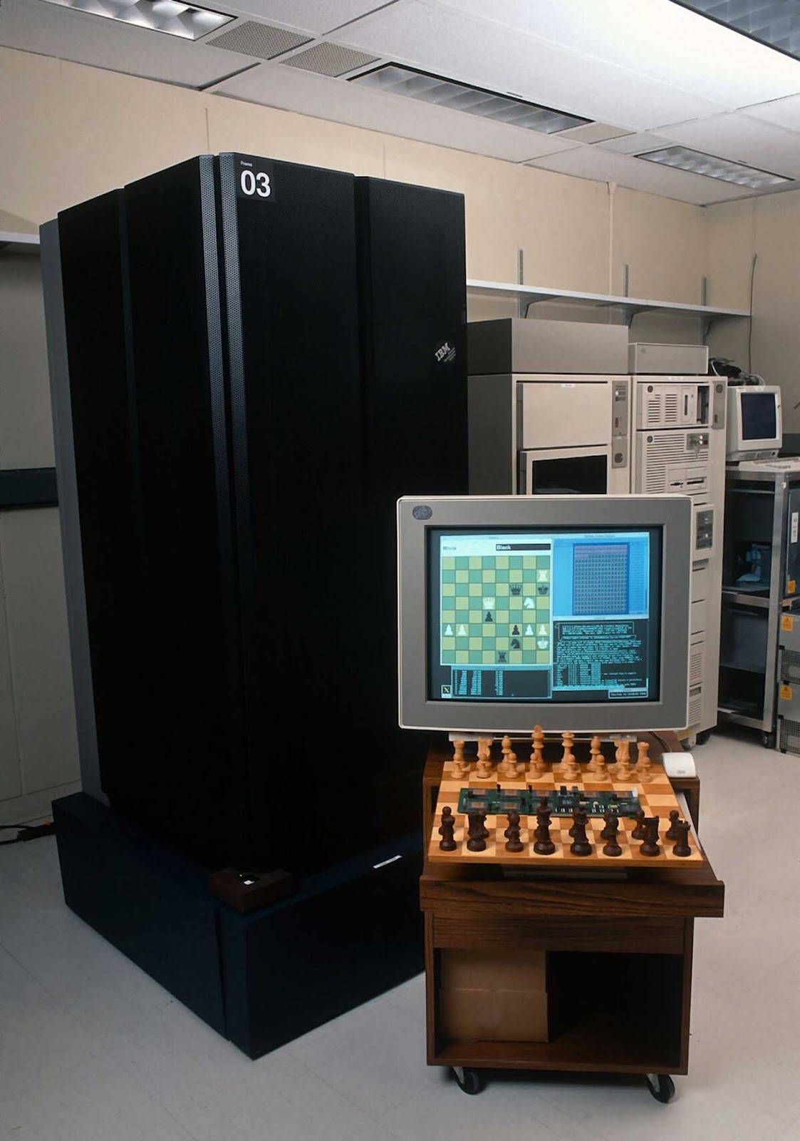
What is ML used for
Computer vision
Autonomous driving
Speech recognition
Stock trading
Recommendation systems
Playing games
AND so much more…

Slide 5
The approaches of ML
Unsupervised Learning
Analyze and cluster unlabeled data
e.g. signal processing, user segmentation, language encoding
Supervised Learning
Learn from labeled dataset to classify or predict outcomes
e.g. image classification, spam filtering, OCR
Reinforcement Learning
Similar to supervised learning, but with a “reward” over time rather than labels. Develops optimal policies or recommendations
e.g. playing games, optimal path finding, robotics

Slide 6
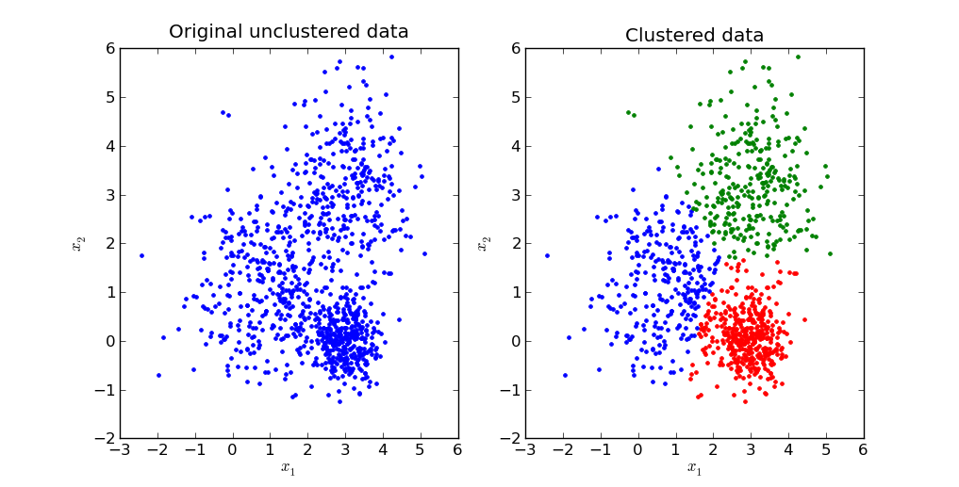
Example of Unsupervised Learning K-Means Algorithm
Problem: Given a set of N points how to divide them into K sets
E.g. If we have noisy signals, how to separate 0 and 1s

Slide 7
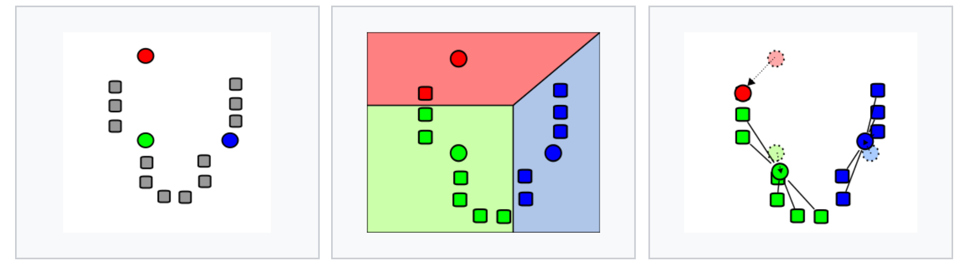
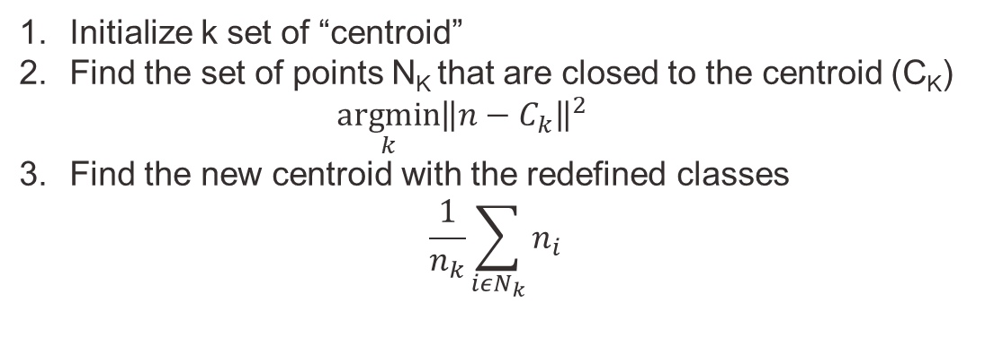
K-Means Algorithm: Psuedocode
Initialize k set of “centroid”
Find the set of points N_{K} that are closed to the centroid (C_{K})
$$\underset{k}{argmin}{{\left\|n−C_{k}\right\|}^{2}}$$
Find the new centroid with the redefined classes
$$\frac{1}{n_{k}}\sum_{iεN_{k}}{n_{i}}$$
Repeat until convergence
Adapted from k-means clustering (Wikipedia)

Slide 8
Extension of Unsupervised Learning
Between supervised and unsupervised learning there is a class called semi-supervised
e.g. medical image with only a diagnosis or noisy labels
Encoders which reduce dimensionality of inputs and are usually fed into other neural networks

Slide 9
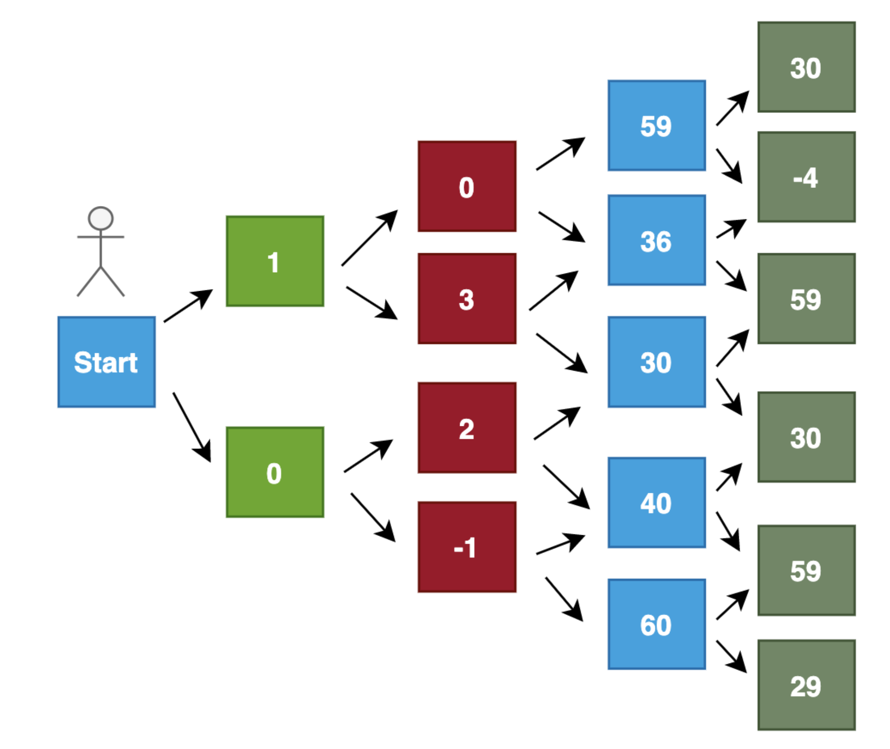
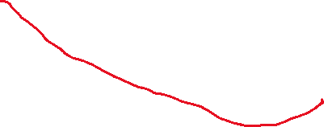
Example of Reinforcement Learning Optimal path finding
Problem: Find the optimal path from left to right of the figure below

Slide 10
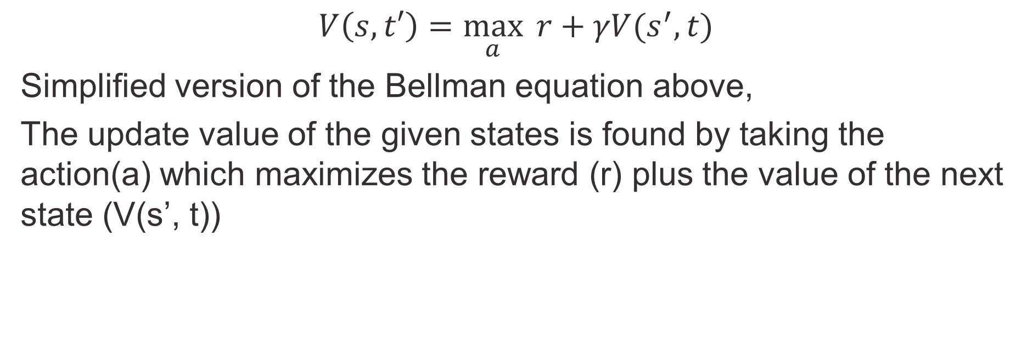
Reinforcement Learning Bellman Equation
$$V\left(s,t′\right)=\max_{a}{ r+γV(s^{′}, t)}$$
Simplified version of the Bellman equation above,
The update value of the given states is found by taking the action(a) which maximizes the reward (r) plus the value of the next state (V(s’, t))

Slide 11
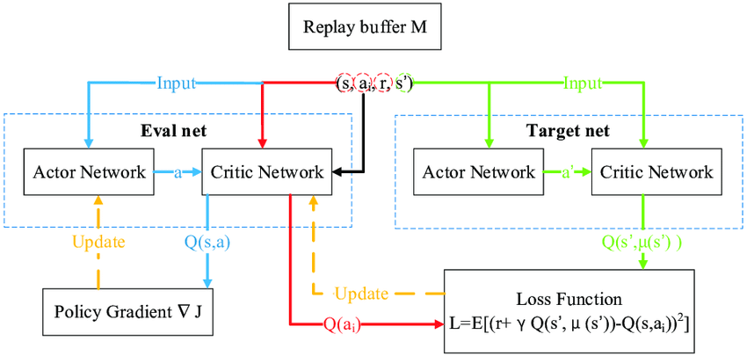
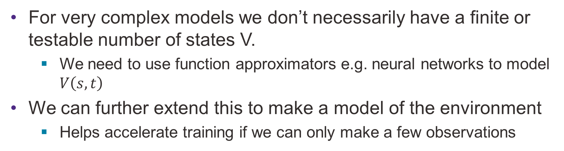
Extension of Reinforcement Learning
For very complex models we don’t necessarily have a finite or testable number of states V.
We need to use function approximators e.g. neural networks to model $V\left(s,t\right)$
We can further extend this to make a model of the environment
Helps accelerate training if we can only make a few observations

Slide 12
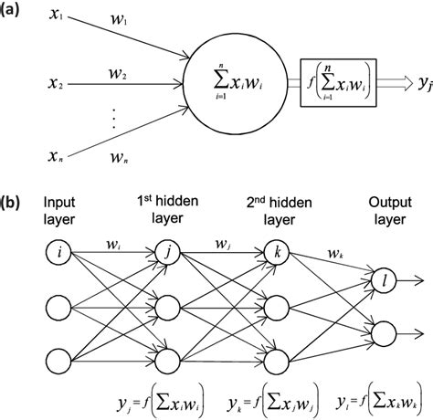
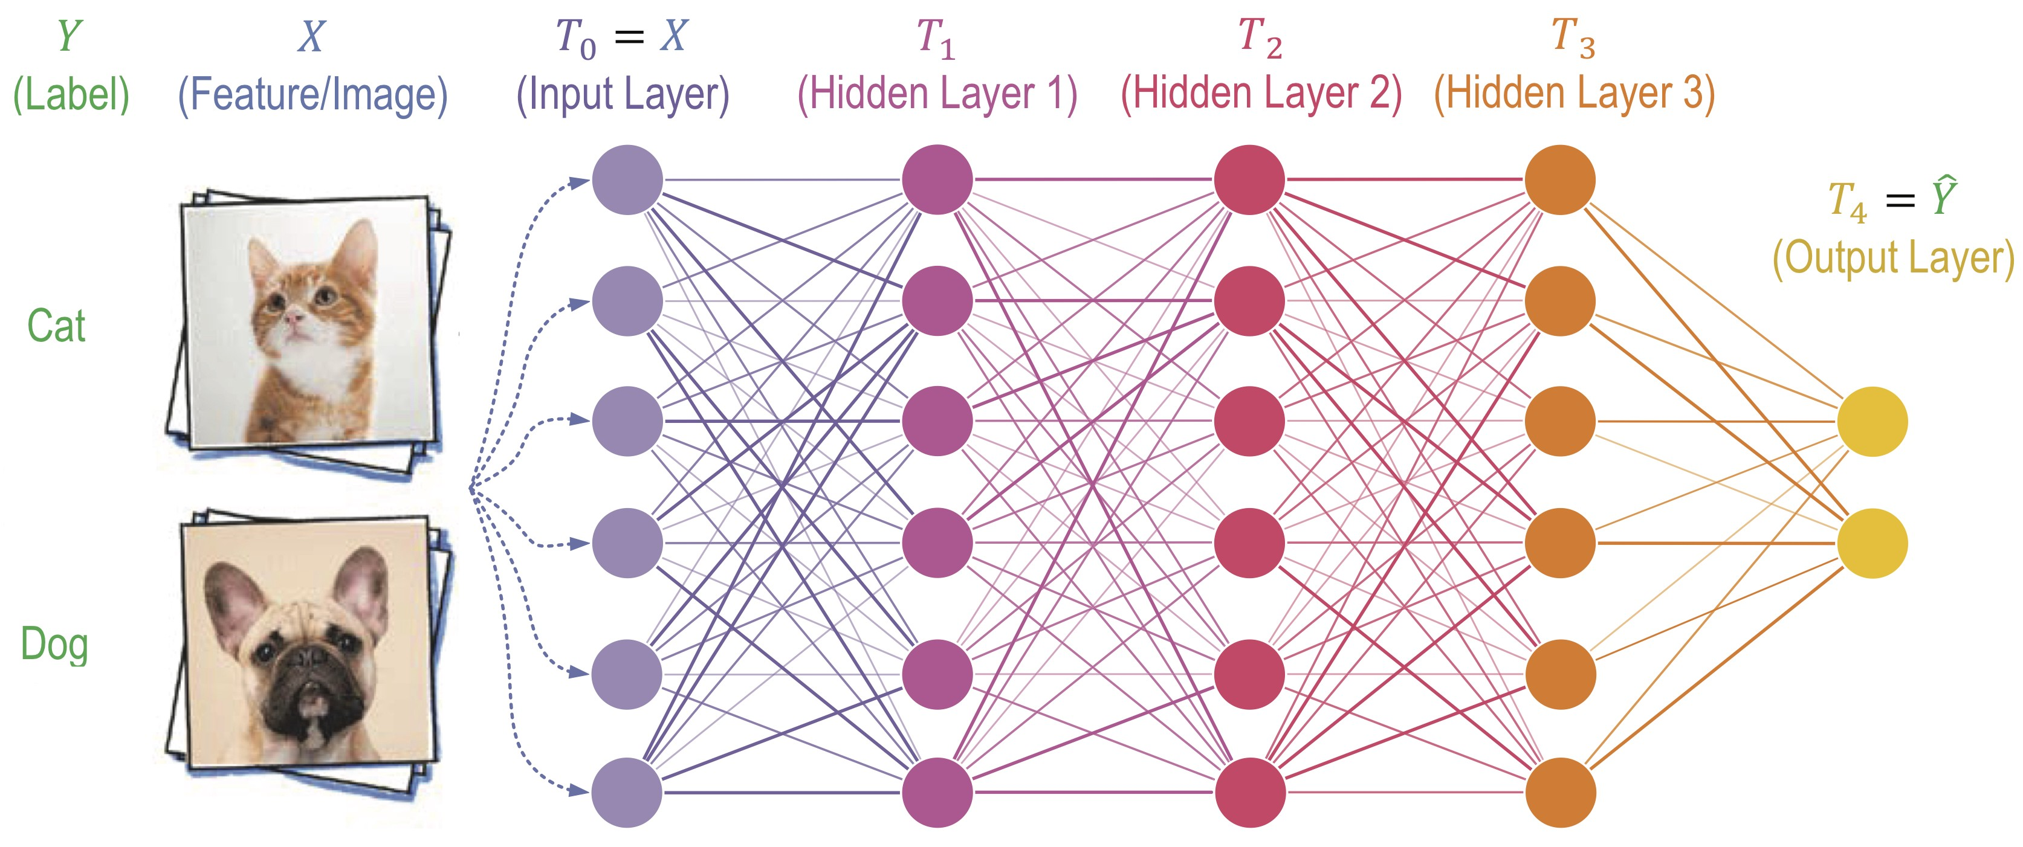
Supervised Learning Neural Networks
Neural networks are a class of function approximators that were originally biologically inspired

Slide 13
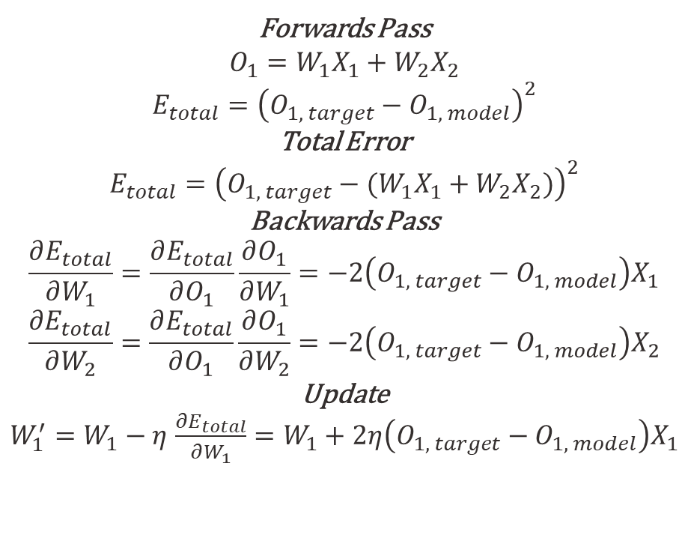
Neural Networks Backpropagation
To update the weights (and biases) of the neural network, we take the derivative with respect to some loss/cost function.
As a “simple” example…
Forwards Pass
$$O_{1}=W_{1}X_{1}+W_{2}X_{2}$$
$$E_{total}={\left(O_{1, target}−O_{1, model}\right)}^{2}$$
Total Error
$$E_{total}={\left(O_{1, target}−(W_{1}X_{1}+W_{2}X_{2})\right)}^{2}$$
Backwards Pass
$$\frac{∂E_{total}}{∂W_{1}}=\frac{∂E_{total}}{∂O_{1}}\frac{∂O_{1}}{∂W_{1}}=−2\left(O_{1, target}−O_{1, model}\right)X_{1}$$
$$\frac{∂E_{total}}{∂W_{2}}=\frac{∂E_{total}}{∂O_{1}}\frac{∂O_{1}}{∂W_{2}}=−2\left(O_{1, target}−O_{1, model}\right)X_{2}$$
Update
$W_{1}^{′}=W_{1}−η$ $\frac{∂E_{total}}{∂W_{1}}=W_{1}+2η\left(O_{1, target}−O_{1, model}\right)X_{1}$
X1
W1
O1
W2
O1 = X1 + X2
X2

Slide 14
Multilayer Perceptrons
By layering neural networks, we can emulate some pretty complex functions…
The example below has an input and output layers that reflect the dimensionality of the input/output and hidden layers

Slide 15
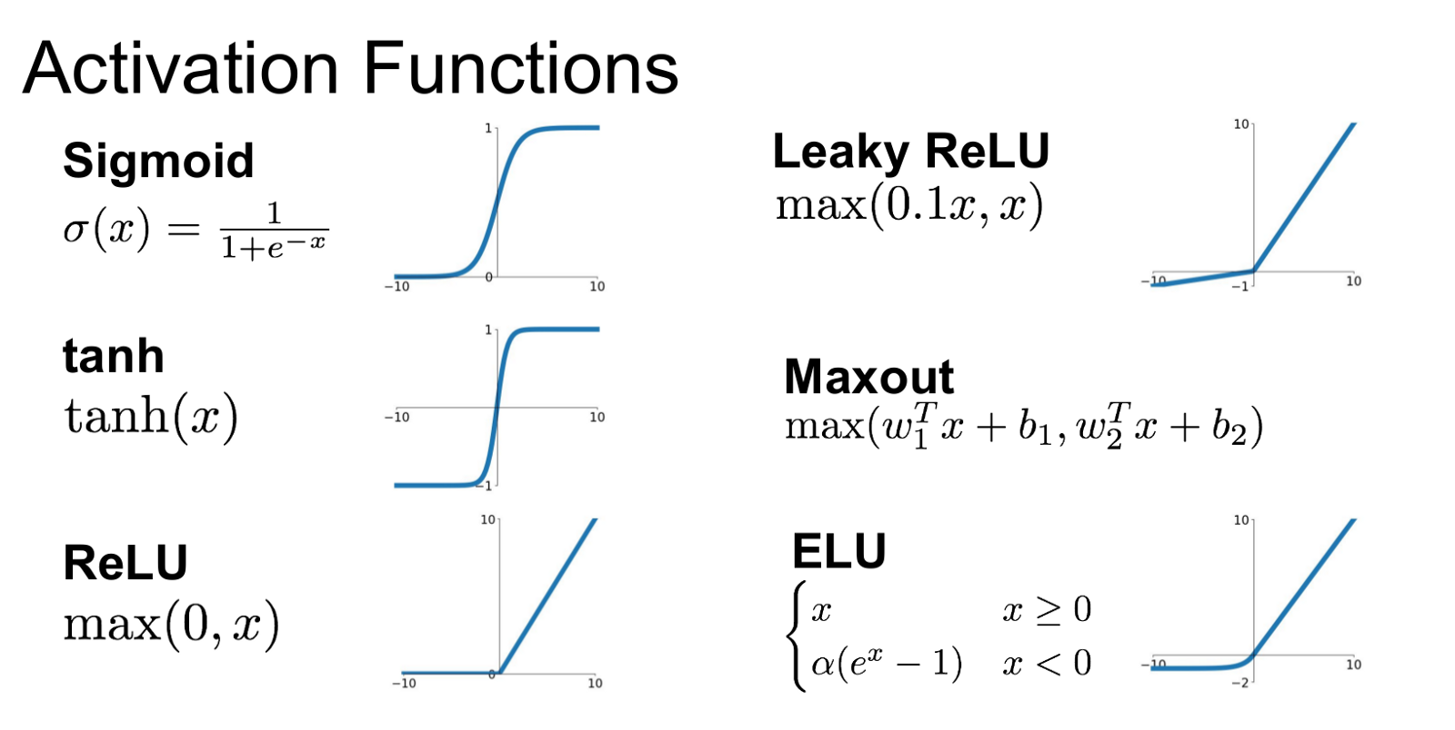
Activation Functions

Slide 16
Neural Network and Tensorflow
For this we will be using a simple sequential model
model = keras.Sequential(
[
layers.Dense(2, activation="relu", name="layer1"),
layers.Dense(3, activation="relu", name="layer2"),
layers.Dense(4, name="layer3"),
]
)
Model: "sequential_3"
_________________________________________________________________
Layer (type) Output Shape Param #
=================================================================
dense_7 (Dense) (1, 2) 10
_________________________________________________________________
dense_8 (Dense) (1, 3) 9
_________________________________________________________________
dense_9 (Dense) (1, 4) 16
=================================================================
Total params: 35
Trainable params: 35
Non-trainable params: 0

Slide 17
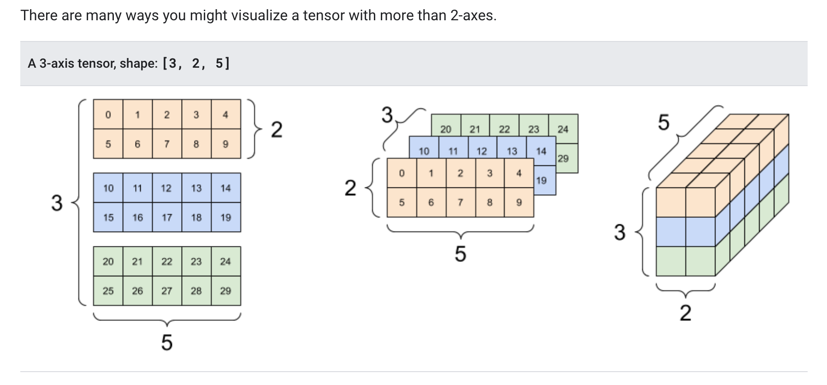
Tensorflow datatypes
Tensorflow models need to compiled, and work on GPUs.
This make error messages pretty unintuitive
Furthermore, Tensorflow has its own datatypes that must be converted from standard numpy outputs.

Slide 18
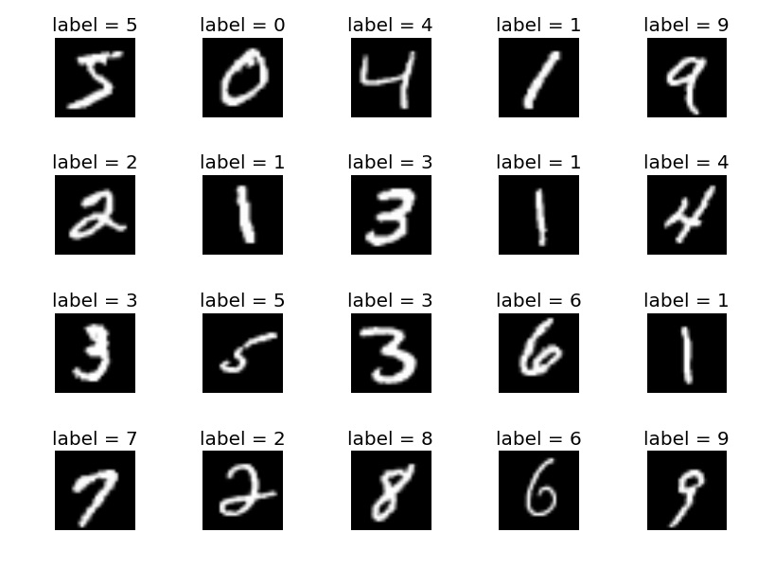
MNIST Dataset
Standard test dataset for handwriting digit recognition and OCR
Images are pretty small (28x28) and cleaned-up (black and white)

Slide 19
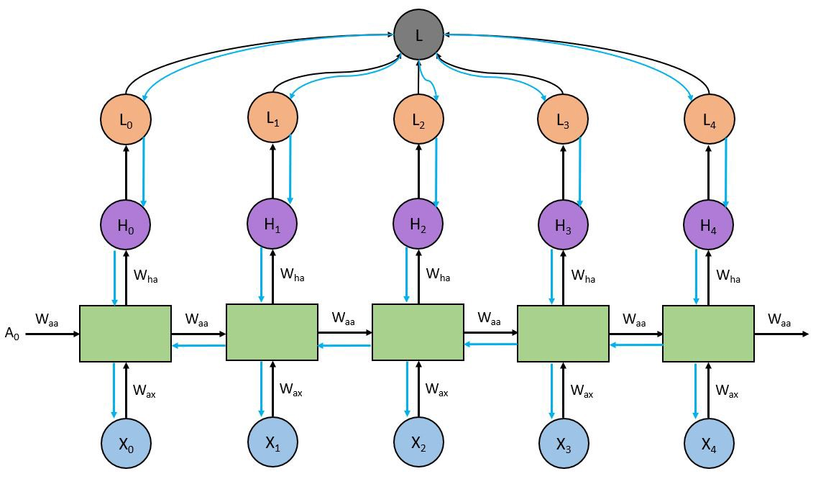
Recurrent Neural Networks
RNN are better suited for time series prediction since the structure accepts past states
Often used for weather prediction, signal analysis, speech recognition, etc.

