Slide 1
Tutorial 4
Nov 2019

Slide 2
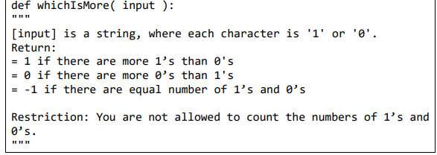
Q1 – Using stack to see if #0’s > 1
Cannot count, can only use a stack (to be declared in the function)
I.e, cannot do something like
sum([int(i) for i in input]) > len(input)/2
(or use a for loop to iterate and count the number of 1’s)

Slide 3
Idea – somehow let the 0’s and 1’s cancel out each other.
Initialize an empty stack s
Stack has three useful operations top (let us see the first item), pop (deletes the top item and returns it) and push items to top of stack
For each character c in input:
If s is empty OR if s.peek() == int(c):
Push c to the top of s
Else (if s.top() != c):
Delete the top item of s (pop)
3 possibilities at the end
If s is empty, it means equal numbers of 0 and 1
If s.top() == 1, what does this mean?
We can use this to deduce that one number has occurred more than the other
Else, …?

Slide 4
Some explanations
For each character c in input:
If s is empty OR if s.top() == int(c):
Push c to the top of s
Else (if s.top() != c):
Delete the top item of s (pop)
First, note that the number on the top of s (s.top()) contains the number which is the most frequent so far.
When s is empty, 2 possibilities. Either we just started, or we encountered an equal number of 0’s and 1’s so far and they cancel each other out.
Either way, this results in the current number being the number which has been encountered the most so far
s.top() == int(c) means so far, we have encountered more of the current number on the top of the stack. We add one more to our collection
Else part means that the current number has not appeared as often as the number at the top of the stack. Hence, we pop the stack as the current number has ‘cancelled’ out one item from the stack

Slide 5
Q1 – Extra challenge
After we have executed the function, can we use the resultant stack to answer this?

Slide 6
Q2 – Infix/postfix
Define
Operands – the numbers
Operators - + - * / etc…
To evaluate a postfix expression
Evaluate from left to right
Keep track of operands encountered until we encounter an operator
Once we encounter an operator, then use it on the operands most recently encountered
Eg, 2 3 4 + *. From left to right
Encounter operands 2, 3, 4 before encountering operator +
Use + on the 2 most recent operands, so 3 + 4 = 7.
Next operand is *, so it becomes 2 * 7 = 14

Slide 7
Q3 – Queue using Stack
Represent each patient as a 3-tuple of (Name, Arrival Time, Consultation Time).
Patients sorted based on arrival time.
Eg (John, 10, 5) means John arrives at time 10, and when he sees the doctor, he will take 5 mins.
Note that arrival time != time he meets the doctor
Eg if we have [(Mary, 8, 7), (John, 10, 5)], then
since Mary is the first patient, she sees the doctor at time 8 and leaves at time 15
When John arrives at time 10, he can only see the doctor at time 15 and leave at time 20

Slide 8
Some considerations
Need a data structure to represent the queue. (Queue)
Need to keep track of patients who have been seen (and have yet been seen)
Keep track of time taken to see all patients
To compute average queue length,
Determine the number of persons queuing at every time interval, and average this.
Eg if the queue lasts for 5 secs, and the number of people at the queue at every sec is 1, 3, 2, 1, 0, then the average queue length is (1+3+2+1+0)/5
Similarly, average waiting time is the sum of all waiting times of a patient/number of patients

Slide 9
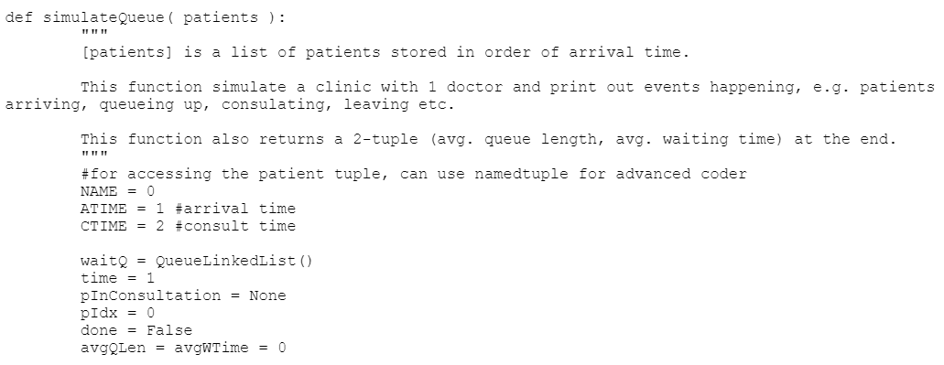
Pseudocode sketch - Variables needed

Slide 10
while not done,
Before we do anything, check if we are currently seeing a patient.
If there is a current patient being consulted, check if he’s done and remove him if possible.
Then, check to see if there are any patients to add to our queue. (if we have reached the next patient arrival time)
If Queue not empty
No patient in consultation
Get the first patient, let him be consulted.
If we have iterated through all the patients, set done = True and terminate
Else, increment time by 1

Slide 11
Computing Time
Average Queue Length
At every time step, get the size of the queue (after inserting and removing patients) and add it to variable avgQLen
When we are done, the Average Queue Length is avgQLen/time
Average Waiting Time
The waiting time for a given patient is given by (time he is served – arrival time)
When we serve a patient, compute his waiting time and add it to avgWtTime
When we are done, get average wait time by avgWtTime/len(patients)

Slide 12
Question 4
1, 2, 3, 4, 5, 10, 9, 8, 7, 6 – ok
When user enters 1,2,3,4,5, step 2 prints it out immediately
6,7,8,9,10 are stored in a stack in step 2 also.
In step 3, the stack can output all its contents. Since its LIFO, will get 10,9,8,7,6
6, 5, 7, 4, 8, 3, 9, 2, 10, 1 – ok
Initially, 1, 2, 3, 4, 5 stored in stack
When input 6, immediately output it
Output 5 from stack (stack now contains 4,3,2,1)
Output 7 immediately
Output 4 from stack (stack now – 3,2,1)
Output 8 immediately
Output 3 from stack (stack – 2, 1)
Output 9 immediately
Output 2 from stack
Output 10 immediately, then output 1 from stack

Slide 13
8, 6, 7, 5, 4, 3, 9, 10, 2, 1 – No
Suppose its possible.
Then only way for the first output to be 8 is that 1-7 is stored in the stack.
Cannot store 8 in the stack as when we are processing 9, we either have to output 9 immediately or save it to the stack.
Then the next output must be 7 (output from stack) or 9 (the next input).
But this isn’t the case, hence proven by contradiction this is false.

Slide 14
Q5
6, 7, 8, 1, 2, 3, 9, 10, 4, 5 – Possible (try to trace yourself)
2, 1, 4, 3, 6, 5, 8, 7, 10, 9 – Possible
5, 1, 7, 10, 2, 9, 3, 4, 6, 8 – No. Instead of tracing let’s reason this.
A queue is FIFO.
Hence, output of the queue must be in ascending order.

