Slide 1
Go with the Flow:
Automating Your Workflows with Airflow
Leo Guinan
07/28/2018

Slide 2
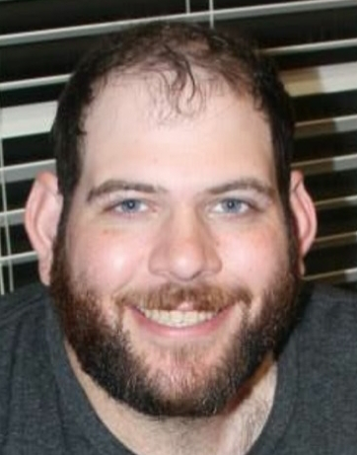
About Me
Software Engineer @ Fuse
Currently writing mostly Python
Data ingest -> Report Output
Previous lives have included good deal of Front-end/Back-end development, most Java-centric
Twitter: @guinanleo
Email: leo.guinan@gmail.com

Slide 3

Workflows

Slide 4
Workflows
Series of Operations
Ordered
Repeated
Ideally idempotent.
Typically atomic (though not always)
Can be simple line
Or more complex branches
But never cycles!
Ad-Hoc
Scheduled

Slide 5


Airflow

Slide 6
Enter Apache Airflow
https://airflow.apache.org/
In the words of Apache
“Airflow is a platform to programmatically author, schedule and monitor workflows.”
“Use airflow to author workflows as directed acyclic graphs (DAGs) of tasks. The airflow scheduler executes your tasks on an array of workers while following the specified dependencies. Rich command line utilities make performing complex surgeries on DAGs a snap. The rich user interface makes it easy to visualize pipelines running in production, monitor progress, and troubleshoot issues when needed.”
“When workflows are defined as code, they become more maintainable, versionable, testable, and collaborative."

Slide 7
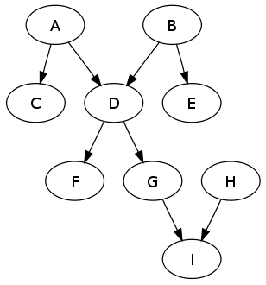
Directed
Acyclic
DAG
Graph
https://en.wikipedia.org/wiki/Directed_acyclic_graph

Slide 8
Operator
How To Do Things
What gets done
Usually atomic
Can be dependent on previous steps
Or not
Assigned to a DAG

Slide 9
Task
Main Unit of Work In Airflow
Instantiation of Operator
Defines specifics of values in templates
Node in DAG

Slide 10
Example Operators Available
S3
MSSQL
MySQL
Postgresql
GCP
Hive
SimpleHTTP
Python
Bash
Docker

Slide 11
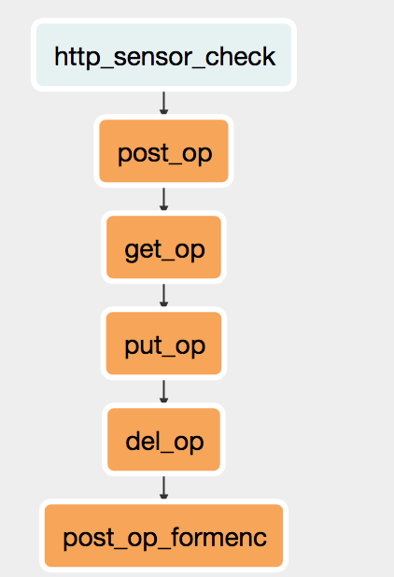
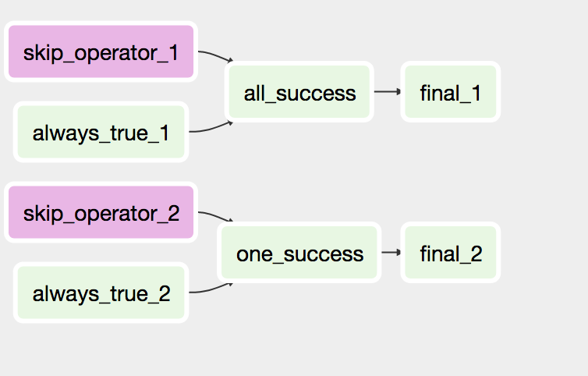
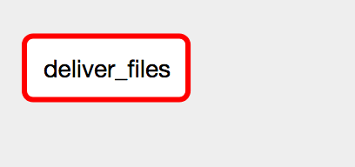
Simple Example DAGs
Super Simple
Little More
Even more

Slide 12
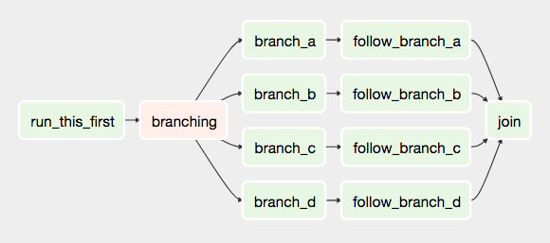
Moderately Complex DAG

Slide 13
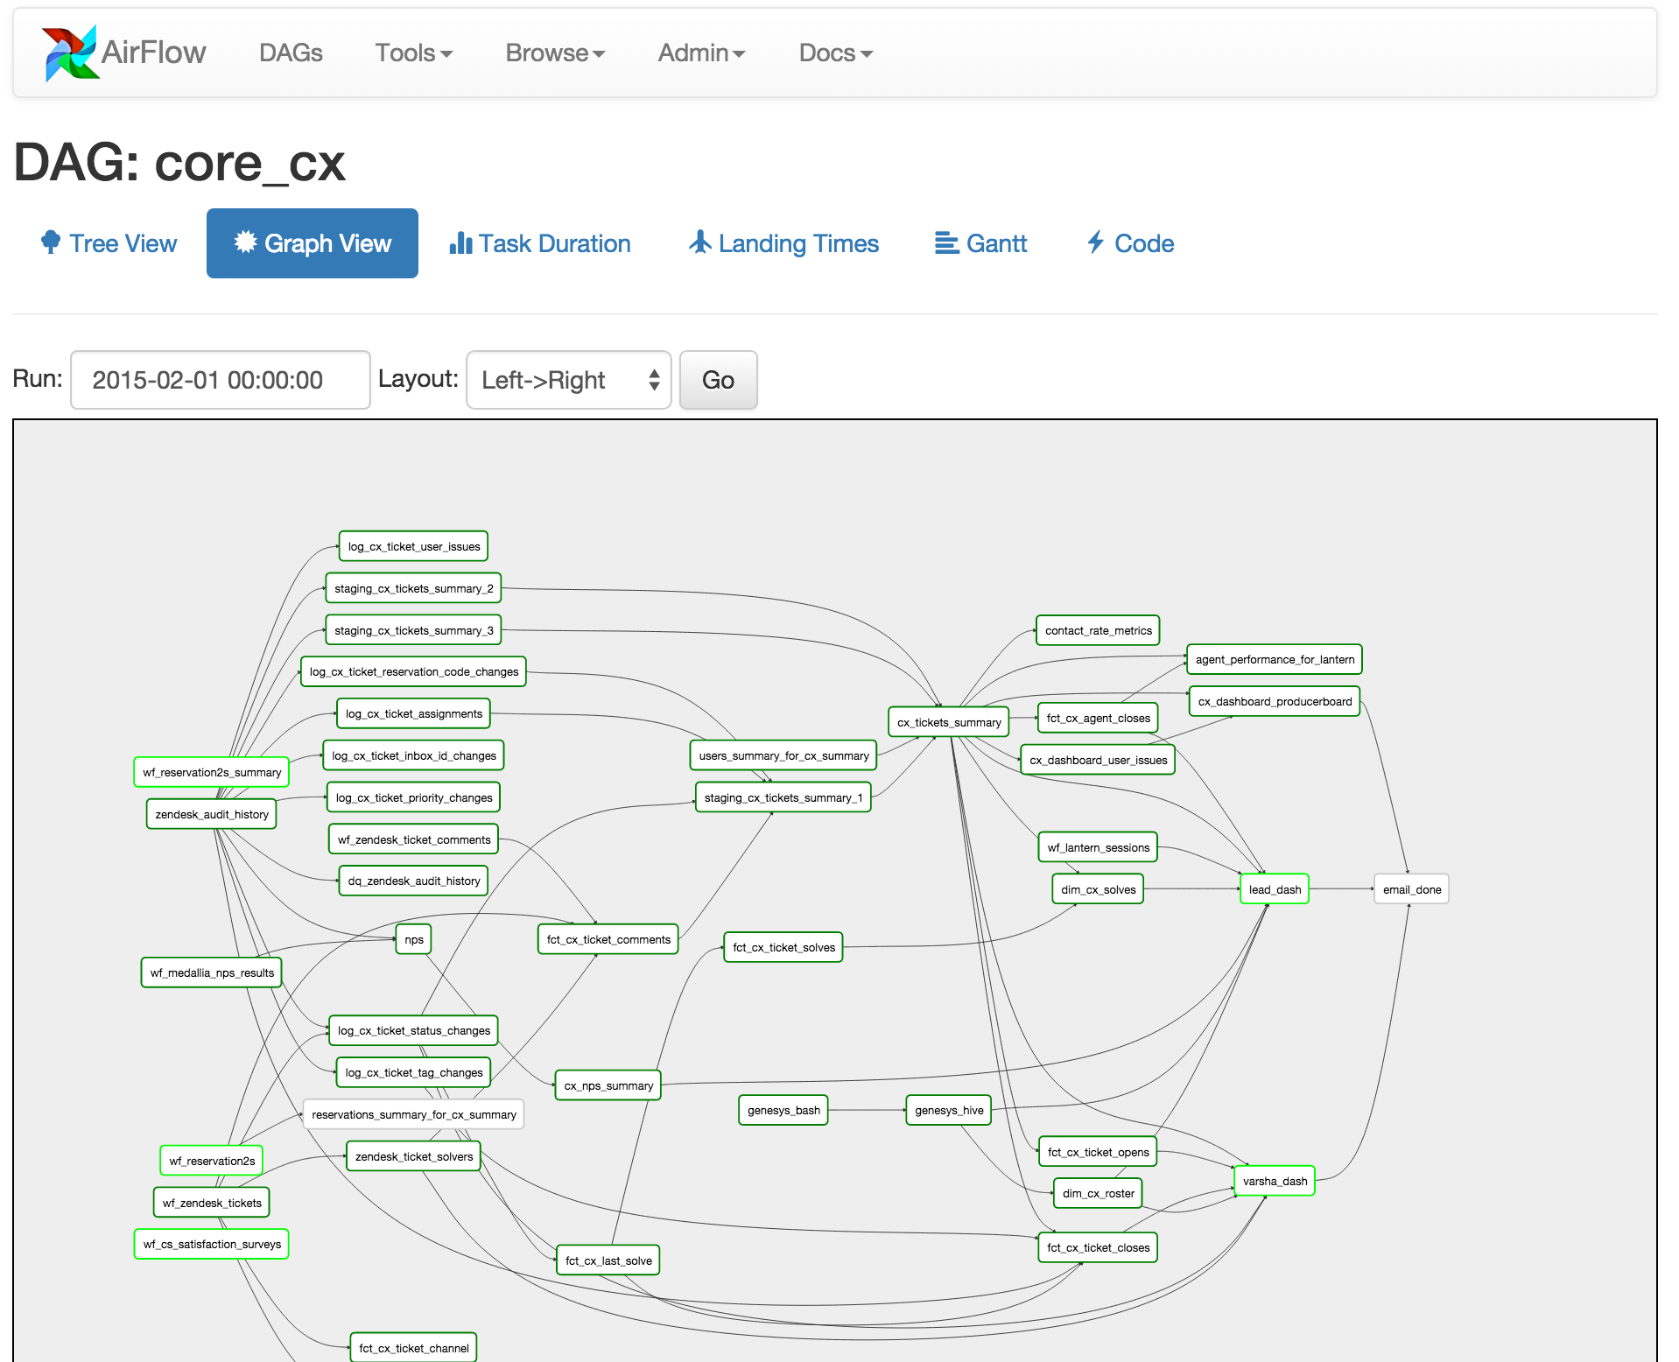
Super complex DAG
https://airflow.apache.org/ui.html

Slide 14
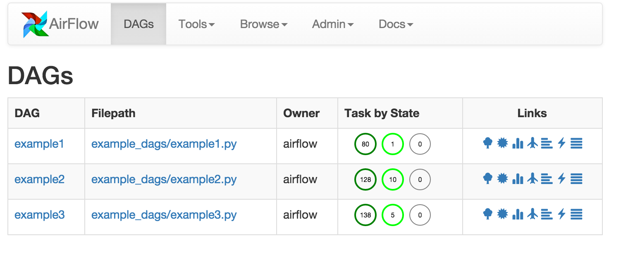
Airflow UI
https://airflow.apache.org/ui.html

Slide 15
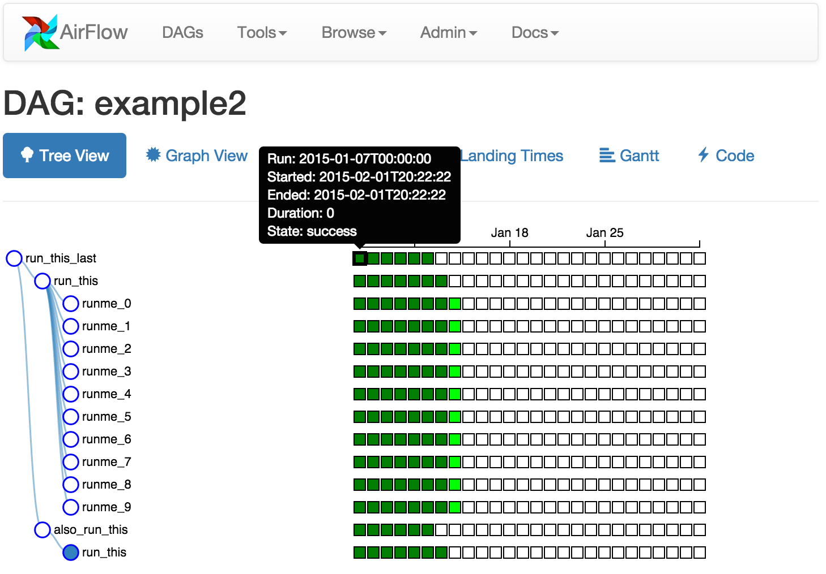
Airflow UI (cont)
https://airflow.apache.org/ui.html

Slide 16
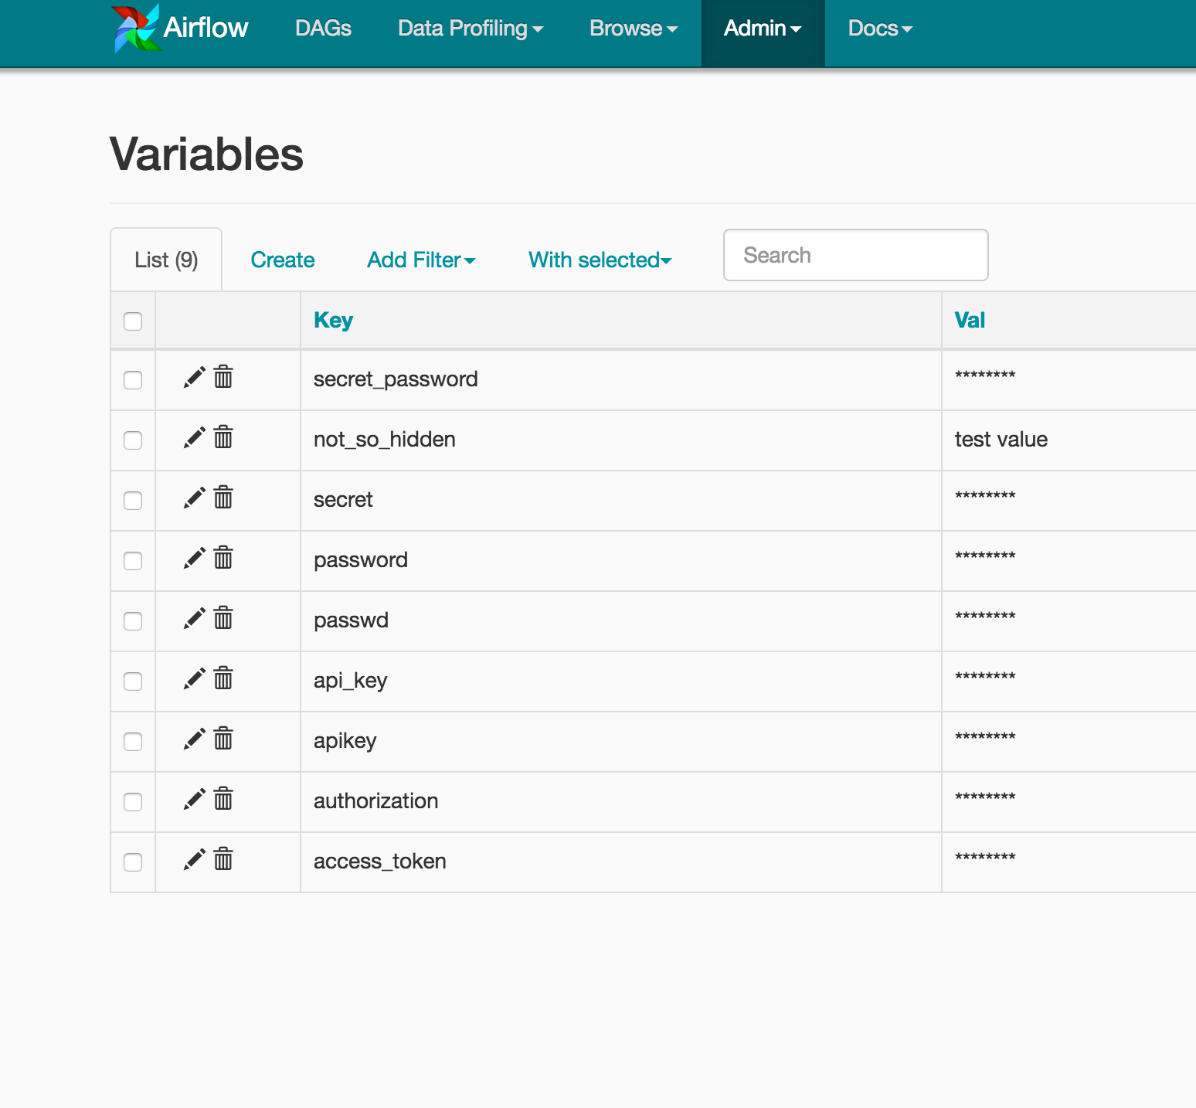
Airflow UI (cont)
https://airflow.apache.org/ui.html

Slide 17
Useful Links
https://airflow.apache.org/
http://michal.karzynski.pl/blog/2017/03/19/developing-workflows-with-apache-airflow/
https://www.slideshare.net/cordiskinsey/data-pipelines-with-python-nwa-techfest-2017
https://medium.com/snaptravel/airflow-part-2-lessons-learned-793fa3c0841e

Slide 18
Thank you!
Questions?
#SaveTheCrew

