Slide 1
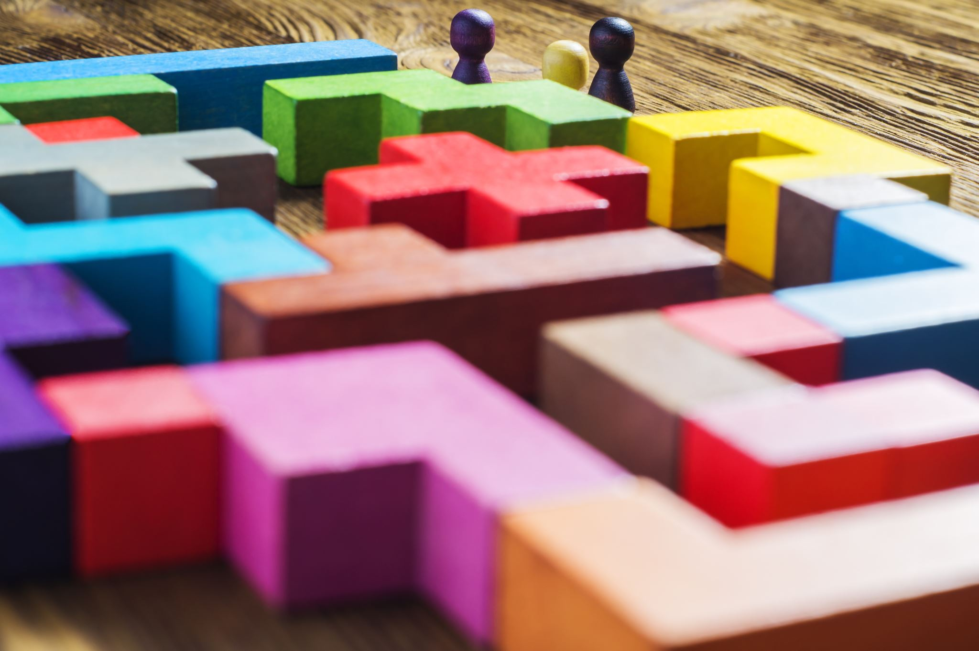
STELARR
JAN RAS
GRANT PINKHAM

Slide 2
STELARR Standalone Teaching Learning and retention resource
Learning Management System
For early education students
Teaches young students basic math, reading, and writing skills
Educational tool for parents, teachers, and student

Slide 3
Origin/ motivation
Series of Lifestyle Questions
Became a Real Life Scenario
Revealed a technological gap between teacher / parent / and student
Create a tool to bridge this gap

Slide 4
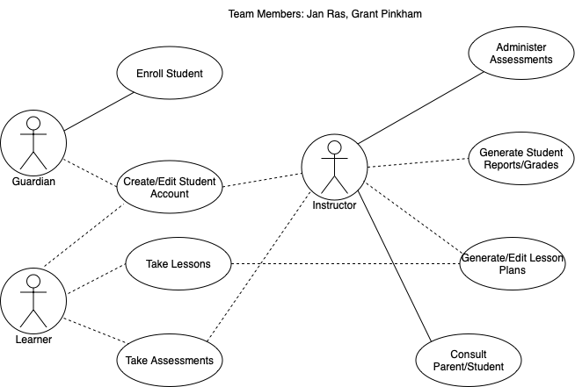

Slide 5
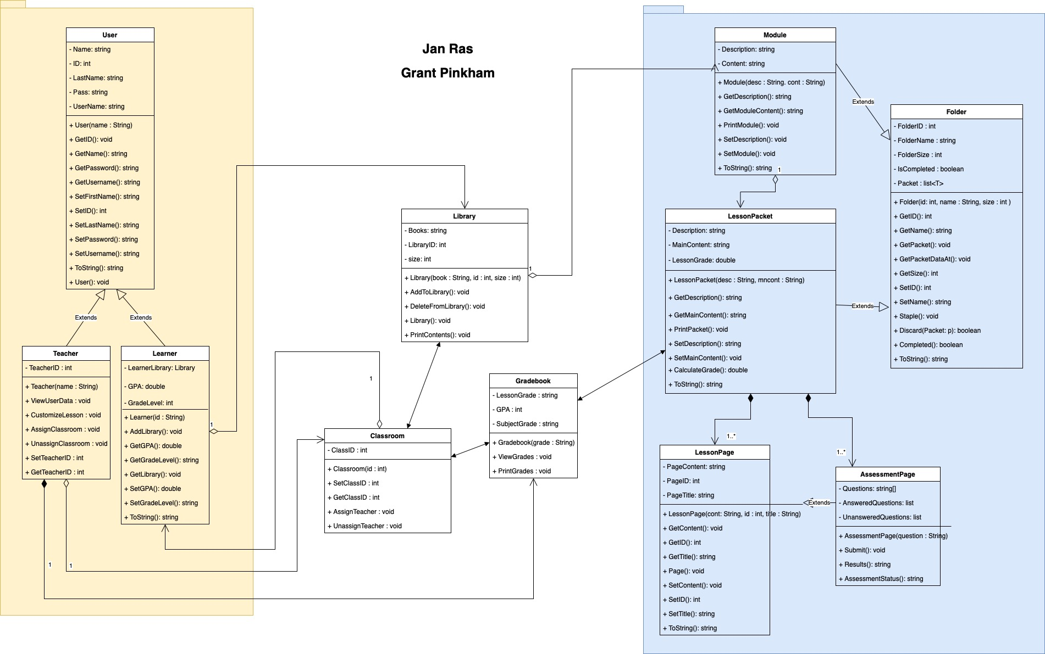
Features

