Slide 1

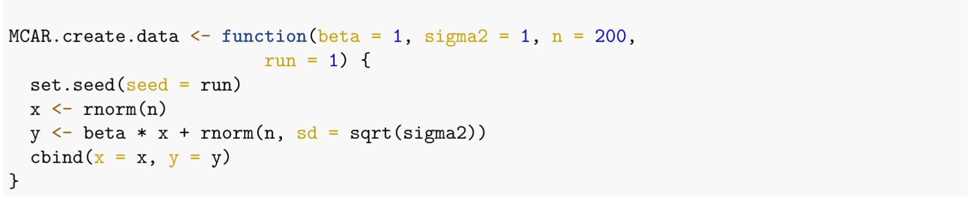
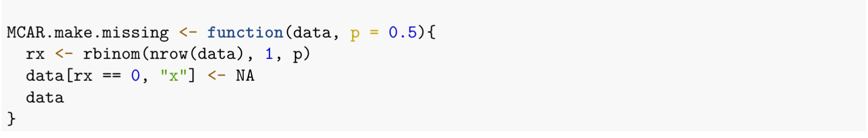
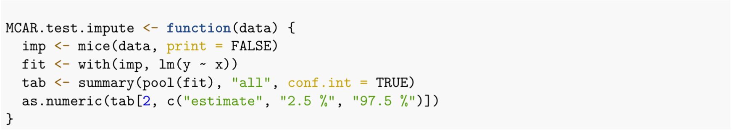
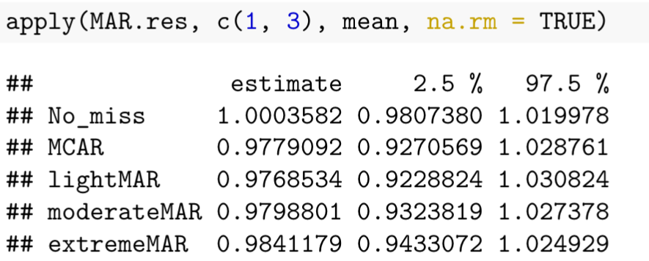
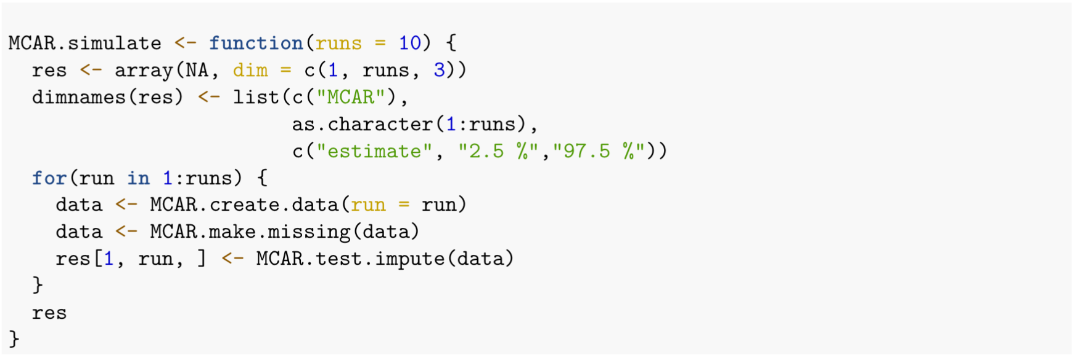
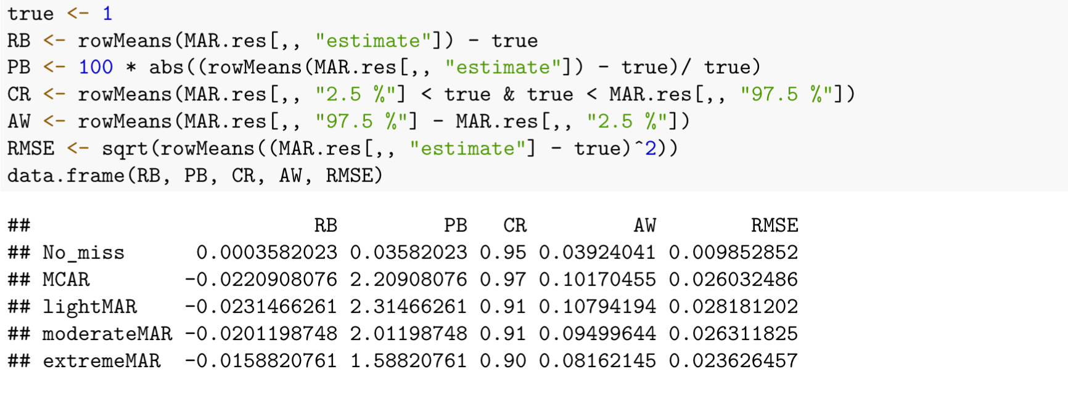

Exploration of the effect of missing data on statistical analysis
Leo Watson, Nathalie Moon
ABSTRACT
INVESTIGATIONS
Analysis of missing data mechanisms and modern approaches to handling missing data. Designing R simulations to investigate hypotheses about imputation technique.
1) Comparing multiple imputation under varying degrees of MCAR, MAR, MNAR
Simulation
Simulate determining $β_{1}=1$
MCAR: $y_{i}=x_{i}β_{1,}+ε_{i}$
MAR: $y_{i}=x_{1,i}β_{1}+x_{2,i}β_{2}+ε_{i}$
MNAR: $y_{i}=x_{i}β_{1,}+ε_{i}$
INTRODUCTION
Motivations
Interested in what scenarios different imputation techniques should be used to reduce runtime without sacrificing bias, error, and other performance measures.
Determine the types of missing data in the real world
Definitions
Missing Data Mechanisms
 | Estimate | PB | CR | AW
MCAR | 0.9779 | 2.209 | 0.97 | 0.102
MAR-light | 0.9768 | 2.315 | 0.91 | 0.108
MAR-moderate | 0.9799 | 2.011 | 0.91 | 0.095
MAR-heavy | 0.9841 | 1.588 | 0.90 | 0.082
MNAR-light | 1.0174 | 1.740 | 0.96 | 0.306
MNAR-moderate | 1.0262 | 2.615 | 0.95 | 0.331
MNAR-heavy | 1.0485 | 4.853 | 0.88 | 0.388
MCAR
MAR
2) When Listwise Deletion Outperforms Multiple Imputation
Hypothesis 2a:
Missing Data only in Response Y
Hypothesis 2b:
Probability of missingness doesn’t depend on Y
Hypothesis 2c:
Data follows Logistic Regression, probability of missingness depends only on Y
MNAR
Simulation
Simulation
Simulation
Imputation Techniques
Results
Results
Results
Listwise Deletion
CONCLUSION
Multiple Imputation
References

Slide 2
 | Estimate | PB | CR | AW
MCAR | 0.9779 | 2.209 | 0.97 | 0.102
MAR-light | 0.9768 | 2.315 | 0.91 | 0.108
MAR-moderate | 0.9799 | 2.011 | 0.91 | 0.095
MAR-heavy | 0.9841 | 1.588 | 0.90 | 0.082
MNAR-light | 1.0174 | 1.740 | 0.96 | 0.306
MNAR-moderate | 1.0262 | 2.615 | 0.95 | 0.331
MNAR-heavy | 1.0485 | 4.853 | 0.88 | 0.388

