Slide 1

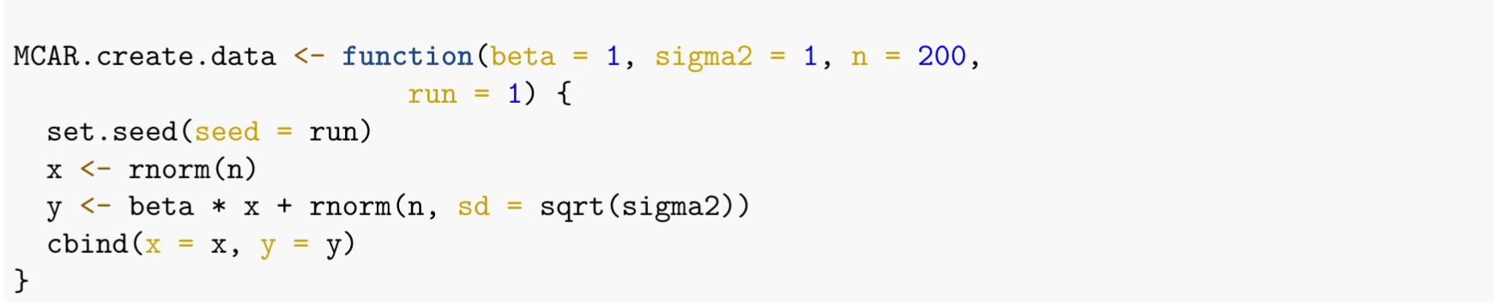
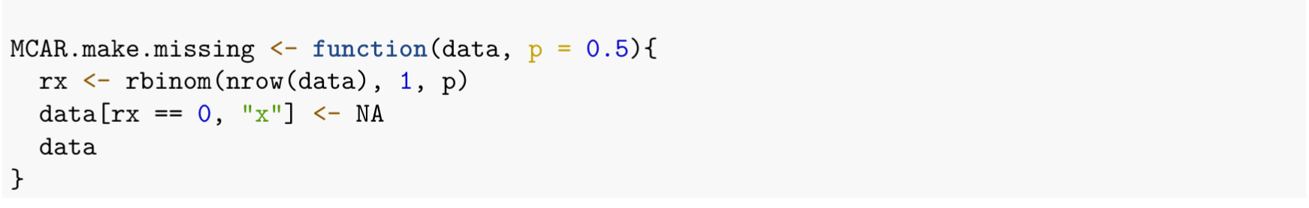
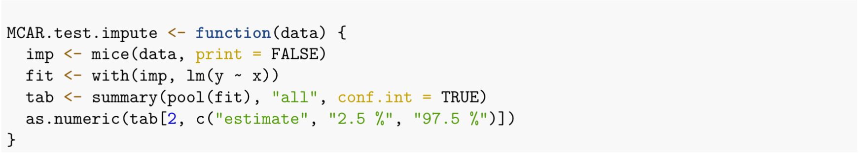
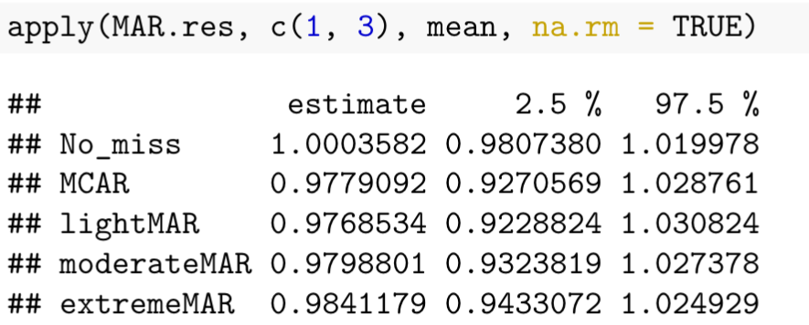
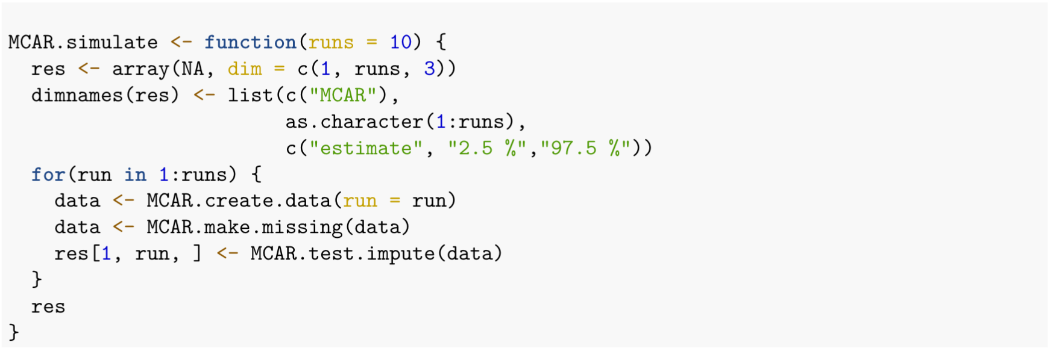
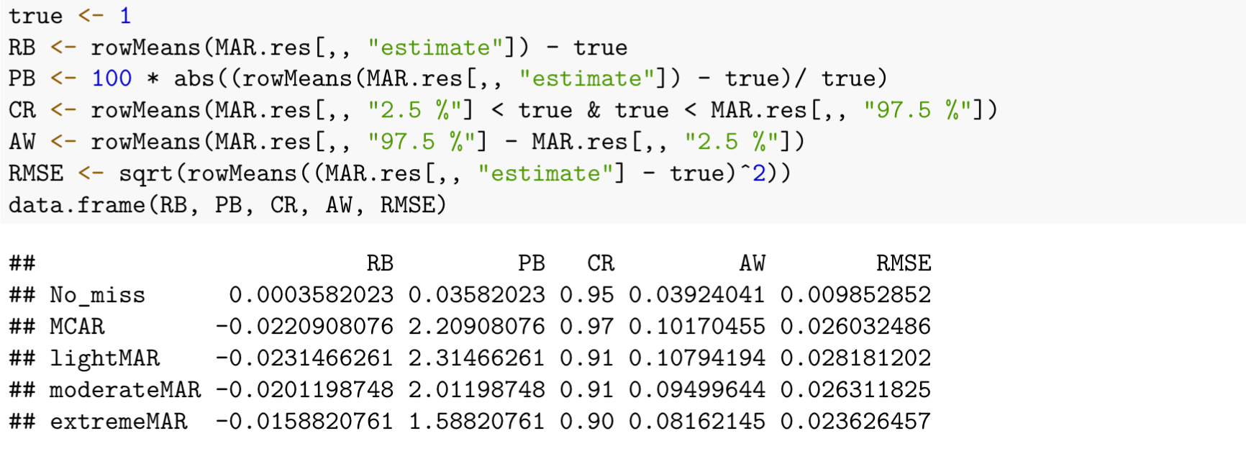
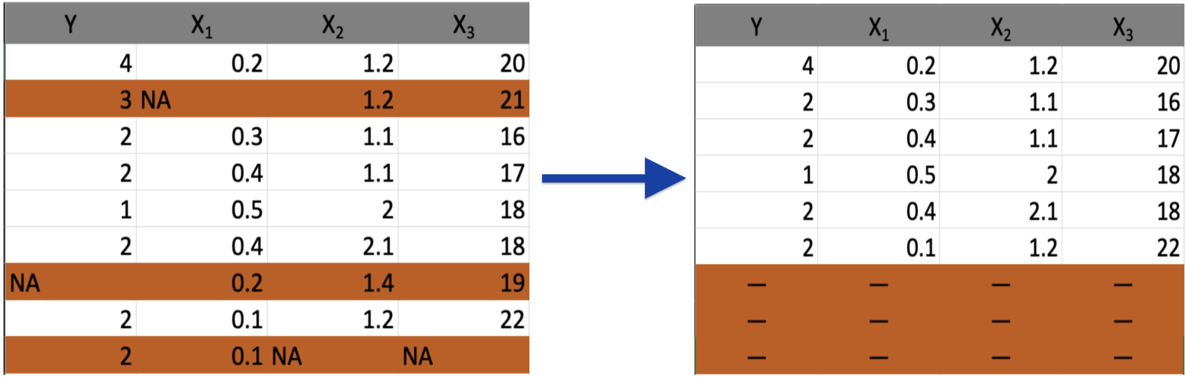
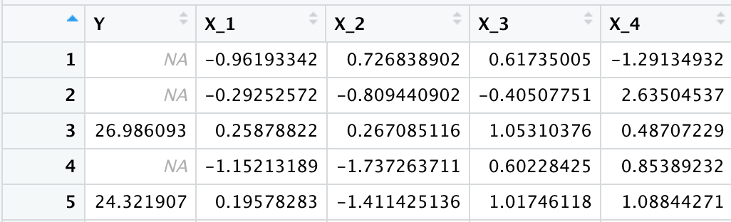
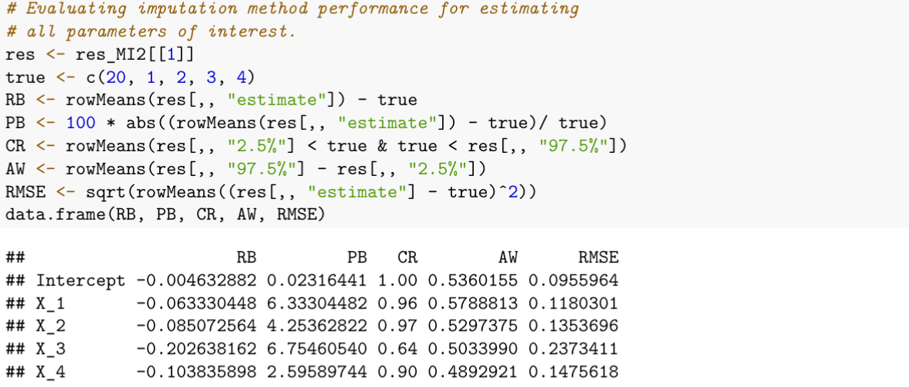
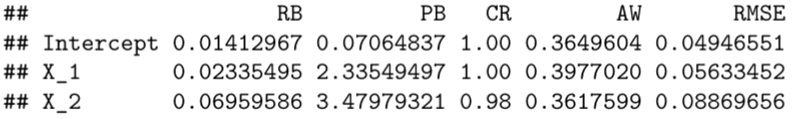
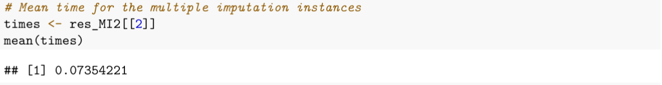
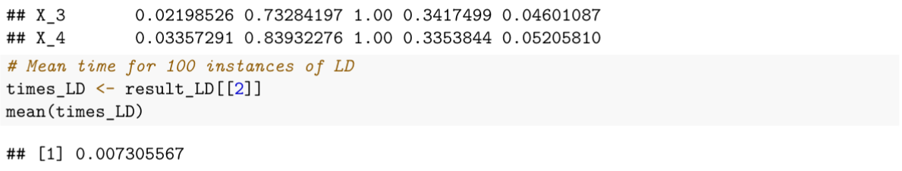
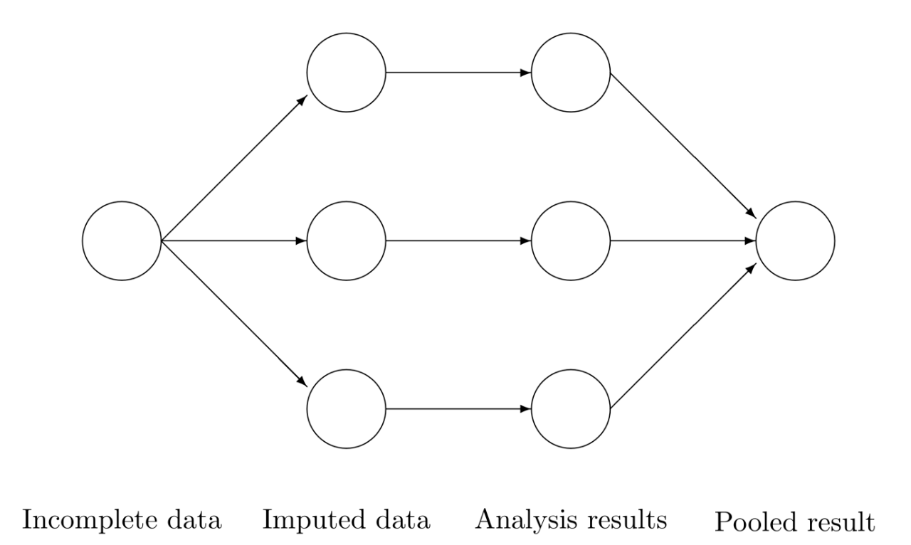
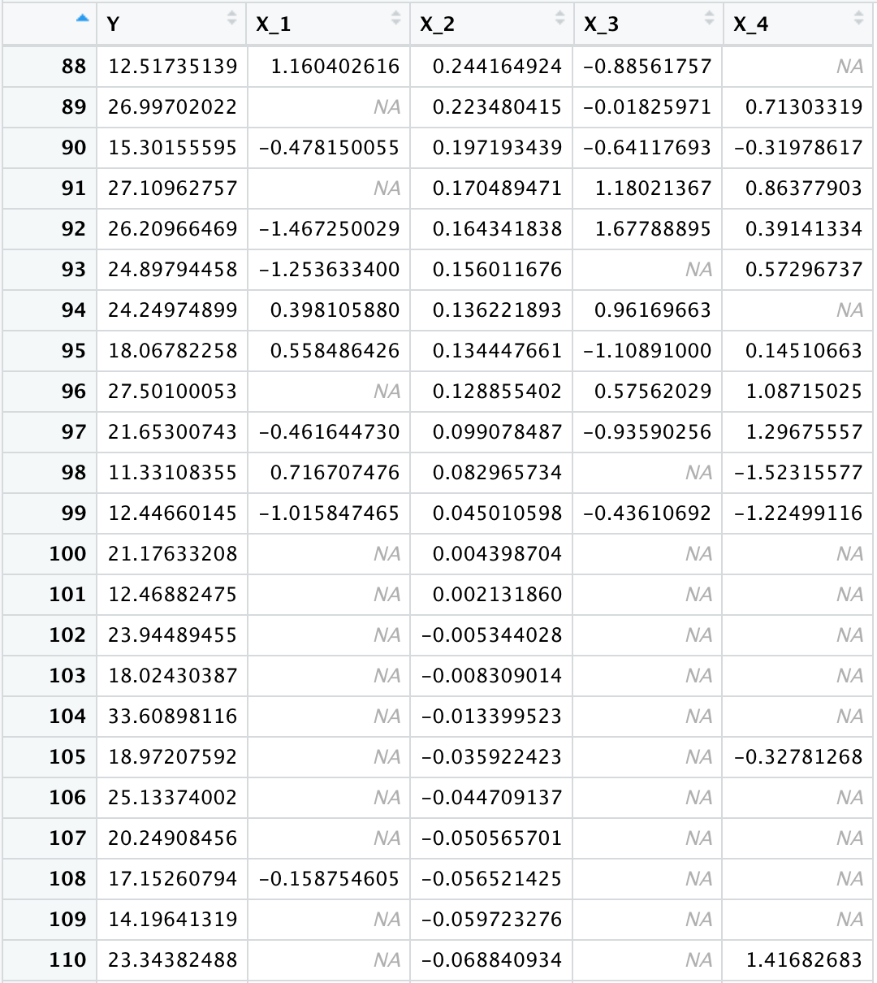
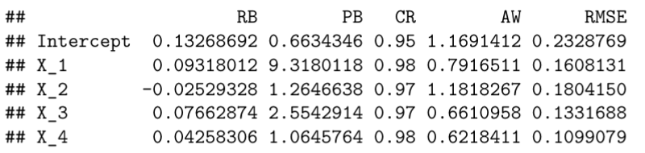
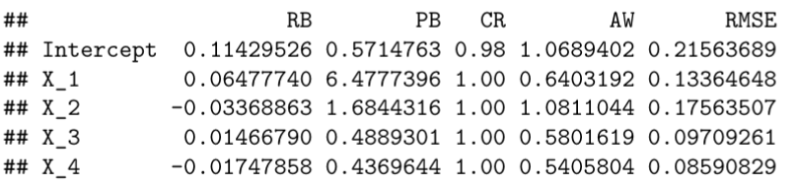
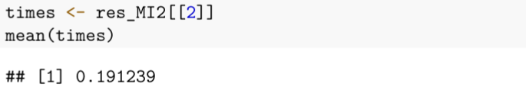
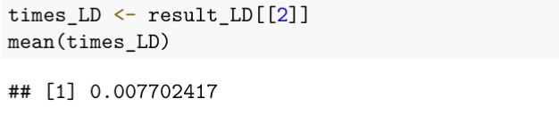

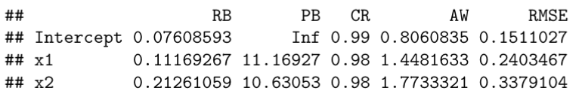
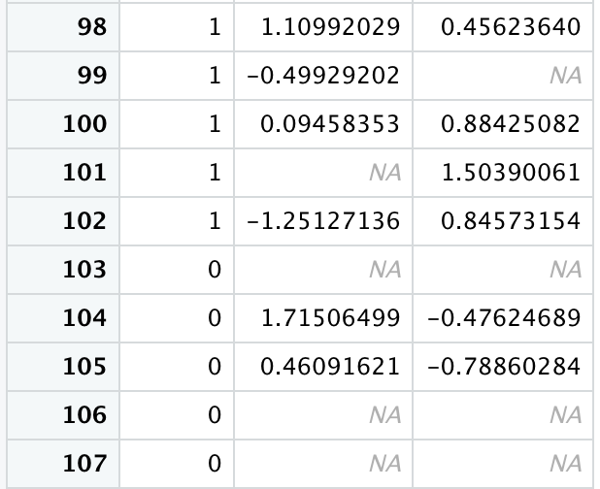
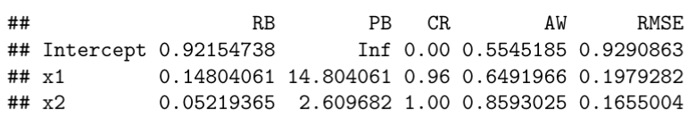
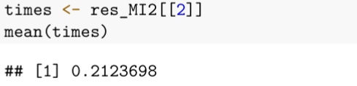
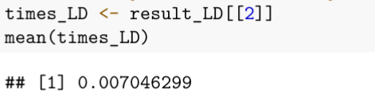

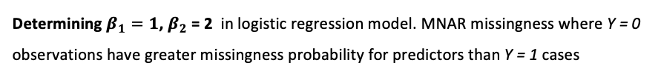
Exploration of the effect of missing data on statistical analysis
Leo Watson, Nathalie Moon
ABSTRACT
INVESTIGATIONS
Analysis of missing data mechanisms and modern approaches to handling missing data. Designing R simulations to investigate hypotheses about imputation technique.
(1) Multiple imputation under varying levels of MCAR, MAR, MNAR
Simulate determining $β_{1}=1$
MCAR: $y_{i}=x_{i}β_{1,}+ε_{i}$
MAR: $y_{i}=x_{1,i}β_{1}+x_{2,i}β_{2}+ε_{i}$
MNAR: $y_{i}=x_{i}β_{1,}+ε_{i}$
INTRODUCTION
Motivations
Interested in what scenarios different imputation techniques should be used to reduce runtime without sacrificing bias, error, and other performance measures.
Determine the types of missing data in the real world
Definitions
Missing Data Mechanisms
MCAR: When probability of missingness for data points in a dataset is constant.
Each student’s mark is stored in a spreadsheet by the instructor but following a computer update 10% of the data is deleted at random.
MAR: When probability of missingness is dependent on some observed variable of the dataset.
Most students joined a class from day 1, but some students joined late from the waitlist due to capacity restrictions. 10% of students who joined on time had a missing submission for the first problem set, while 30% of students who joined late missed the first problem set.
 | Estimate | PB | CR | AW
MCAR | 0.9779 | 2.209 | 0.97 | 0.102
MAR-light | 0.9768 | 2.315 | 0.91 | 0.108
MAR-moderate | 0.9799 | 2.011 | 0.91 | 0.095
MAR-heavy | 0.9841 | 1.588 | 0.90 | 0.082
MNAR-light | 1.0174 | 1.740 | 0.96 | 0.306
MNAR-moderate | 1.0262 | 2.615 | 0.95 | 0.331
MNAR-heavy | 1.0485 | 4.853 | 0.88 | 0.388
MNAR: When probability of missingness is dependent on the true value of the data point which we don’t
know for all subjects.
• Due to a system failure, the instructor loses all the students’ marks. Left with no choice, the instructor requests the students to calculate and share their true final marks to the instructor. If they don’t, the instructor will input that they got a B.
– If a student’s true mark is an A, they are 90% likely to state their true mark. – If a student’s true mark is a B, they are 70% likely to state their true mark. – If a student’s true mark is a C, they are 50% likely to state their true mark.
(2) When Listwise Deletion Outperforms Multiple Imputation
Imputation Techniques
Case 1: Missing Data only in Response Y
Listwise Deletion: Eliminates all observations containing ANY missing values in variables of interest
Determining $β_{1}=1$, $β_{2}$ = 2, $β_{3}$ = 3, $β_{4}$ = 4 in model $y_{i}=x_{1,i}β_{1}+x_{2,i}β_{2}+x_{3,i}β_{3}+x_{4,i}β_{4}+ε_{i}$
Multiple Imputation
Listwise Deletion
Multiple Imputation:
Takes incomplete dataset and creates multiple copies of it.
Impute incomplete columns with plausible values through an iterative predictive method for each copy
Obtain estimate for parameter of interest for each copy
Pool estimators together to create a single pooled estimate.
Case 2: Missing Data independent of response Y
Determining $β_{1}=1$, $β_{2}$ = 2, $β_{3}$ = 3, $β_{4}$ = 4 in model $y_{i}=x_{1,i}β_{1}+x_{2,i}β_{2}+x_{3,i}β_{3}+x_{4,i}β_{4}+ε_{i}$
[1]
Multiple Imputation
Listwise Deletion
CONCLUSION
Case 3: Logistic regression model & probability to be missing depends only on Y
If in doubt, choosing multiple imputation for your dataset is generally safest approach.
Depending on the missinginess mechanism underlying your data, the quality of your imputations will vary significantly (investigation 1).
Moreover, there are situations where listwise deletion is orders of magnitude faster and provides unbiased regression coefficients (investigation 2).
There are far more imputation methods than just the two discussed here; it is vital to deliberately consider which imputation method is best for your dataset when performing statistical analyses.
Determining $β_{1}=1$, $β_{2}$ = 2 in logistic regression model. MNAR missingness where Y = 0 observations have greater missingness probability for predictors than Y = 1 cases
Multiple Imputation
Listwise Deletion
References & Acknowledgment
Textbook, paper (TODO)
Thank you to Professor Nathalie Moon for her expertise and guidance
Add Github link for full code
Investigation (2) Summarized Results:
 | Listwise Del runtime (s) | Multiple Imp (s) | Rate
Case 1 | 0.00731 | 0.07354 | 10x faster
Case 2 | 0.00770 | 0.19124 | ~25x faster
Case 3 | 0.00705 | 0.21237 | ~30x faster
Notes:
5

Slide 2

Exploration of the effect of missing data on statistical analysis
Leo Watson, Nathalie Moon
ABSTRACT
INVESTIGATIONS
Analysis of missing data mechanisms and modern approaches to handling missing data. Designing R simulations to investigate hypotheses about imputation technique.
(1) Multiple imputation under varying levels of MCAR, MAR, MNAR
Simulate determining $β_{1}=1$
MCAR: $y_{i}=x_{i}β_{1,}+ε_{i}$
MAR: $y_{i}=x_{1,i}β_{1}+x_{2,i}β_{2}+ε_{i}$
MNAR: $y_{i}=x_{i}β_{1,}+ε_{i}$
INTRODUCTION
Motivations
Interested in what scenarios different imputation techniques should be used to reduce runtime without sacrificing bias, error, and other performance measures.
Determine the types of missing data in the real world
Definitions
Missing Data Mechanisms
MCAR: When probability of missingness for data points in a dataset is constant.
Each student’s mark is stored in a spreadsheet by the instructor but following a computer update 10% of the data is deleted at random.
MAR: When probability of missingness is dependent on some observed variable of the dataset.
Most students joined a class from day 1, but some students joined late from the waitlist due to capacity restrictions. 10% of students who joined on time had a missing submission for the first problem set, while 30% of students who joined late missed the first problem set.
 | Estimate | PB | CR | AW
MCAR | 0.9779 | 2.209 | 0.97 | 0.102
MAR-light | 0.9768 | 2.315 | 0.91 | 0.108
MAR-moderate | 0.9799 | 2.011 | 0.91 | 0.095
MAR-heavy | 0.9841 | 1.588 | 0.90 | 0.082
MNAR-light | 1.0174 | 1.740 | 0.96 | 0.306
MNAR-moderate | 1.0262 | 2.615 | 0.95 | 0.331
MNAR-heavy | 1.0485 | 4.853 | 0.88 | 0.388
MNAR: When probability of missingness is dependent on the true value of the data point which we don’t
know for all subjects.
• Due to a system failure, the instructor loses all the students’ marks. Left with no choice, the instructor requests the students to calculate and share their true final marks to the instructor. If they don’t, the instructor will input that they got a B.
– If a student’s true mark is an A, they are 90% likely to state their true mark. – If a student’s true mark is a B, they are 70% likely to state their true mark. – If a student’s true mark is a C, they are 50% likely to state their true mark.
(2) When Listwise Deletion Outperforms Multiple Imputation
Imputation Techniques
Case 1: Missing Data only in Response Y
Listwise Deletion: Eliminates all observations containing ANY missing values in variables of interest
Determining $β_{1}=1$, $β_{2}$ = 2, $β_{3}$ = 3, $β_{4}$ = 4 in model $y_{i}=x_{1,i}β_{1}+x_{2,i}β_{2}+x_{3,i}β_{3}+x_{4,i}β_{4}+ε_{i}$
Multiple Imputation
Listwise Deletion
Multiple Imputation:
Takes incomplete dataset and creates multiple copies of it.
Impute incomplete columns with plausible values through an iterative predictive method for each copy
Obtain estimate for parameter of interest for each copy
Pool estimators together to create a single pooled estimate.
Case 2: Missing Data independent of response Y
Determining $β_{1}=1$, $β_{2}$ = 2, $β_{3}$ = 3, $β_{4}$ = 4 in model $y_{i}=x_{1,i}β_{1}+x_{2,i}β_{2}+x_{3,i}β_{3}+x_{4,i}β_{4}+ε_{i}$
[1]
Multiple Imputation
Listwise Deletion
CONCLUSION
Case 3: Logistic regression model & probability to be missing depends only on Y
If in doubt, choosing multiple imputation for your dataset is generally safest approach.
Depending on the missinginess mechanism underlying your data, the quality of your imputations will vary significantly (investigation 1).
Moreover, there are situations where listwise deletion is orders of magnitude faster and provides unbiased regression coefficients (investigation 2).
There are far more imputation methods than just the two discussed here; it is vital to deliberately consider which imputation method is best for your dataset when performing statistical analyses.
Determining $β_{1}=1$, $β_{2}$ = 2 in logistic regression model. MNAR missingness where Y = 0 observations have greater missingness probability for predictors than Y = 1 cases
Multiple Imputation
Listwise Deletion
References & Acknowledgment
Textbook, paper (TODO)
Thank you to Professor Nathalie Moon for her expertise and guidance
Add Github link for full code
Investigation (2) Summarized Results:
 | Listwise Del runtime (s) | Multiple Imp (s) | Rate
Case 1 | 0.00731 | 0.07354 | 10x faster
Case 2 | 0.00770 | 0.19124 | ~25x faster
Case 3 | 0.00705 | 0.21237 | ~30x faster
Notes:
5

Slide 3

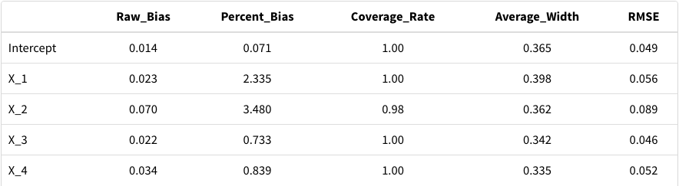
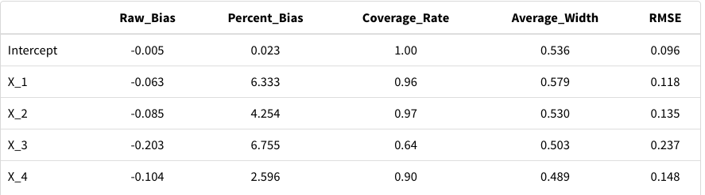
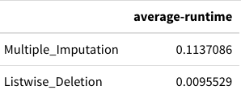
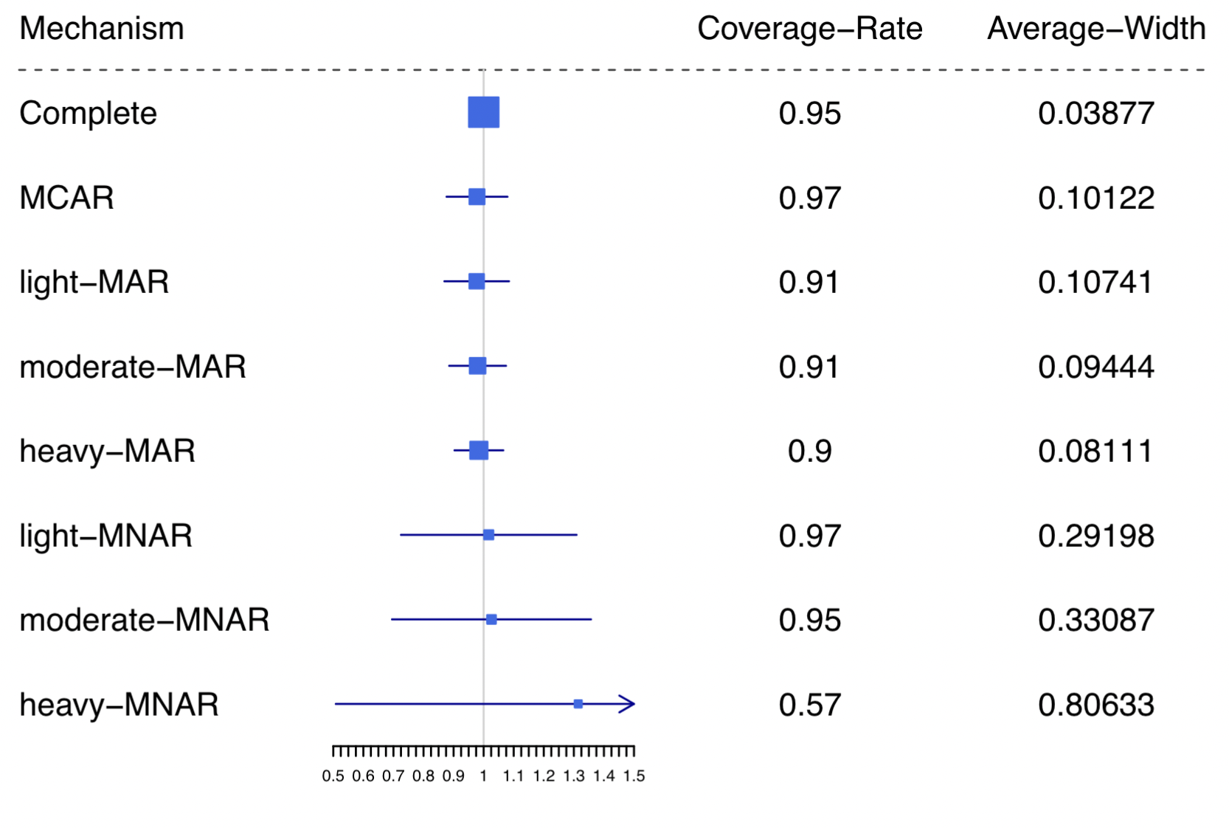
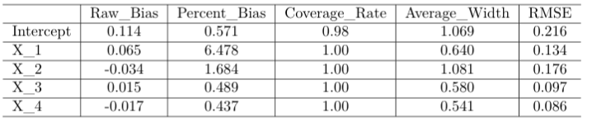
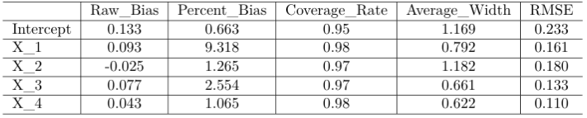



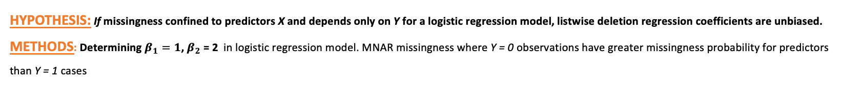
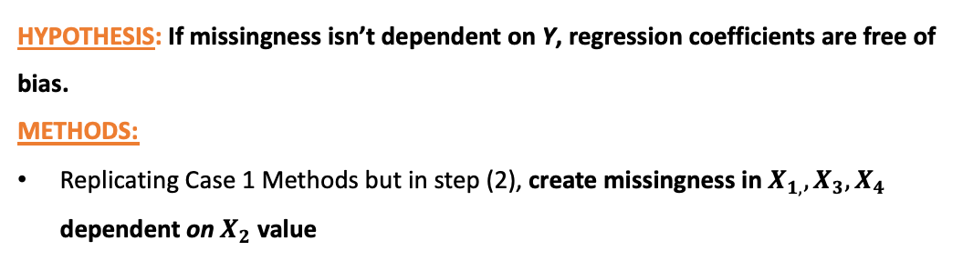
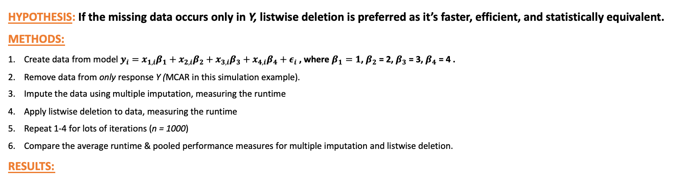
Effects of missing data on statistical analysis
Leo Watson, Nathalie Moon ; Department of Statistical Sciences
Abstract
Investigation (1):
Multiple Imputation under varying degrees of MCAR, MAR, MNAR
Investigation (2):
When Listwise Deletion Outperforms Multiple Imputation
Analyzing missing data mechanisms, modern approaches to handling missing data. Designing R simulations to investigate hypotheses about imputation techniques.
OBJECTIVE
Case 1: Missing Data only in Response Y
Introduction
Compare the effectiveness of multiple imputation under different missing mechanisms.
HYPOTHESIS: If the missing data occurs only in Y, listwise deletion is preferred as it’s faster, efficient, and statistically equivalent.
METHODS:
Create data from model $y_{i}=x_{1,i}β_{1}+x_{2,i}β_{2}+x_{3,i}β_{3}+x_{4,i}β_{4}+ε_{i}$ , where $β_{1}=1$, $β_{2}$ = 2, $β_{3}$ = 3, $β_{4}$ = 4 .
Remove data from only response Y (MCAR in this simulation example).
Impute the data using multiple imputation, measuring the runtime
Apply listwise deletion to data, measuring the runtime
Repeat 1-4 for lots of iterations (n = 1000)
Compare the average runtime & pooled performance measures for multiple imputation and listwise deletion.
RESULTS:
METHODS
MOTIVATIONS
Designed R simulations for each of MCAR, MAR, MNAR. Each simulation consists of
Creating data from a complete data model (specified to the right)
Removing some of it (how it’s removed depends on the mechanism),
Imputing the data using multiple imputation
Obtain estimate and 95% confidence interval for $β_{1}=1$
Measure the performance and statistical validity of the newly minted dataset
Repeat 1-4 for lots of iterations (n = 1000)
Pool results
Complete Data Models:
MCAR: $y_{i}=x_{i}β_{1,}+ε_{i}$
MAR: $y_{i}=x_{1,i}β_{1}+x_{2,i}β_{2}+ε_{i}$
MNAR: $y_{i}=x_{i}β_{1,}+ε_{i}$
Missing data everywhere in the real world but often troublesome & swept under the rug.
Look into modern imputation techniques & their pros/cons
Specifically, runtime and how to optimize it without sacrificing bias, error, and other performance measures.
DEFINITIONS
Listwise Deletion
Multiple Imputation
Missing Data Mechanisms
RESULTS
MCAR: Probability of missingness for data points in a dataset is constant.
Each student’s mark is stored in a spreadsheet but following a computer update 10% of the data is deleted at random.
 | Estimate | Percent Bias | Coverage Rate | Average Width
MCAR | 0.9779 | 2.209 | 0.97 | 0.102
MAR-light | 0.9768 | 2.315 | 0.91 | 0.108
MAR-moderate | 0.9799 | 2.011 | 0.91 | 0.095
MAR-heavy | 0.9841 | 1.588 | 0.90 | 0.082
MNAR-light | 1.0174 | 1.740 | 0.96 | 0.306
MNAR-moderate | 1.0262 | 2.615 | 0.95 | 0.331
MNAR-heavy | 1.3146 | 31.463 | 0.57 | 0.806
MAR: Probability of missingness is dependent on some observed variable of the dataset.
Most students joined a class from day 1, but some students joined late from the waitlist. 10% of students who joined on time missed submitting the first problem set, while 30% of late students missed the first problem set.
MNAR: Probability of missingness dependent on true value of the data point.
• Due to a system failure, the instructor loses all the students’ marks. The instructor requests the students to calculate and share their final marks to the instructor. If they don’t, the instructor will input that they got a B.
– If a student’s true mark is an A, they are 90% likely to state their true mark.
– If a student’s true mark is a C, they are 50% likely to state their true mark.
Case 2: Missing Data independent of response Y
HYPOTHESIS: If missingness isn’t dependent on Y, regression coefficients are free of bias.
METHODS:
Replicating Case 1 Methods but in step (2), create missingness in $X_{1,}, X_{3}, X_{4}$ dependent on $X_{2}$ value
Imputation Techniques
Listwise Deletion: Eliminates all observations containing ANY missing values in variables of interest
Listwise Deletion
Multiple Imputation
Multiple Imputation:
Takes incomplete dataset and creates multiple copies of it.
Impute incomplete columns with plausible values through an iterative predictive method for each copy
Obtain estimate for parameter of interest for each copy
Pool estimators together to create a single pooled estimate.
Case 3: Logistic regression model & probability to be missing depends only on Y
HYPOTHESIS: If missingness confined to predictors X and depends only on Y for a logistic regression model, listwise deletion regression coefficients are unbiased.
METHODS: Determining $β_{1}=1$, $β_{2}$ = 2 in logistic regression model. MNAR missingness where Y = 0 observations have greater missingness probability for predictors than Y = 1 cases
DISCUSSION
Bias and average confidence interval width tended to increase as the mechanism’s severity increased.
Although true MAR had the lowest average coverage rate, once we consider how MNAR had much larger confidence intervals, MNAR is clearly the worst at accurately estimating our parameter
Conclusions
Acknowledgments
Notes:
5

Slide 4
Effects of missing data on statistical analysis
Leo Watson, Nathalie Moon
Abstract
Investigation 1
Investigation 2
Analyzing missing data mechanisms, modern approaches to handling missing data. Designing R simulations to investigate hypotheses about imputation techniques.
Imputation Techniques
Listwise Deletion: Eliminates all observations containing ANY missing values in variables of interest
Introduction
Motivations
Missing data everywhere in the real world but often troublesome & swept under the rug.
Look into modern imputation techniques & their pros/cons
Specifically, runtime and how to optimize it without sacrificing bias, error, and other performance measures.
Multiple Imputation:
Takes incomplete dataset and creates multiple copies of it.
Impute incomplete columns with plausible values through an iterative predictive method for each copy
Obtain estimate for parameter of interest for each copy
Pool estimators together to create a single pooled estimate.
Definitions
Missing Data Mechanisms
MCAR: Probability of missingness for data points in a dataset is constant.
Each student’s mark is stored in a spreadsheet but following a computer update 10% of the data is deleted at random.
MAR: Probability of missingness is dependent on some observed variable of the dataset.
Most students joined a class from day 1, but some students joined late from the waitlist. 10% of students who joined on time missed submitting the first problem set, while 30% of late students missed the first problem set.
Conclusions
Acknowledgments
MNAR: Probability of missingness dependent on true value of the data point.
• Due to a system failure, the instructor loses all the students’ marks. The instructor requests the students to calculate and share their final marks to the instructor. If they don’t, the instructor will input that they got a B.
– If a student’s true mark is an A, they are 90% likely to state their true mark.
– If a student’s true mark is a C, they are 50% likely to state their true mark.
Notes:
5

Slide 5

Exploration of the effect of missing data on statistical analysis
Leo Watson, Nathalie Moon
ABSTRACT
INVESTIGATIONS
Analysis of missing data mechanisms and modern approaches to handling missing data. Designing R simulations to investigate hypotheses about imputation technique.
1) Comparing multiple imputation under varying degrees of MCAR, MAR, MNAR
Simulation
Simulate determining $β_{1}=1$
MCAR: $y_{i}=x_{i}β_{1,}+ε_{i}$
MAR: $y_{i}=x_{1,i}β_{1}+x_{2,i}β_{2}+ε_{i}$
MNAR: $y_{i}=x_{i}β_{1,}+ε_{i}$
INTRODUCTION
Motivations
Interested in what scenarios different imputation techniques should be used to reduce runtime without sacrificing bias, error, and other performance measures.
Determine the types of missing data in the real world
Definitions
Missing Data Mechanisms
MCAR: When probability of missingness for data points
in a dataset is constant.
Each student’s mark is stored in a spreadsheet by the instructor but following a computer update 10% of the data is deleted at random.
MAR: When probability of missingness is dependent on some observed variable of the dataset.
Most students joined a class from day 1, but some students joined late from the waitlist due to capacity restrictions. 10% of students who joined on time had a missing submission for the first problem set, while 30% of students who joined late missed the first problem set.
 | Estimate | PB | CR | AW
MCAR | 0.9779 | 2.209 | 0.97 | 0.102
MAR-light | 0.9768 | 2.315 | 0.91 | 0.108
MAR-moderate | 0.9799 | 2.011 | 0.91 | 0.095
MAR-heavy | 0.9841 | 1.588 | 0.90 | 0.082
MNAR-light | 1.0174 | 1.740 | 0.96 | 0.306
MNAR-moderate | 1.0262 | 2.615 | 0.95 | 0.331
MNAR-heavy | 1.0485 | 4.853 | 0.88 | 0.388
MNAR: When probability of missingness is dependent on the true value of the data point which we don’t
know for all subjects.
• Due to a system failure, the instructor loses all the students’ marks. Left with no choice, the instructor requests the students to calculate and share their true final marks to the instructor. If they don’t, the instructor will input that they got a B.
– If a student’s true mark is an A, they are 90% likely to state their true mark. – If a student’s true mark is a B, they are 70% likely to state their true mark. – If a student’s true mark is a C, they are 50% likely to state their true mark.
Imputation Techniques
2) When Listwise Deletion Outperforms Multiple Imputation
Listwise Deletion: Eliminates all observations containing ANY missing values in variables of interest
Hypothesis 2a:
Missing Data only in Response Y
Hypothesis 2b:
Probability of missingness doesn’t depend on Y
Hypothesis 2c:
Data follows Logistic Regression, probability of missingness depends only on Y
Simulation
Simulation
Simulation
Multiple Imputation:
Takes incomplete dataset and creates multiple copies of it.
Impute incomplete columns with plausible values through an iterative predictive method for each copy
Obtain estimate for parameter of interest for each copy
Pool estimators together to create a single pooled estimate.
Results
Results
Results
[1]
CONCLUSION
References

Slide 6
 | Estimate | PB | CR | AW
MCAR | 0.9779 | 2.209 | 0.97 | 0.102
MAR-light | 0.9768 | 2.315 | 0.91 | 0.108
MAR-moderate | 0.9799 | 2.011 | 0.91 | 0.095
MAR-heavy | 0.9841 | 1.588 | 0.90 | 0.082
MNAR-light | 1.0174 | 1.740 | 0.96 | 0.306
MNAR-moderate | 1.0262 | 2.615 | 0.95 | 0.331
MNAR-heavy | 1.0485 | 4.853 | 0.88 | 0.388

Slide 7
