Slide 1


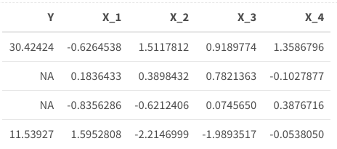
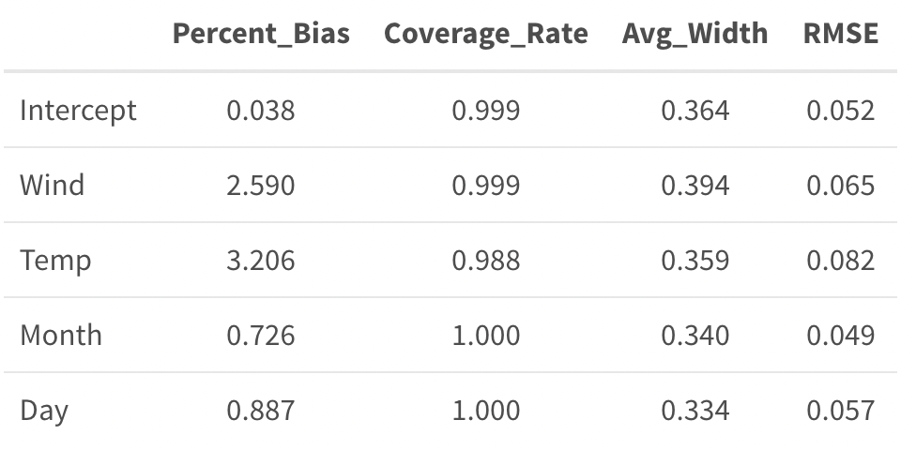
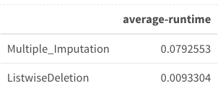
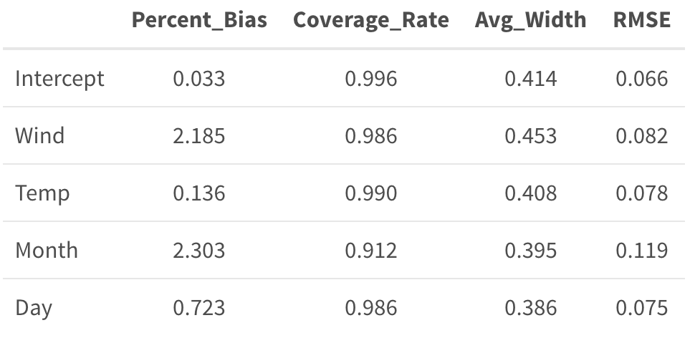
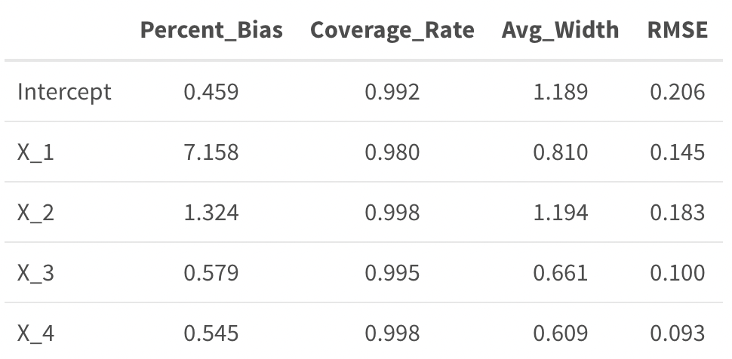
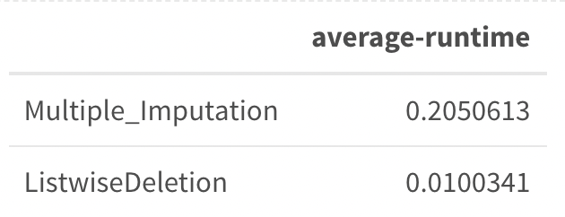
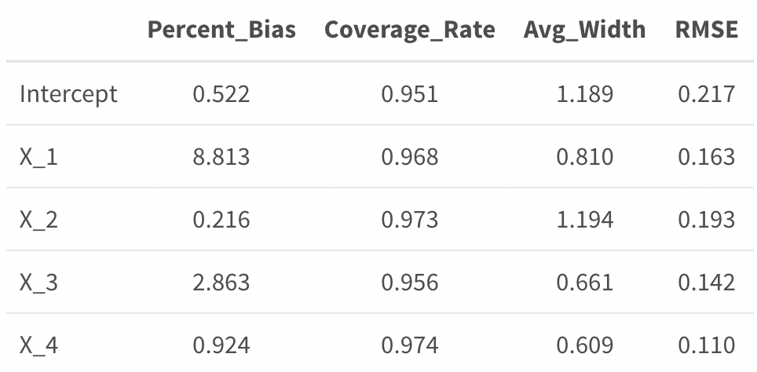
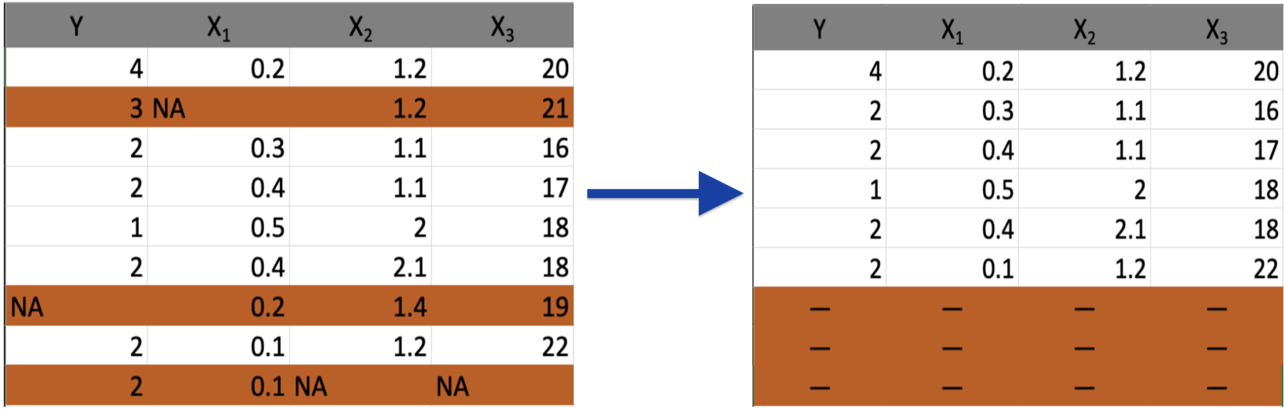
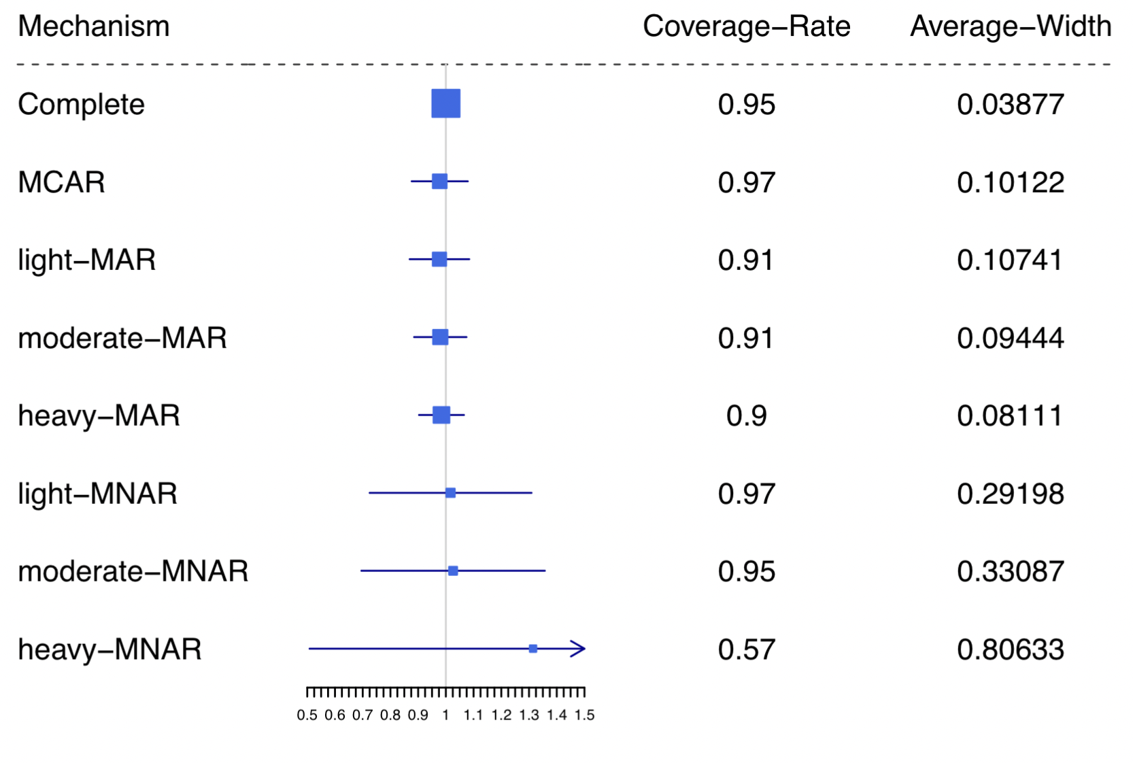
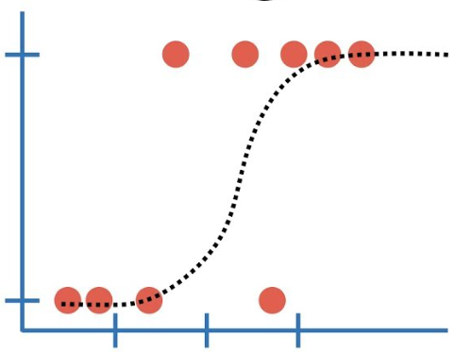
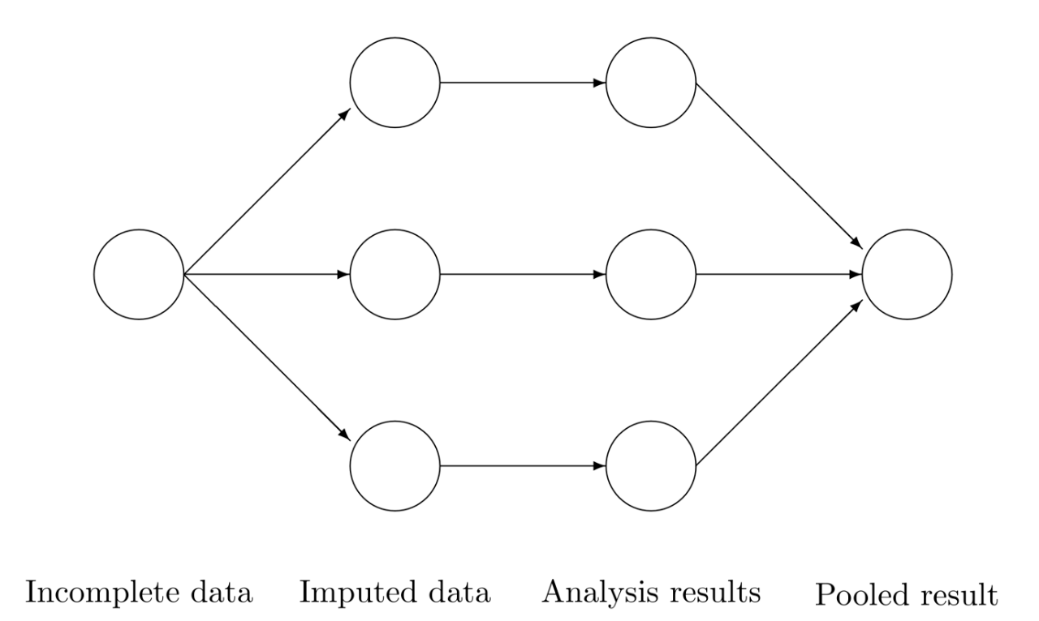
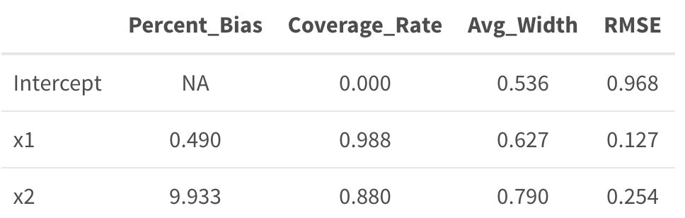
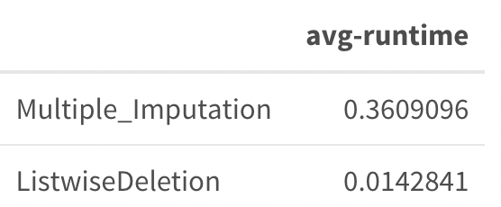
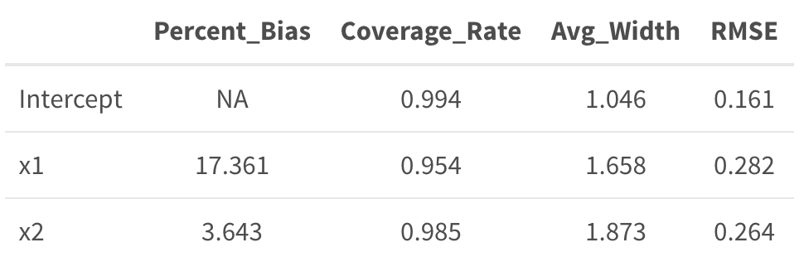


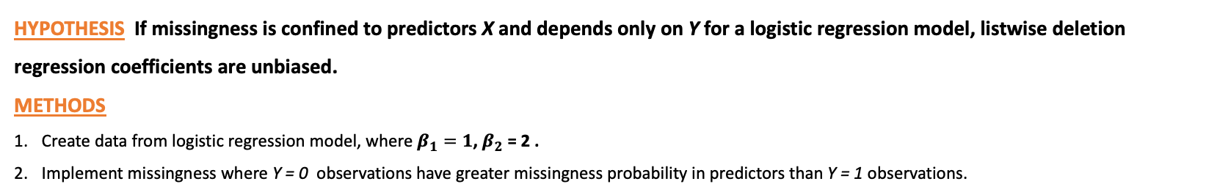
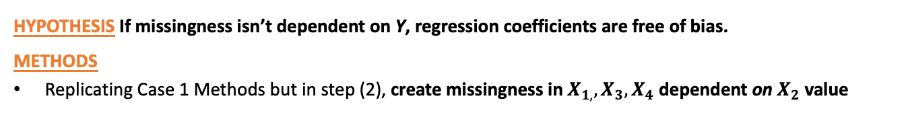
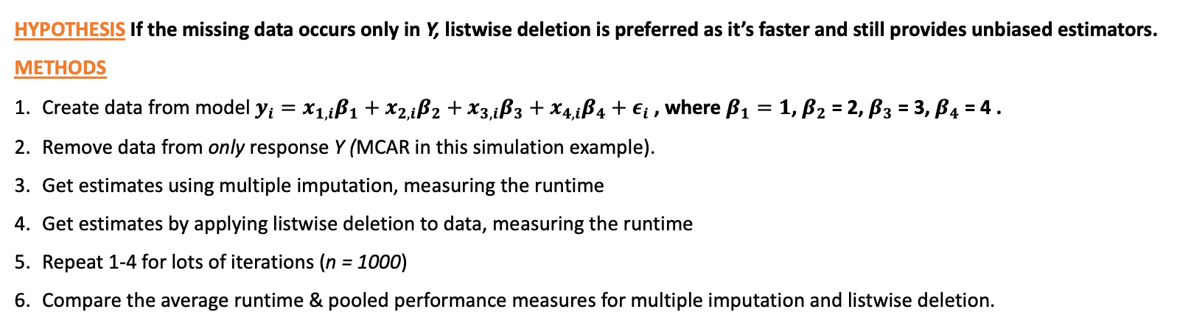
Effects of missing data on statistical analysis
Leo Watson, Nathalie Moon ; Department of Statistical Sciences
Abstract
Investigation (1):
Multiple Imputation under varying degrees of MCAR, MAR, MNAR
Investigation (2):
When Listwise Deletion Outperforms Multiple Imputation
Analyzing missing data mechanisms, modern approaches to handling missing data. Designing R simulations to investigate hypotheses about imputation techniques.
Case 1: Missing Data only in Response Y
OBJECTIVE
HYPOTHESIS If the missing data occurs only in Y, listwise deletion is preferred as it’s faster and still provides unbiased estimators.
METHODS
Create data from model $y_{i}=x_{1,i}β_{1}+x_{2,i}β_{2}+x_{3,i}β_{3}+x_{4,i}β_{4}+ε_{i}$ , where $β_{1}=1$, $β_{2}$ = 2, $β_{3}$ = 3, $β_{4}$ = 4 .
Remove data from only response Y (MCAR in this simulation example).
Get estimates using multiple imputation, measuring the runtime
Get estimates by applying listwise deletion to data, measuring the runtime
Repeat 1-4 for lots of iterations (n = 1000)
Compare the average runtime & pooled performance measures for multiple imputation and listwise deletion.
Introduction
Compare the effectiveness of multiple imputation under different missingness mechanisms.
METHODS
MOTIVATIONS
Designed R simulations for each of MCAR, MAR, MNAR. Each simulation consists of
Creating data from a complete data model (specified to the right)
Removing some of it (how it’s removed depends on the mechanism),
Create multiple ‘copies’ of the data, imputing plausible values in each to make them complete
For each copy in (3.):
Obtain estimate and 95% confidence interval for $β_{1}=1$
Measure the performance and statistical validity of the newly minted dataset
Pool estimates from step 4b
Repeat steps 1-5 many times (e.g. n = 1000) and calculate estimate, bias, etc.
Complete Data Models:
MCAR: $y_{i}=x_{i}β_{1,}+ε_{i}$
MAR: $y_{i}=x_{1,i}β_{1}+x_{2,i}β_{2}+ε_{i}$
MNAR: $y_{i}=x_{i}β_{1,}+ε_{i}$
Missing data arises everywhere in the real world but often troublesome & swept under the rug.
Standard statistical analysis methods usually assume no missing data — gap between reality & common practice
Look into modern imputation techniques & their pros/cons
Specifically, runtime and how to optimize it without sacrificing bias, error, and other performance measures.
DEFINITIONS
Listwise Deletion
Multiple Imputation
Missing Data Mechanisms
MCAR: Probability of missingness for data points in a dataset is constant.
Each student’s mark is stored in a spreadsheet but following a computer update 10% of the data is deleted at random.
RESULTS
MAR: Probability of missingness is dependent on some observed variable of the dataset.
Most students joined a class from day 1, but some students joined late from the waitlist. 10% of students who joined on time missed submitting the first problem set, while 30% of late students missed the first problem set.
 | Estimate | Percent Bias | Coverage Rate | Average Width (of 95% CI)
MCAR | 0.9779 | 2.209 | 0.97 | 0.102
MAR-light | 0.9768 | 2.315 | 0.91 | 0.108
MAR-moderate | 0.9799 | 2.011 | 0.91 | 0.095
MAR-heavy | 0.9841 | 1.588 | 0.90 | 0.082
MNAR-light | 1.0174 | 1.740 | 0.96 | 0.306
MNAR-moderate | 1.0262 | 2.615 | 0.95 | 0.331
MNAR-heavy | 1.3146 | 31.463 | 0.57 | 0.806
Case 2: Missing Data independent of response Y
MNAR: Probability of missingness dependent on true value of the data point.
• Due to a system failure, the instructor loses all the students’ marks. The instructor requests the students to calculate and share their final marks to the instructor. If they don’t, the instructor will input that they got a B.
– If a student’s true mark is an A, they are 90% likely to state their true mark.
– If a student’s true mark is a C, they are 50% likely to state their true mark.
HYPOTHESIS If missingness isn’t dependent on Y, regression coefficients are free of bias.
METHODS
Replicating Case 1 Methods but in step (2), create missingness in $X_{1,}, X_{3}, X_{4}$ dependent on $X_{2}$ value
Listwise Deletion
Multiple Imputation
(A few) Imputation Techniques
Listwise Deletion: (Complete Case Analysis) Eliminates all observations containing ANY missing values in variables of interest
Case 3: Logistic regression model & probability to be missing depends only on Y
Narrower intervals that achieve a coverage rate as close as possible to 1 are preferred
HYPOTHESIS If missingness is confined to predictors X and depends only on Y for a logistic regression model, listwise deletion regression coefficients are unbiased.
METHODS
Create data from logistic regression model, where $β_{1}=1$, $β_{2}$ = 2 .
Implement missingness where Y = 0 observations have greater missingness probability in predictors than Y = 1 observations.
Listwise Deletion
Multiple Imputation
Multiple Imputation:
Takes incomplete dataset and creates multiple copies of it.
Impute incomplete columns with plausible values through an iterative predictive method for each copy
Obtain estimate for parameter of interest for each copy
Pool estimators together to create a single pooled estimate.
DISCUSSION
Depending on the missingness mechanism, the quality of your imputations will vary significantly.
Bias & average confidence interval width tended to increase as the mechanism’s severity increased.
Although multiple imputation under MAR had the lowest average coverage rate, once we consider how MNAR had much larger confidence intervals, it is clear that estimation is most impacted by MNAR mechanisms.
DISCUSSION
In each of the situations above, listwise deletion is orders of magnitude faster and provides unbiased estimates of regression coefficients.
If in doubt, multiple imputation for your dataset is the safest approach
There are far more imputation methods than just the two discussed here; it is vital to deliberately consider which imputation method is best for your dataset when performing statistical analyses.
 | Runtime Ratio (LD/MI)
Case 1 | ~10x faster
Case 2 | ~20x faster
Case 3 | ~35x faster
Notes:
5

