Slide 1
4S(3stupid and 1smart)
Simulating a toy model:
1D Random sequential absorption process
#6 清華大學 洪偉翔
精誠高中 張仁瑀
中興大學 張萬冠
元智大學 林琪芬

Slide 2
Outline
Random sequential absorption (RSA) model
Comparison b/w different random number generators
Configurable single-step site dependent absorption model
Future work
Notes:
C operator is relevant configuration
Comparing of configuration adsorption capacity to find out an Optimal configuration
Metal cost saving, configuration can be controlled

Slide 3
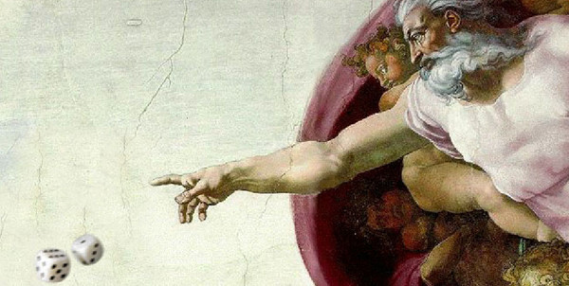

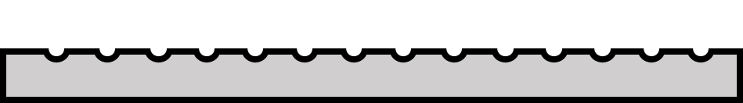
RSA model
Three ways to generate random number:
classical uniform distribution
Hadmard random number
quantum random walk

Slide 4
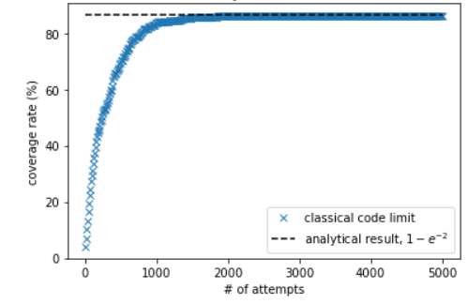
Verification
Our Algorithm
Analytical Value
0.86
0.86466

Slide 5
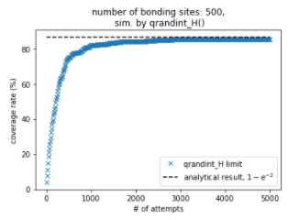
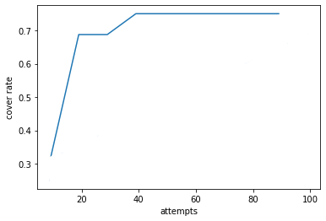
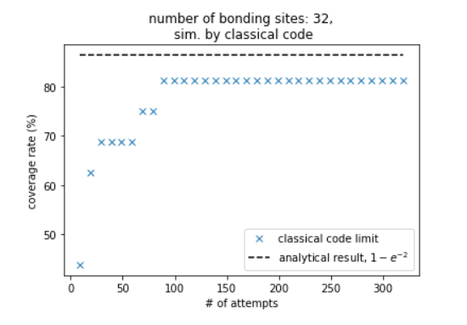
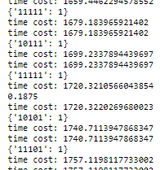




classical | quantum random walk | Hadamard random number
 |  | time cost= 0.02s circuit depth = 5
# sites = 500
# sites = 32
# sites = 32
time cost=20s
circuit depth > 300
time cost < 0.020s

Slide 6
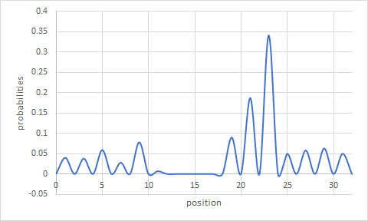
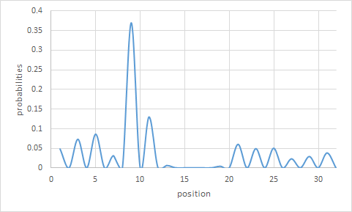

coin initial value = X
Configurable single-step site dependent absorption model
coin initial value = Z
Theoretical model
coverage rate (H)
Theoretical model
coverage rate (Z)
Notes:
site dependent bonding failure rate

Slide 7
Why using quantum walk to implement our dice?

Slide 8
Future Work
‹#›
use IBM transpiler to reduce circuit depth
Hardware limit - Expanding Sample size
2D Random Sequential Adsorption process - develop 2D quantum walk
Apply to CO2 absorption to help battle against global warming

Slide 9
References
MATTHEW P. CLAY AND NANDOR J. SIMANYI ,
RENYI’S PARKING PROBLEM REVISITED
,Mon, 29 Dec 2014
Haiying He,1* Christopher Morrissey,1 Larry A. Curtiss2 and Peter Zapol2,
Graphene Supported Monometallic and Bimetallic Dimers for Electrochemical CO2 Reduction,
November 26, 2018

Slide 10
Thanks for Listening

