Slide 1
Quantum Walk On Circular Graphs with Search Algorithms

Slide 2
Future prospects
1. Examples of applying to real-life examples
Mapping of enzymes. To understand the evolution of enzymes when exposed to mutagens. Only 33 nodes are required for this problem, these nodes can be mapped to 7 qubit circuits.
2. Examples of applying physical materials
In the case of electron movement in graphene, it is necessary to design three direction of quantum random walk mode, and use quantum walk to understand the electron transfer situation of graphite.

Slide 3
Future prospects
3. Design a new type of quantum walking circuit to perform quantum walking with different patterns.
4.Try to use three-dimensional quantum random walk to simulate Brownian motion.

Slide 4
Research Purpose
1. Explore the impact of different coins to the distribution of quantum walks.
2.Establish a fair quantum coin and judge.
3.Explore the feasibility of realizing quantum walk in multi-dimensional space.
4.Build a quantum random walking circuit which can automatically stop.

Slide 5
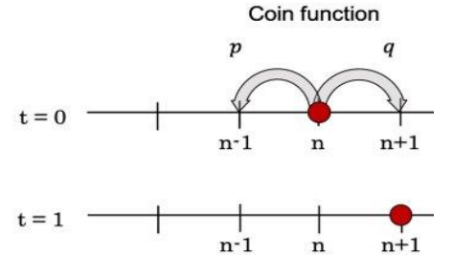
Experimental design and methods
1. Theoretical explanation
(1)Classical random walk
Mentioned in the paper that stochastic process is a system that experiences fluctuations of opportunity over time System, a random variable {Xt} can be used to describe such a system, where Xt measures the properties of the system of interest at time t. Random walk is a special type of random process that is related to mathematical entities, physics and computer science, etc. Field-related, in research, I am interested in comparing the statistical properties and computational applications of discrete random walks (that is, classical random walks with discrete time steps in discrete space) and its quantum mechanics counterparts.

Slide 6
Experimental design and methods
(2)Quantum random walk on the circle
Classical random walks on graphs are very important to the development of random algorithms. Therefore, quantum walks on graphs have become an active field of quantum computing research.

Slide 7
Experimental design and methods
Let G=(V, E) be the d-dimensional graph of | V | = n, and let Hv be the Hilbert space spanned by the state | 𝑣 >, where v∈V. In addition, the size of the coin space HA is defined as d and the coin operator C constitutes the Hilbert Space {| 𝑖> | 𝑖 ∈ {1,... 𝑑}}, as a single transformation in HA, and then mark the edges in each direction with a number between 1 and d so that the edges in each direction Form an arrangement situation.

Slide 8
Experimental design and methods
Now, define the position shift operator S above so that S | 𝑎, 𝑣 >= | 𝑎, 𝑢 >, where u is the a-th neighbor of v (because the edge marker is a permutation, S is positive). Finally, the quantum step on G is defined as 𝑈 𝑠𝑡𝑒𝑝 = movement operator 𝑆 (coin operator 𝐶 ⨂ initial operator 𝐼).

Slide 9
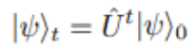
Experimental design and methods
Just like when studying quantum travel, if |𝜓>0 is the initial state of quantum travel, then quantum travel on graph G can be defined as
Before introducing the concept before the quantum phase correction problem, provide an example of quantum walk on the graph: a discrete quantum walk on a loop.

Slide 10
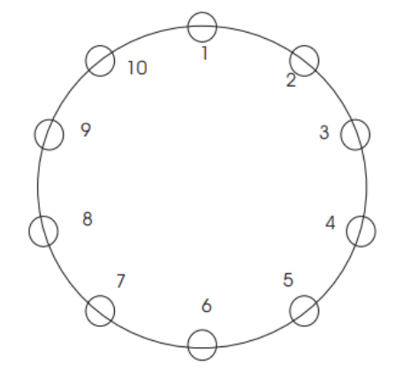
Experimental design and methods
Figure (1) Quantum walk in the loop The loop shown in this figure has 10 vertices.

Slide 11
Experimental design and methods
Example: Discrete quantum walk on the loop
1. The pedestrian is located at a specific point n in the N-dimensional space (N = 1, and the walker walks along a line from point n)
2. Generate a random coin with a custom probability to determine which direction the walker will walk in.
3. The walker moves to the nearest point (n-1) or (n + 1) on the map based on the random coin generated in step 2 (for example, up and down or 0, 1), by adjusting different coins and Converter, looking for fair coins with more symmetrical distribution.

Slide 12
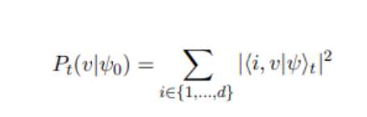
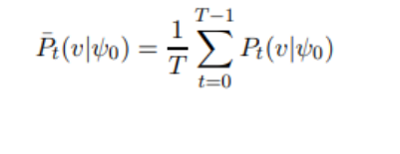
Experimental design and methods
If the probability distributions P0 and P1 at time 0 and 1 are different, it can be proved that the above formula Pt does not converge, and Pt=the following formula

Slide 13
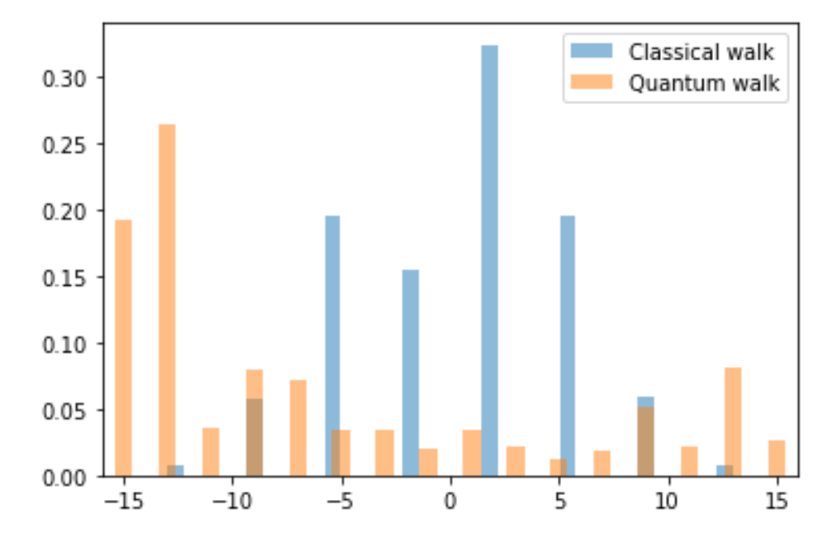
Experimental design and methods
(3)The difference between quantum and classical
It can be seen that the probability of classical random walking is a bell-shaped distribution, while quantum random walking has a tendency to spread to both sides

Slide 14
Experimental design and methods
2. Experimental design
(1) Experimental flowchart
(2) Pretest experiment: Quantum random walking circuit model making

Slide 15
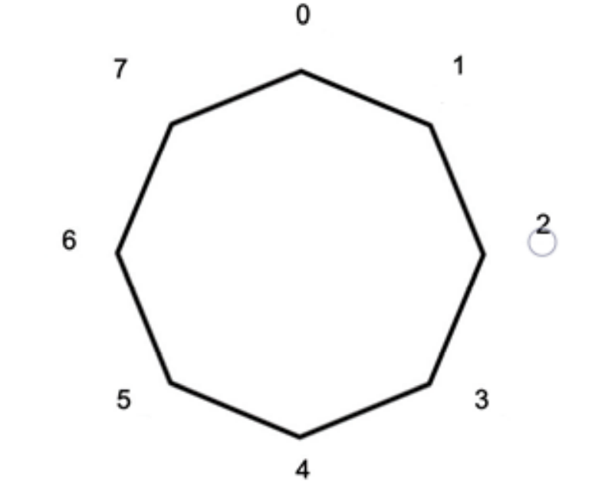
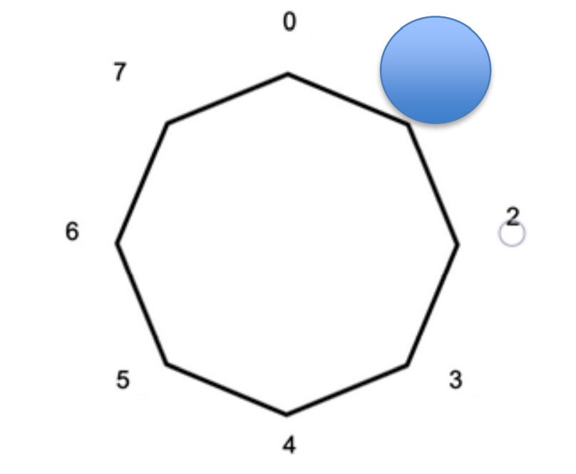
Experimental design and methods
Define circular walk:
1.Classical random walk
Define the initial position as 0. As shown in Figure directly above, you can get 0 after you roll the dice once, then go to the left to 7 and go to the right to 1 when you roll the dice.

Slide 16
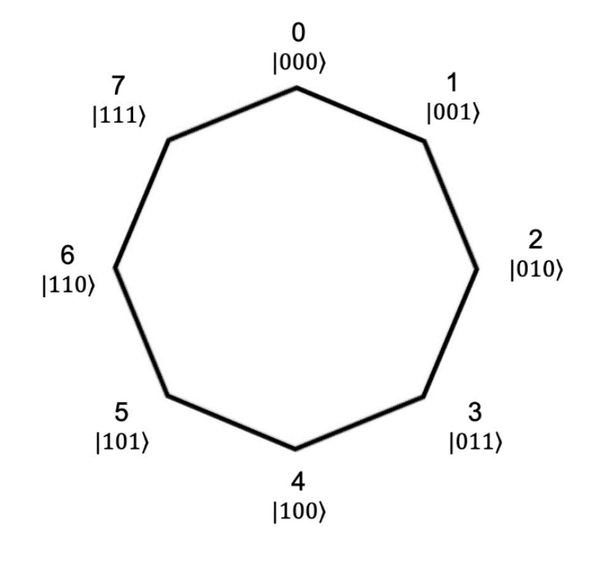
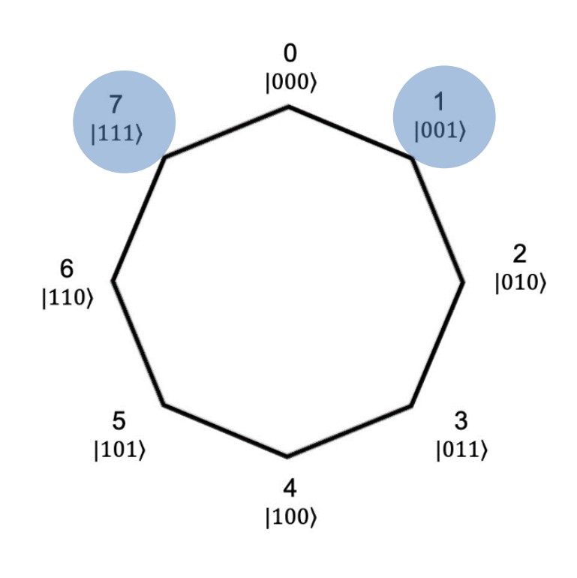
Experimental design and methods
(2)Quantum random walk
Define the initial position as 0, which is the position of the quantum state | 000> as shown in Figure. After the dice is rolled once, it will go left and right at the same time. If you go left, you will reach 7 which is the quantum state | 111> If you go to the right, you will reach 1, which is the position of the quantum state | 001 >, as shown in Figure.

Slide 17






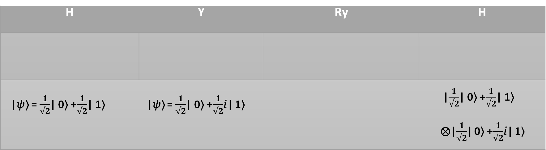
Variable 1: Design Quantum Random Walk of Different Coins
Experimental Design :
→This experiment expects the distribution curve of four gates is
symmetric.
H | Y | Ry | H
1
|𝜓⟩ = $\frac{1}{√2}$| 0⟩ +$\frac{1}{√2}$| 1⟩ | |𝜓⟩ = $\frac{1}{√2}$| 0⟩ +$\frac{1}{√2}$𝑖| 1⟩ |  | |$\frac{1}{√2}$| 0⟩ +$\frac{1}{√2}$| 1⟩ ⨂|$\frac{1}{√2}$| 0⟩ +$\frac{1}{√2}$𝑖| 1⟩
|𝜓⟩ = $\sqrt{0.85}$| 0⟩ $−\sqrt{0.15}$𝑖| 1⟩

Slide 18
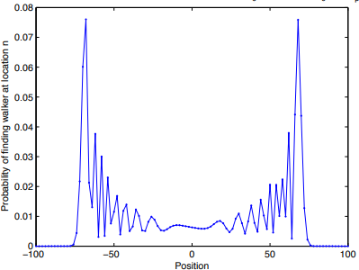
Variable 1: Design Quantum Random Walk of Different Coins
Experimental Purpose : Design the circuit of quantum random walk
by the formula provided by thesis.
Fig. 7: Expected quantum random walk

Slide 19
Experiment 1: Hadamard(H) Gate
Expected Distribution of Quantum Walk: Give that H gate could generate 50% of 0 and 50% of 1 , i.e. the superposition state, hence we expect that we could design a two-faced dice which can decide to turn right or left by using the H gate.

Slide 20
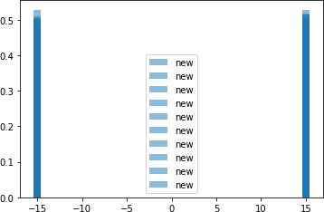
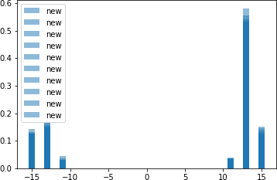
Experiment 1: Hadamard(H) Gate - Results
Step = 1 | Step = 5 | Step = 10
Table 1: The distribution of the dice as walker of H gate
→In order to consider the Error Bar, we do the experiment for ten times, we could observe the distribution of using H gate as dice is not symmetric diffusion as the experiment anticipated.

Slide 21
Experiment 2: Y Gate
Reason of Designing: The thesis indicates that H gate is not a fair dice, the reason may be the emergence of the phase and the generation of destructive and constructive interference; therefore, according to the conditions given by the thesis, we designed a new Y gate.

Slide 22
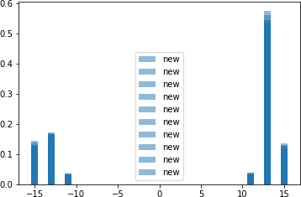
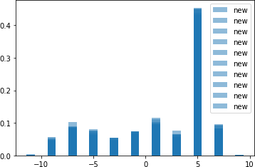
Experiment 2: Y Gate - Results
Step = 1 | Step = 5 | Step = 10
Table 2: The distribution of the dice as walker of Y gate
→From the above chart , we could observe the distribution of using Y gate given by the thesis as dice is not symmetric diffusion after we considered Error Bar.

Slide 23
Experiment 3: Ry Gate
Reasons of Designing: In addition to the Y gate in the thesis, we think we still have room for improvement to ameliorate the dice, hence we designed a new Ry gate in this experiment.

Slide 24
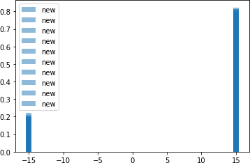
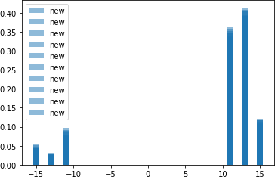
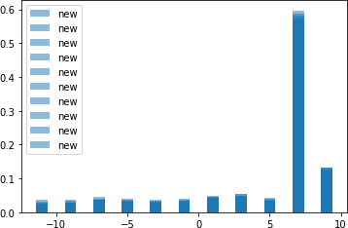
Experiment 3: Ry Gate - Results
Step = 1 | Step = 5 | Step = 10
Table 3: The distribution of the dice as walker of Ry gate
→From the above chart , we could observe the distribution of using Ry gate given by the thesis as dice is not symmetric diffusion after we considered Error Bar.

Slide 25
Experiment 4: Revise Initial Value
Reasons of Designing: Because the thesis indicates that the dice shifts owing to the phase interference, thus we would like to do the phase correction to the H gate directly.

Slide 26
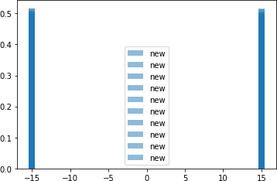
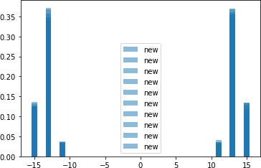
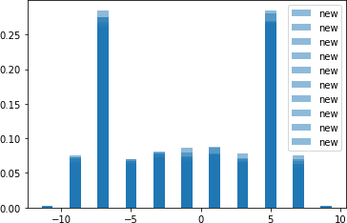
Experiment 4: Revise Initial Value - Results
Step = 1 | Step = 5 | Step = 10
Table 4: The distribution of the walker of revising H dice

Slide 27
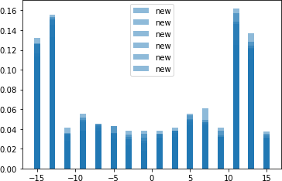
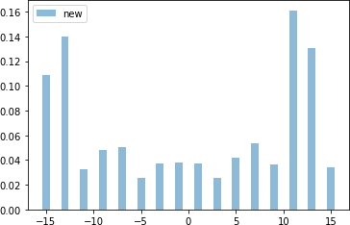
Experiment 4: Revise Initial Value - Results
Fig.15: Run the circuit of Experiment 4 for 6 times , Step =20
Fig.16: Run the circuit of Experiment 4 for 1 time , Step =20
→Complete the Error Bar from the results of Experiment 4, we could observe the distribution of position after 10 steps is nearly symmetric.

Slide 28
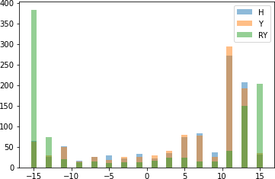
Variable 1 – Comprehensive Results
→From Variable 1, we could know that changing the initial value of coins operator of quantum random walk could increase the symmetry efficiently.

Slide 29
Variable 2: Simulate Quantum Random Walk By Matrix Multiplication
Experimental Design : Simulate quantum random walk by matrix multiplication
Experimental Purpose : To find the difference between matrix calculation and quantum impulse control

Slide 30
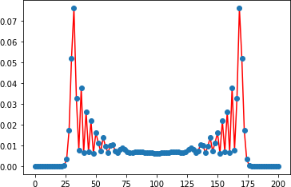
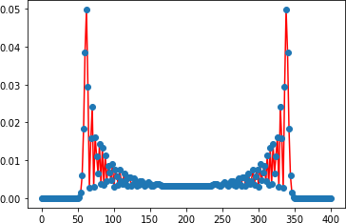
Variable 2 - Results
Fig.18: Calculate the Quantum Walk by Matrix Multiplication , Step = 100
Fig.19: Calculate the Quantum Walk by Matrix Multiplication , Step = 200
→From Variable 2, we could know that it is symmetric diffusion by using matrix multiplication, and it also proves that discrete quantum walk is symmetric, not inclining to one side.

Slide 31
Variable 3:Distribution of Higher Dimensional Quantum Random Walk
Experimental Design : Expand the applicability to 2D- and 3D-space
Experimental Purpose : To find the randomness in higher dimensional space by round quantum walk
2D-Quantum Random Walk
First, we must define the Qubits represent x-axis and y-axis. So we define x, y being the information register of x-direction and y-direction, respectively

Slide 32
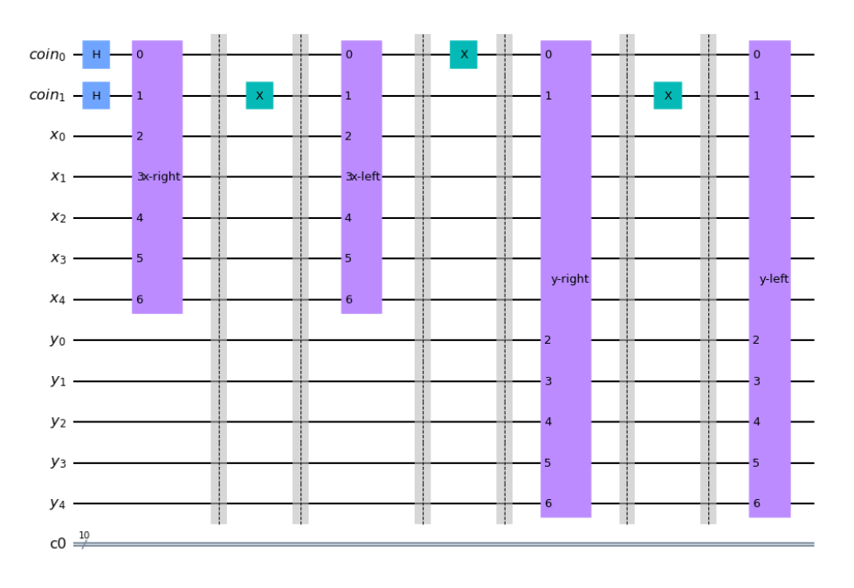
2D Quantum Random Walk
coin0 is the dimension detector, → walker goes along y-axis when qubit 0 is 0 → walker goes along x-axis when qubit 0 is 1
coin1 is for turning direction, after the decision of coin0, we know which direction we are going, and distinguish whether going left or right by coin1
X Qubits is the register for x-axis position
Y Qubits is the register for y-axis position
Fig. 8: 2D-quantum random walk circuit

Slide 33
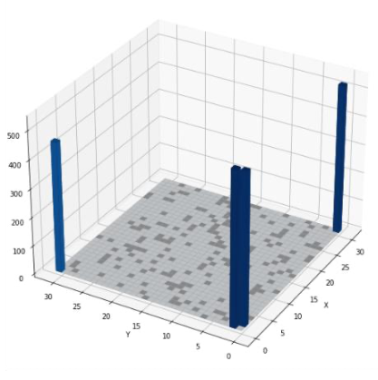
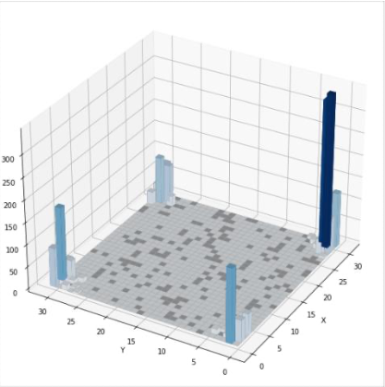
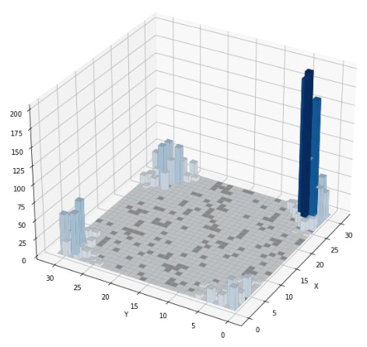
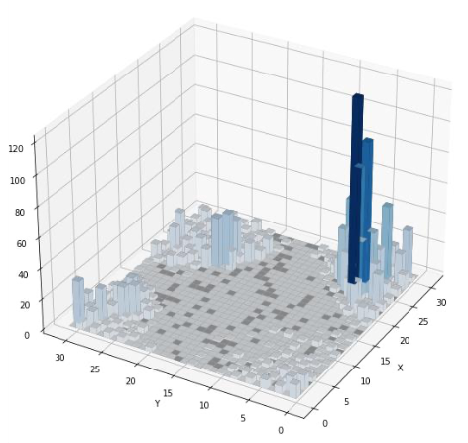
Results
Step = 1 | Step = 5
Step = 10 | Step = 20
H gate 2D probability distribution
→ from data in Table 5, we know that the dice made of H gate in 2D-space also do not have symmetry
Table 5: H coin 2D-quantum random walk

Slide 34
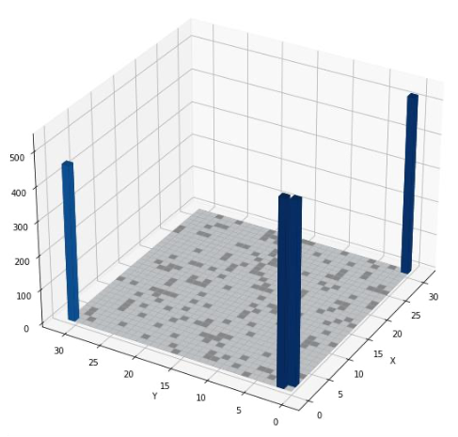
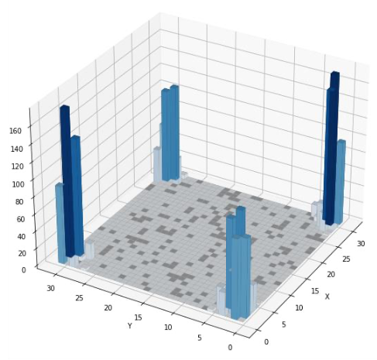
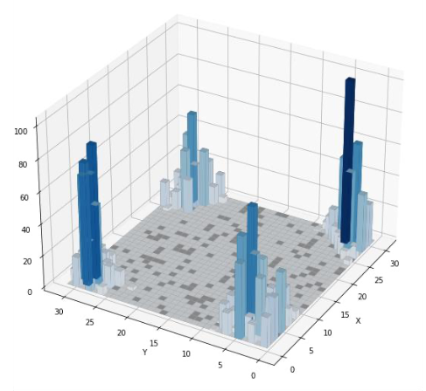
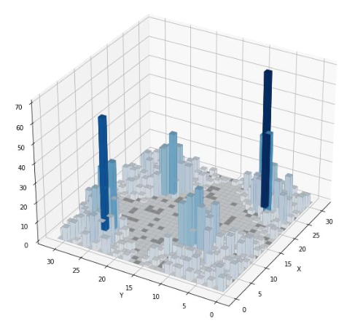
Results: Changing initial value
Step = 1 | Step = 5
Step = 10 | Step = 20
→ from data in Table 6, we know that the dice made of H gate in 2D-space after changing initial value have symmetry
Table 6: H coin 2D-quantum random walk
after changing initial value

Slide 35
Variable 4:Perform quantum random walk on the real machine “ibmq_casablanca”
Because the superconducting quantum computer in IBM has larger deviation, so we assume the walking property may not appear

Slide 36
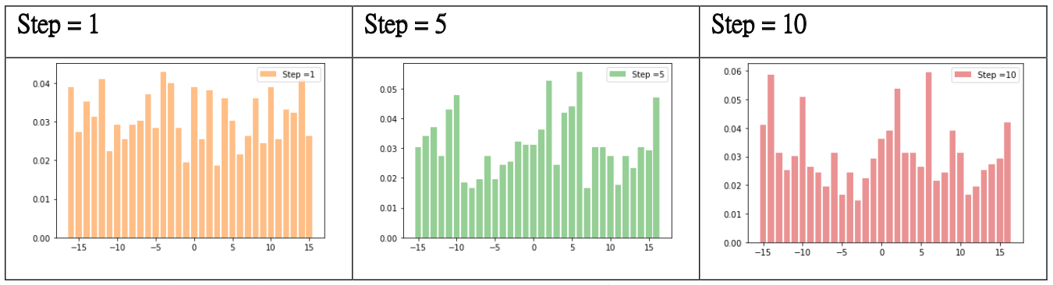
1D Results
Use H gate which can generate even superposition states as coin to perform 1D-quantum random walk
Table 7: Simulating H coin quantum random walk on a real quantum computer
→ Could not observe the expected properties on the real quantum computer, instead, all states appeared

Slide 37
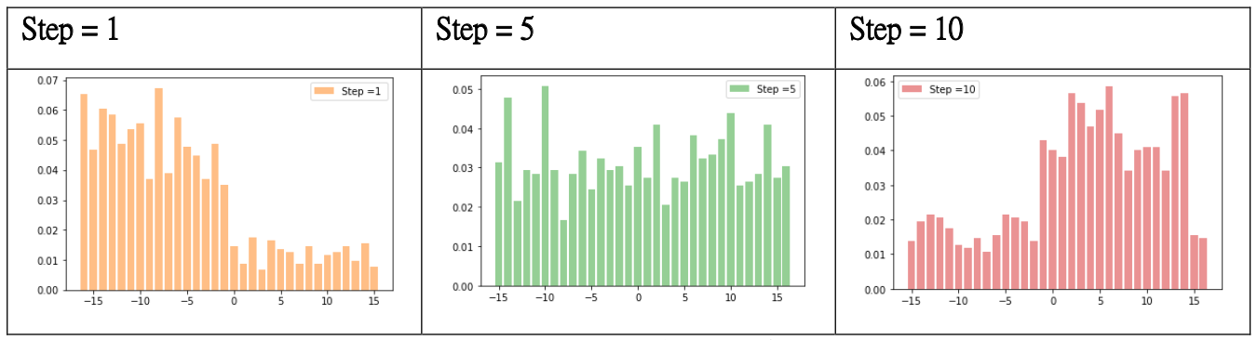
1D Results: Changing initial value
Use Variable 1-Exp. 4:Changing initial value as coin to perform 1D-quantum random walk
Table 8: Simulating H coin quantum random walk with revised initial value on a real quantum computer

Slide 38
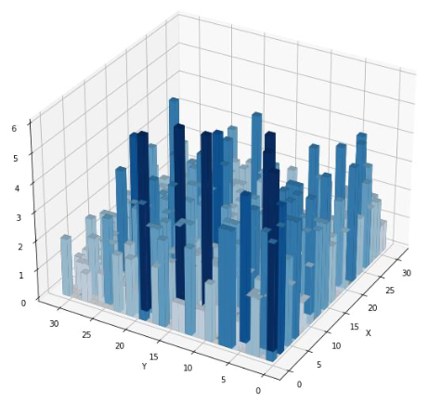
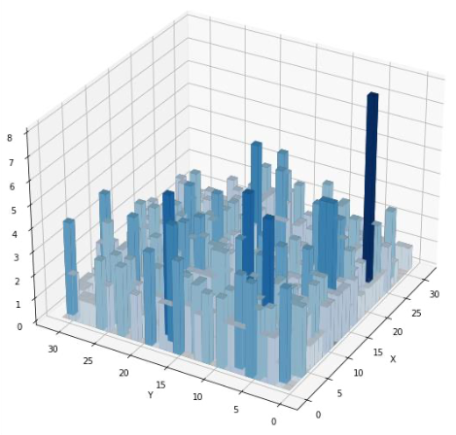
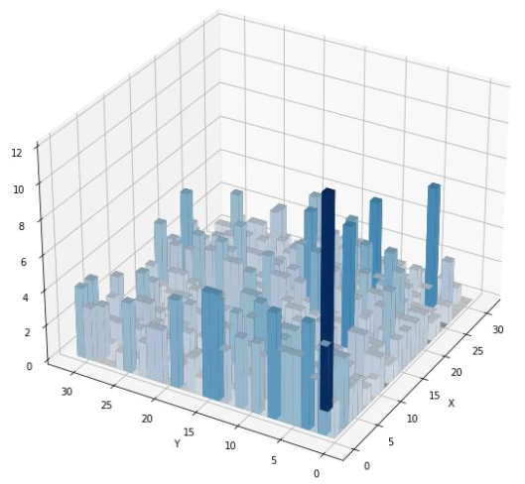
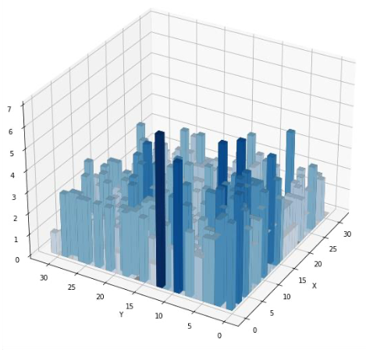
2D Results
Step = 1 | Step = 5
Step = 10 | Step = 20
Use H gate which can generate even superposition states as coin to perform 2D-quantum random walk
Table 9: H coin 2D-quantum random walk
perform on a real quantum computer

Slide 39
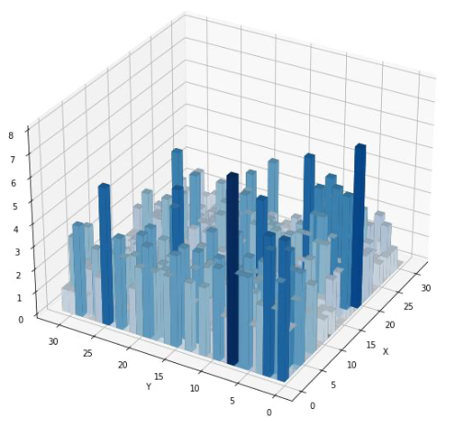
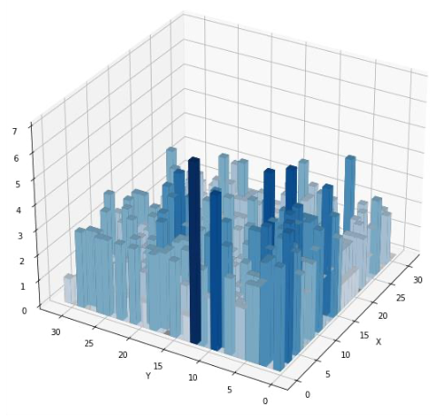
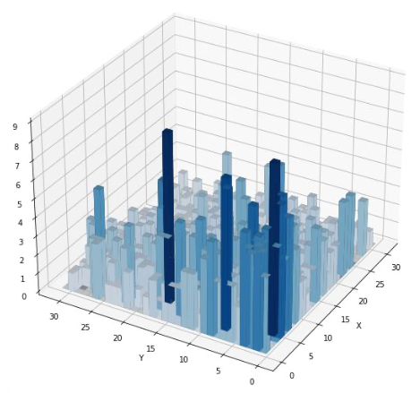
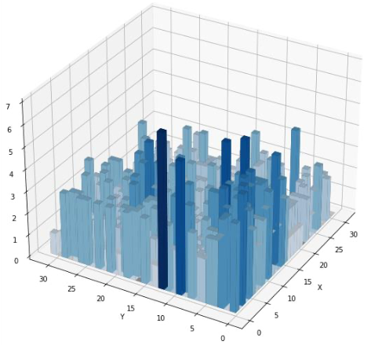
2D Results: Changing initial value
Step = 1 | Step = 5
Step = 10 | Step = 20
Use Variable 1-Exp. 4:Changing initial value as coin to perform 2D-quantum random walk
Table 10: H coin 2D-quantum random walk
with revised initial value, performed on a real quantum computer

Slide 40
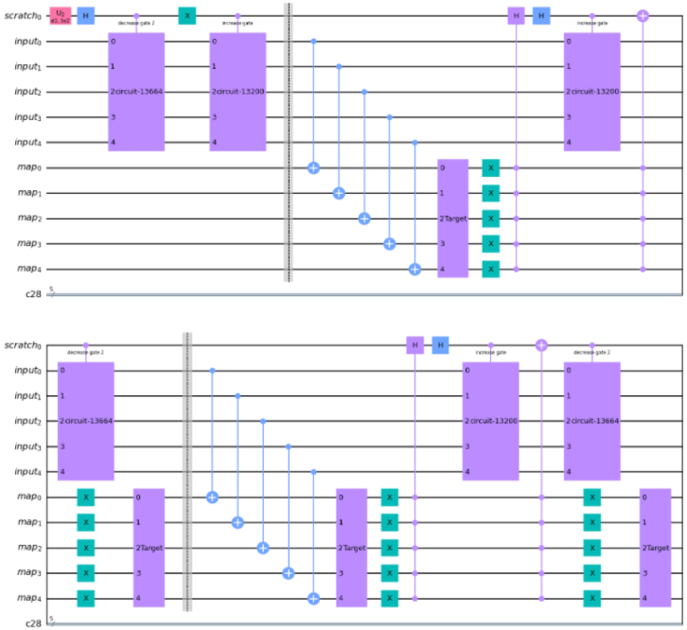
Variable 5: Making quantum random walk circuit for searching a specific target
Fig. 9: 1D-quantum random walk searching circuit

Slide 41
coin1 is for turning direction, determines whether it goes left or right
input Qubits are registers for walker’s position
map Qubits are position searching qubits
2 circuit-13664 is for left turning
2 circuit-13200 is for right turning
CX Gate groups record the position down to map Qubits
Target Gate is the searching target
Multi-control H Gates for canceling the superposition of coins
Multi-control X Gates for canceling the function of 2 circuit-13200 (right-turn)
→ Circuit will not do any operation after found the target
Fig. 9: 1D-quantum random walk searching circuit

Slide 42
Results: Design a Quantum random walk searching algorithm
Classical Walk Searching Algo.
Quantum Searching Algo. : Ry(29𝜋/100)
 | Roll Number for Searching Target | Probability
11011 | 4/6 | 0.0615 / 0.09485
00111 | 7/9 | 0.0083 / 0.0186
01100 | 12/14 | 0.0015 / 0.001
 | Roll Number for Searching Target | Probability
11011 | 5/7 | 0.028 / 0.202
00111 | 4/6 | 0.066 / 0.284
01100 | 6/8 | 0.017 / 0.145

Slide 43
Initial discussion

Slide 44
1.Why the asymmetry situation occur?
It can be known from the variable factor two that the quantum random walks should be a symmetrical walk, but when using H gate which can produce an average superposition state
The gate performs quantum random walk, and it can be found that the position probability distribution graph is not symmetrical.
The reason is that when we considering quantum behavior, particles have volatility between walking, or more strictly speaking, in quantum mechanics we use wave functions to describe the motion behavior of particles, so quantum behavior has phase destructiveness.

Slide 45
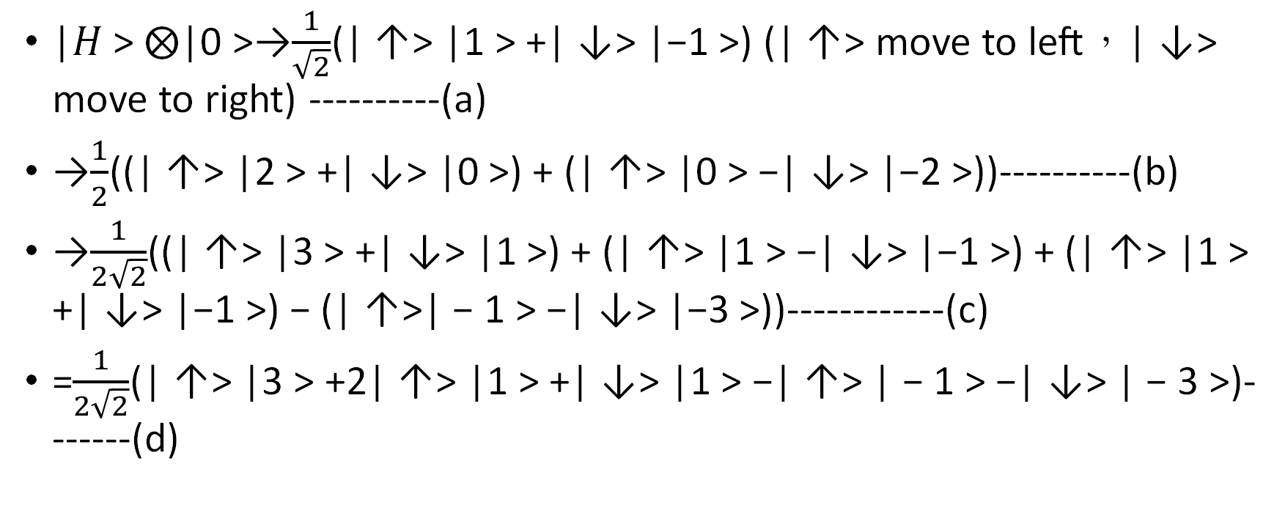
The detailed derivation of the first three steps is as follows:
|𝐻 > ⨂|0 >→$\frac{1}{\sqrt{2}}$(| ↑> |1 > +| ↓> |−1 >) (| ↑> move to left，| ↓> move to right) ----------(a)
→$\frac{1}{2}$((| ↑> |2 > +| ↓> |0 >) + (| ↑> |0 > −| ↓> |−2 >))----------(b)
→$\frac{1}{2\sqrt{2}}$((| ↑> |3 > +| ↓> |1 >) + (| ↑> |1 > −| ↓> |−1 >) + (| ↑> |1 > +| ↓> |−1 >) − (| ↑>| − 1 > −| ↓> |−3 >))------------(c)
=$\frac{1}{2\sqrt{2}}$(| ↑> |3 > +2| ↑> |1 > +| ↓> |1 > −| ↑> | − 1 > −| ↓> | − 3 >)-------(d)

Slide 46
Detail:
(a) represents the result of moving after the first step (first time threw the quantum dice )
(b) represents the result of second step (second time threw the quantum dice )
(c) represents the result of the third step (third time threw the quantum dice )
(d) is the sorting data of (c).

Slide 47
Contact the formula of (c):
The last position appear at 1 may be 2| ↑> |1> +| ↓> |1>, and another last position appears in position -1 may be −| ↑> | − 1 >, so the probability of appearing at 1 is 4/8+1/8=5/8, and the probability of appearing at -1 is 1/8.
Each reason can be known from (c), because the way to 1 and -1 are different in discharge, and the phenomenon is called quantum destructiveness.

Slide 48
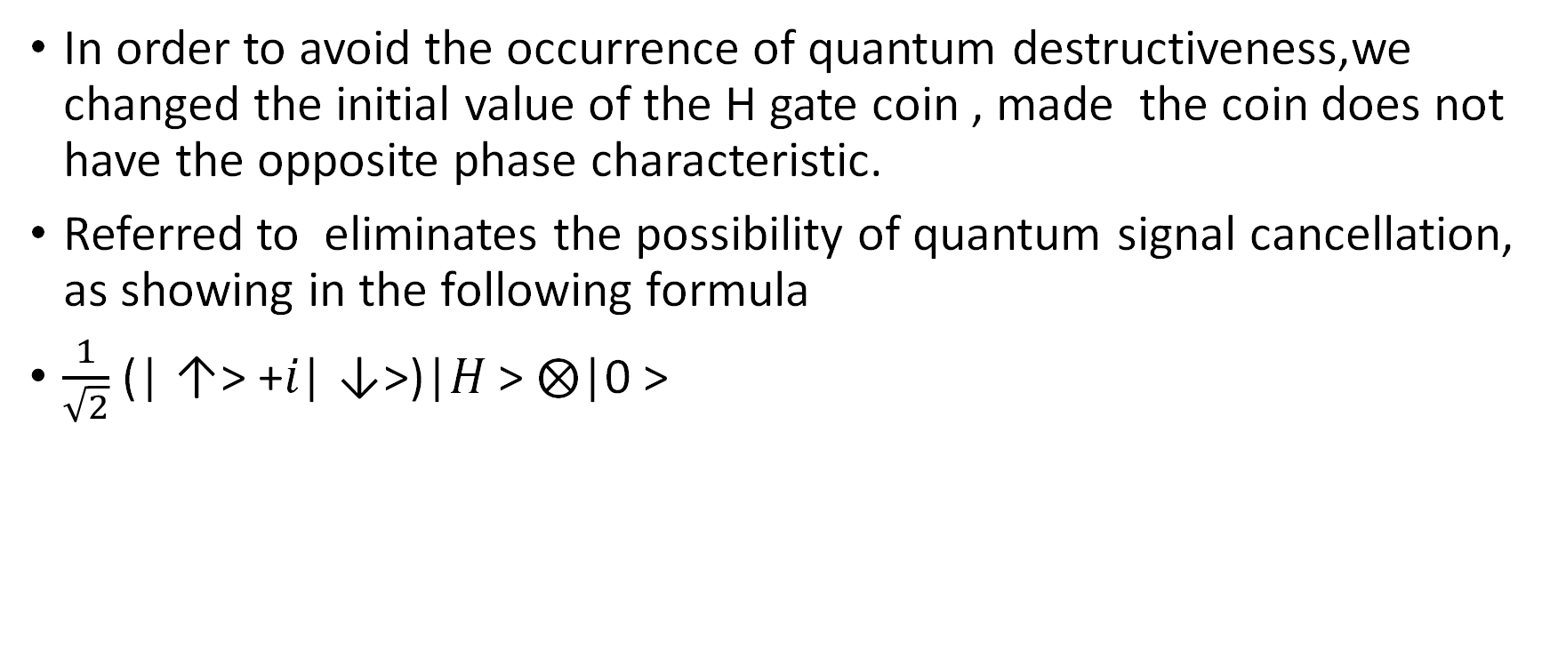
Avoid the occurrence of quantum destructiveness
In order to avoid the occurrence of quantum destructiveness,we changed the initial value of the H gate coin , made the coin does not have the opposite phase characteristic.
Referred to eliminates the possibility of quantum signal cancellation, as showing in the following formula
$\frac{1}{\sqrt{2}}$ (| ↑> +𝑖| ↓>)|𝐻 > ⨂|0 >

Slide 49
Two-dimensional walking
After drawing this experiment successfully made a two-dimensional random walk and showed its outward diffusion characteristics. Among them, the two-dimensional walking does not have symmetry, but has a tendency to walk towards (31, 0), so we used the experiment four in variable one which had the one-dimensional symmetry.
It can be seen from Experiment 4 that when Step = 5, it has the characteristics of spreading around and is symmetrical.
When Step = 20, there is still symmetrical, and its characteristics are preferences (31, 0) and (0, 31)

Slide 50
Two-dimensional walking
Therefore, this experiment successfully achieved a symmetrical quantum walk in two-dimensional quantum.
Table (6) shows that the two-dimensional random walk is spherical random walk, because when the walker walks to the edge.
In the next step there will be a half possibility of returning to the starting point of the ball, and then walking randomly from the starting point of the ball

Slide 51
Comparison between quantum search algorithm and classical
In the variable factor four, we designed a Quantum Walk that can stop automatically, wishing that it can be designed as a quantum walk search method compares the probability of finding the target for the first time. It can be found that when searching for a target close to the initial position,
The classical walking search has a higher probability, and if the target is far from the initial position, it has a higher possibility.

Slide 52
Comparison of simulator and actual quantum computer
It can be seen from Experiment 4 that although the quantum random walk in one-dimensional quantum can successfully display the symmetry characteristics of the quantum walk, shown in Table (4).
But after being executed on the actual quantum computer, not only changed the initial value of H coin symmetrically, shown in Table (1).
Even the basic H gate does not show the distribution characteristics of quantum random walks, as shown in Table (7, 8).

Slide 53
Comparison of simulator and actual quantum computer
It’s same for two-dimensional quantum random walking. It can be seen from Table (6). That successfully executed on the simulator spherical quantum random walk, also known as two-dimensional quantum random walk, but when using an actual quantum computer the distribution of quantum random walk cannot be seen from the data, as shown in Table (5, 6)

Slide 54
Comparison of simulator and actual quantum computer
Therefore, it is speculated that the error value of the quantum computer is relatively large (the main error comes from the initial state, each operation,measurement method, and the main mathematical [physical] form is qubit flip [Decoheren quantum decoherence], quantity sub-phase shift (phase flip) [Dephasing phase decoherence]. Therefore, it is still unable to show the result of the quantum algorithm.
As a result, there won’t be good distribution.

Slide 55
Preliminary Conclusions
1. This experiment successfully designed a quantum random walk with excellent symmetry.
2.This experiment proves that the H gate, which can produce an average superposition state, cannot be designed as a quantum dice, because after dice multiple times, quantum coherence will be generated due to the phase problem, which will affect the walking result.

Slide 56
Preliminary Conclusions
3. This experiment successfully designed two-dimensional quantum random walking, also known as spherical quantum random walking, and got the same trend as one-dimensional walking.
4.The quantum walk is spreading to both sides, and the classical walk is a bell-shaped distribution.

Slide 57
Preliminary Conclusions
5.When the target is closer to the center value, you can use the quantum walk search method to have a greater possibility of finding the target. On the contrary, use the classical method, which can find the center target better because of its bell-shaped distribution characteristics.
6.The current quantum computer has a large error value and still cannot handle multi-bit quantum algorithms.

