Slide 1
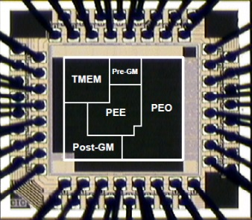
Counter_PLL & Signal Tap
Song-Nien Tang
Department of Information & Computer Engineering
Chung Yuan Christian University
sntang@ice.cycu.edu.tw

Slide 2
Lab. Contents
PLL (Phase Lock Loop)
(Clock Generator)
Top
en
up
dout[7:0]
rst
Counter
50 MHz
40 MHz
Osc.
PLL
Signal Tap
80 MHz
rst_clk
locked

Slide 3
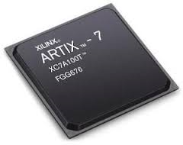
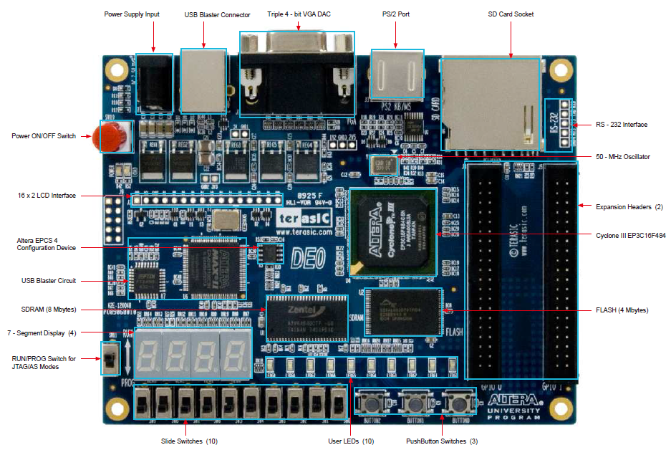
Altera FPGA Evaluation Board
module Top (
dout,
clk_src,
rst_clk,
rst,
en,
up,
locked
);
3
up
en
rst
rst_clk

Slide 4
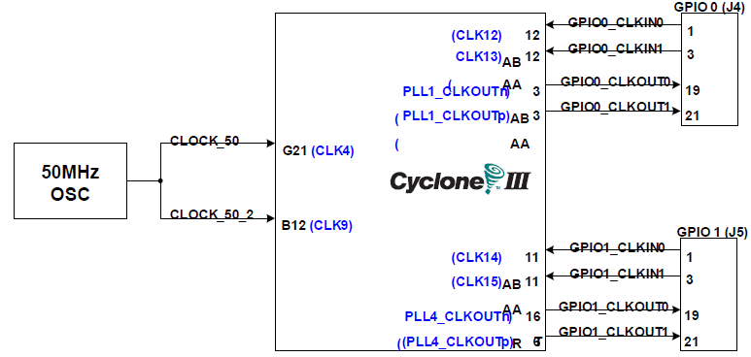

Clock Sources

Slide 5
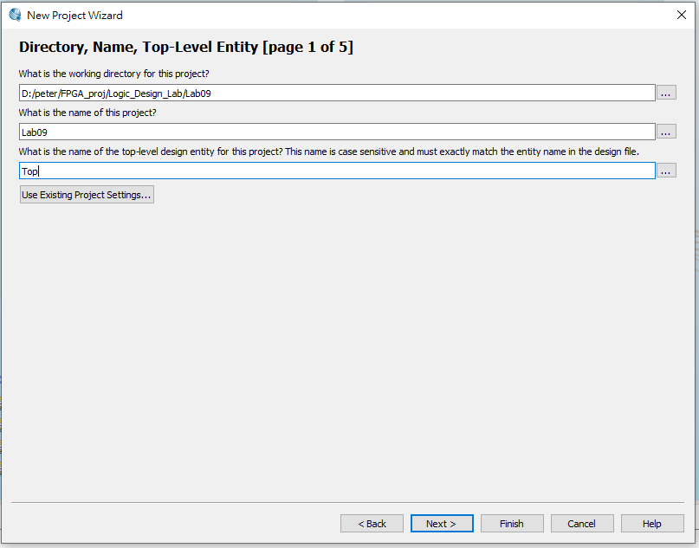
Starting a Project [1]
請開工作目錄”…./Lab_09/” (或其他”非中文”目錄)
Your Design: Counter.v, Top.v (top-level module)

Slide 6
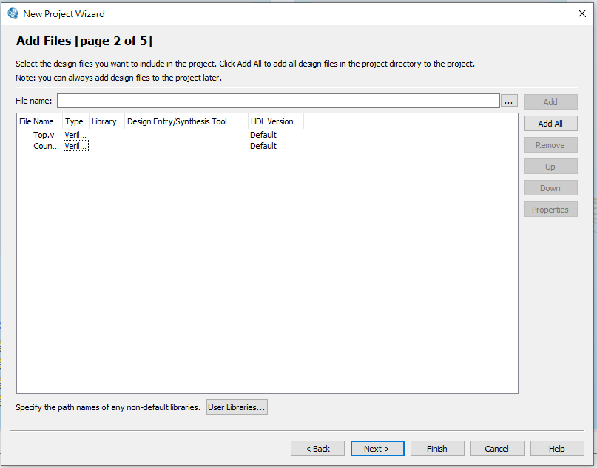
Starting a Project [2]

Slide 7
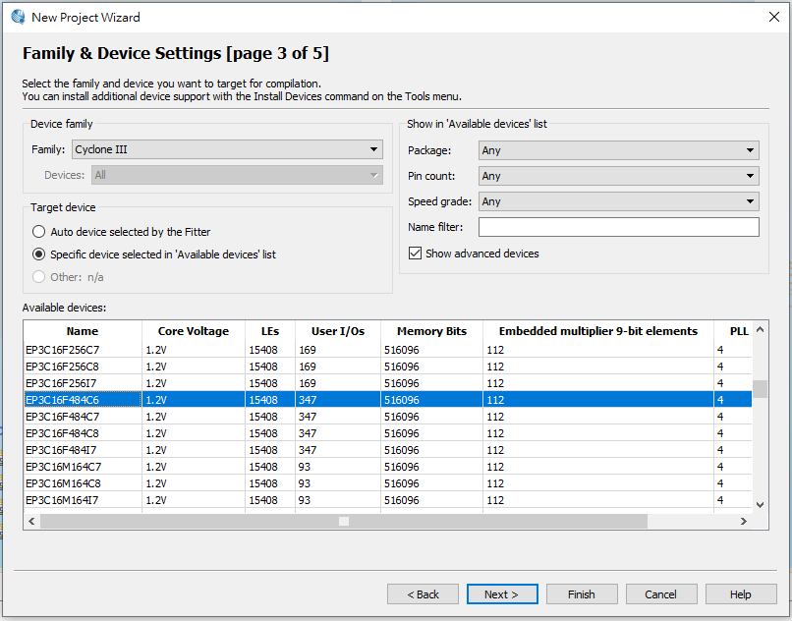

Slide 8
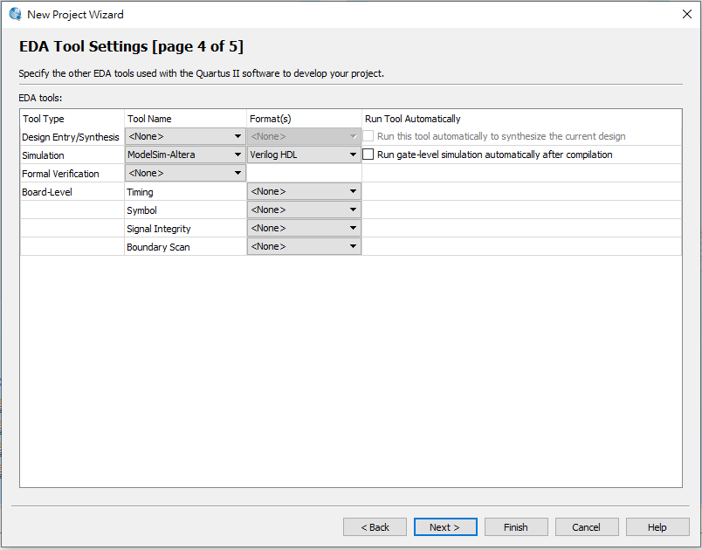

Slide 9
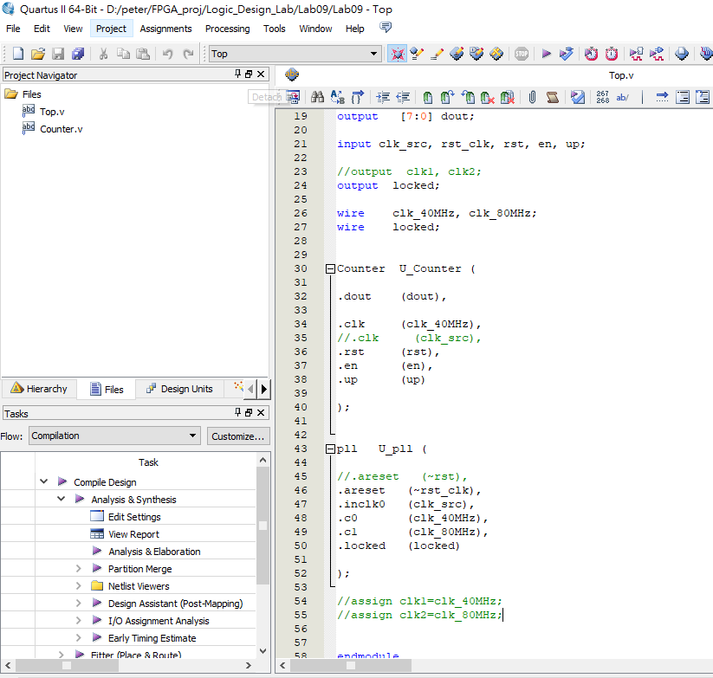

Slide 10
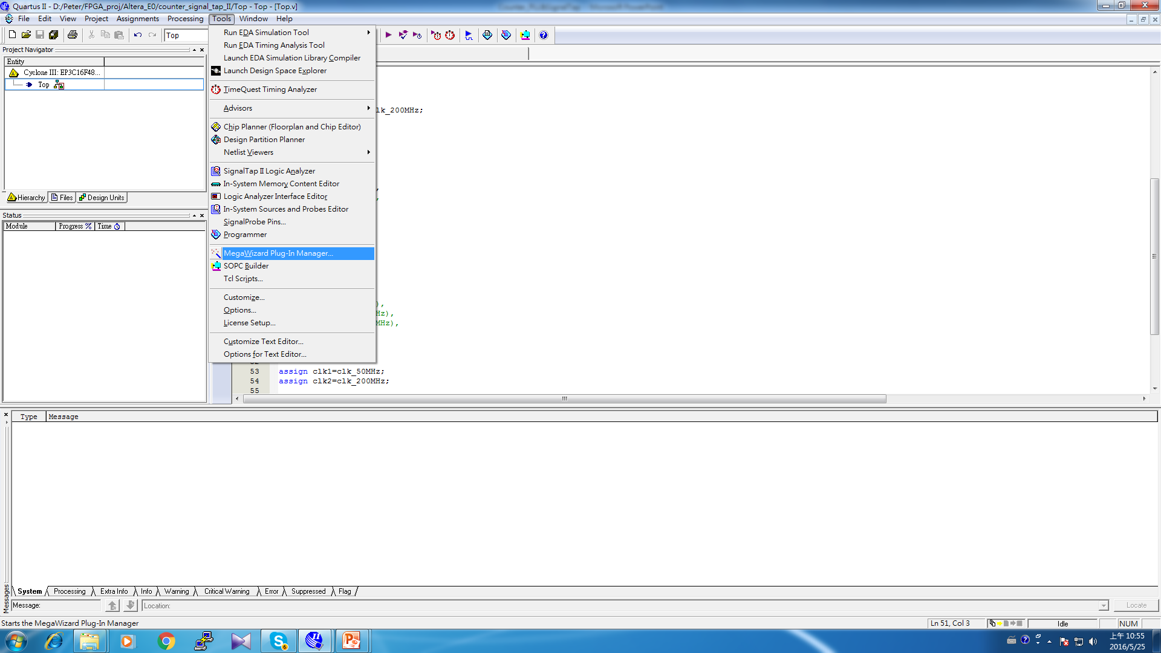
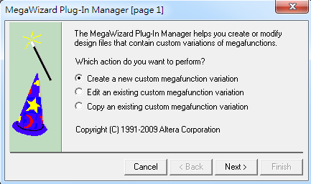
Using PLL (DCM) – clock generator

Slide 11
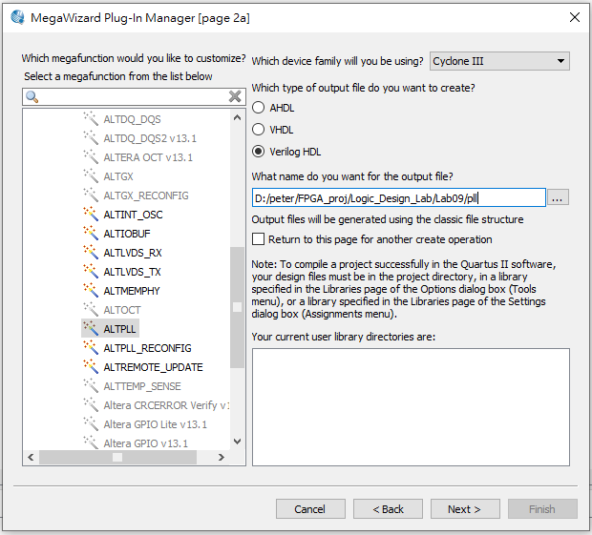
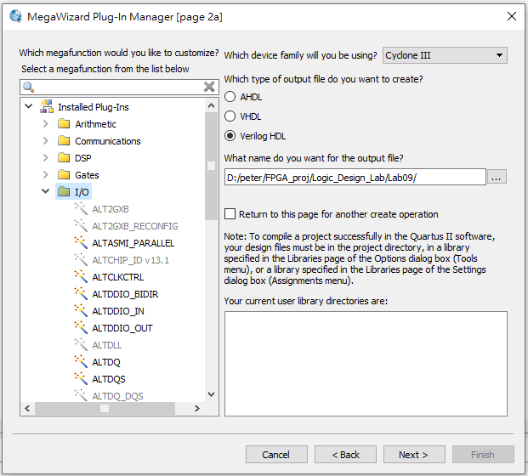
Starting the flow for using PLL IP

Slide 12
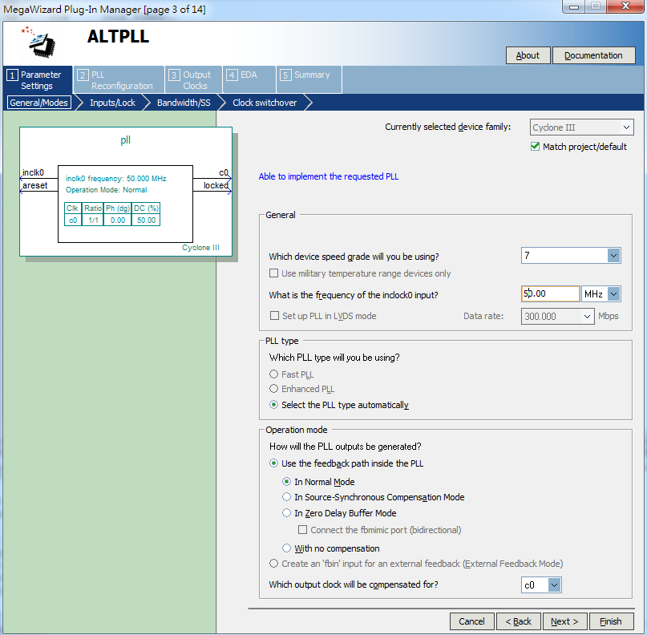

Slide 13
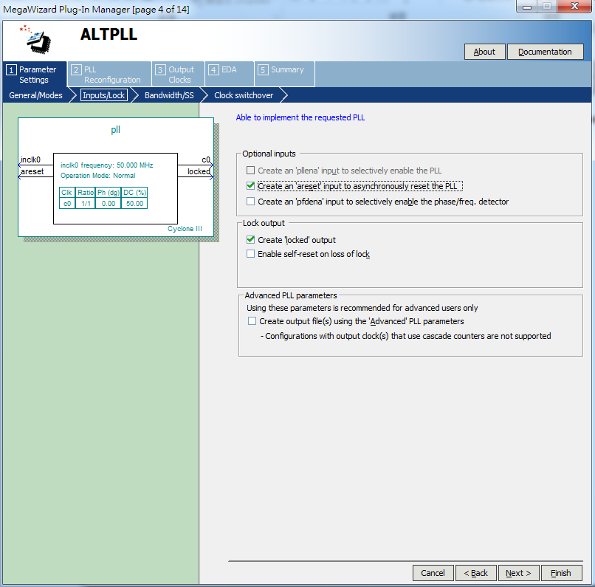

Slide 14
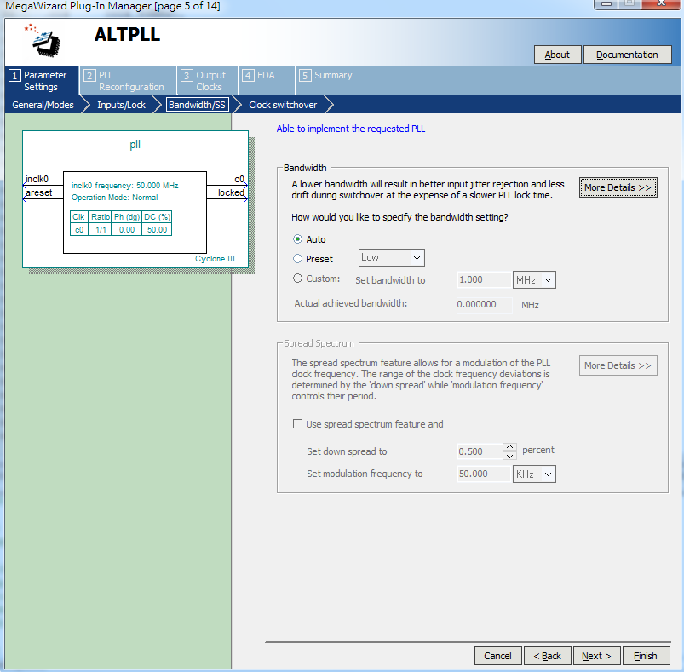
跳過

Slide 15
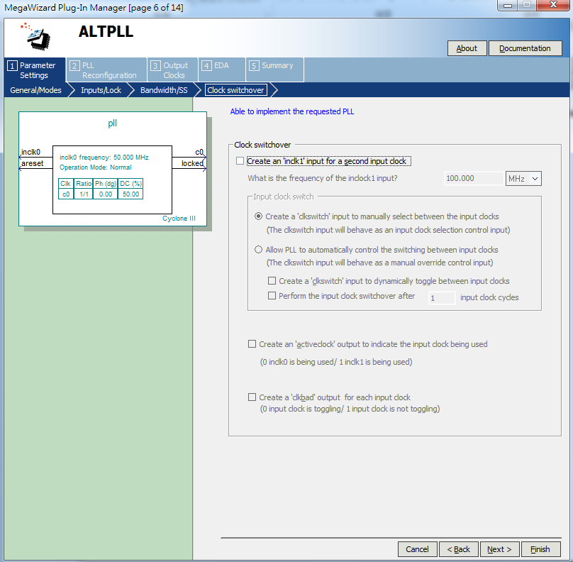
跳過

Slide 16
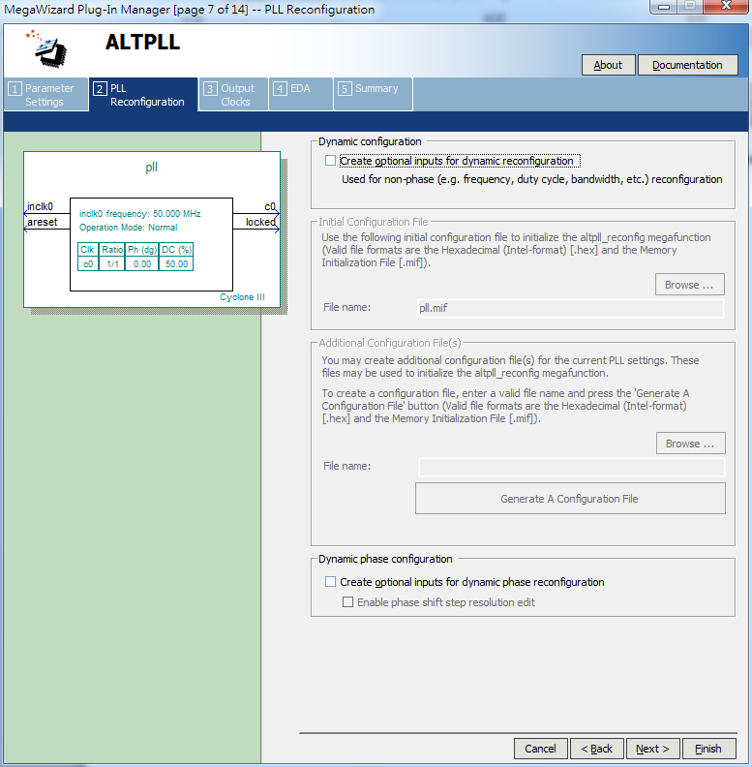
跳過

Slide 17
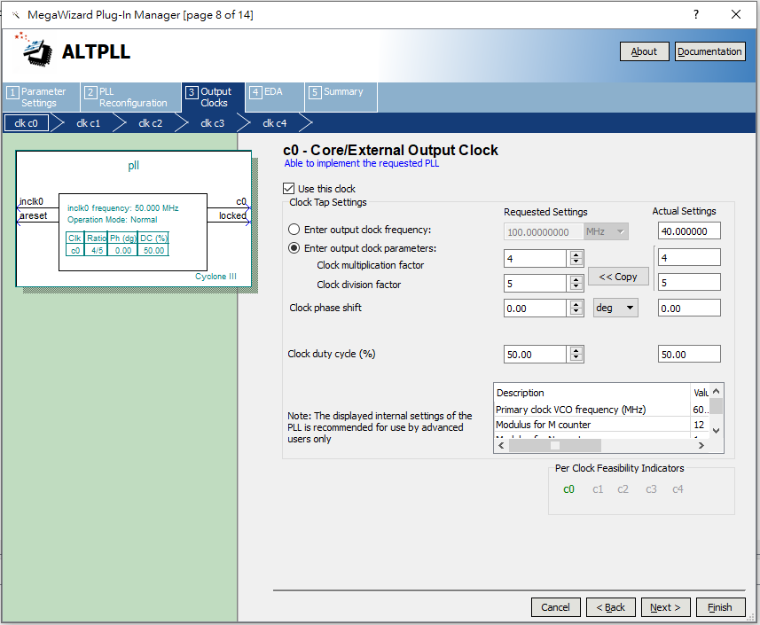

Slide 18


Slide 19
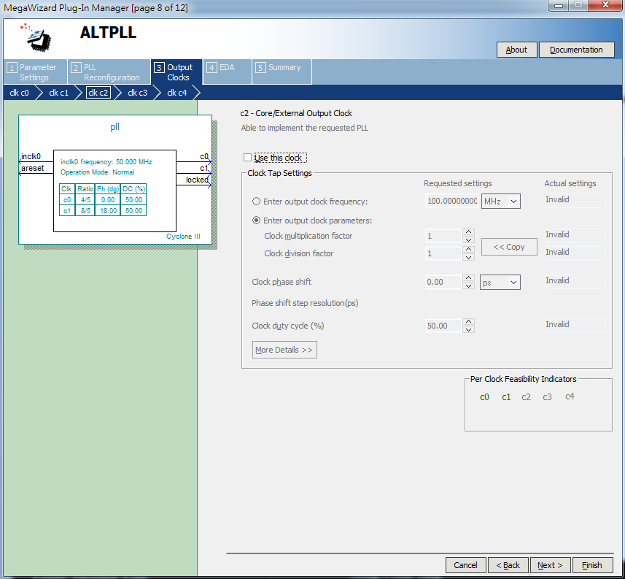
跳過c2~c4

Slide 20
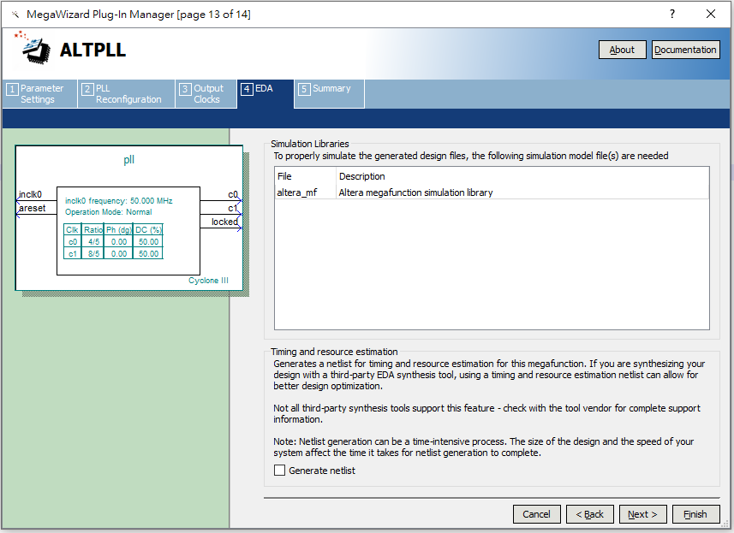

Slide 21
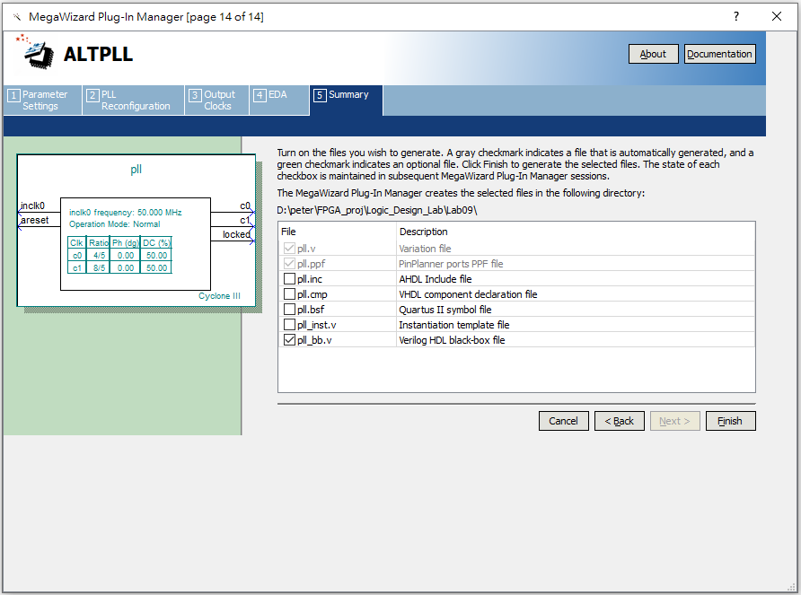
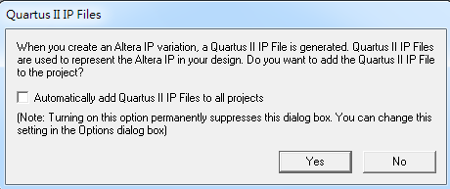

Slide 22
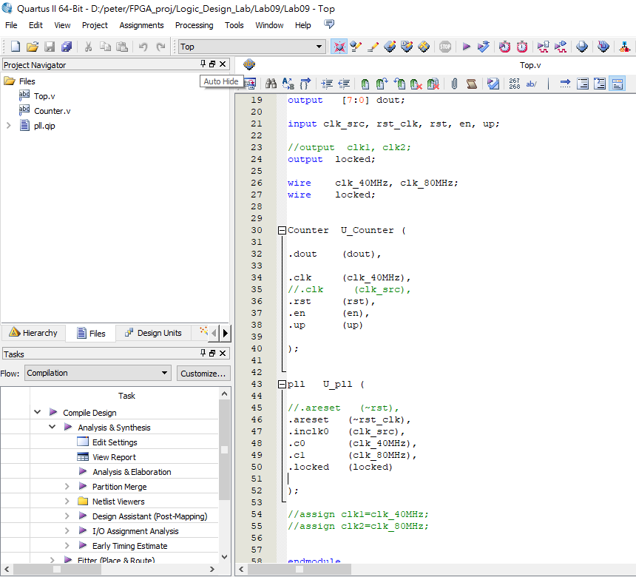

Slide 23
還是要執行的程序!!
還是需Review Lab05的步驟(或是review Phase-II的遠距教學影片)!
Processing >> Start >> Start Analysis & Elaboration
Processing >> Start >> Start Analysis Synthesis
Tools >> Netlistviewer >> RTL view (optional, 觀察用途)
Processing >> Start >> Start Fitter

Slide 24
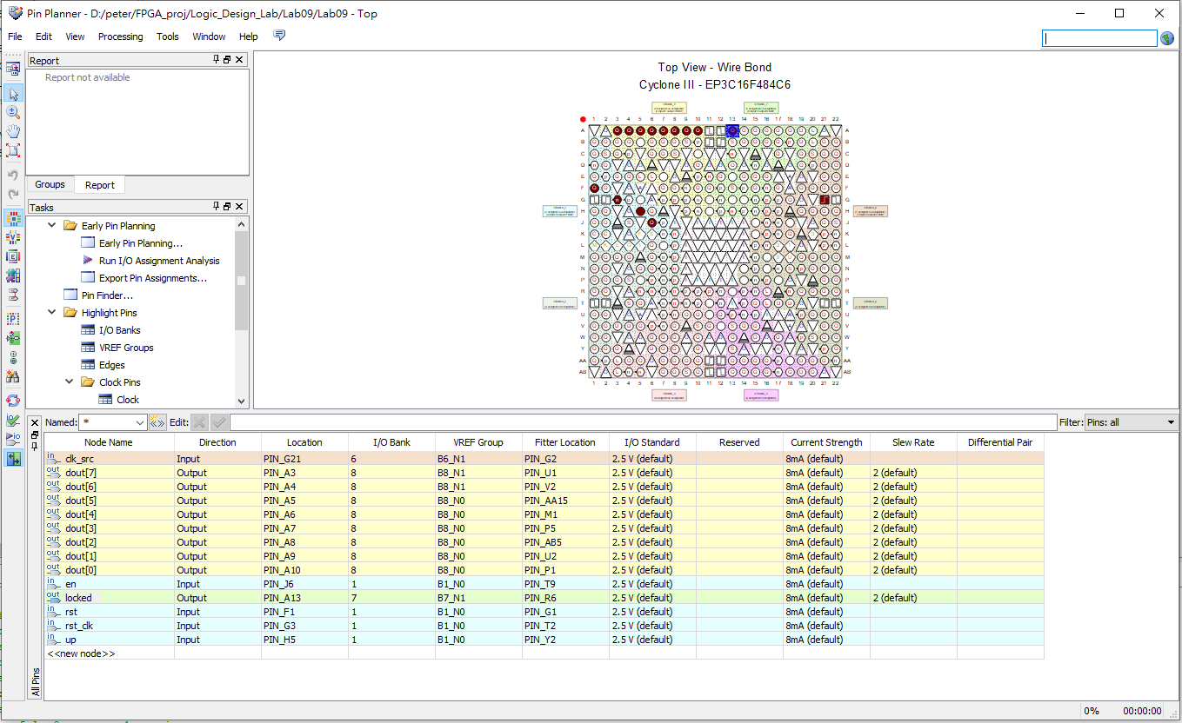
Pin Assignment
clk_src → 接”PIN_G21”
en→ 接”PIN_J6”
rst→ 接”PIN_F1”
rst_clk→ 接”PIN_G3”
up→ 接”PIN_H5”

Slide 25
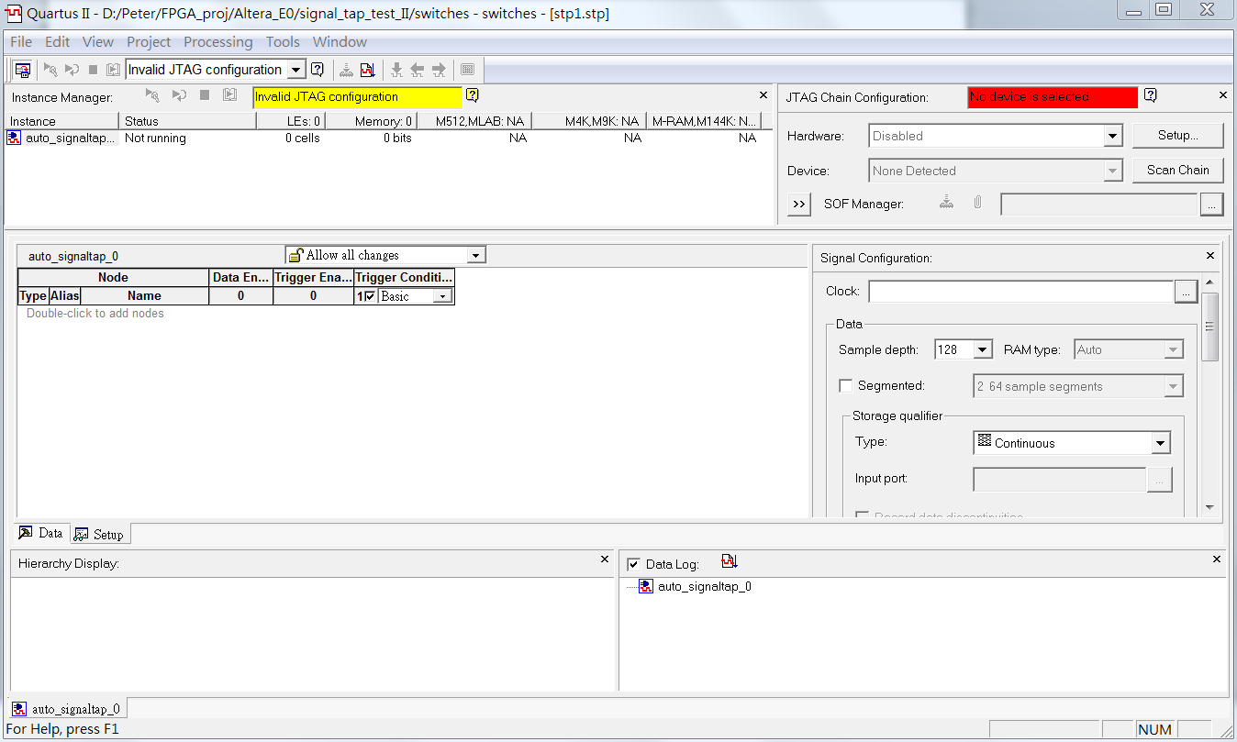
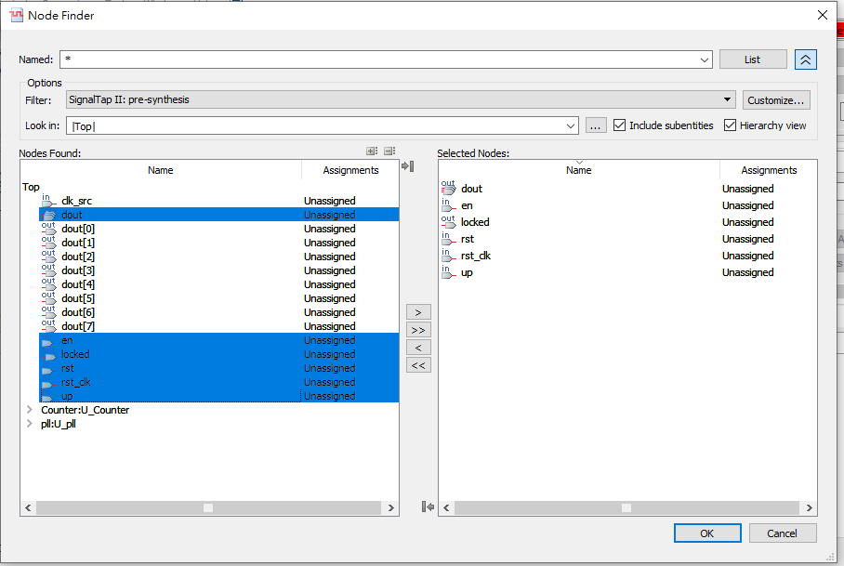
Starting Signal-Tap Setting [1]

Slide 26
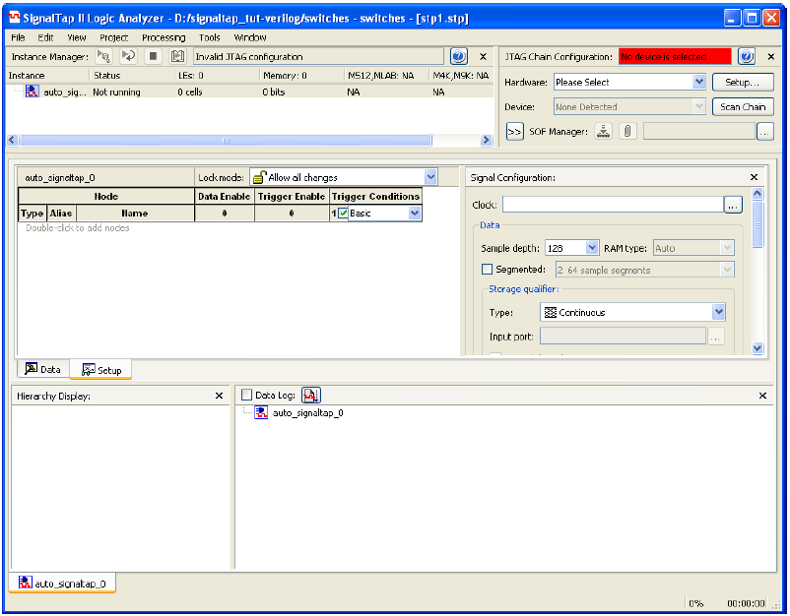
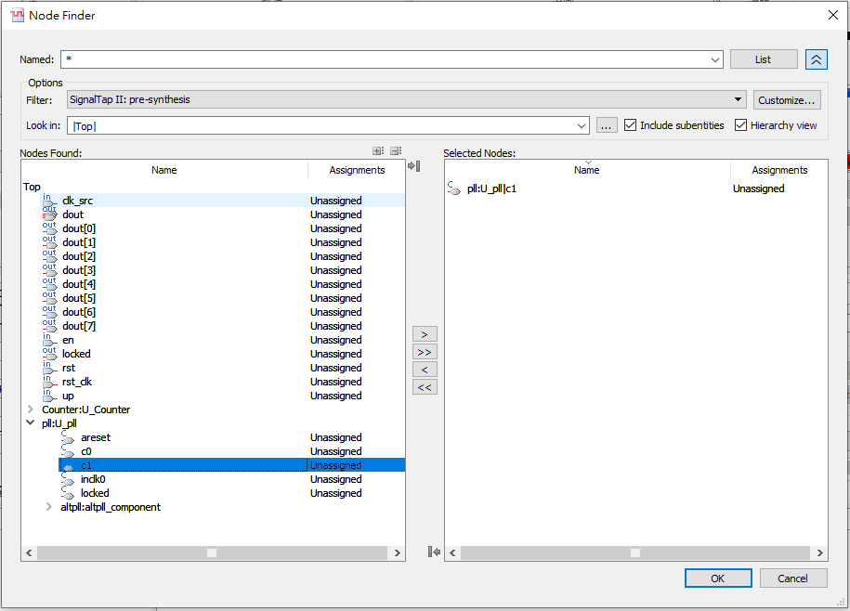
Starting Signal-Tap Setting [2]
用clk_80MHz

Slide 27
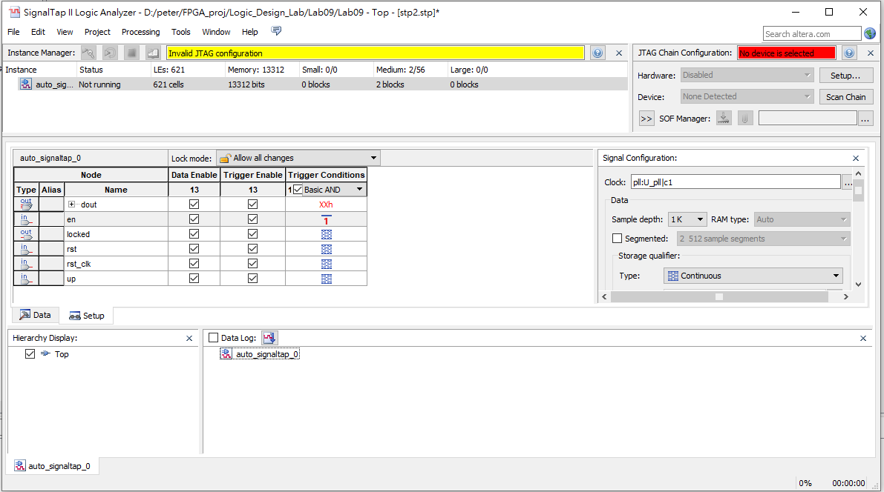
Starting Signal-Tap Measurement [1]

Slide 28
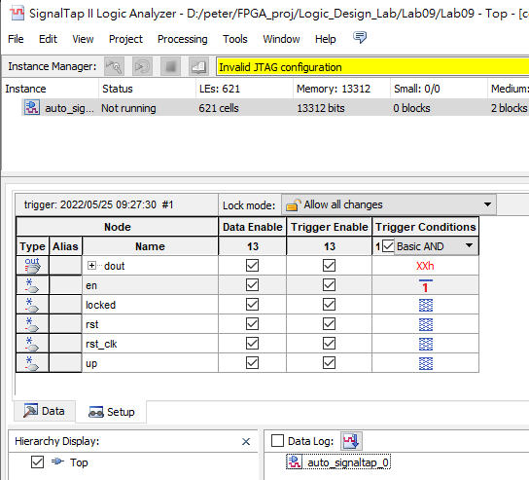
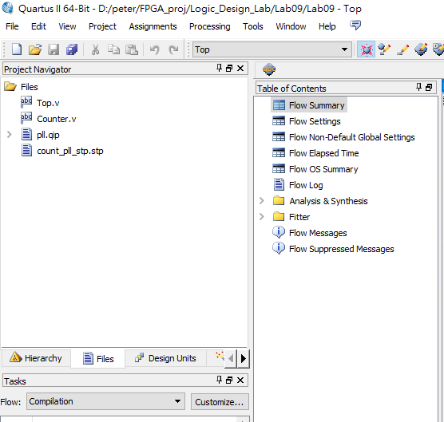
Starting Signal-Tap 設定記得存檔
save

Slide 29
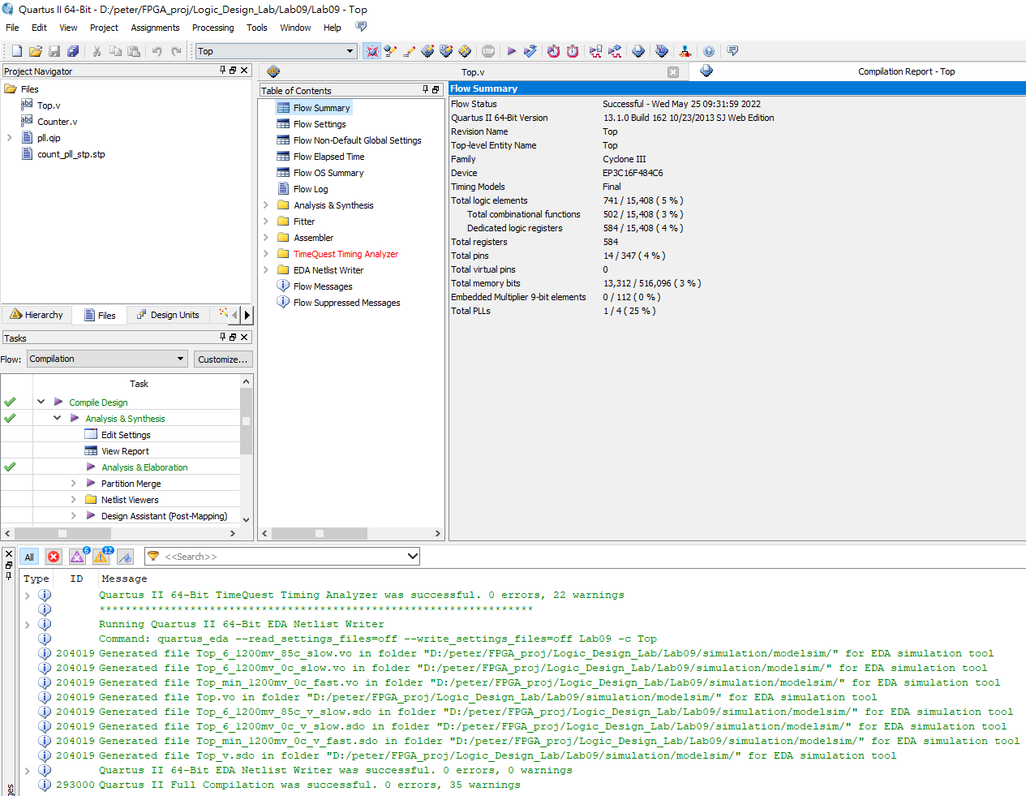
還是要執行Compilation !!
Processing >> Start Compilation

Slide 30
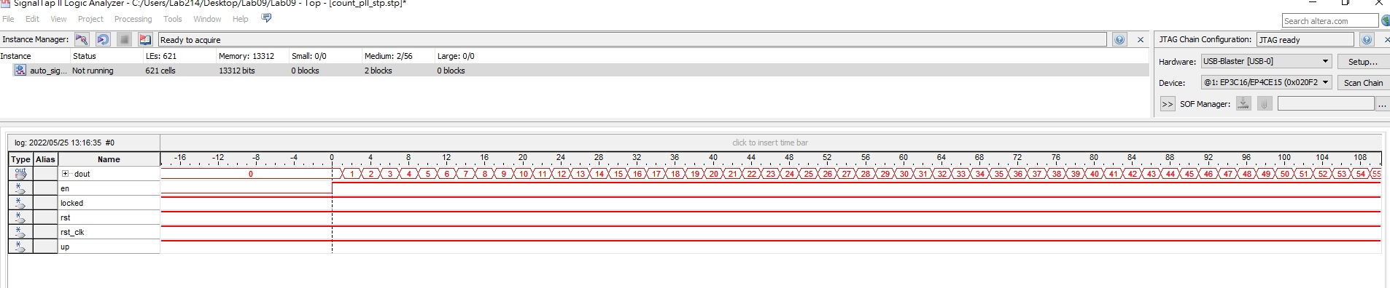
Starting Signal-Tap Measurement [2]
將測試waveform放大後可看到計數結果。
往後拉可看到最終計數至255，之後維持不變。
1. 測試一開始，en先設為0，up設為1
2. 接著按”兩次”reset → 先按rst_clk，然後按rst!
3. 啟動signal tap測試，waiting for trigger
→ 之後才en設為1 >> 啟動trigger
up
en
rst
rst_clk

Slide 31
檢查與報告(70%): 6/1、6/8(四) (一周緩衝)
1. Signal-Tap的測試結果 (p.p.30) (60%)
>> 有計數值出來但結果不完全正確
(正確值為0,1,…,255,之後維持0) (40%)
PS 計數值有暫態變化可以OK。
>> 有做實驗但完全測不出值來 (30%)
2. 執行狀況說明或心得 (10%)
>> 此即為報告內容 (6/8 午夜前)
(6/1) 課程出席 : (30%)
(每位同學做紀錄，分數以個人為單位)

