Slide 1
Lab1 ─ Ripple carry counter

Slide 2
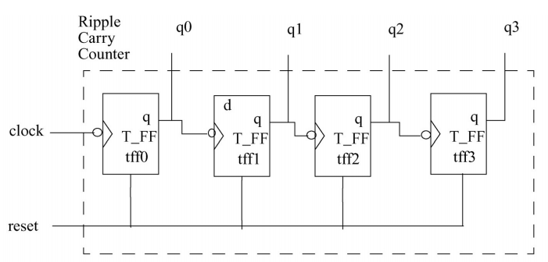
4-Bits ripple carry counter

Slide 3
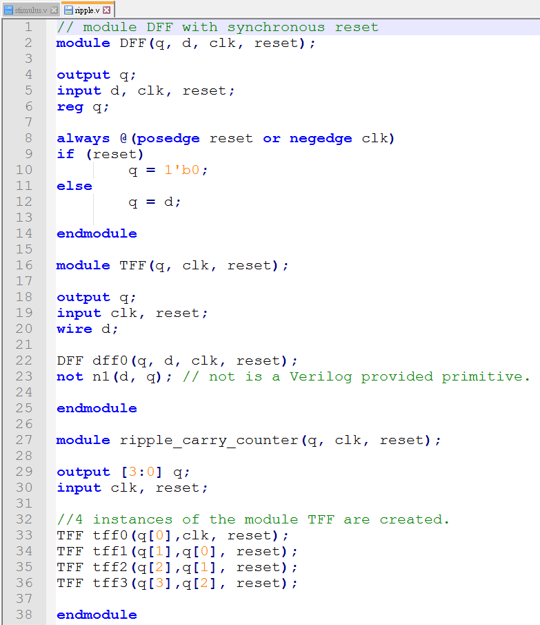
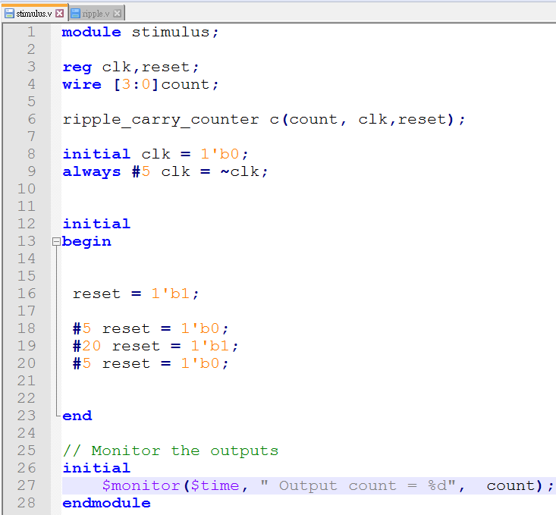
4-Bits ripple carry counter

Slide 4
實作說明
將給定的4-bits ripple carry counter由4bits改為8bits

Slide 5
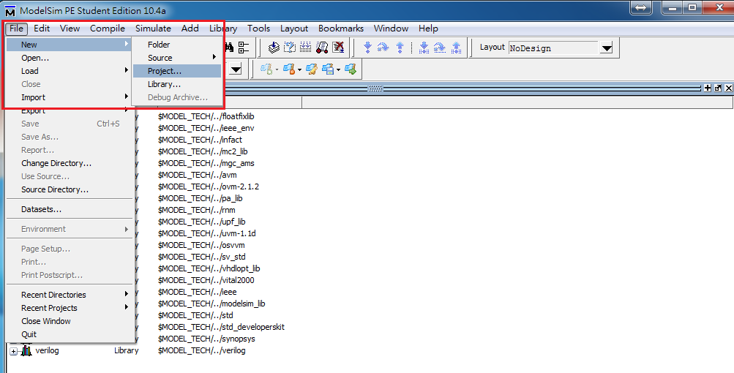
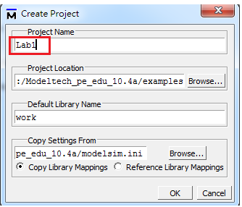
Create project

Slide 6
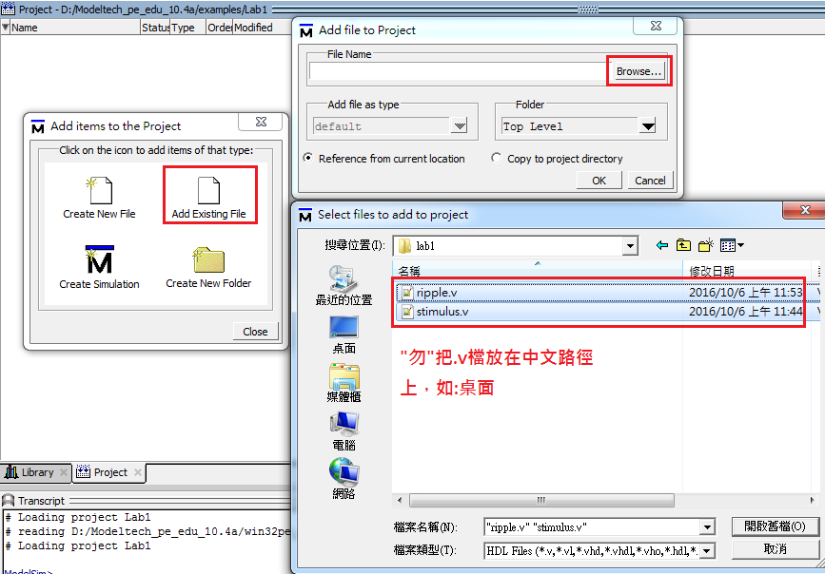
Add .v file

Slide 7
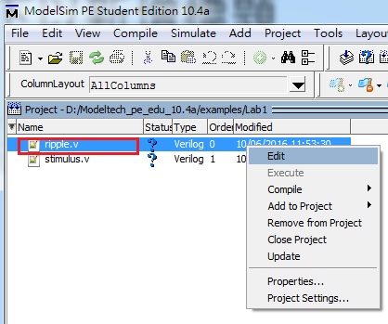
Modify ripple.v
依照說明修改ripple.v檔

Slide 8
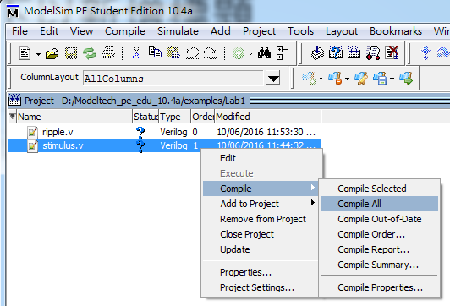
Compile

Slide 9
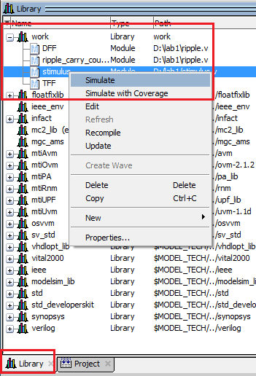
Simulate

Slide 10
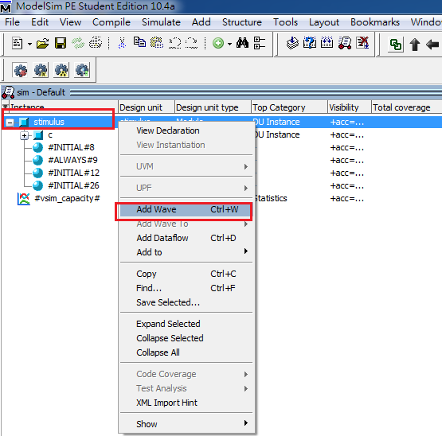
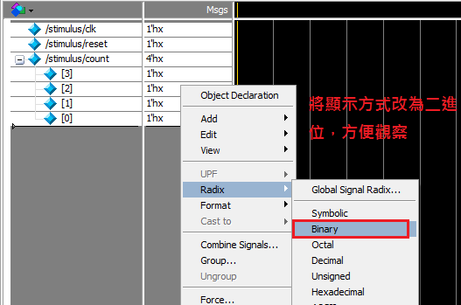
Add wave

Slide 11

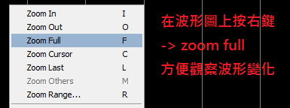
Run & result

