Slide 1











Style
Semantic Map

Slide 2











Style
Semantic Map

Slide 3








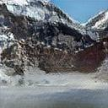


Style
Semantic Map

