Slide 1
Addressing Function Approximation Error in Actor-Critic Methods
組員: 鄭適其、林冠中、劉宗翰

Slide 2
Outline
Introduction
Background
Overestimation Bias
Accumulating Error
Addressing Overestimation Bias
Addressing High Variance
Ablation Studies

Slide 3
Introduction
Overestimation bias and the accumulation of error in temperal difference methods are presented in an actor-critic setting
Overestimation bias is a property of Q-Learning in which the maximization of noisy value estimate induces a consistent overestimation. And it is solved by the proposed clipped Double Q-Learning.
Given the connection of noise to overestimation bias, this paper contains two method that address variance reduction
delayed policy updates
target policy smoothing

Slide 4
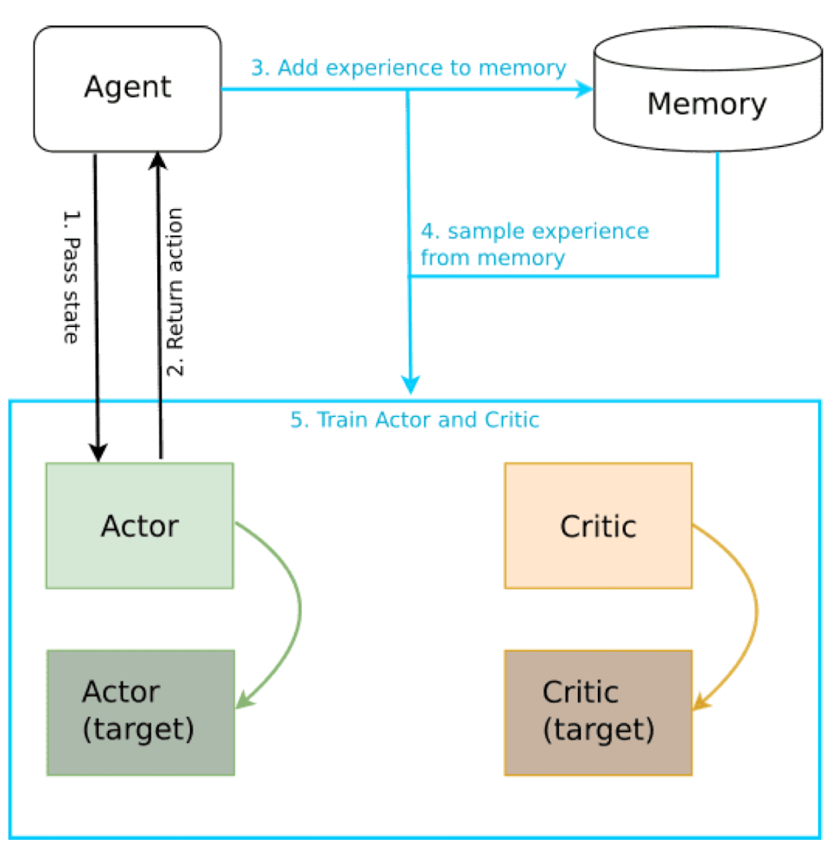
Background
Figure Credit : https://www.katnoria.com/ddpg-reacher/
DDPG architecture
Twin Delayed Deep Deterministic policy gradient algorithm (TD3) is based on Deep Deterministic policy gradient algorithm (DDPG)
DDPG applied several techniques: (1) Target networks (2) Experience replay (3) Ornstein-Uhlenbeck process for exploration (optional)

Slide 5
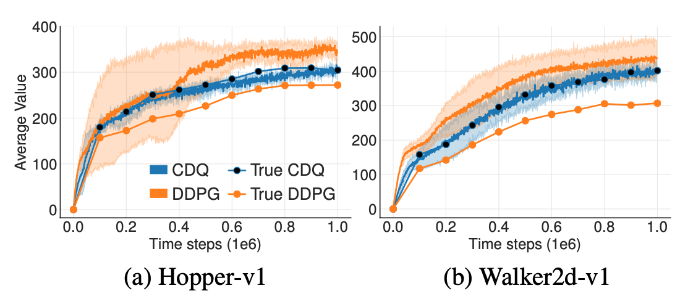
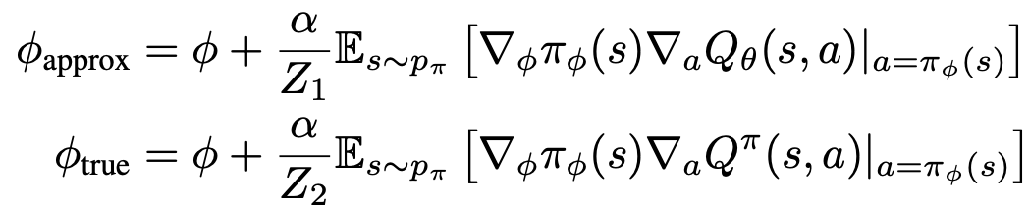
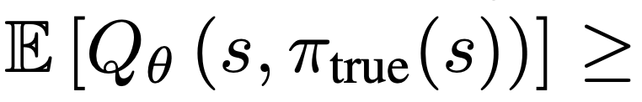
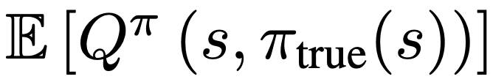
Overestimation Bias
Figure Credit: http://proceedings.mlr.press/v80/fujimoto18a/fujimoto18a.pdf
if 𝛂 is small enough
? ? ?
if 𝛂 is small enough

Slide 6
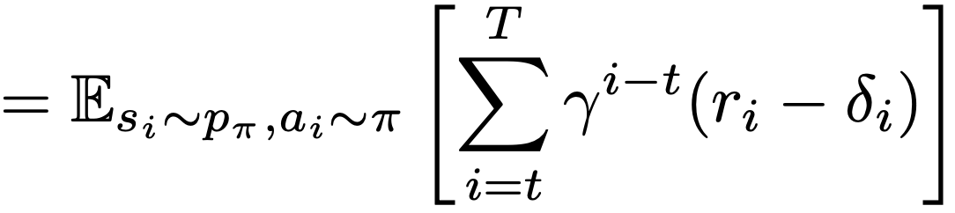
Accumulating Error
The Bellman equation is never exactly satisfied, and each update leaves some amount of residual TD-error
residual TD-error
The value estimate approximates the expected return minus the expected discounted sum of future TD-errors
Thus, the variance of the estimate will be proportional to the variance of future reward and estimation error

Slide 7
Addressing Overestimation Bias

Slide 8
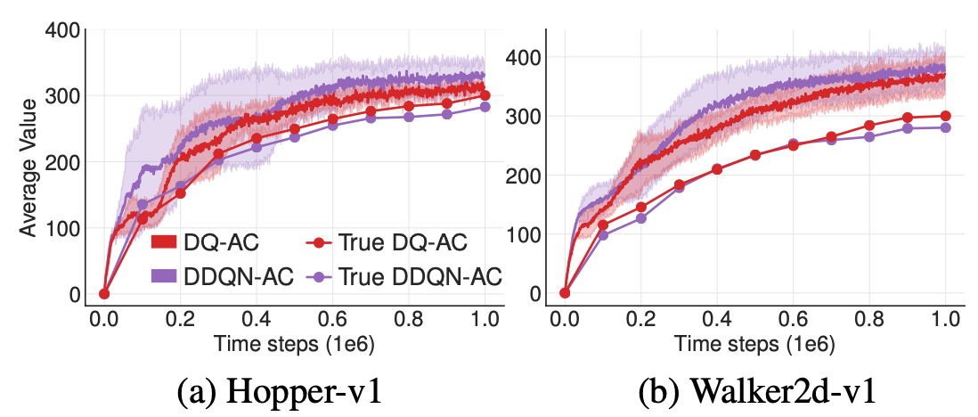
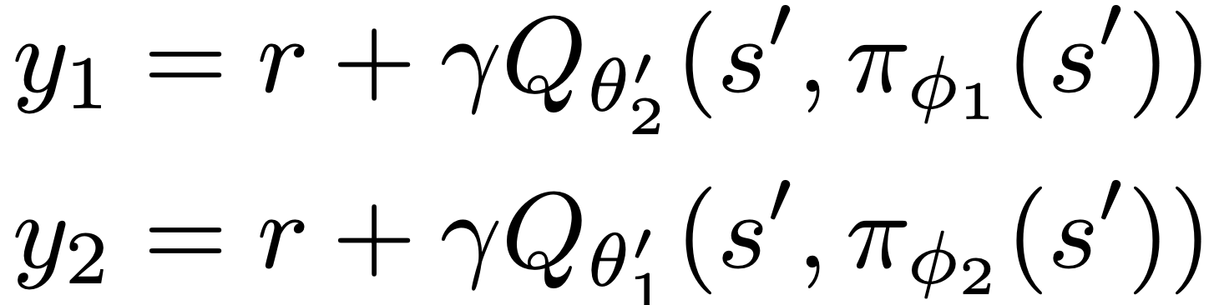
Clipped Double Q-Learning
Figure Credit: http://proceedings.mlr.press/v80/fujimoto18a/fujimoto18a.pdf
because of the slow-changing policy in actor-critic, the current and target networks were too similar to make an independent estimation, and offered little improvement
the original Double Q-Learning formulation can be used
However the critics are not entirely independent, because they share the same replay buffer

Slide 9
Addressing High Variance

Slide 10
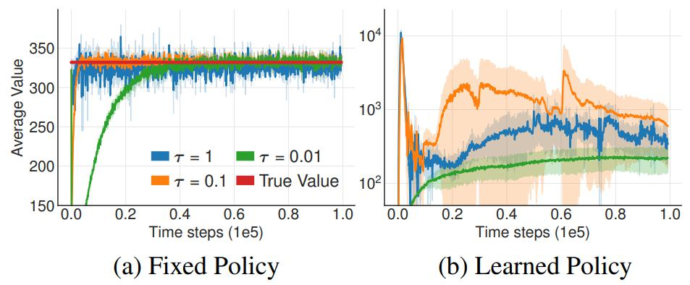
Target Networks
A target network is a copy of the action-value function that is held constant to serve as a stable target for learning for some fixed number of timesteps
Target networks can avoid catastrophic forgetting
Soft update:
θ' ← τθ + (1 − τ )θ'

Slide 11
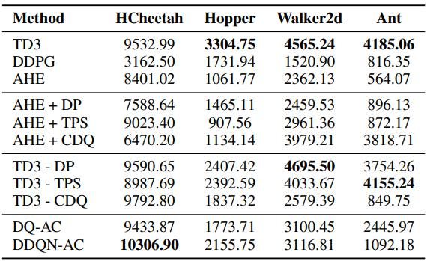
Delayed Policy Updates
The policy network updated at a lower frequency than the value network, to first minimize error before introducing a policy update.
To ensure the TD-error remains small, we update the target networks slowly θ'← τθ + (1 − τ )θ'
This creates a two-timescale algorithm

Slide 12
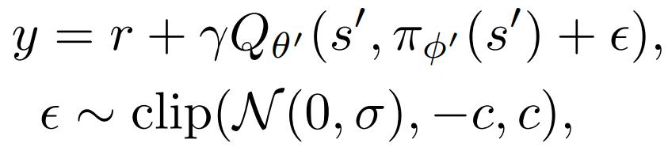
Target Policy Smoothing
Target Policy Smoothing is a regularization strategy for the Q target network
Idea:
similar actions should have similar value
Target policy smoothing adds a small amount of random noise to the target policy
The modified target update is:
A similar idea was introduced concurrently by Nachum et al. (2018), smoothing over Qθ, rather than Qθ' .

Slide 13
Ablation Studies

Slide 14
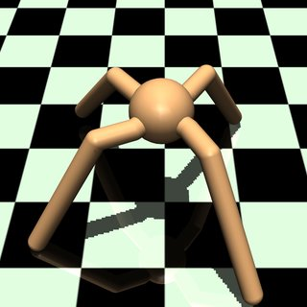
Detailed Implementation
We use Pytorch to implement our deep learning model.
We use Mujoco Ant-v2 as the enviroment for testing TD3 algorithm.
The goal of Mujoco Ant-v2 is to make the robot which has four legs run as fast as possible. The faster we make the robot run, the higher score we will get in this enviroment.

Slide 15
TD3
(1) Initialize actor(A), target actor(At), two critics(Q₁, Q₂), two target critics(Qt₁, Qt₂), reply buffer(B)
(2) if we don’t have enough transition experience in B:
Randomly sample action(a) for the state(s)
else:
Sample action(a = A(s)) with exploration noise(~N(0, 0.1)) for the state(s)
(3) Observe reward(r), new state(s’), time steps += 1
(4) Store transition tuple (s, a, r, s’, d) into B (d means whether we finish this episode)
(5) IF d == True:
Train TD3 model (<= detail in next page)
(6) IF time steps == 1e7:
End
ELSE:
Back to (2)

Slide 16
Training TD3
(1) Sample mini-batch of N transitions tuples (s, a, r, s’, d) from B
(2) Select action : a’ = At(s)
(3) Do target policy smoothing on a’
(4) Get TD-target with clipped double Q-learning : y = r + γ (1 - d) min_{i=1,2} Qt_{i} (s’, a’)
(5) Update Q₁, Q₂ with gradient of the loss function : ▽loss_{i} = ▽Σ(y - Q_{i}(s, a))² / N , for i=1, 2
(6) IF training step t and actor update frequency 2 satisfy t mod 2 == 0 (delayed policy update) :
Update A with gradient of the loss function : ▽loss = - Σ ( ▽Q₁(s, A(s)) ) / N .
Update parameters of Qt₁, Qt₂ : W_{Qti} = 0.005 * W_{Qi} + (1 - 0.005) * W_{Qti} , for i=1, 2
Update parameters of At : W_{At} = 0.005 * W_{A} + (1 - 0.005) * W_{At}
(7) Back to (1) until End.

Slide 17
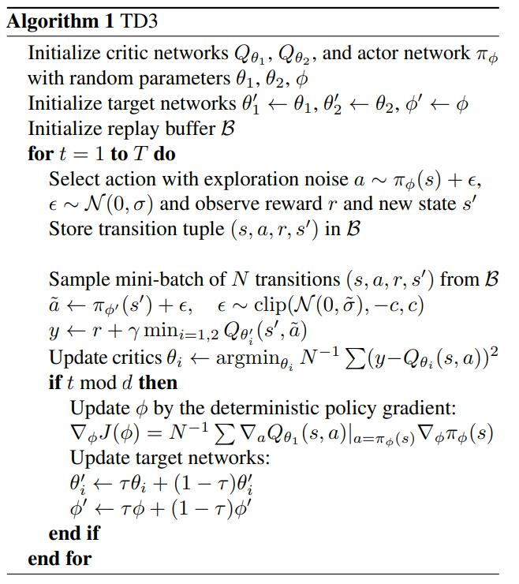
TD3 - DP
Original:
d = 2
=> d = 1

Slide 18
TD3 - TPS
Original:
ε ~ clip(N(0, σ), -c, c), c=0.5
=> ε ~ clip(N(0, σ), -c, c), c=0

Slide 19
TD3 - CDQ

Slide 20
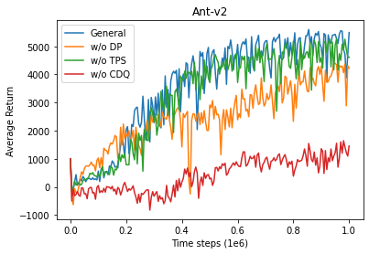
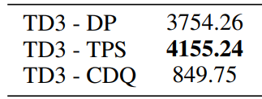
Conclusion
Paper
Ours

Slide 21
Q&A

