Slide 1
Systems Analysis and Design
Alan Dennis, Barbara Haley Wixom, and Roberta Roth
John Wiley & Sons, Inc.
Slides by Candace S. Garrod
Red Rocks Community College

Slide 2
Process Modeling

Slide 3
Process Modeling
  Process Modeling is a method used to visually represent how a business system operates.
  It shows the activities, data flows, and interactions within a system.
  Helps analysts understand how information moves and where improvements can be made.
  Provides a clear picture of the system for both analysts and developers.
  One of the most common techniques in process modeling is Data Flow Diagramming (DFD).
  DFDs illustrate how data enters, moves through, and leaves a system.

Slide 4
Key Definitions
Process model
  A formal way of representing how a business system operates
  Illustrates the activities that are performed and how data moves among them
Data flow diagramming
  A common technique for creating process models
  It uses symbols like processes, data stores, data flows, and external entities to show how data moves through the system

Slide 5
Key Definitions
Logical process models describe processes without suggesting how they are conducted
Physical process models provide information that is needed to build the system
Notes:
1. Logical Process Models
Logical process models show what the system must do without describing how it will actually be implemented.
Key Characteristics:
Technology-independent
Focus on business processes, inputs, outputs, and rules
Do not include hardware, software, or physical methods
Describe the essence of the system
Purpose:
To understand the true requirements of the system before making decisions about design or implementation.
Example (Library System):
Logical model might show:
“Process Borrow Request”
“Check Book Availability”
“Record Borrowing Transaction”
But it does not specify:
Which database (MySQL? Oracle?)
Whether borrowing is done via computer or paper
How the user interface looks
How data is stored physically
It is purely conceptual and business-focused.
2. Physical Process Models
Physical process models show how the system will actually be built and implemented.
Key Characteristics:
Technology-dependent
Includes specific hardware, software, files, databases
Includes manual procedures and user interfaces
Describes how processes are carried out in the real world
Purpose:
To guide developers and designers in building the actual system based on the logical requirements.
Example (Library System):
Physical model might show:
“Search MySQL Database for Available Books”
“Record Transaction in borrow_tbl”
“Update book_status column”
“Librarian scans barcode using barcode scanner”
“Web interface displays confirmation message”
It includes:
Database names
Table names
Data formats
Devices used
Screens and forms
A Data Flow Diagram (DFD) is a logical model because it shows what the system does and how data moves, without showing how the system will be built.

Slide 6
DATA FLOW DIAGRAMS (DFD)

Slide 7
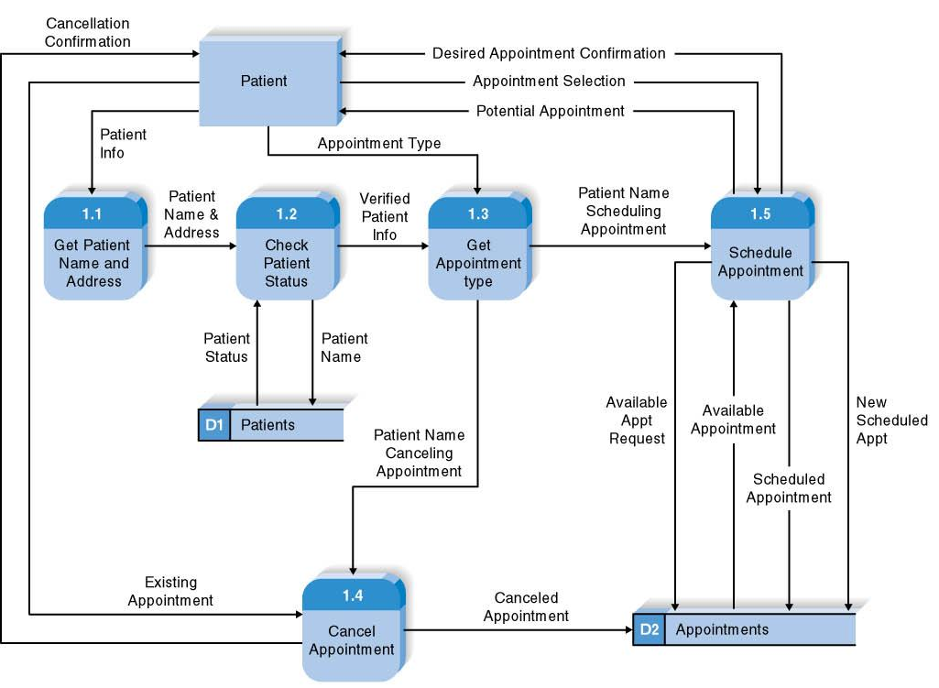
Reading a DFD

Slide 8
Elements of a DFD
Process
  An activity or function performed for a specific business reason
  Manual or computerized
Data flow
  A single piece of data or a logical collection of data
  Always starts or ends at a process

Slide 9
DFD Elements
Data Store
  A collection of data that is stored in some way
  Data flowing out is retrieved from the data store
  Data flowing in updates or is added to the data store
External entity
  A person, organization, or system that is external to the system but interacts with it.

Slide 10
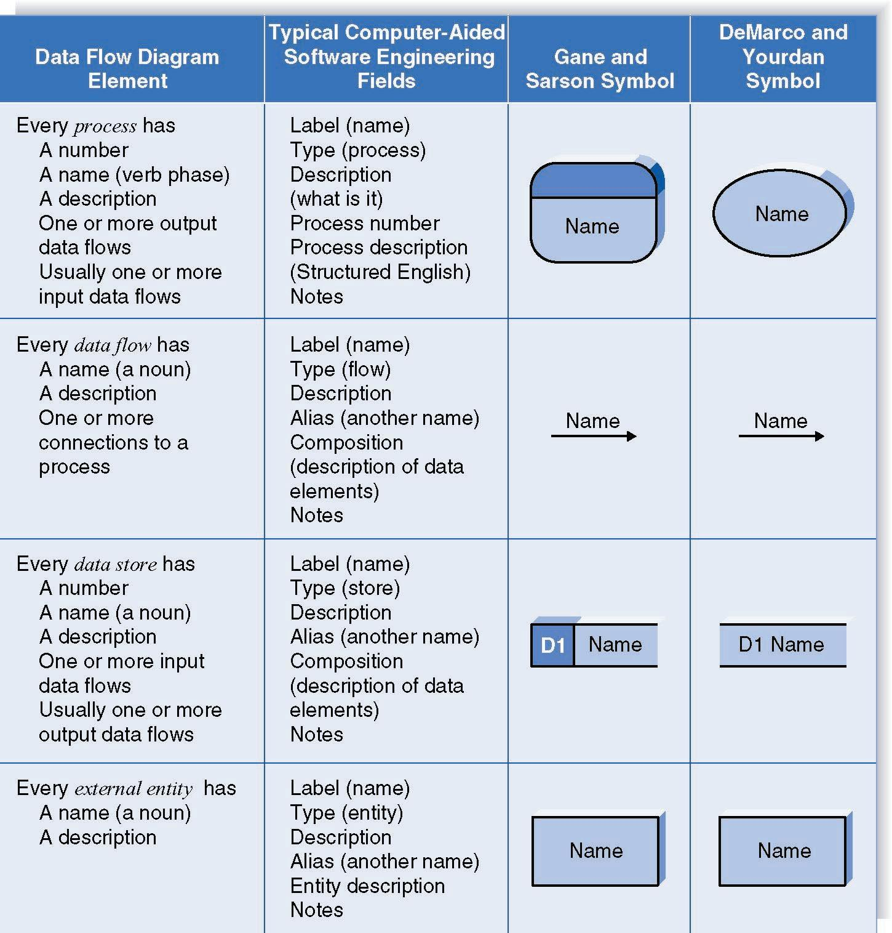
Naming and Drawing DFD Elements
Process
Data flow
Data store
External
entity

Slide 11
Using a DFD to Define Business Processes
Business processes are too complex to be shown on a single DFD
Decomposition means breaking big processes into smaller, clearer processes in a series of DFD levels.
  Is the process of representing the system in a hierarchy of DFD diagrams
  Child diagrams show a portion of the parent diagram in greater detail

Slide 12
Key Definition
Balancing involves insuring that information presented at one level of a DFD is accurately represented in the next level DFD.

Slide 13
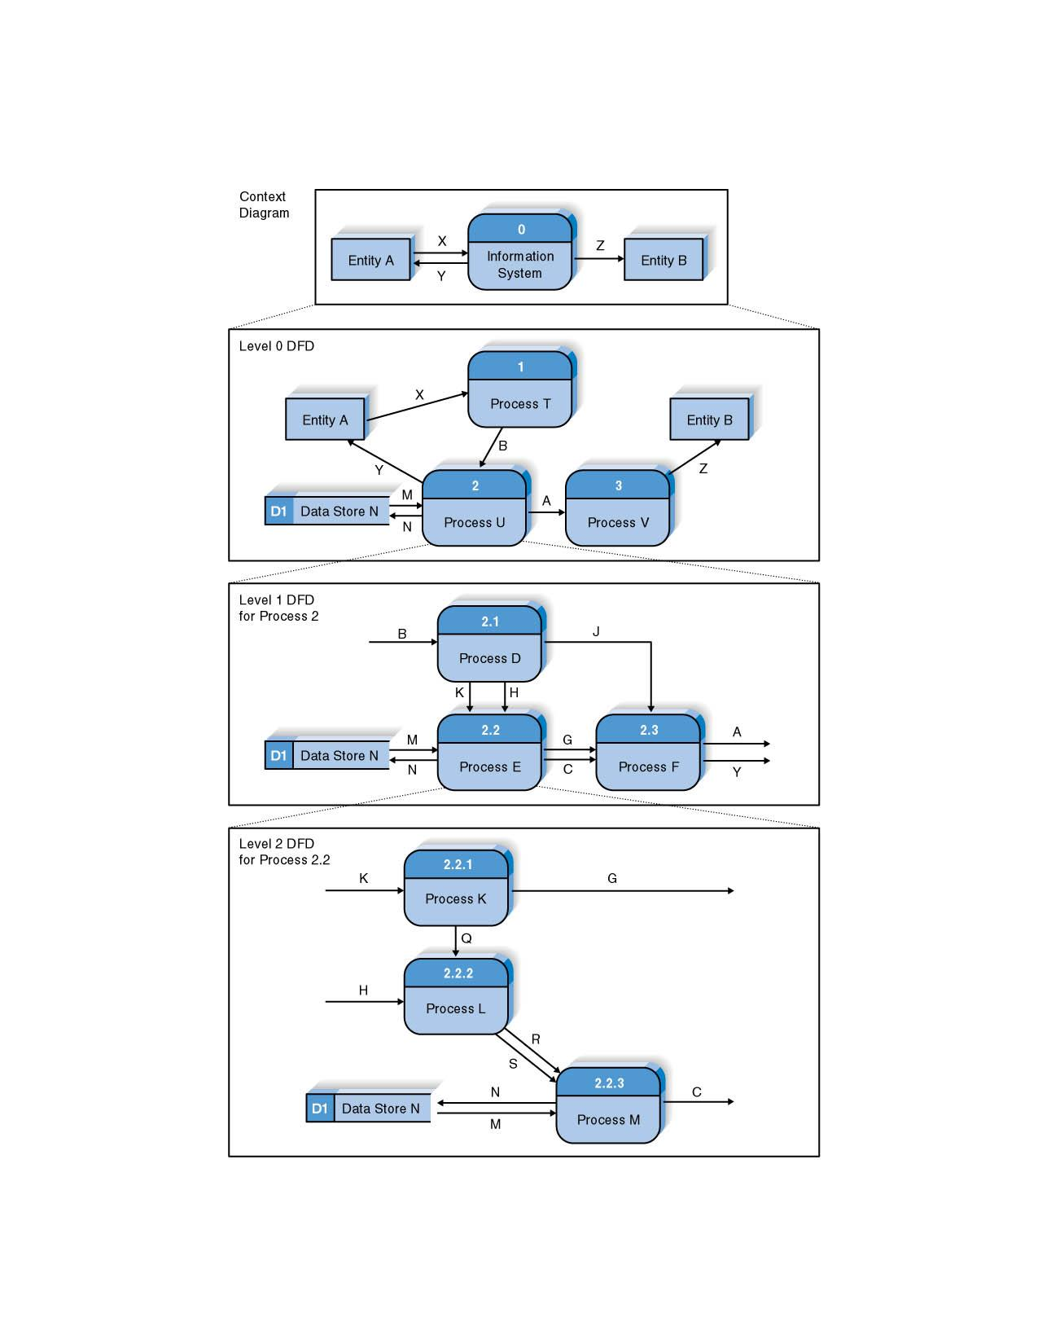
Relationship among Levels of DFDs
Context diagram
Level 0 diagram
Level 1 diagram
Level 2 diagram

Slide 14
Context Diagram
First DFD in every business process
Shows the context into which the business process fits
Shows the overall business process as just one process (process 0)
Shows all the external entities that receive information from or contribute information to the system

Slide 15
Level 0 Diagram
Shows all the major processes that comprise the overall system – the internal components of process 0
Shows how the major processes are interrelated by data flows
Shows external entities and the major processes with which they interact
Adds data stores

Slide 16
Level 1 Diagrams
Generally, one level 1 diagram is created for every major process on the level 0 diagram
Shows all the internal processes that comprise a single process on the level 0 diagram
Shows how information moves from and to each of these processes
If a parent process is decomposed into, for example, three child processes, these three child processes wholly and completely make up the parent process

Slide 17
Level 2 Diagrams
Shows all processes that comprise a single process on the level 1 diagram
Shows how information moves from and to each of these processes
Level 2 diagrams may not be needed for all level 1 processes
Correctly numbering each process helps the user understand where the process fits into the overall system

Slide 18
Alternative Data Flows
Where a process can produce different data flows given different conditions
We show both data flows and use the process description to explain why they are alternatives
Tip -- alternative data flows often accompany processes with IF statements

Slide 19
Your Turn
At this point in the process it is easy to lose track of the “big picture”.
Describe the difference between data flows, data stores, and processes.
Describe in your own words the relationship between the DFD and the ultimate new application being developed.

Slide 20
Process Descriptions
Text-based process descriptions provide more information about the process than the DFD alone
If the logic underlying the process is quite complex, more detail may be needed in the form of
  Structured English
  Decision trees
  Decision tables

Slide 21
CREATING DATA FLOW DIAGRAMS

Slide 22
Integrating Scenario Descriptions
DFDs start with the use cases and requirements definition
Generally, the DFDs integrate the use cases
Names of use cases become processes
Inputs and outputs become data flows
“Small” data inputs and outputs are combined into a single flow

Slide 23
Steps in Building DFDs
Build the context diagram
Create DFD fragments for each use case
Organize DFD fragments into level 0 diagram
Decompose level 0 processes into level 1 diagrams as needed; decompose level 1 processes into level 2 diagrams as needed; etc.
Validate DFDs with user to ensure completeness and correctness

Slide 24
Creating the Context Diagram
Draw one process representing the entire system (process 0)
Find all inputs and outputs listed at the top of the use cases that come from or go to external entities; draw as data flows
Draw in external entities as the source or destination of the data flows

Slide 25
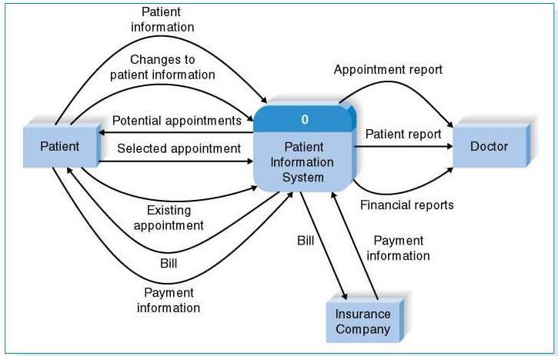
A Context Diagram Example

Slide 26
Creating DFD Fragments
Each use case is converted into one DFD fragment
Number the process the same as the use case number
Change process name into verb phrase
Design the processes from the viewpoint of the organization running the system

Slide 27
Creating DFD Fragments
Add data flows to show use of data stores as sources and destinations of data
Layouts typically place
  processes in the center
  inputs from the left
  outputs to the right
  stores beneath the processes

Slide 28
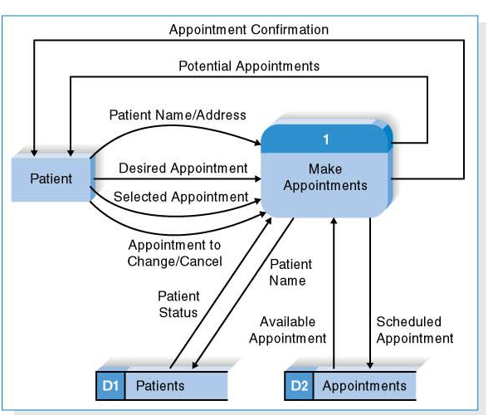
A DFD Fragment Example

Slide 29
Creating the Level 0 Diagram
Combine the set of DFD fragments into one diagram
Generally move from top to bottom, left to right
Minimize crossed lines
Iterate as needed
  DFDs are often drawn many times before being finished, even with very experienced systems analysts

Slide 30
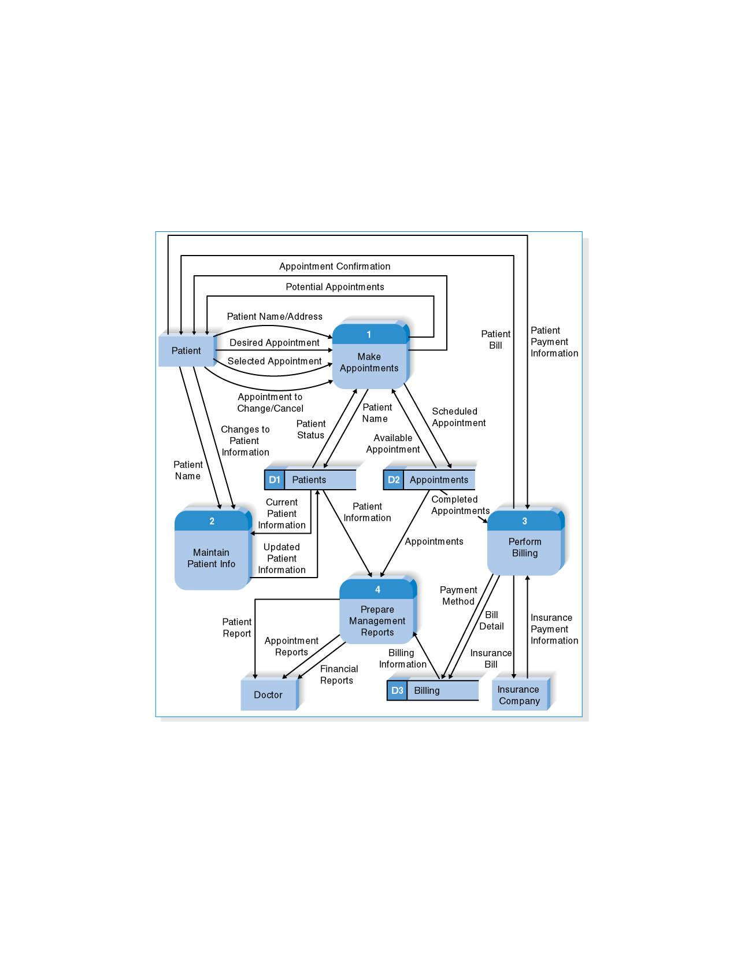
A Level 0 DFD Example

Slide 31
Creating Level 1 Diagrams (and Below)
Each use case is turned into its own DFD
Take the steps listed on the use case and depict each as a process on the level 1 DFD
Inputs and outputs listed on use case become data flows on DFD
Include sources and destinations of data flows to processes and stores within the DFD
May also include external entities for clarity

Slide 32
Creating Level 1 Diagrams (and Below)
When to stop decomposing DFDs?
  Ideally, a DFD has at least three processes and no more than seven to nine.

Slide 33
Validating the DFD
Syntax errors – diagram follows the rules
  Assure correct DFD structure
For each DFD:
Check each process for:
A unique name: action verb phrase; number; description
        At least one input data flow
        At least one output data flow
        Output data flow names usually different than
        input data flow names
        Between 3 and 7 processes per DFD
Notes:
Example: Level 0 DFD for a Library System
Borrow Book
Return Book
Search Catalog
Manage Inventory
Update Borrower Records
Level 1 of “Borrow Book”
Check Book Availability
Verify Borrower Account
Record Borrow Transaction
Update Inventory
Generate Borrow Receipt

Slide 34
Validating the DFD
For each DFD:
Check each data flow for:
A unique name: noun; description
Connects to at least one process
Shown in only one direction (no two-headed arrows)
A minimum number of crossed lines
Check each data store for:
A unique name: noun; description
At least one input data flow
At least one output data flow
Check each external entity for:
A unique name: noun; description
At least one input or output data flow

Slide 35
Validating the DFD
Across DFDs:
Context Diagram:
Every set of DFDs must have one Context Diagram
Viewpoint:
There is a consistent viewpoint for the entire set of DFDs
Decomposition:
Every process is wholly and complete described by the
processes on its children DFDs
Balance:
Every data flow, data store, and external entity on a higher level
DFD is shown on the lower level DFD that decomposes it
No data stores or data flows appear on lower-lever DFDs that do
not appear on their parent DFD

Slide 36
Validating the DFD
Semantics errors – diagram conveys correct meaning
  Assure accuracy of DFD relative to actual/desired business processes
To verify correct representation, use
  User walkthroughs
  Role-play processes
Examine lowest level DFDs to ensure consistent decomposition
Examine names carefully to ensure consistent use of terms

Slide 37
A Quick Review of Decomposition for CD Selections

Slide 38
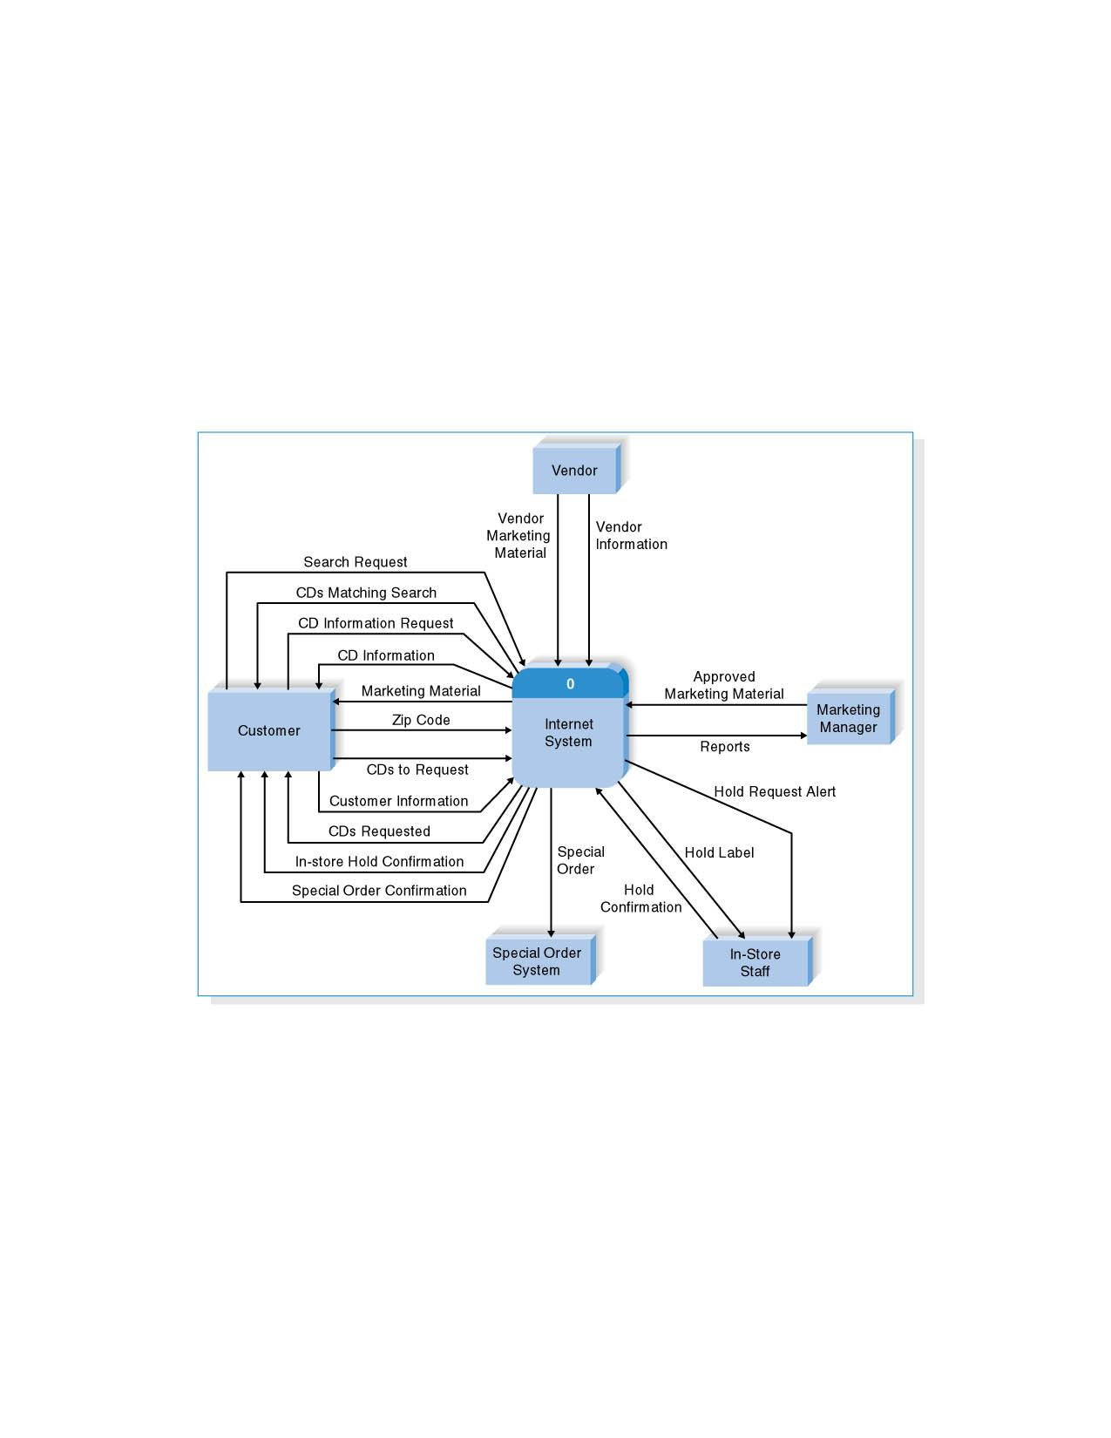
Context Diagram for CD Selections Internet Sales System

Slide 39
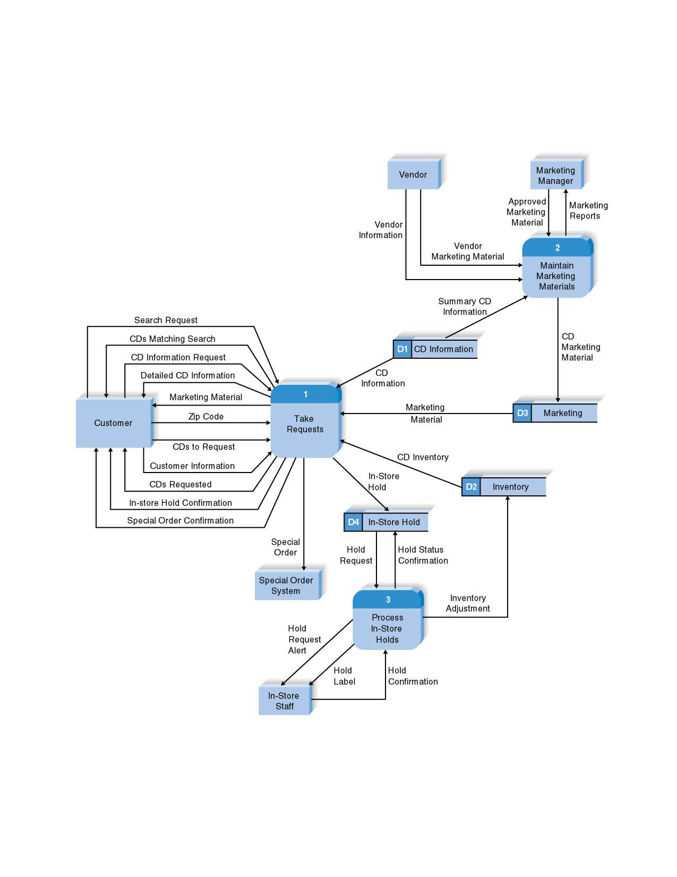
Level 0 DFD for CD Selections Internet System

Slide 40
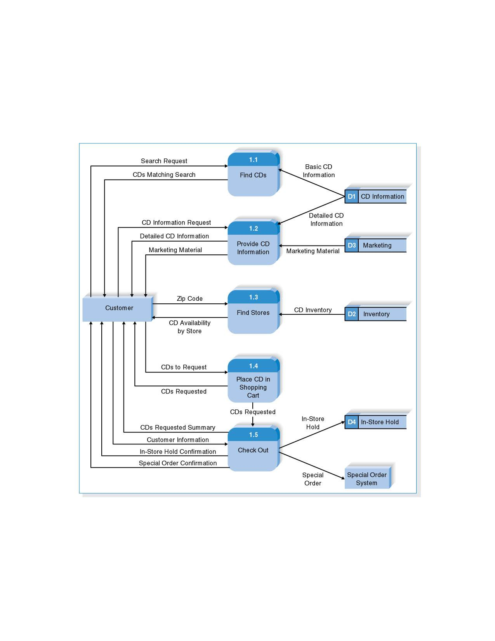
Level 1 DFD for CD Selections Process 1: Take Requests

Slide 41
Summary
The Data Flow Diagram (DFD) is an essential tool for creating formal descriptions of business processes.
Use cases record the input, transformation, and output of business processes and are the basis for process models.
Eliciting use cases and modeling business processes are critically important skills for the systems analyst to master.

Slide 42
Copyright © 2009 John Wiley & Sons, Inc.
All rights reserved. Reproduction or translation of this work beyond that permitted in Section 117 of the 1976 United States Copyright Act without the express written permission of the copyright owner is unlawful.
Request for further information should be addressed to the Permissions Department, John Wiley & Sons, Inc.
The purchaser may make back-up copies for his/her own use only and not for redistribution or resale.
The Publisher assumes no responsibility for errors, omissions, or damages, caused by the use of these programs or from the use of the information contained herein.

