Slide 1
Java程式設計之四
Socket
陳興夏 編輯

Slide 2
Java通訊重要內建封包
Socket (java.net.Socket, java.net.ServerSocket)

Slide 3
Socket
Socket是什麼？
插槽的概念
介於兩部主機之間的連線
Client
Server
Request
Response
ClientSocket
ServerSocket

Slide 4
Socket
Socket能做什麼？
連接到遠端機器
傳送資料
接收資料
關閉連線
繫結到特定通訊埠
接受遠端機器從繫結通訊埠進來的連線

Slide 5
Socket
如何建構Socket？
Socket()
Socket( String host, int port ) throws IOException, UnknownHostException
EX：
try{
Socket mySocket = new Socket("localhost",80);
}
catch(IOException e){}
catch(UnknownHostException e){}
Socket( InetAddress host, int port) throws IOException
EX：
try{
InetAddress addr = new InetAddress.getByName("www.cycu.edu.tw");
Socket mySocket = new Socket(addr,80);
}
catch(IOException e){}
catch(UnknownHostException e){}

Slide 6
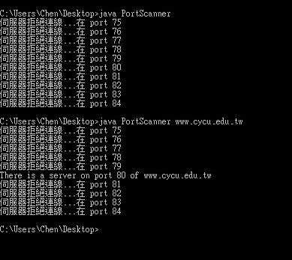
Socket
import java.net.*;
import java.io.*;
public class PortScanner{
public static void main(String[] args){
String host = "localhost";
if(args.length>0)
host = args[0];
for(int i=75 ; i< 85 ; i++){
try{
Socket s = new Socket(host,i);
System.out.println("There is a server on port " + i + " of " + host);
}
catch(UnknownHostException e){
System.out.println(e.toString());
break;
}
catch(ConnectException e){ System.out.println("伺服器拒絕連線...在 port " + i); }
catch(IOException e){ System.out.println(e.toString()); }
}
}
}

Slide 7
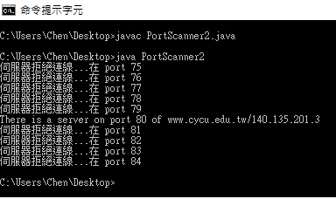
Socket
import java.net.*;
import java.io.*;
public class PortScanner2{
public static void main(String[] args){
InetAddress host = null;
try{
host = InetAddress.getByName("www.cycu.edu.tw");
}
catch(UnknownHostException e){ System.out.println(e.toString()); }
for(int i=75 ; i< 85 ; i++){
try{
Socket s = new Socket(host,i);
System.out.println("There is a server on port " + i + " of " + host);
}
catch(ConnectException e){ System.out.println("伺服器拒絕連線...在 port " + i); }
catch(IOException e){ System.out.println(e.toString()); }
}
}
}

Slide 8
Socket
取得Socket的資訊
getInetAddress()
回傳一InetAddress型態的物件；紀錄該socket物件所連接的遠端主機位址，若該socket物件尚未連接到遠端主機，則回傳null
getPort()
回傳一int型態的變數；紀錄該socket物件連接到遠端主機的那一個通訊埠，若該socket物件尚未連接到遠端主機，則回傳0

Slide 9
Socket
取得Socket的資訊
getLocalAddress()
回傳一InetAddress型態的物件；紀錄該socket是繫結在本地端的那一個網路介面，若是該socket物件尚未繫結，則回傳InetAddress.anyLocalAddress()
getLocalPort()
回傳一int型態的變數；紀錄該socket是繫結在本地端的那一個通訊埠，若該socket尚未繫結，則回傳-1

Slide 10
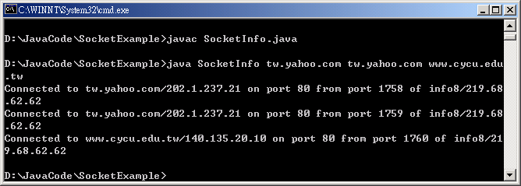
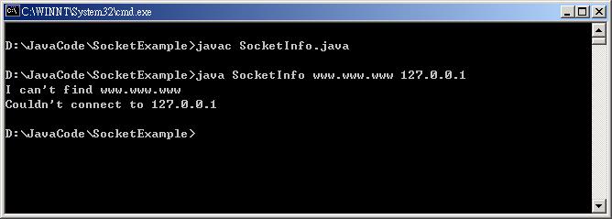
Socket
import java.net.*;
import java.io.*;
public class SocketInfo{
public static void main(String[] args){
for(int i=0 ; i<args.length ; i++){
try{
Socket MySocket = new Socket(args[i],80);
System.out.print("Connected to " + MySocket.getInetAddress());
System.out.print(" on port " + MySocket.getPort());
System.out.print(" from port " + MySocket.getLocalPort());
System.out.print(" of " + MySocket.getLocalAddress() + "\n");
}
catch(UnknownHostException e){ System.out.println("I can't find " + args[i]); }
catch(SocketException e){ System.out.println("Couldn't connect to " + args[i]); }
catch(IOException e){ System.out.println(e.toString()); }
}
}
}

Slide 11
Socket
如何建構ServerSocket？
ServerSocket() throws IOException
ServerSocket(int port) throws IOException, BindException
EX：
try{
ServerSocket myServer = new ServerSocket(8888);
}
catch(IOException e){}
catch(BindException e){}
ServerSocket(int port, int queuelength) throws IOException, BindException
EX：
try{
ServerSocket myServer = new ServerSocket(8888,5);
}
catch(IOException e){}
catch(BindException e){}

Slide 12
Socket
accept()
回傳一socket型態的物件；是ServerSocket用來等待連線的method；我們就是用這個回傳的Socket物件來跟Client端做溝通；另外，在等待連線期間，程式會停頓(block)住。
EX：
ServerSocket myServer = new ServerSocket(8888);
Socket connection = myServer.accept();

Slide 13
Socket
ServerSocket與Socket
在Server端create一個ServerSocket物件等待Client端連接
Client端的socket物件連接到Server端
Server端接到Client端的request後會create一個socket物件與Client端做溝通
由Server端的socket物件與Client端的socket物件進行互動
Server端或Client端(或雙方)關閉socket連線
Server端回到等待狀態等待下一次連線

Slide 14
Socket
Client
Server
ServerSocket
request
wait
new Socket
request
connect
new Socket
accept
send
receive
Read/Write
Data
I/O Stream
Write/Read
Data
receive
send
close Socket
close
disconnect
close Socket
close

Slide 15
Socket
Server端
import java.net.ServerSocket;
import java.net.Socket;
public class SocketServer{
public static void main(String[] args){
ServerSocket SocketServer = null;
Socket SocketConnector = null;
int count = 0;
try{
SocketServer = new ServerSocket(8888);
System.out.println("Listening at port 8888...");
while(true){
SocketConnector = SocketServer.accept();
System.out.println(++count + " Socket(s) connected...");
}
}
catch(Exception e){
System.out.println(e.toString());
}
}
}

Slide 16
Socket
Client端
import java.net.Socket;
public class SocketClient{
public static void main(String[] args){
Socket SocketClient = null;
try{
SocketClient = new Socket("localhost",8888);
System.out.println("Connected to Server...");
}
catch(Exception e){
System.out.println(e.toString());
}
}
}

Slide 17
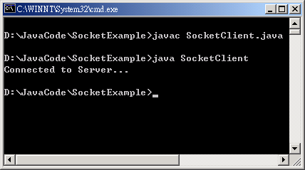
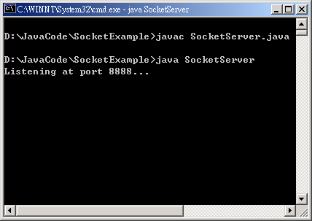
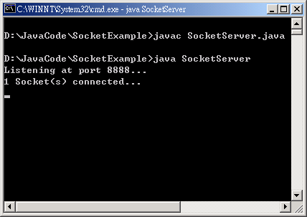
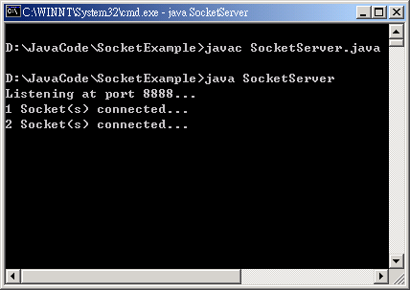
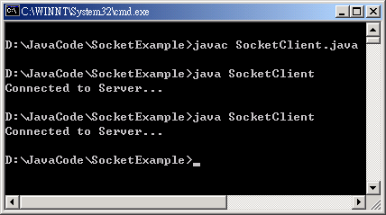
Socket
執行結果
Client
Server

Slide 18
Socket
關閉Client端的Socket
close() throws IOException
EX：
try{
Socket mySocket = new Socket("localhost",80);
}
catch(IOException e){}
finally{
if(mySocket != null)
try{
mySocket.close();
}
catch(IOException e){}
}

Slide 19
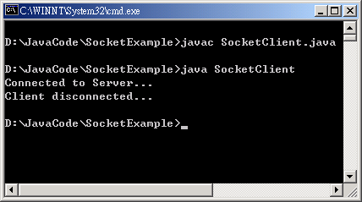
Socket
改寫後的Client端
import java.net.Socket;
public class SocketClient{
public static void main(String[] args){
Socket SocketClient = null;
try{
SocketClient = new Socket("localhost",8888);
System.out.println("Connected to Server...");
}
catch(Exception e){ System.out.println(e.toString()); }
finally{
if(SocketClient != null){
try{
SocketClient.close();
}
catch(Exception e){ System.out.println(e.toString()); }
}
System.out.println("Client disconnected...");
}
}
}

Slide 20
Socket
如何傳送資料？
利用Socket類別的getOutputStream()取得輸出串流
再利用OutputStreamWriter跟BufferedWriter建立輸出介面
呼叫BufferedWriter類別的write()跟flush()送出要送出的資料
EX：
BufferedWriter wr = new BufferedWriter(new OutputStreamWriter(SocketClient.getOutputStream()));
wr.write("Hello! How are you?");
wr.flush();

Slide 21
Socket
如何接收資料？
利用Socket類別的getInputStream()取得輸入串流
再利用InputStreamReader跟BufferedReader建立輸入介面
呼叫BufferedReader類別的readLine()接收傳送進來的資料
EX：
BufferedReader rd = new BufferedReader(new InputStreamReader(SocketClient.getInputStream()));
String str;
while ((str = rd.readLine()) != null) {
System.out.println(str);
}

Slide 22
Socket
import java.net.ServerSocket;
import java.net.Socket;
import java.io.*;
public class SocketServer2{
public static void main(String[] args){
ServerSocket SocketServer = null;
Socket SocketConnector = null;
try{
SocketServer = new ServerSocket(8888);
System.out.println("Listening at port 8888...");
while(true){
SocketConnector = SocketServer.accept();
try {
BufferedReader rd = new BufferedReader(new InputStreamReader(SocketConnector.getInputStream()));
String str;
while ((str = rd.readLine()) != null) {
System.out.println(str);
}
rd.close();
} catch (IOException e) { System.out.println(e.toString()); }
}
}
catch(Exception e){ System.out.println(e.toString()); }
}
}
Server端的程式

Slide 23
Socket
import java.net.Socket;
import java.io.*;
public class SocketClient2{
public static void main(String[] args){
Socket SocketClient = null;
try{
SocketClient = new Socket("127.0.0.1",8888);
System.out.println("Connected to Server...");
try{
BufferedWriter wr = new BufferedWriter(new OutputStreamWriter(SocketClient.getOutputStream()));
wr.write("Hello! How are you?");
wr.flush();
}
catch(IOException e){ System.out.println(e.toString()); }
}
catch(Exception e){ System.out.println(e.toString()); }
finally{
if(SocketClient != null){
try{
SocketClient.close();
}
catch(Exception e){ System.out.println(e.toString()); }
}
System.out.println("Client disconnected...");
}
}
}
Client端的程式

Slide 24
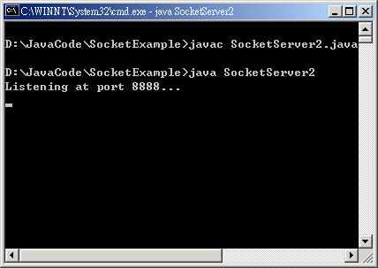
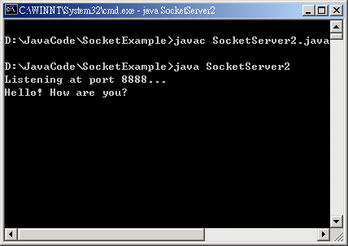
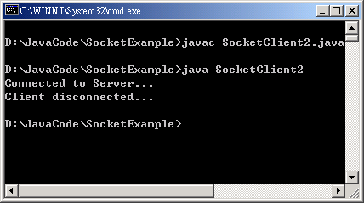
Socket
執行結果
Server
Client

Slide 25
Socket
範例：使用socket設計線上傳訊功能
利用ServerSocket的accept()等待遠端的連線
使用System.in.read()讀取使用者所鍵入要傳送的資料並將其存入StringBuffer中
使用Socket.getOutputStream()與OutputStreamWriter及BufferedWriter建立輸出資料的管道
使用Socket.getInputStream()與InputStreamReader及BufferedReader建立輸入資料的管道
使用BufferedReader.readLine()讀取接收到的資料及BufferedWriter.flush()送出要傳送的資料

Slide 26
Socket
import java.net.*;
import java.io.*;
public class SocketServer3{
public static void main(String[] args){
ServerSocket SocketServer = null;
Socket SocketConnector = null;
try{
SocketServer = new ServerSocket(8888);
System.out.println("Listening at port 8888...");
while(true){
SocketConnector = SocketServer.accept();
BufferedReader rd = new BufferedReader(new InputStreamReader(SocketConnector.getInputStream()));
BufferedWriter wr = new BufferedWriter(new OutputStreamWriter(SocketConnector.getOutputStream()));
String str;
int ch;
while(true){
while((str = rd.readLine()) != null){
if(str.length() > 0 ){
System.out.println(str);
break;
}
}
System.out.print(">");
StringBuffer sb = new StringBuffer();
while ( (ch = System.in.read()) != 13)
sb.append( (char) ch );
sb.append((char)13);
wr.write(sb.toString());
wr.flush();
}
}
}
catch(Exception e){
System.out.println(e.toString());
}
}
}
Server端的Socket
等待遠端的連線
建立與遠端Socket的資料
輸入與資料輸出的管道
等待資料傳入並接收資
料且列印在螢幕上
讀取使用者所鍵入的資
料將其傳送至遠端的
Socket
SERVER端

Slide 27
Socket
import java.net.Socket;
import java.io.*;
public class SocketClient3{
public static void main(String[] args){
Socket SocketClient = null;
try{
SocketClient = new Socket("localhost",8888);
System.out.println("Connected to Server...");
BufferedWriter wr = new BufferedWriter(new OutputStreamWriter(SocketClient.getOutputStream()));
BufferedReader rd = new BufferedReader(new InputStreamReader(SocketClient.getInputStream()));
int ch;
String str;
while (true) {
System.out.print(">");
StringBuffer sb = new StringBuffer();
while ( (ch = System.in.read()) != 13)
sb.append( (char) ch );
sb.append((char)13);
wr.write(sb.toString());
wr.flush();
while((str = rd.readLine()) != null){
if(str.length() > 0 ){
System.out.println(str);
break;
}
}
}
}
catch(Exception e){
System.out.println(e.toString());
}
finally{ if(SocketClient != null){
try{ SocketClient.close(); }
catch(Exception e){ System.out.println(e.toString()); }
} System.out.println("Client disconnected...");
}
}
}
建立與Server端Socket的資
料輸入與資料輸出的管道
讀取使用者所鍵入的
資料將其傳送至Server
端的Socket
等待資料傳入並接收資
料且列印在螢幕上
在所有程式執行完畢後
將與Server的連線關閉
CLIENT端

Slide 28
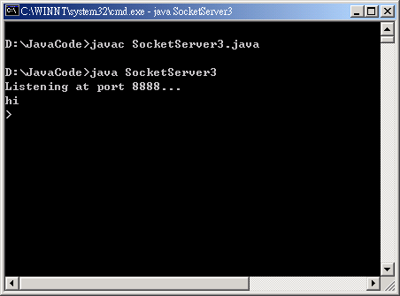
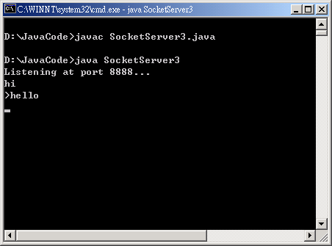
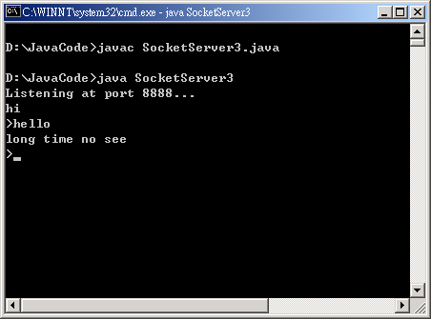
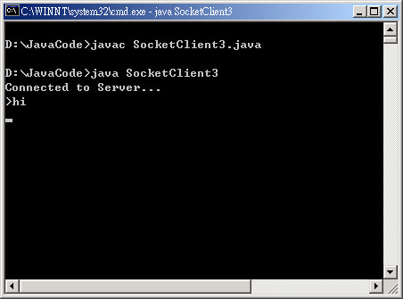




Socket
SERVER端
CLIENT端

