Slide 1
Java程式設計之五
Thread and Socket
陳興夏 編輯

Slide 2
Java 重要內建封包
Thread (java.lang.Thread)
Socket (java.net.Socket, java.net.ServerSocket)

Slide 3
Thread
每一個執行中的程式都是一個執行緒
讓程式能夠同時做兩件以上事情時，你需要執行緒(thread)來做，稱為多工
Single thread
讀取資料
運算處理
輸出資料
讀取資料
運算處理
輸出資料
……
Time
Multiple threads
thread1
讀取資料
運算處理
輸出資料
讀取資料
運算處理
輸出資料
……
thread2
讀取資料
運算處理
輸出資料
讀取資料
運算處理
……
thread3
讀取資料
運算處理
輸出資料
讀取資料
……

Slide 4
Thread
如何建立執行緒並執行？
使用Thread的建構子建立執行緒
呼叫start()來啟動執行緒
呼叫stop()停止執行緒
EX：
Thread thread1 = new thread();
//建立名為thread1的執行緒
thread1.start();
//啟動thread1
thread1.stop();
//停止thread1

Slide 5
Thread
執行緒的執行示意圖
thread1
main thread
run(){
//code for thread1
}
main(){
//create thread1
//start thread1
//create thread2
//start thread2
//create thread3
//start thread3
}
thread2
run(){
//code for thread2
}
thread3
run(){
//code for thread3
}

Slide 6
Thread
Daemon thread & User thread
Daemon thread(駐留程式執行緒)：
也就是背景執行緒，附屬於建立它的那個執行緒，當建立Daemon thread的執行緒結束時，Daemon thread也會跟著結束
User thread(使用者執行緒)：
擁有獨立的生命週期，當建立它的執行緒結束時，User thread會繼續執行
用setDaemon()來設定是否為Daemon thread，傳入型態為 boolean的變數

Slide 7
Thread
讓執行緒暫停
sleep(long millis)傳入型態為long的變數，單位是毫秒
sleep(long millis,int nanos)傳入型態為long的變數，單位是毫秒以及型態為int的變數，單位是毫微秒
中斷執行緒(幫執行緒做標記)
interrupt()：替執行緒設定一個停止標記
isInterrupted()：檢查執行緒是否已中斷，回傳一boolean變數
interrupted()：可清除已設定的停止標記

Slide 8
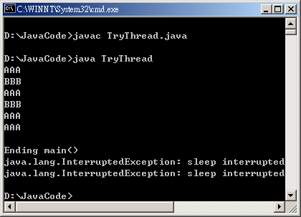
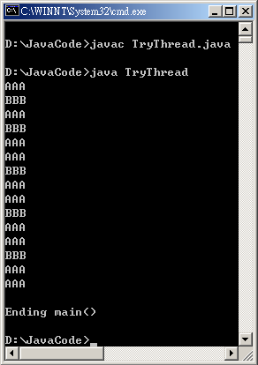
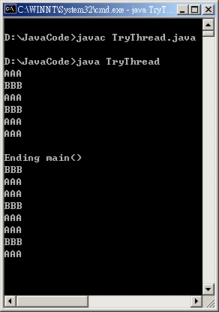
Thread
T1
T2
Time
Example
import java.io.IOException;
public class TryThread extends Thread{
String name;
long awhile;
public TryThread(String a,long delay){
name = a;
awhile = delay;
setDaemon(true);
}
public static void main(String[] args){
Thread T1 = new TryThread("AAA",1000L);
Thread T2 = new TryThread("BBB",2000L);
T1.start();
T2.start();
try{
System.in.read();
}
catch(IOException e){
System.out.println(e);
}
System.out.println("Ending main()");
}
public void run(){
try{
while(true){
System.out.println(name);
sleep(awhile);
}
}
catch(InterruptedException e){
System.out.println(e);
}
}
}
AAA
BBB
0
AAA
1000
AAA
BBB
2000
AAA
3000
AAA
BBB
4000
AAA
5000
AAA
BBB
6000
T1.interrupt();
T2.interrupt();
AAA
7000
AAA
BBB
8000
………

Slide 9
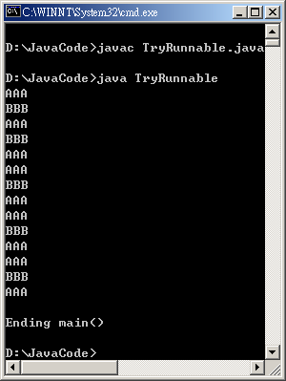
Thread
改寫TryThread，使用Runnable介面並實作run()
import java.io.IOException;
public class TryRunnable implements Runnable{
String name;
long awhile;
public TryRunnable(String a,long delay){
name = a;
awhile = delay;
}
public static void main(String[] args){
Thread T1 = new Thread(new TryRunnable("AAA",1000L));
Thread T2 = new Thread(new TryRunnable("BBB",2000L));
T1.setDaemon(true);
T2.setDaemon(true);
T1.start();
T2.start();
try{
System.in.read();
}
catch(IOException e){
System.out.println(e);
}
System.out.println("Ending main()");
}
public void run(){
try{
while(true){
System.out.println(name);
Thread.sleep(awhile);
}
}
catch(InterruptedException e){
System.out.println(name+e);
}
}
}

Slide 10
Thread
設定優先順序(Priority)
優先順序的最大值是由MAX_PRIORITY定義的，其值為10；最小值是由MIN_PRIORITY定義的，其值為1；程式中，執行緒的預設優先順序是NORM_PRIORITY，其值為5
getPriority()：回傳執行緒的優先順序，型態是int
setPriority(int i)：傳入一int型態的參數，若小於1或大於10將會拋出IllegalArgumentException

Slide 11
Thread
管理執行緒的方法
使用同步化(synchronized)
確保當多個執行緒要存取單一資源時，只有一個執行緒可在指定的時間內存取它
可用於函式，稱為同步化函式
Ex：synchronized public void method1(){……}
可用於程式區塊，稱為同步化區塊
Ex：synchronized(Object){……}

Slide 12
Thread
Thread1
Thread2
Thread3
run(){
Obj1.method2();
}
run(){
Obj1.method3();
Obj1.method2();
Obj2.Method1();
}
run(){
Obj2.method3();
Obj2.method2();
}
Always
OK
OK
OK
Always
OK
Obj1
Obj2
synchronized
method1()
synchronized
method2()
method3()
NO!
Obj1.method2 is
executing
synchronized
method1()
synchronized
method2()
method3()
NO!
Obj2.method1 is
executing

Slide 13
Thread
currentThread()
回傳當時正在執行的Thread物件
Ex：Thread.currentThread();
getName()
回傳該Thread物件的名稱，型態為String
Ex：Thread1.getName();
join()
在正在執行中的執行緒裡等待另一個執行緒結束
Ex：Thread1.join();

Slide 14
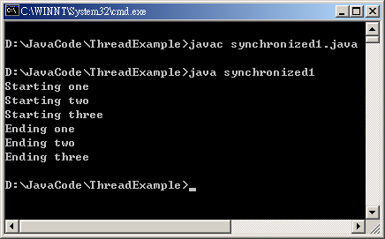
Thread
public class synchronized1{
public static void main(String[] args){
Shared shared = new Shared();
CustomThread CT1 = new CustomThread(shared,"one");
CustomThread CT2 = new CustomThread(shared,"two");
CustomThread CT3 = new CustomThread(shared,"three");
try{
CT1.join();
CT2.join();
CT3.join();
}
catch(InterruptedException e){}
}
}
class CustomThread extends Thread{
Shared shared;
public CustomThread(Shared shared,String name){
super(name);
this.shared = shared;
start();
}
public void run(){
shared.doWork(Thread.currentThread().getName());
}
}
class Shared{
void doWork(String name){
System.out.println("Starting "+name);
try{
Thread.sleep(1L);
}
catch(InterruptedException e){}
System.out.println("Ending " +name);
}
}

Slide 15
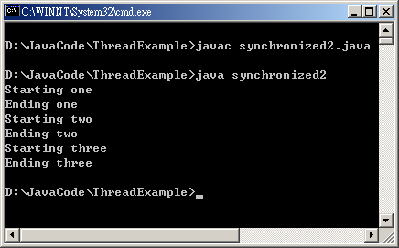
Thread
public class synchronized2{
public static void main(String[] args){
Shared shared = new Shared();
CustomThread CT1 = new CustomThread(shared,"one");
CustomThread CT2 = new CustomThread(shared,"two");
CustomThread CT3 = new CustomThread(shared,"three");
try{
CT1.join();
CT2.join();
CT3.join();
}
catch(InterruptedException e){}
}
}
class CustomThread extends Thread{
Shared shared;
public CustomThread(Shared shared,String name){
super(name);
this.shared = shared;
start();
}
public void run(){
shared.doWork(Thread.currentThread().getName());
}
}
class Shared{
synchronized void doWork(String name){
System.out.println("Starting "+name);
try{
Thread.sleep(100L);
}
catch(InterruptedException e){}
System.out.println("Ending " +name);
}
}

Slide 16

Thread
public class synchronized3{
public static void main(String[] args){
Shared shared = new Shared();
CustomThread CT1 = new CustomThread(shared,"one");
CustomThread CT2 = new CustomThread(shared,"two");
CustomThread CT3 = new CustomThread(shared,"three");
try{
CT1.join();
CT2.join();
CT3.join();
}
catch(InterruptedException e){}
}
}
class CustomThread extends Thread{
Shared shared;
public CustomThread(Shared shared,String name){
super(name);
this.shared = shared;
start();
}
public void run(){
synchronized(shared){
shared.doWork(Thread.currentThread().getName());
}
}
}
class Shared{
void doWork(String name){
System.out.println("Starting "+name);
try{
Thread.sleep(100L);
}
catch(InterruptedException e){}
System.out.println("Ending " +name);
}
}

Slide 17
Thread
死鎖(Deadlock)
較容易發生在使用同步化區塊時。因為執行時，程式會將傳入的物件作同步化，也就是鎖定不讓其它執行緒呼叫該物件的任何函式，若有兩個執行緒互相鎖定對方要執行的物件函式，則兩個執行緒將都無法繼續執行下去

Slide 18
Thread
Thread1
Thread1呼叫sleep函式
Thread2 在此時啟動
Thread2
run(){
synchronized(OneObject){
sleep(1000L);
……
AnotherObject.method2();
}
}
run(){
synchronized(AnotherObject){
sleep(1000L);
……
OneObject.method1();
}
}
Thread2呼叫sleep函式
Thread1獲得執行權
OneObject
Thread1
鎖定物件
OneObject
method1()
因為Thread1無法繼續
執行，Thread2再次獲
得執行權，卻也無法
執行OneObject的
method1()
AnotherObject
method2()
Thread2
鎖定物件
AnotherObject
Thread1無法繼續執行AontherObject的
method2()，除非Thread2中的同步化
區塊執行完畢

Slide 19
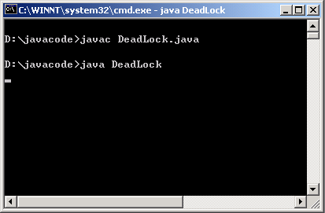
Thread
Example
class CustomThread1 extends Thread{
Shared shared1,shared2;
public CustomThread1(Shared shared1,Shared shared2,String name){
super(name);
this.shared1 = shared1;
this.shared2 = shared2;
start();
}
public void run(){
synchronized(shared1){
try{
Thread.sleep(1000L);
}
catch(Exception e){}
synchronized(shared2){
shared2.doWork(Thread.currentThread().getName());
}
}
}
}
class CustomThread2 extends Thread{
Shared shared1,shared2;
public CustomThread2(Shared shared1,Shared shared2,String name){
super(name);
this.shared1 = shared1;
this.shared2 = shared2;
start();
}
public void run(){
synchronized(shared2){
try{
Thread.sleep(1000L);
}
catch(Exception e){}
synchronized(shared1){
shared1.doWork(Thread.currentThread().getName());
}
}
}
}
class Shared{
void doWork(String name){
System.out.println("Starting "+name);
System.out.println("Ending " +name);
}
}
public class DeadLock{
public static void main(String[] args){
Shared shared1 = new Shared();
Shared shared2 = new Shared();
CustomThread1 CT1 = new CustomThread1(shared1,shared2,"one");
CustomThread2 CT2 = new CustomThread2(shared1,shared2,"two");
}
}

Slide 20
Socket
Socket是什麼？
插槽的概念
介於兩部主機之間的連線
Client
Server
Request
Response
ClientSocket
ServerSocket

Slide 21
Socket
Socket能做什麼？
連接到遠端機器
傳送資料
接收資料
關閉連線
繫結到特定通訊埠
接受遠端機器從繫結通訊埠進來的連線

Slide 22
Socket
如何建構Socket？
Socket()
Socket( String host, int port ) throws IOException, UnknownHostException
EX：
try{
Socket mySocket = new Socket("localhost",80);
}
catch(IOException e){}
catch(UnknownHostException e){}
Socket( InetAddress host, int port) throws IOException
EX：
try{
InetAddress addr = new InetAddress.getByName("www.cycu.edu.tw");
Socket mySocket = new Socket(addr,80);
}
catch(IOException e){}
catch(UnknownHostException e){}

Slide 23
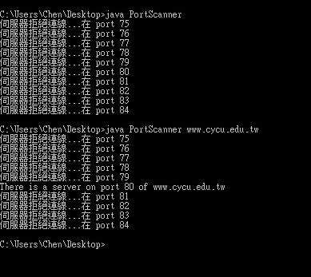
Socket
import java.net.*;
import java.io.*;
public class PortScanner{
public static void main(String[] args){
String host = "localhost";
if(args.length>0)
host = args[0];
for(int i=75 ; i< 85 ; i++){
try{
Socket s = new Socket(host,i);
System.out.println("There is a server on port " + i + " of " + host);
}
catch(UnknownHostException e){
System.out.println(e.toString());
break;
}
catch(ConnectException e){ System.out.println("伺服器拒絕連線...在 port " + i); }
catch(IOException e){ System.out.println(e.toString()); }
}
}
}

Slide 24
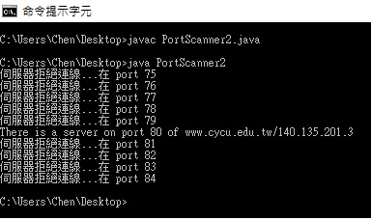
Socket
import java.net.*;
import java.io.*;
public class PortScanner2{
public static void main(String[] args){
InetAddress host = null;
try{
host = InetAddress.getByName("www.cycu.edu.tw");
}
catch(UnknownHostException e){ System.out.println(e.toString()); }
for(int i=75 ; i< 85 ; i++){
try{
Socket s = new Socket(host,i);
System.out.println("There is a server on port " + i + " of " + host);
}
catch(ConnectException e){ System.out.println("伺服器拒絕連線...在 port " + i); }
catch(IOException e){ System.out.println(e.toString()); }
}
}
}

Slide 25
Socket
取得Socket的資訊
getInetAddress()
回傳一InetAddress型態的物件；紀錄該socket物件所連接的遠端主機位址，若該socket物件尚未連接到遠端主機，則回傳null
getPort()
回傳一int型態的變數；紀錄該socket物件連接到遠端主機的那一個通訊埠，若該socket物件尚未連接到遠端主機，則回傳0

Slide 26
Socket
取得Socket的資訊
getLocalAddress()
回傳一InetAddress型態的物件；紀錄該socket是繫結在本地端的那一個網路介面，若是該socket物件尚未繫結，則回傳InetAddress.anyLocalAddress()
getLocalPort()
回傳一int型態的變數；紀錄該socket是繫結在本地端的那一個通訊埠，若該socket尚未繫結，則回傳-1

Slide 27
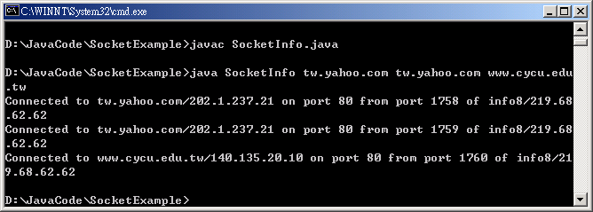
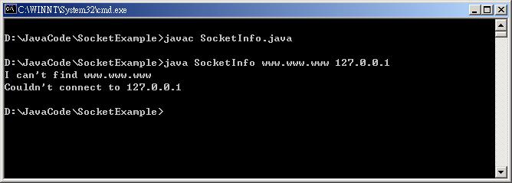
Socket
import java.net.*;
import java.io.*;
public class SocketInfo{
public static void main(String[] args){
for(int i=0 ; i<args.length ; i++){
try{
Socket MySocket = new Socket(args[i],80);
System.out.print("Connected to " + MySocket.getInetAddress());
System.out.print(" on port " + MySocket.getPort());
System.out.print(" from port " + MySocket.getLocalPort());
System.out.print(" of " + MySocket.getLocalAddress() + "\n");
}
catch(UnknownHostException e){ System.out.println("I can't find " + args[i]); }
catch(SocketException e){ System.out.println("Couldn't connect to " + args[i]); }
catch(IOException e){ System.out.println(e.toString()); }
}
}
}

Slide 28
Socket
如何建構ServerSocket？
ServerSocket() throws IOException
ServerSocket(int port) throws IOException, BindException
EX：
try{
ServerSocket myServer = new ServerSocket(8888);
}
catch(IOException e){}
catch(BindException e){}
ServerSocket(int port, int queuelength) throws IOException, BindException
EX：
try{
ServerSocket myServer = new ServerSocket(8888,5);
}
catch(IOException e){}
catch(BindException e){}

Slide 29
Socket
accept()
回傳一socket型態的物件；是ServerSocket用來等待連線的method；我們就是用這個回傳的Socket物件來跟Client端做溝通；另外，在等待連線期間，程式會停頓(block)住。
EX：
ServerSocket myServer = new ServerSocket(8888);
Socket connection = myServer.accept();

Slide 30
Socket
ServerSocket與Socket
在Server端create一個ServerSocket物件等待Client端連接
Client端的socket物件連接到Server端
Server端接到Client端的request後會create一個socket物件與Client端做溝通
由Server端的socket物件與Client端的socket物件進行互動
Server端或Client端(或雙方)關閉socket連線
Server端回到等待狀態等待下一次連線

Slide 31
Socket
Client
Server
ServerSocket
request
wait
new Socket
request
connect
new Socket
accept
send
receive
Read/Write
Data
I/O Stream
Write/Read
Data
receive
send
close Socket
close
disconnect
close Socket
close

Slide 32
Socket
Server端
import java.net.ServerSocket;
import java.net.Socket;
public class SocketServer{
public static void main(String[] args){
ServerSocket SocketServer = null;
Socket SocketConnector = null;
int count = 0;
try{
SocketServer = new ServerSocket(8888);
System.out.println("Listening at port 8888...");
while(true){
SocketConnector = SocketServer.accept();
System.out.println(++count + " Socket(s) connected...");
}
}
catch(Exception e){
System.out.println(e.toString());
}
}
}

Slide 33
Socket
Client端
import java.net.Socket;
public class SocketClient{
public static void main(String[] args){
Socket SocketClient = null;
try{
SocketClient = new Socket("localhost",8888);
System.out.println("Connected to Server...");
}
catch(Exception e){
System.out.println(e.toString());
}
}
}

Slide 34
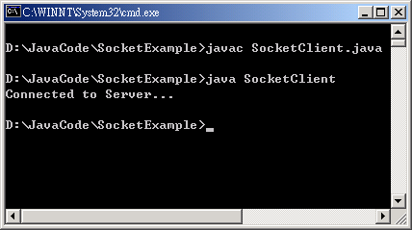
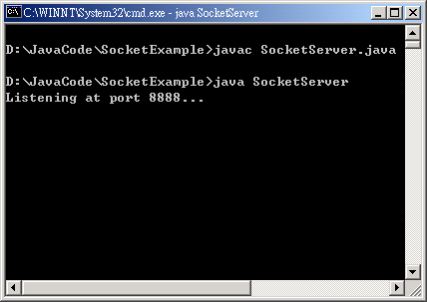
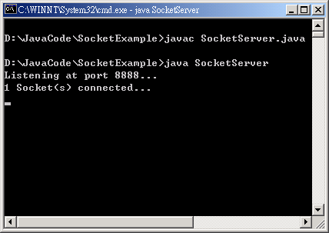
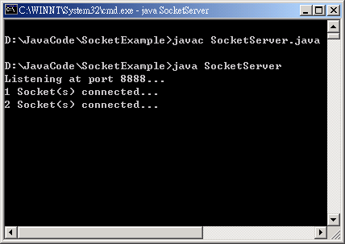
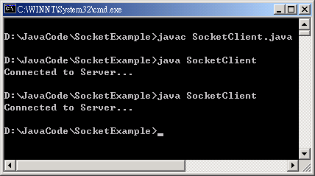
Socket
執行結果
Client
Server

Slide 35
Socket
關閉Client端的Socket
close() throws IOException
EX：
try{
Socket mySocket = new Socket("localhost",80);
}
catch(IOException e){}
finally{
if(mySocket != null)
try{
mySocket.close();
}
catch(IOException e){}
}

Slide 36
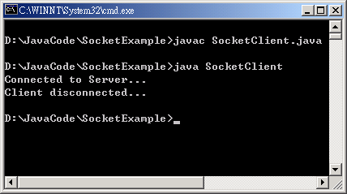
Socket
改寫後的Client端
import java.net.Socket;
public class SocketClient{
public static void main(String[] args){
Socket SocketClient = null;
try{
SocketClient = new Socket("localhost",8888);
System.out.println("Connected to Server...");
}
catch(Exception e){ System.out.println(e.toString()); }
finally{
if(SocketClient != null){
try{
SocketClient.close();
}
catch(Exception e){ System.out.println(e.toString()); }
}
System.out.println("Client disconnected...");
}
}
}

Slide 37
Socket
如何傳送資料？
利用Socket類別的getOutputStream()取得輸出串流
再利用OutputStreamWriter跟BufferedWriter建立輸出介面
呼叫BufferedWriter類別的write()跟flush()送出要送出的資料
EX：
BufferedWriter wr = new BufferedWriter(new OutputStreamWriter(SocketClient.getOutputStream()));
wr.write("Hello! How are you?");
wr.flush();

Slide 38
Socket
如何接收資料？
利用Socket類別的getInputStream()取得輸入串流
再利用InputStreamReader跟BufferedReader建立輸入介面
呼叫BufferedReader類別的readLine()接收傳送進來的資料
EX：
BufferedReader rd = new BufferedReader(new InputStreamReader(SocketClient.getInputStream()));
String str;
while ((str = rd.readLine()) != null) {
System.out.println(str);
}

Slide 39
Socket
import java.net.ServerSocket;
import java.net.Socket;
import java.io.*;
public class SocketServer2{
public static void main(String[] args){
ServerSocket SocketServer = null;
Socket SocketConnector = null;
try{
SocketServer = new ServerSocket(8888);
System.out.println("Listening at port 8888...");
while(true){
SocketConnector = SocketServer.accept();
try {
BufferedReader rd = new BufferedReader(new InputStreamReader(SocketConnector.getInputStream()));
String str;
while ((str = rd.readLine()) != null) {
System.out.println(str);
}
rd.close();
} catch (IOException e) { System.out.println(e.toString()); }
}
}
catch(Exception e){ System.out.println(e.toString()); }
}
}
Server端的程式

Slide 40
Socket
import java.net.Socket;
import java.io.*;
public class SocketClient2{
public static void main(String[] args){
Socket SocketClient = null;
try{
SocketClient = new Socket("127.0.0.1",8888);
System.out.println("Connected to Server...");
try{
BufferedWriter wr = new BufferedWriter(new OutputStreamWriter(SocketClient.getOutputStream()));
wr.write("Hello! How are you?");
wr.flush();
}
catch(IOException e){ System.out.println(e.toString()); }
}
catch(Exception e){ System.out.println(e.toString()); }
finally{
if(SocketClient != null){
try{
SocketClient.close();
}
catch(Exception e){ System.out.println(e.toString()); }
}
System.out.println("Client disconnected...");
}
}
}
Client端的程式

Slide 41
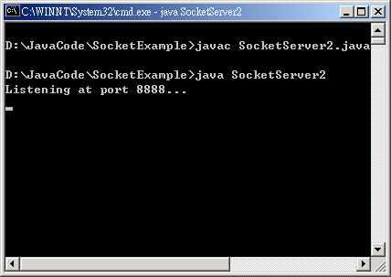
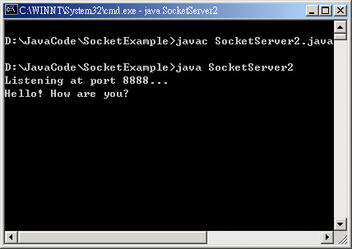
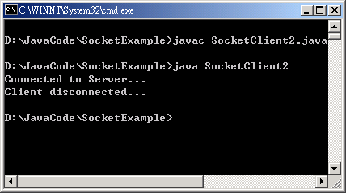
Socket
執行結果
Server
Client

Slide 42
Socket
範例：使用socket設計線上傳訊功能
利用ServerSocket的accept()等待遠端的連線
使用System.in.read()讀取使用者所鍵入要傳送的資料並將其存入StringBuffer中
使用Socket.getOutputStream()與OutputStreamWriter及BufferedWriter建立輸出資料的管道
使用Socket.getInputStream()與InputStreamReader及BufferedReader建立輸入資料的管道
使用BufferedReader.readLine()讀取接收到的資料及BufferedWriter.flush()送出要傳送的資料

Slide 43
Socket
import java.net.*;
import java.io.*;
public class SocketServer3{
public static void main(String[] args){
ServerSocket SocketServer = null;
Socket SocketConnector = null;
try{
SocketServer = new ServerSocket(8888);
System.out.println("Listening at port 8888...");
while(true){
SocketConnector = SocketServer.accept();
BufferedReader rd = new BufferedReader(new InputStreamReader(SocketConnector.getInputStream()));
BufferedWriter wr = new BufferedWriter(new OutputStreamWriter(SocketConnector.getOutputStream()));
String str;
int ch;
while(true){
while((str = rd.readLine()) != null){
if(str.length() > 0 ){
System.out.println(str);
break;
}
}
System.out.print(">");
StringBuffer sb = new StringBuffer();
while ( (ch = System.in.read()) != 13)
sb.append( (char) ch );
sb.append((char)13);
wr.write(sb.toString());
wr.flush();
}
}
}
catch(Exception e){
System.out.println(e.toString());
}
}
}
Server端的Socket
等待遠端的連線
建立與遠端Socket的資料
輸入與資料輸出的管道
等待資料傳入並接收資
料且列印在螢幕上
讀取使用者所鍵入的資
料將其傳送至遠端的
Socket
SERVER端

Slide 44
Socket
import java.net.Socket;
import java.io.*;
public class SocketClient3{
public static void main(String[] args){
Socket SocketClient = null;
try{
SocketClient = new Socket("localhost",8888);
System.out.println("Connected to Server...");
BufferedWriter wr = new BufferedWriter(new OutputStreamWriter(SocketClient.getOutputStream()));
BufferedReader rd = new BufferedReader(new InputStreamReader(SocketClient.getInputStream()));
int ch;
String str;
while (true) {
System.out.print(">");
StringBuffer sb = new StringBuffer();
while ( (ch = System.in.read()) != 13)
sb.append( (char) ch );
sb.append((char)13);
wr.write(sb.toString());
wr.flush();
while((str = rd.readLine()) != null){
if(str.length() > 0 ){
System.out.println(str);
break;
}
}
}
}
catch(Exception e){
System.out.println(e.toString());
}
finally{ if(SocketClient != null){
try{ SocketClient.close(); }
catch(Exception e){ System.out.println(e.toString()); }
} System.out.println("Client disconnected...");
}
}
}
建立與Server端Socket的資
料輸入與資料輸出的管道
讀取使用者所鍵入的
資料將其傳送至Server
端的Socket
等待資料傳入並接收資
料且列印在螢幕上
在所有程式執行完畢後
將與Server的連線關閉
CLIENT端

Slide 45
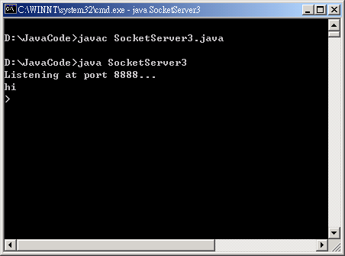
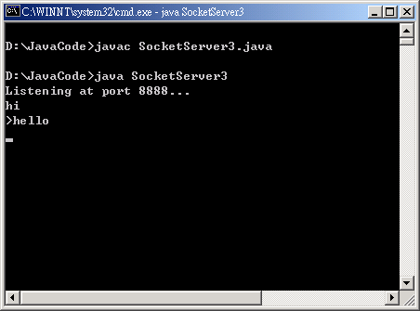
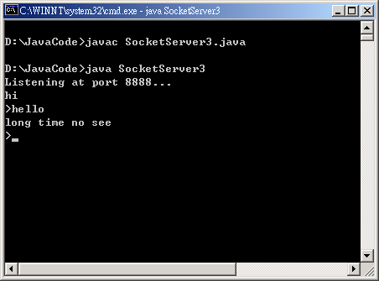
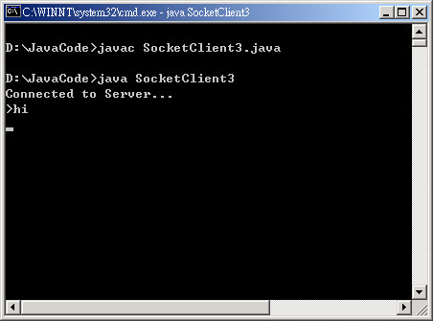




Socket
SERVER端
CLIENT端

