Slide 1
Memory compiler tutorial – TSMC 40nm technology
2022/08/05
Ref: Shih Wei Hsieh

Slide 2
Outline
Memory Compiler Introduction
Memory Compiler Interface
Parameters
Files Generation
Using the Files
Memory Ports
Lab #1 – Dual-Port SRAM
Lab #2 – Asynchronous FIFO

Slide 3
Memory Compiler Introduction
*不包括DRAM
Memory compiler is the SRAM/ Register File/ ROM generator for ASIC design. The generated files include:
User guide
Verilog model (for simulation)
Timing information (for synthesis and APR)
Physical layout (for APR)
We will focus on the Memory compiler for TSMC 40nm technology
Settings should be similar for other technology nodes
Location:
90nm: /cad/cell_library/CBDK_TSMC90G_Arm/CIC/Memory/
40nm: /cad/cell_library/CBDK_TSMC40_Arm_f2.0/CIC/Memory/

Slide 4
Memory Compiler Introduction
Folders:
Single-port: 1 read or 1 write per clock
Two-port: 1 read or 1 write or 1 read+ 1 write per clock
Dual-port: 2 reads or 2 writes or 1 read+ 1 write per clock
Directory name | Generate type
rf_2p_hse_rvt_hvt_rvt/ | High-speed two-port register file
rf_sp_hde_rvt_hvt_rvt/ | High-density single-port register file
rf_sp_hsd_rvt_rvt_hvt/ | High-speed single-port register file
rom_via_rvt_hvt_rvt/ | ROM
sram_dp_hde_rvt_hvt_rvt | High-density dual-port SRAM
sram_sp_hde_rvt_hvt_rvt/ | High-density single-port SRAM
sram_sp_hsc_rvt_hvt_rvt/ | High-speed single-port SRAM

Slide 5
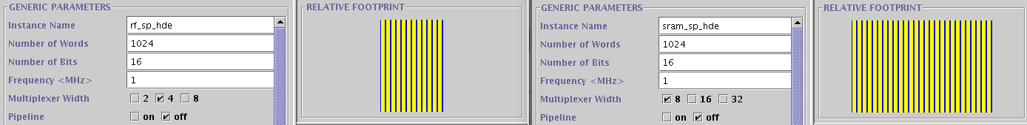
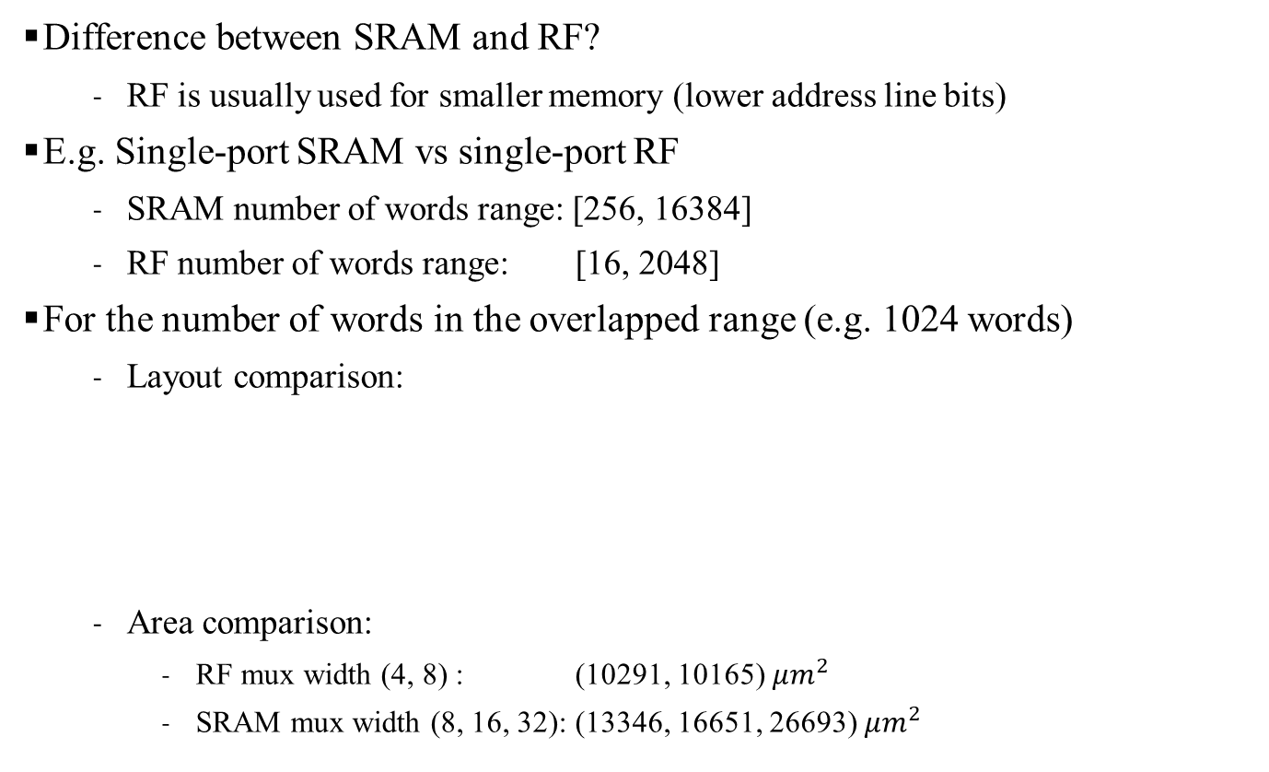
Memory Compiler Introduction
Difference between SRAM and RF?
RF is usually used for smaller memory (lower address line bits)
E.g. Single-port SRAM vs single-port RF
SRAM number of words range: [256, 16384]
RF number of words range: [16, 2048]
For the number of words in the overlapped range (e.g. 1024 words)
Layout comparison:
Area comparison:
RF mux width (4, 8) : (10291, 10165) $μm^{2}$
SRAM mux width (8, 16, 32): (13346, 16651, 26693) $μm^{2}$
RF
SRAM

Slide 6
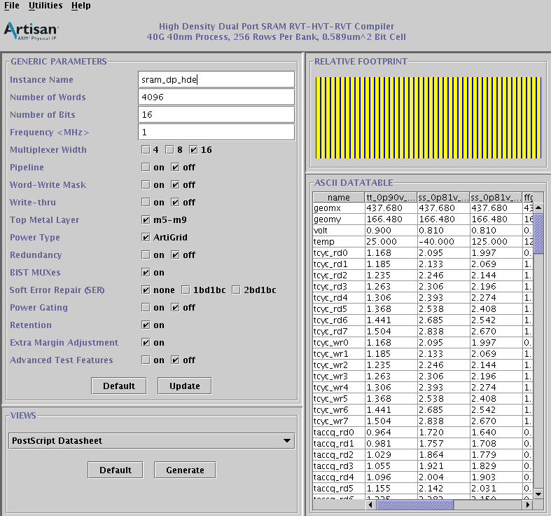
Memory Compiler – Parameters
Interface (take dual-port SRAM for example):
execute the following command
/cad/cell_library/CBDK_TSMC40_Arm_f2.0/CIC/Memory/sram_dp_hde_rvt_hvt_rvt/r5p0/bin/sram_dp_hde_rvt_hvt_rvt
*可加 &背景執行

Slide 7
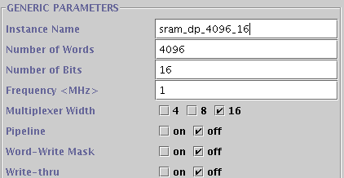

Memory Compiler – Parameters
Usually we only modify:
Name
Number of words
Number of bits
Multiplexer Width
(Word-write mask)
Multiplexer width:
You should not read and write in the same clock where the address difference $<$ multiplexer width to avoid row contention
Otherwise, the read or write operation might fail

Slide 8
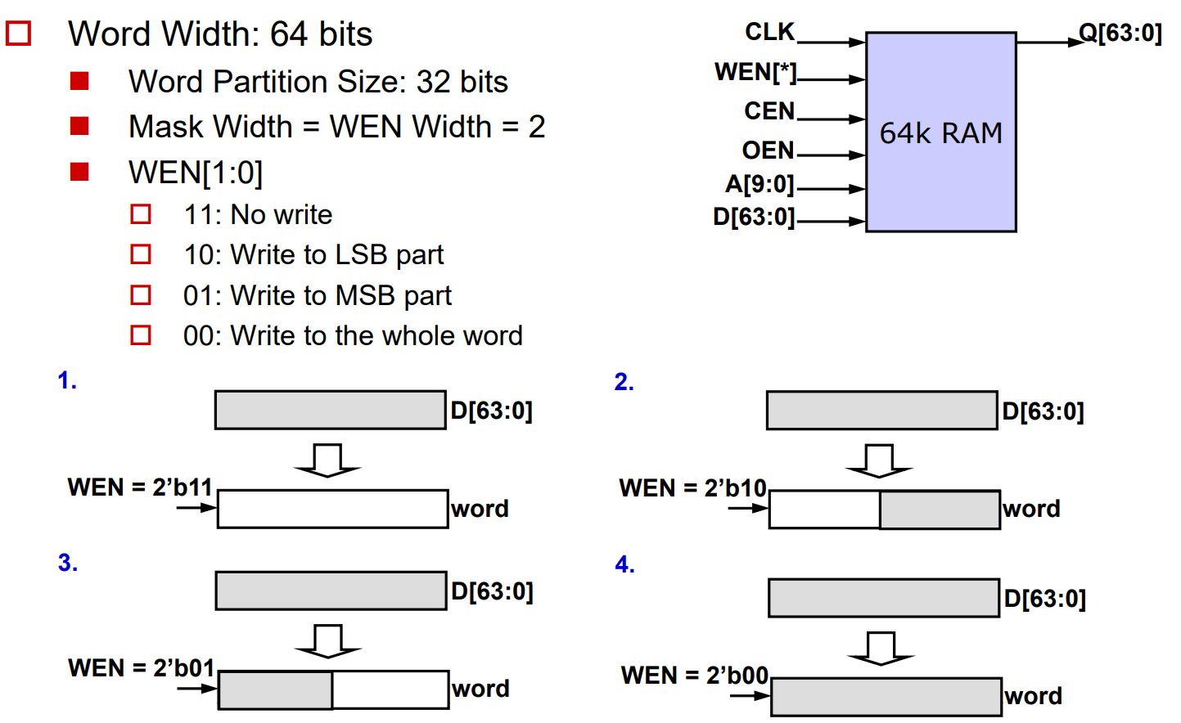
Memory Compiler – Parameters
Word-write mask:
Useful when you don’t want to write the whole word but part of the word
*與mask重疊的部分直接丟掉
Ref: http://www.ee.ncu.edu.tw/~jfli/vlsidi/lecture08/design-compiler

Slide 9
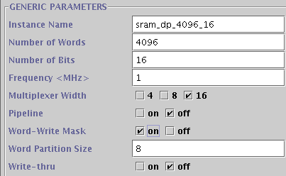

Memory Compiler – Parameters
Word-write mask:
Useful when you don’t want to write the whole word but part of the word
Word partition option will appear after you check the word-write box
Without word-write mask, you have to do the following steps to achieve the same result:
Read the content first $→$ change part of the data $→$ write the whole word back
*單位為bit
*Like in FPGA，需要直接手寫出對data的處理

Slide 10
Memory Compiler – Parameters
Pipeline:
A flip-flop is placed between the output of the memory and QA
Write-through:
The data written into the memory is propagated through to the output port
If you are interested in other options, you can find the detail explanation in the user guide document located at */Memory/*/*/doc/*_userguide.pdf
E.g. /cad/cell_library/CBDK_TSMC40_Arm_f2.0/CIC/Memory/sram_dp_hde_rvt_hvt_rvt/r5p0/doc/sram_dp_hde_rvt_hvt_rvt_userguide.pdf

Slide 11
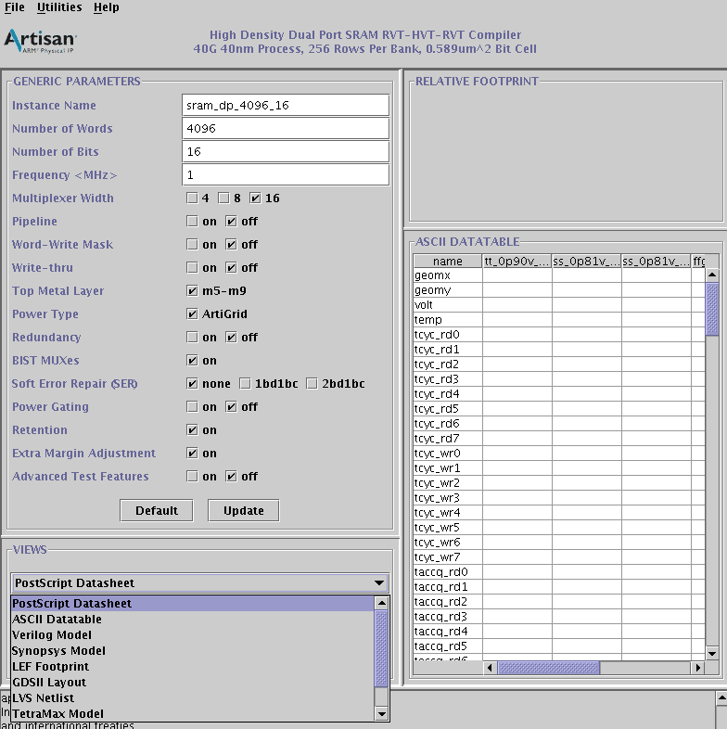
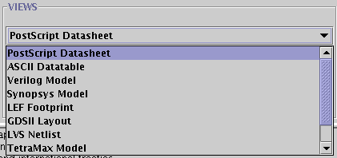
Memory Compiler – Files Generation
You will only need:
Verilog model (.v): for ncverilog simulation
Synopsys model (.lib): timing information for synthesis and APR tool
LEF footprint (.lef/ .clf): physical layout for the APR tool
PostScript DataSheet (.ps) (optional): user guide

Slide 12
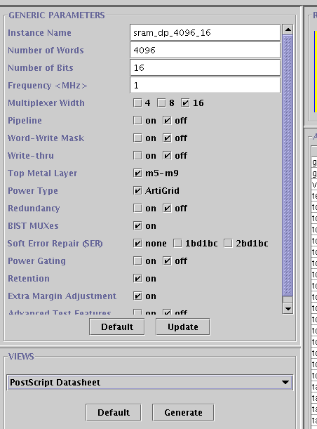
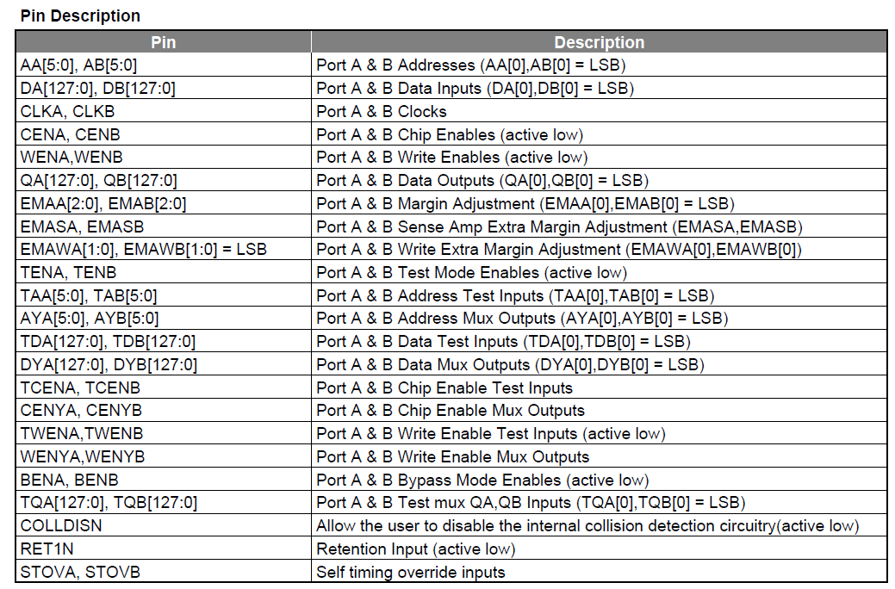
Memory Compiler – Files Generation
PostScript DataSheet (.ps)
The generated files are ps files
Convert to PDF: ps2pdf *.ps
You can find the pin description in the document
1.
2.
Pin description for the DP-SRAM

Slide 13
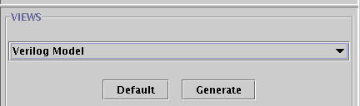
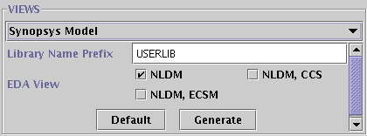
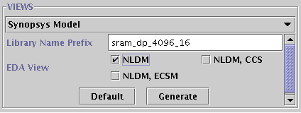
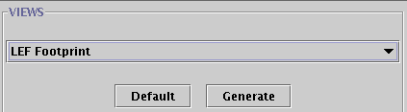
Memory Compiler – Files Generation
Verilog model
Synopsis model
The default library name is “USERLIB”
It is recommended that you change the name to your instance name
Use lc_shell to convert .lib to .db (necessary)
LEF Footprint
3.
4.
5.
6.

Slide 14
Memory Compiler – Files Generation
Use lc_shell to convert .lib to .db (necessary)
Step.1 Open library compiler with lc_shell
Step.2 Read library (read_lib *.lib)
Step.3 Convert to db (write_lib * -o *.db)
We will convert three different corners
Slow: ss + 125c
Typical: tt + 25c
Fast: ff + m40c
*注意不要打錯字喔
>> read_lib sram_dp_64x128_nldm_tt_0p90v_0p90v_25c_syn.lib
Library file
Library name (will be “USERLIB_...” if you didn’t change the name )
>> write_lib sram_dp_64x128_nldm_tt_0p90v_0p90v_25c
-o sram_dp_64x128_nldm_tt_0p90v_0p90v_25c_syn.db
db file

Slide 15
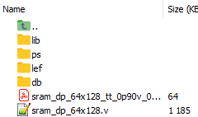
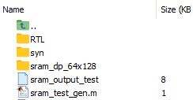
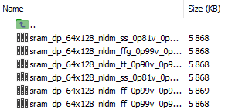



Memory Compiler – Files Generation
Organizing your files
Move files to their respective folders (lib/ ps/ lef/ db)
lef (2 files)
db (3 files)
Lib (6 files)
ps (3 ps/pdf files)

Slide 16
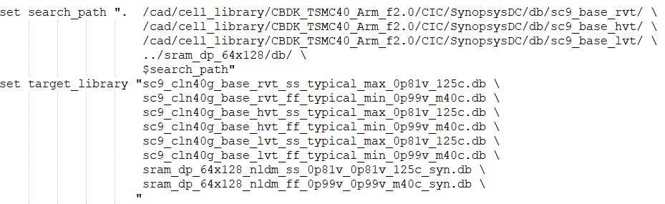
Memory Compiler – Using the files
Verilog model: post rtl/syn/apr simulation
ncverilog … sram_dp_64x128.v
DB files (Synthesis):
Add path to .synopsys_dc.setup

Slide 17
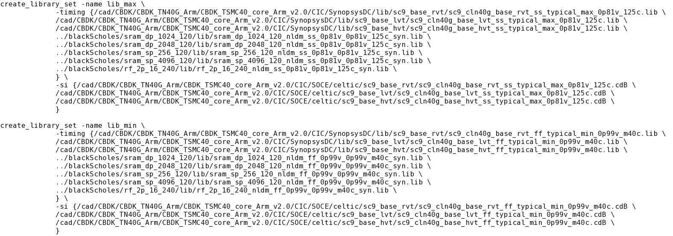
Memory Compiler – Using the files
Library files (APR) :
Add path to the .view file

Slide 18
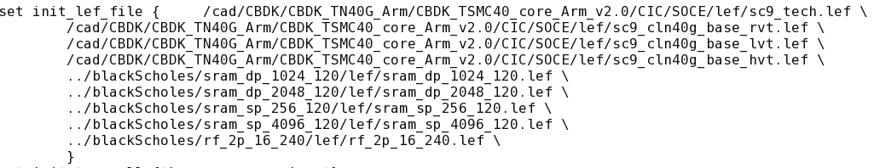
Memory Compiler – Using the files
Lef files (APR) :
Add path to the .globals file
APR for 40nm technology requires access to the EDA Cloud
We will not practice APR today

Slide 19
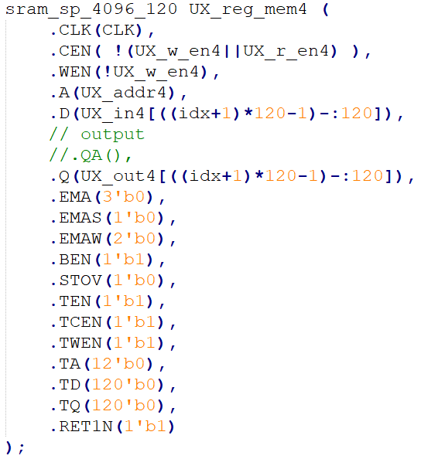
Memory Compiler – Ports
Single-port SRAM:
Port name | Description
CLK | Clock
CEN | Active-low chip enable (0 to enable)
WEN | Active-low write enable (1 for read, 0 for write)
A | Address
D | Data input
Q | Data output
Ohers | Connect to 0 or 1
Example

Slide 20
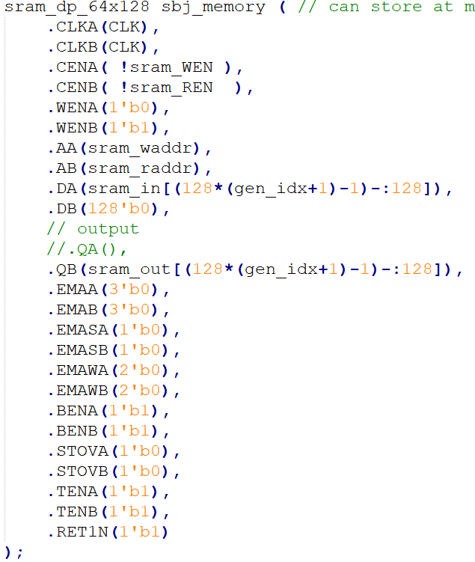
Memory Compiler – Ports
Dual-port SRAM:
Port name | Description
CLKA/ CLKB | Clock
CENA/ CENB | Active-low chip enable (0 to enable)
WENA/ WENB | Active-low write enable (1 for read, 0 for write)
AA/ AB | Address
DA/ DB | Data input
QA/ QB | Data output
Ohers | Connect to 0 or 1
Example (always 1 read 1 write)

Slide 21
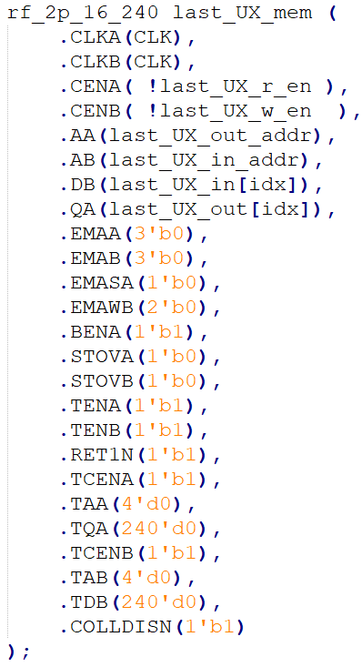
Memory Compiler – Ports
2-port RF:
Port name | Description
CLKA/ CLKB | Clock
CENA/ CENB | Active-low chip enable (0 to enable)
AA/ AB | Address
DB | Data input
QA | Data output
Ohers | Connect to 0 or 1
Example (A: read; B: write)

Slide 22

Lab #1 – Dual-Port SRAM
Function:
Input $→$ Store in SRAM $→$ Read from SRAM $→$ Output
Dual-Port
SRAM
(64x128)
Dual-Port
SRAM
(64x128)
Data input
Dual-Port
SRAM
(64x128)
Dual-Port
SRAM
(64x128)
Data output

Slide 23
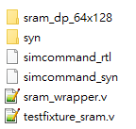
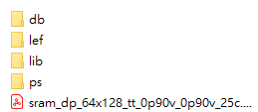
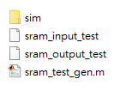
Lab #1 – Dual-Port SRAM
We have completed partial RTL files and synthesis script
Your task:
Use the memory compiler to generate the necessary files and put them in respective folders
Spec:
Instance name: sram_dp_64x128
Number of words: 64
Number of bits: 128
Multiplexer width: 4
Fill the blank folders with the
.db/ .lib/ .lef/ .ps/ .v files

Slide 24
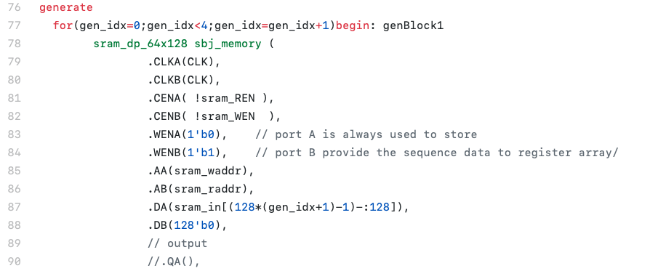
Lab #1 – Dual-Port SRAM
Port name | Description
CLKA/ CLKB | Clock
CENA/ CENB | Active-low chip enable (0 to enable)
WENA/ WENB | Active-low write enable (1 for read, 0 for write)
AA/ AB | Address
DA/ DB | Data input
QA/ QB | Data output
Ohers | Connect to 0 or 1
Dual-port SRAM:
always 1 read 1 write
take A as write port
take B as read port

Slide 25
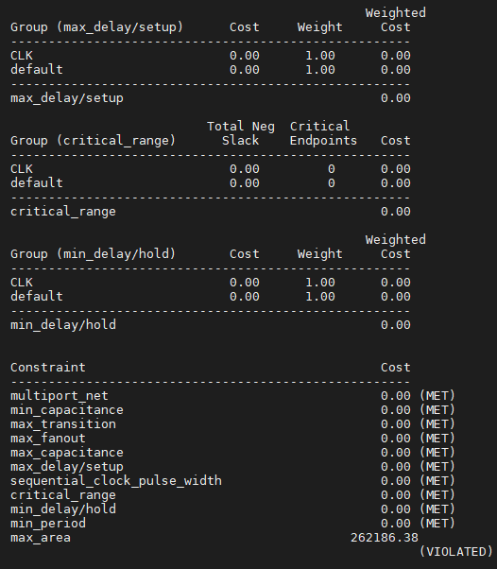
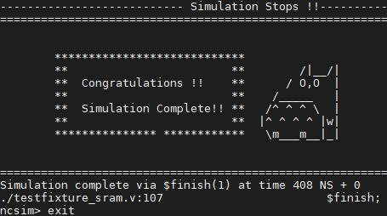
Lab #1 – Dual-Port SRAM
Steps:
Generate all the files
RTL simulation: bash simcommand_rtl
Synthesis (syn/): dc_shell –f all_syn.tcl
Post-Synthesis simulation: bash simcommand_syn
Pass simulation
Synthesis result

Slide 26
Lab #2 – Asynchronous FIFO
Data transfer between hardware modules
The most frequently used handshake mechanism in digital design is the valid-ready protocol
Source asserts valid when it has data to transfer, and puts data on the line
Sinks asserts ready when it is ready to receive, and stores the data
Source acknowledges the ready signal and sends the next data
What if the source generates the data faster than the sink can consume them?
E.g. Source generates data in a burst while sink receives them slow but steadily
Module A
(Source)
(clock = 10 ns)
Data
Module B
(Sink)
(clock = 10 ns)
Valid
Ready

Slide 27
Lab #2 – Asynchronous FIFO
Data transfer between hardware modules
A synchronous FIFO can be inserted that act as a buffer when the data transfer is not at the same rate
Synchronous: the same clock is used for both reading and writing
FIFO depth: the size of the buffer inside the FIFO
Calculating FIFO depth: http://www.asic-world.com/tidbits/fifo_depth.html
What if source and sink operate at different frequency?
Module A
(Source)
(clock = 10 ns)
Data
Data
Module B
(Sink)
(clock = 10 ns)
Synchronous FIFO
WEN
REN
full
empty

Slide 28
Lab #2 – Asynchronous FIFO
Data transfer between hardware modules
An asynchronous FIFO uses different clock for reading and writing
The design tips of asynchronous FIFO can be found in paper:
We will be using the implementation from https://github.com/dpretet/async_fifo for today’s lab
Module A
(Source)
(clock = 3 ns)
Data
Data
Module B
(Sink)
(clock = 10 ns)
Asynchronous FIFO
WEN
REN
full
empty
Cummings, Clifford E. "Simulation and synthesis techniques for asynchronous FIFO design."
SNUG 2002 (Synopsys Users Group Conference, San Jose, CA, 2002) User Papers. 2002.

Slide 29
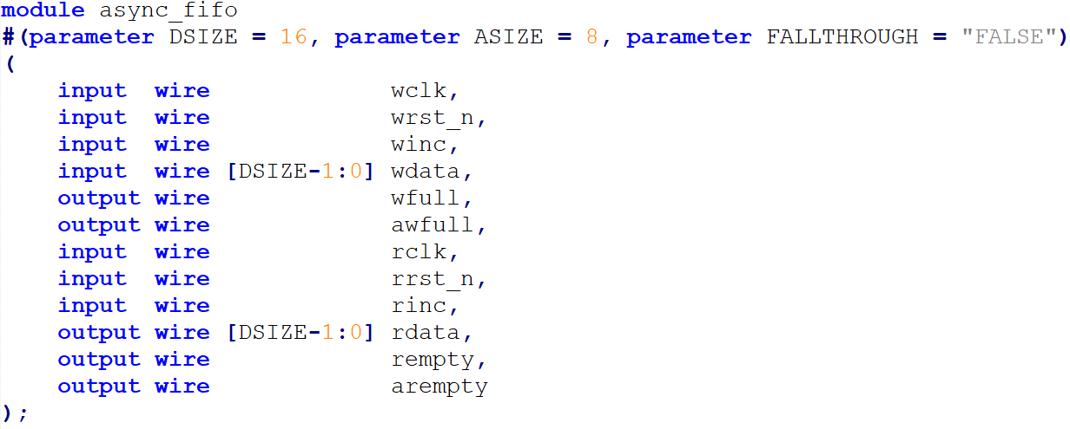

Lab #2 – Asynchronous FIFO
Asynchronous FIFO ports ($2^{8}$ words, 16 bits data):
Read data will appear in the next clock
Port name | Description
wclk | Clock
wrst_n | Active low reset
winc | Write enable
wdata | Write data
wfull | Indicates FIFO is full
awfull | Almost full
Port name | Description
rclk | Clock
rrst_n | Active low reset
rinc | Read enable
rdata | Read data
rempty | Indicates FIFO is empty
arempty | Almost empty

Slide 30
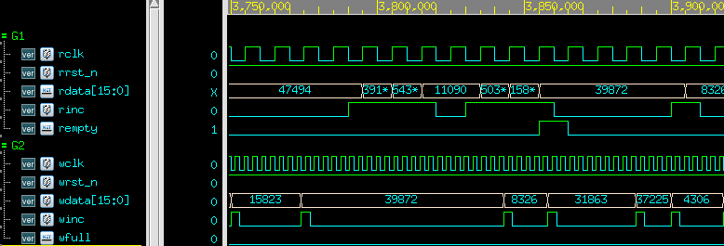
Lab #2 – Asynchronous FIFO
Testbench: random reads and writes
Default: balanced number of reads and writes
+define+PAT2: increase number of writes (test full)
+define+PAT3: decrease number of writes (test empty)

Slide 31
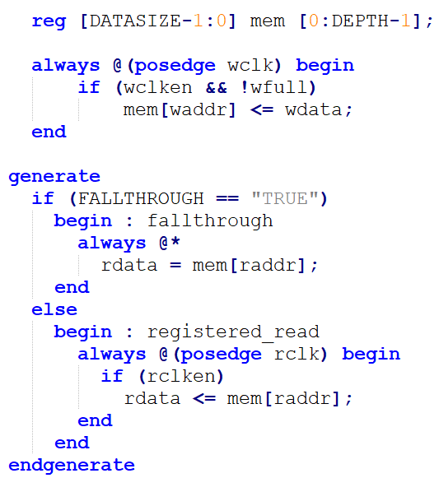
Lab #2 – Asynchronous FIFO
Data memory inside the FIFO (fifo_2mem.v):
The provided file uses registers to compose the buffer
For FPGA synthesis, this will be synthesized as block RAM by inference
For ASIC design, however, this will be synthesized as registers (large area)
We can replace the memory with a 2 port RF to reduce the area

Slide 32
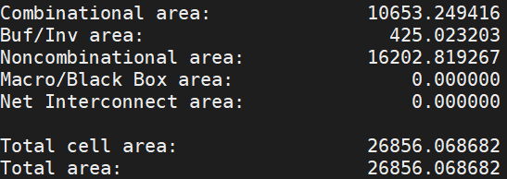
Lab #2 – Asynchronous FIFO
You should be able to successfully run simulation and synthesis before any modification:
RTL simulation: bash simcommand_rtl
Synthesis (syn/): dc_shell –f all_syn.tcl
Post-Synthesis simulation: bash simcommand_syn
The area of FIFO after synthesis is 26856

Slide 33
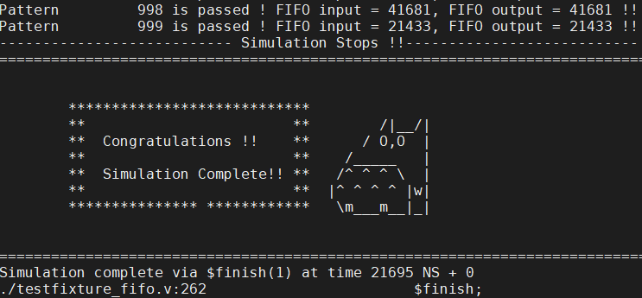
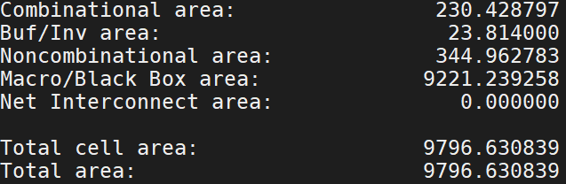
Lab #2 – Asynchronous FIFO
In this lab, You task is to replace the FIFO memory (fifo_2mem.v) with a 2-port register file to reduce the total cell area to < 10000
Step-by-step hints:
Find the proper parameters (# of words, # of bits, …) for the 2-port RF
Generate all the files (.db, .lib, .v)
Replace the memory in fifo_2mem.v with the RF you generates
Modify simcommand_rtl and run RTL simulation
Add the path of the db files to .synopsys_dc.setup
Run synthesis (record total cell area)
Modify simcommand_syn and run post-synthesis simulation
Done
Reference result

