Slide 1

Ⅲ. Main Result
OLS
Before incorporating fixed effects for monitoring stations, it can be observed that metro density is positively correlated with air pollution levels.
After progressively adding fixed effects for monitoring stations, driving restrictions, and time trends, it can be observed that metro density shows a stable negative correlation with air pollution levels.
The complete model, through the inclusion of time trend fixed effects, can be interpreted as reflecting its long-term impact.

Slide 2
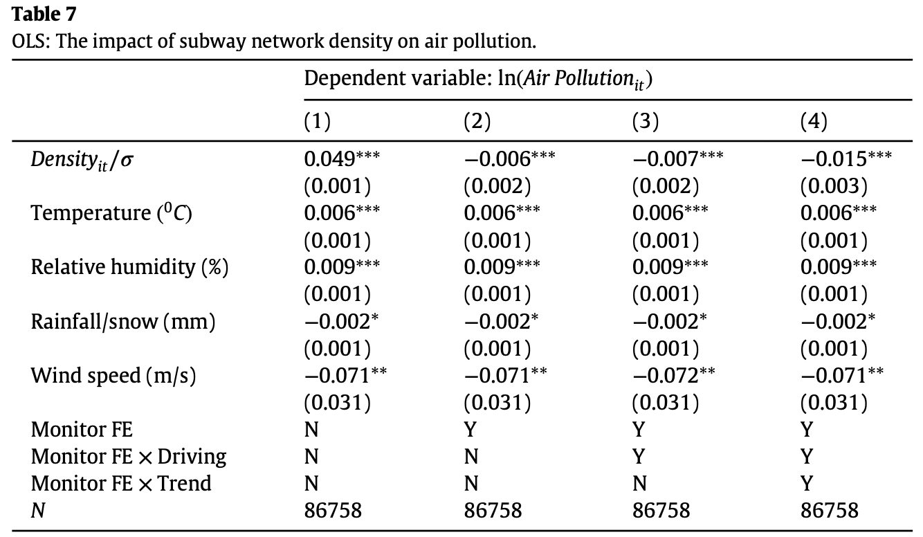
OLS

Slide 3
Ⅲ. Main Result
Difference-In-Differences & Robustness check
In the dynamic impact model, it can be observed that the inclusion or exclusion of fixed effects leads to the same conclusion (OLS) regarding the effect of the treatment.
The author conducts a robustness test by splitting the days before and after the opening date, showing a significant negative correlation within the time window of 40 to 100 days.
The inclusion of staggered rollout fixed effects in the heterogeneous impact model helps researchers control for the effects caused by different metro lines being launched in phases at different time points.

Slide 4
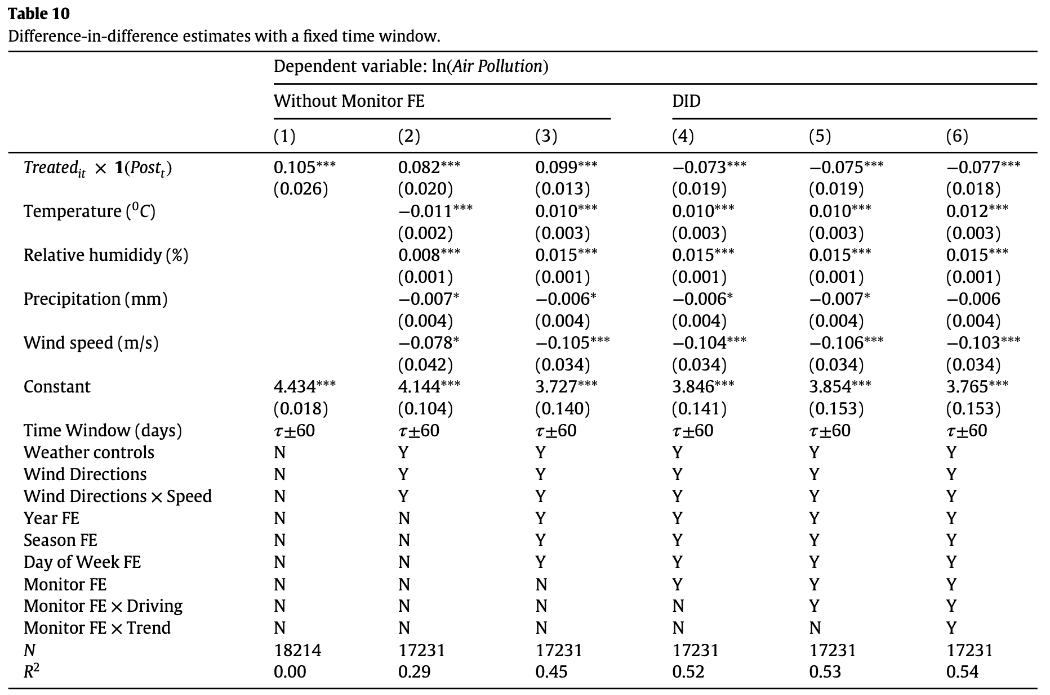
Difference-In-Differences：Dynamic Impact Model

Slide 5
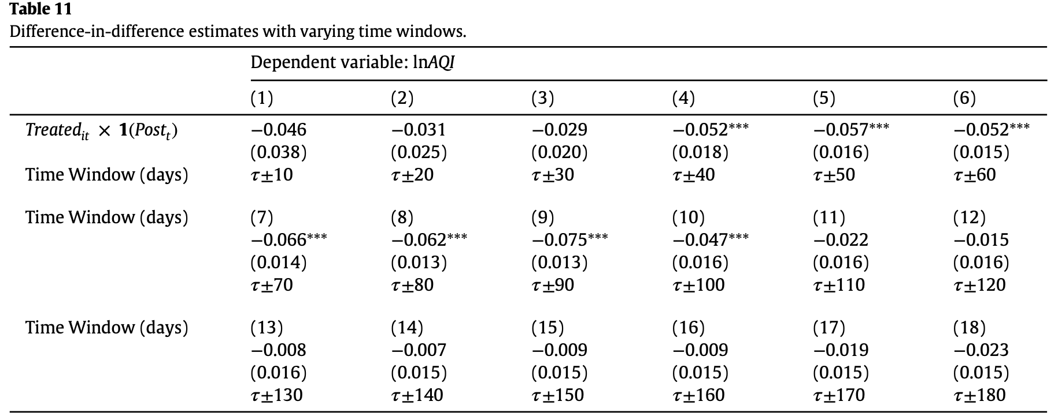
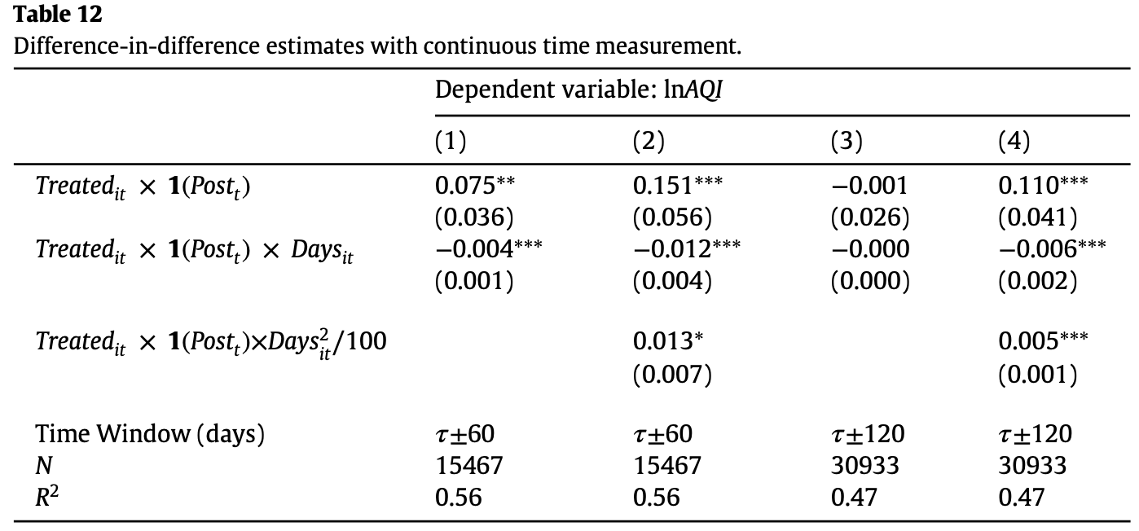
Difference-In-Differences：Dynamic Impact Model
Robustness check
Nonlinear Effects

Slide 6
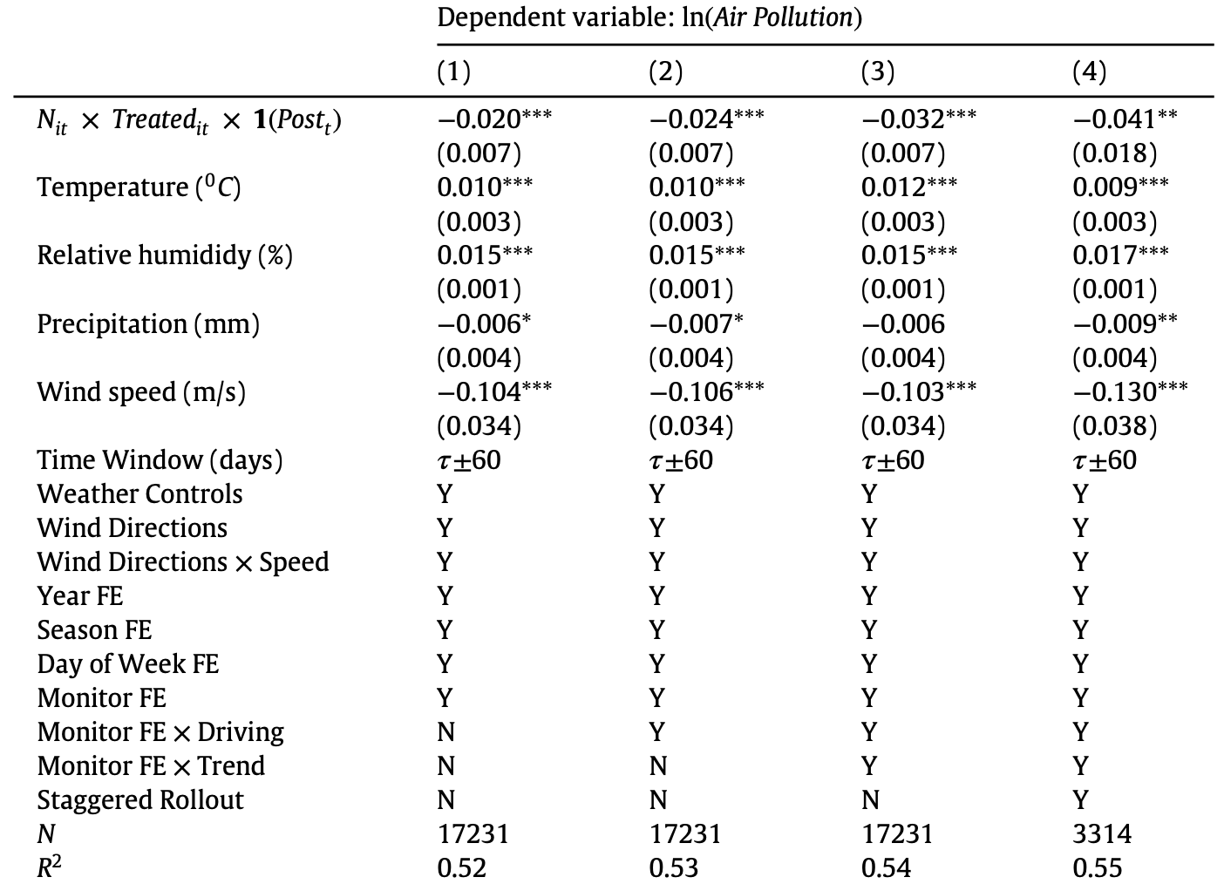
Difference-In-Differences：Heterogeneous Impact Model

