Slide 1
STYLE
TRANSFER

Slide 2

GALLERY
FACE
RECONGITION

Slide 3
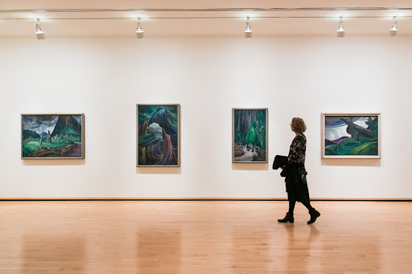
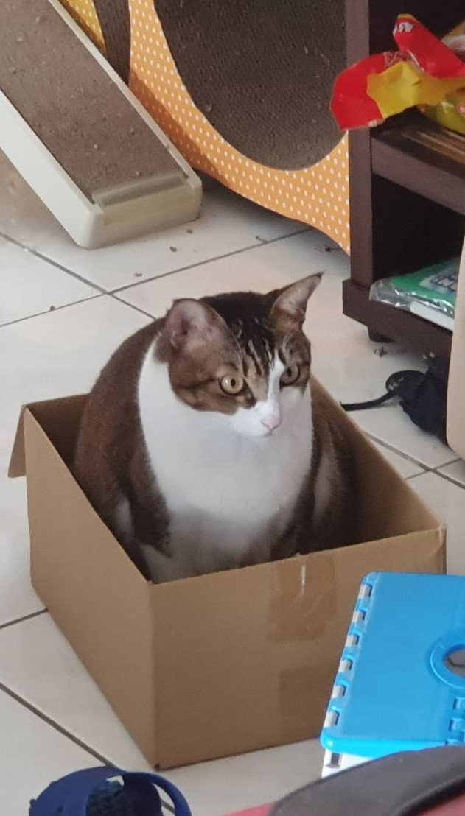



Slide 4
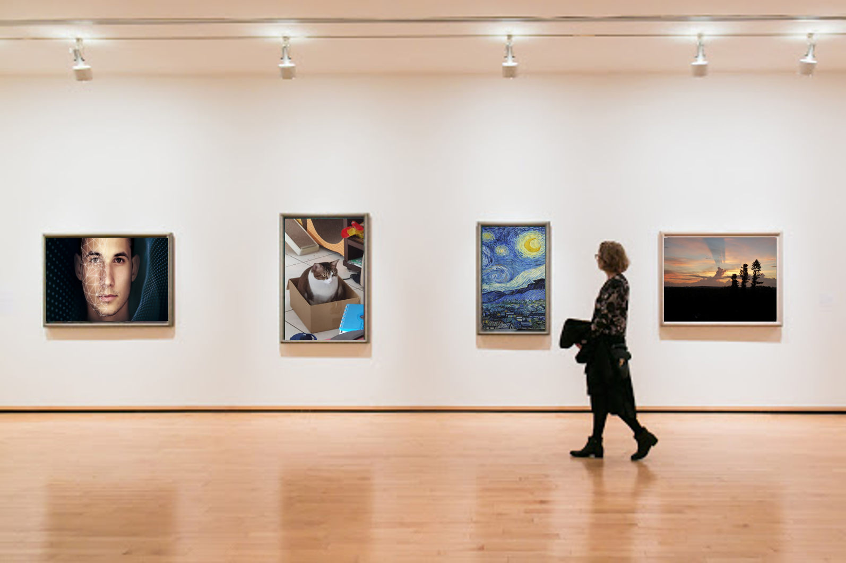
GALLERY

