Slide 1



A Novel Framework for
Uncertainty-Driven Adaptive Exploration
Leonidas Bakopoulos & Georgios Chalkiadakis
Technical University of Crete
Notes:
I should add affiliations etc

Slide 2
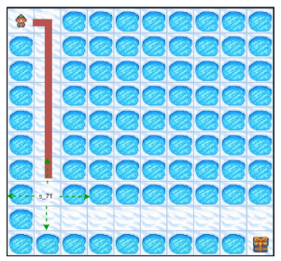
Motivation
Learning environments efficient exploration is the key
A common Approach: push the agent to explore
Decide: when to explore ? when to trust gained knowledge?
Notes:
In that environment, the agent starts from the to left corner, and aims to learn how to reach the bottom right one. The problem is, that every time that the agent visits a state with a whole, it falls into that whole and the episode is reset.

Slide 3
Our Contributions
ADEU
Framework
  A general Adaptive Exploration framework
    Balances exploration and exploitation in a principled way
    with Uncertainty leveraging that alternation
Utilizes all uncertainty definitions
Incorporates all existing adaptive exploration approaches ( special cases)
Gives rise to new approaches
Optimality results in a general class of games
Show improved performance

Slide 4
Adaptive Exploration in a nutshell
Low Uncertainty
High Uncertainty
Current practices:
select action to maximise uncertainty
Drown
Adaptive Exploration:
Low uncertainty → Exploit
High uncertainty → Explore
71
71
Reach 71

Slide 5

The ADEU Framework
Adaptive Exploration via Uncertainty
Action Distribution
Mechanism to measure uncertainty in state s
Normalization function
Policy at state s

Slide 6
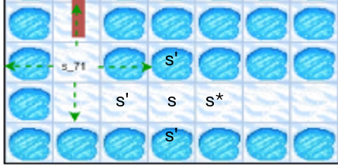
Theoretical Guarantees
Definition [Increasing-Reward Single-Agent Games] :
  In each state s, there is a unique state-action pair s* a*, with which the agent achieves higher reward than the maximum reward in the current state.
  For all the other future states (s' ≠ s*) the maximum reward max(s' , a') is less than the maximum reward of the current state
  For the current state s, there is a unique action b that maximizes the reward function in that state.
  When b is executed, the agent will be transferred to state s*
Increasing Reward Single Agent Games (IR-SAGs)
Generic Class of Games
  Sorting
  Ordering
  Searching for a sole trajectory
Reward motivates the agent to visit the true high value states

Slide 7
Theoretical Guarantees
An agent acts optimally if and only if, it selects action b.
  No added exploration is required
1
An ADEU agent that has executed action b in a state s, will reduce the degree of exploration in that state s proportionally to the effectiveness of f(s, )
2

Slide 8
Further Guarantees
Assuming an efficient f(s),
we guarantee efficient exploration
In sparse IRSAG
In stochastic versions of IRSAG
Assuming a specific f(s), we calculate probabilistic bounds in tabular domains
DeepSea
Frozen Lake
via defining hyper states and hyper actions

Slide 9
Generality of ADEU
f(s) candidate mechanisms that:
  quantify novelty in Intrinsic Motivation
  measure uncertainty in Uncertainty-Driven
  Can emulate all known adaptive exploration methods
    … with sophisticated f(s,...) i.e., f(s) considers and other measurements
ADEU utilizes these mechanisms to alternate between
exploration and exploitation within the same episode

Slide 10
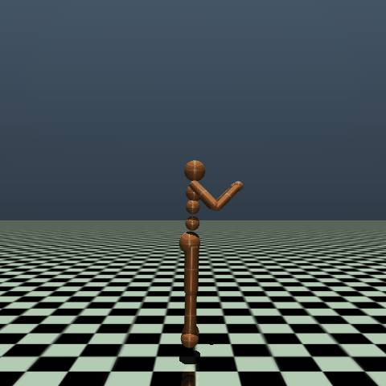
Experimental Evaluation: MuJoCo
Demanding Control Tasks (MuJoCo)
Test two effective ADEU instances
  f(s): the mechanism used in Intrinsic Motivation (RND)
  f(s): the UCB criterion used to guide agents in highly uncertain states
Notes:
we wanted to test instances of our framework both in difficult control tasks, in which the difficulty arises from the continuous sand multi dimensional action space and to Deep exploration domains (or to be more precise in domains that require Deep Exploration), where the difficulty arises from the delayed positive reward.

Slide 11
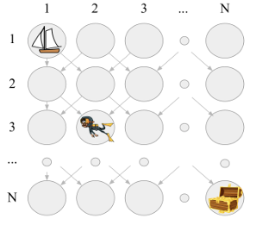
Experimental Evaluation
Deep Sea domain
  Domain that requires Deep Exploration
    Test one ADEU instance that emulates a previous adaptive exploration work

Slide 12
Results | MuJoCo
Domain /Method | ADEU + IM | ADEU + UCB | Naïve ADEU | UCB | IM | Noisy Nets
Walker2d | 745;947 | 413;500 | 564;726 | 355;397 | 1;23 | 519;657
Hopper | 733;1167 | 293;514 | 376;631 | 245;422 | 10;35 | 429;766
Swimmer | 52;62 | 36;39 | 40;46 | 32;36 | -3;-2 | 30;35
Ant | 1072;1341 | 1134;1500 | 345;980 | 585;790 | -2658;980 | 364;981
Humanoid | 313;345 | 512;658 | 86;132 | 89;149 | 85;132 | 75;88
Hum.Stand | 73895;79978 | 72978;80139 | 61511;64490 | 54928;56527 | 55211;56057 | 62152;63645
Notes:
We define as “instance”, an agent within the ADEU framework equipped with a specific f(s)
Goal of our experiments: we would like to show that every specific instance of ADEU equipped with a specific f(s) outperforms the ordinary use of this f(s). For example, we would like to show that the ADEU instance equipped with the RND mechanism outperforms the standard use of the RND (which is the Intrinsic Motivation exploration that uses RND to reward the agent for visiting novel states). In addition, we would like to show that the Naïve ADEU does not learn high rewarding policies, and it is outperformed by the other ADEU instances---at least in most of the cases. Finally, we would like to show that at least one ADEU instance outperforms all the other opponents. I should note that we also test ADEU against a standard Noisy Based approach that achieves descent (or we can say good) performance in these domains.
We also know, (and that is based on our implementation) that the RND mechanism converges slower than the Q std. This slower convergence (and hence, the higher output even when the agent has visited the same state numerous times) seems to allow the agent for more effective exploration and hence, learning a higher rewarding policy. Additionally, the fact that the Naïve ADEU does not converge, allow it to find a better than the Q_std policy, but obviously not better than ADEU with RND.

Slide 13
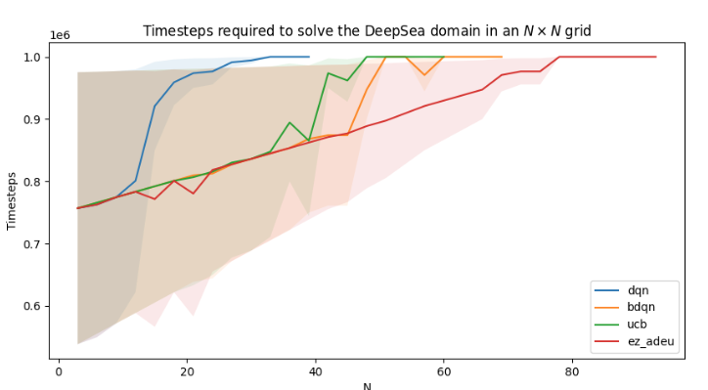
Results | Deep Sea
ez-ADEU emulates ez-greedy[3]
[3] Dabney et al. "Temporally-Extended ε-Greedy Exploration." International Conference on Learning Representations.
Notes:
An example of F(s, in which uncertainty is “not stictry depending on the state” way of calculating uncertainty. That is how we emulate ez greedy
I should not forget to explain the figures (axes etc)

Slide 14
Conclusions
We created a Generic Adaptive Exploration Framework
Theoretical Guarantees in a general Class of Games
Decides in a principled way to alternate between exploration and exploitation and vice versa
Outperform other exploration methods

Slide 15

Future Directions
Test background knowledge
Escape suboptimal knowledge
Interpret safe exploration as an adaptive one
Guide exploration via modifying higher moments of the distribution
Multiagent exploration

Slide 16
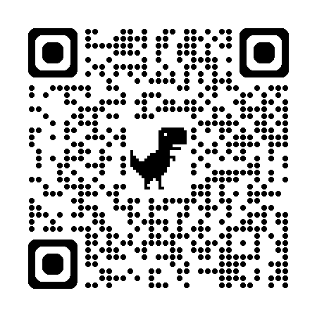
Thank you!
Any Questions?
{lbakopoulos, gchalkiadakis}@tuc.gr
A Novel Framework for
Uncertainty-Driven Adaptive Exploration
If you want to read more:

