Slide 1


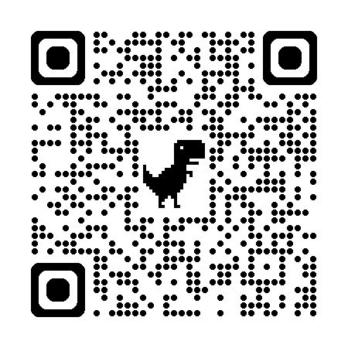

Uncertainty-Driven Adaptive Exploration
Towards Enabling Agent Self-Evolution & Organizational Knowledge via Individual Experiences
Leonidas Bakopoulos & Georgios Chalkiadakis
Technical University of Crete
Download published proceedings paper version at:
https://www.ifaamas.org/Proceedings/aamas2026/pdfs/HQII4250.pdf
Notes:
I should add affiliations etc

Slide 2
[Safe]
Uncertainty-Driven Adaptive Exploration
Towards Enabling Agent Self-Evolution & Organizational Knowledge via Individual Experiences
Leonidas Bakopoulos & Georgios Chalkiadakis
Technical University of Crete
Download published proceedings paper version at:
https://www.ifaamas.org/Proceedings/aamas2026/pdfs/HQII4250.pdf
Notes:
I should add affiliations etc

Slide 3
Μotivation:
An agent should remember its past, to extend its knowledge
WHAT THE AGENT REMEMBERS
The memory of an agent is stored in the weights of its neural network (NN).
By using its NN, the agent can either:
EXPLOIT
Recall its memory
EXPLORE
Create a new memory
Too little exploration
Excessive exploration
Knowledge never expands.
Catastrophic forgetting of prior learning.

Slide 4
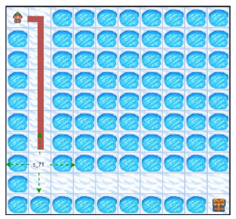
Motivation ++
In long horizon tasks, efficient and effective exploration is the key.
A common approach: push the agent to explore
A better approach: Decide ...
- When to explore ?
- When to trust your memory / gained knowledge?
Notes:
In that environment, the agent starts from the to left corner, and aims to learn how to reach the bottom right one. The problem is, that every time that the agent visits a state with a hole, it falls into that hole and the episode is reset.

Slide 5
Further Μotivation / Multiagent Extension:
Towards Organizational Knowledge
Starting from individual exploration and uncertainty...
Create a shared agents' memory, also encompassing their uncertainty
Effective and Efficient Multiagent Exploration
Avoiding redundant exploration

Slide 6
Our Contributions
The ADEU
Framework
  A generic ADaptive Exploration framework
    Balances exploration and exploitation in a principled way; i.e.,
    Exploration-exploitation alternation leveraged via Uncertainty
Incorporates any uncertainty measuring mechanism
Incorporates all existing adaptive exploration approaches (as special cases)
Gives rise to new approaches
e.g., safe exploration ones
Optimality guarantees in a general class of games
Improved performance compared to standard methods
Notes:
Standard uses of uncertainty for exploration

Slide 7


Adaptive Exploration in a nutshell
Low Uncertainty
High Uncertainty
Standard current practices:
explore at a constant rate, or
select action to maximise uncertainty
Drown
Adaptive Exploration:
Low uncertainty → Exploit
High uncertainty → Explore
71
Reach 71
71
Κey Challenge:
Determine when to alternate;
i.e., when uncertainty is low/high

Slide 8

The ADEU Framework
ADaptive Exploration via Uncertainty
Action Distribution
Mechanism to measure uncertainty in state s
(Eq. 1)
Normalization function
(current) policy at state s
Key intuition: distribution’s spread ⇔ agent’s uncertainty regarding π(s)
Notes:
In more detail, this action will be chosen by sampling from a distribution 𝐷. The first moment of that distribution is the policy
𝜋 (𝑠) that the DRL agent has already learned. Hence, the mean of the probability distribution 𝐷 (intuitively, its center of mass) is the
policy 𝜋 (𝑠). The second moment (variance) of that distribution is 𝑔(𝑓 (𝑠)), which is proportional to the uncertainty. Hence, 𝑔(𝑓 (𝑠))
defines how “spread” the distribution is, and how close the sampled action 𝑎 will be to the policy 𝜋 (𝑠).
The key intuition in ADEU is that the spread of the distribution should be defined so that it corresponds to the agent’s uncertainty regarding the 𝜋 (𝑠) policy; while that uncertainty can be calculated in any way considered appropriate. In this paper, we use the first raw moment (mean) and the second central moment (variance), both in the context of continuous and discrete distributions. One could conceivably use any other moments of choice to enhance action selection. For instance, one could use some function of the third standardized moment in order to guide exploration towards a specific direction, e.g., a direction that is deemed safe [38, 39], if such a direction can be in some way associated with the kurtosis of the distribution

Slide 9
Generality of ADEU
f(s) candidate mechanisms
  quantify novelty in Intrinsic Motivation-based exploration
  measure confidence in Q in uncertainty-driven exploration
  can emulate all known adaptive exploration methods!
    with sophisticated f(s,...) ; i.e., f(s) makes complex uncertainty measurements as required
ADEU utilizes these mechanisms to alternate between
exploration and exploitation within the same episode
Notes:
the intrinsic motivation (IM) family rewards the agent whenever a novel state is visited. This non-stationary reward, termed as
𝑟intrinsic (𝑠), is added to the external reward provided by the environment,
Epistemic uncertainty-driven methods employ different representations of the same Q-function to measure
how certain an agent is about its policy in a specific state. For exam-
ple, the UCB [6, 18] strategy greedily selects actions that maximize
the upper bound of the 𝑄-function shown in Equation 4.

Slide 10
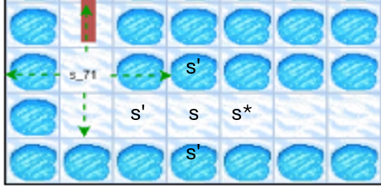
Theoretical Guarantees
Definition [Increasing-Reward Single-Agent Games (IR-SAGs] :
  In each state s, there is a unique future state s' = s* giving rise to a unique (s* , a*) state-action pair with which the agent achieves higher reward than the maximum reward in current state s.
  For all other future states (s' ≠ s*) , the maximum reward max(s' , a') is lower than the maximum reward of the current state
  For the current state s, there is a unique action b that maximizes the reward function in that state.
  When b is executed, the agent will be transferred to state s*
Increasing Reward Single Agent Games (IR-SAGs)
Α Generic Class of Games
  Sorting
  Ordering
  Searching for a sole trajectory
Reward motivates the agent to visit the true high value states

Slide 11
Theoretical Guarantees: In IR-SAGs...
An agent acts optimally if and only if it selects action b.
  No added exploration is required
1
An ADEU agent that has executed action b in a state s, will reduce the degree of exploration in that state s proportionally to the effectiveness of f(s, )
2
Notes:
The agent will focus on exploring s' states instead and eventually solve the IR-SAG

Slide 12
Further Guarantees
Assuming an efficient f(s),
we guarantee efficient exploration
In sparse IR-SAG
In stochastic versions of IR-SAG
Assuming a specific f(s), we calculate probabilistic bounds in tabular domains
DeepSea
Frozen Lake
via defining hyper states and hyper actions

Slide 13
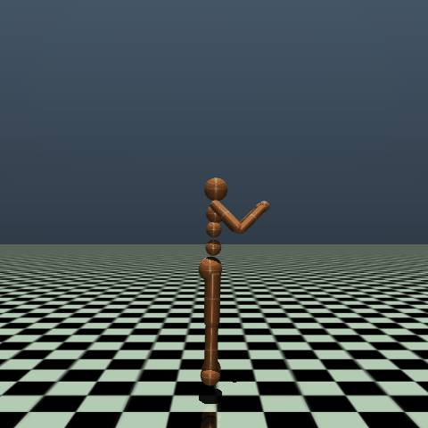
Experimental Evaluation: MuJoCo
Demanding Control Tasks (MuJoCo)
Test two effective ADEU instances
  f(s): the well-known RND mechanism used for Intrinsic Motivation
  f(s): the UCB criterion used to guide agents in highly uncertain states
Notes:
we wanted to test instances of our framework both in difficult control tasks, in which the difficulty arises from the continuous sand multi dimensional action space and to Deep exploration domains (or to be more precise in domains that require Deep Exploration), where the difficulty arises from the delayed positive reward.
--------------------------------------------------------------------------------------------------
[03:11:2026] As previously discussed, we tested our method on difficult control tasks. More specifically, we created two effective instances of ADEU: (i) an instance that measures uncertainty as novelty and uses the function from RND to measure/approximate the intrinsic motivation reward; and (ii) an instance that measures uncertainty by calculating the UCB over an ensemble of policy networks.

Slide 14
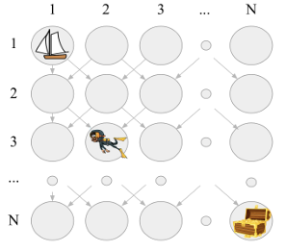
Experimental Evaluation: Deep Sea
Deep Sea domain
  Domain that requires Deep Exploration
    Test one ADEU instance that emulates a previous adaptive exploration work
Notes:
[03:11:2026] We also tested an instance of ADEU in a domain that requires deep exploration. This instance is the ez-greedy (Note: it is pronounced easy-greedy) adaptive exploration method, as implemented within ADEU.

Slide 15
Results | MuJoCo
Domain /Method | ADEU + IM | ADEU + UCB | Naïve ADEU | UCB | IM | Noisy Nets
Walker2d | 745;947 | 413;500 | 564;726 | 355;397 | 1;23 | 519;657
Hopper | 733;1167 | 293;514 | 376;631 | 245;422 | 10;35 | 429;766
Swimmer | 52;62 | 36;39 | 40;46 | 32;36 | -3;-2 | 30;35
Ant | 1072;1341 | 1134;1500 | 345;980 | 585;790 | -2658;980 | 364;981
Humanoid | 313;345 | 512;658 | 86;132 | 89;149 | 85;132 | 75;88
Hum.Stand | 73895;79978 | 72978;80139 | 61511;64490 | 54928;56527 | 55211;56057 | 62152;63645
Notes:
We define as “instance”, an agent within the ADEU framework equipped with a specific f(s)
Goal of our experiments: we would like to show that every specific instance of ADEU equipped with a specific f(s) outperforms the ordinary use of this f(s). For example, we would like to show that the ADEU instance equipped with the RND mechanism outperforms the standard use of the RND (which is the Intrinsic Motivation exploration that uses RND to reward the agent for visiting novel states). In addition, we would like to show that the Naïve ADEU does not learn high rewarding policies, and it is outperformed by the other ADEU instances---at least in most of the cases. Finally, we would like to show that at least one ADEU instance outperforms all the other opponents. I should note that we also test ADEU against a standard Noisy Based approach that achieves descent (or we can say good) performance in these domains.
We also know, (and that is based on our implementation) that the RND mechanism converges slower than the Q std. This slower convergence (and hence, the higher output even when the agent has visited the same state numerous times) seems to allow the agent for more effective exploration and hence, learning a higher rewarding policy. Additionally, the fact that the Naïve ADEU does not converge, allow it to find a better than the Q_std policy, but obviously not better than ADEU with RND.
----------------------------------------------------------------------------------------------------------
[03:11:2026] We will now present the results on several MuJoCo domains. We created two effective instances of ADEU and one naive instance. The naive instance does not use a meaningful representation of uncertainty; it always outputs a constant value. As you can see, each effective instance of ADEU outperforms the original use of its mechanism. ( Note: use the animation here, to compare each adeu instance with the original use of its mechanism). Moreover, in every domain, at least one effective adeu instance, and in some cases both, outperforms the others. (Note: according to the official documentation, the top three domains are the easiest of those tested and the bottom domains are the hardest)

Slide 16
Results | MuJoCo
Domain /Method | ADEU + IM | ADEU + UCB | Naïve ADEU | UCB | IM | Noisy Nets
Walker2d | 745;947 | 413;500 | 564;726 | 355;397 | 1;23 | 519;657
Hopper | 733;1167 | 293;514 | 376;631 | 245;422 | 10;35 | 429;766
Swimmer | 52;62 | 36;39 | 40;46 | 32;36 | -3;-2 | 30;35
Ant | 1072;1341 | 1134;1500 | 345;980 | 585;790 | -2658;980 | 364;981
Humanoid | 313;345 | 512;658 | 86;132 | 89;149 | 85;132 | 75;88
Hum.Stand | 73895;79978 | 72978;80139 | 61511;64490 | 54928;56527 | 55211;56057 | 62152;63645
Notes:
We define as “instance”, an agent within the ADEU framework equipped with a specific f(s)
Goal of our experiments: we would like to show that every specific instance of ADEU equipped with a specific f(s) outperforms the ordinary use of this f(s). For example, we would like to show that the ADEU instance equipped with the RND mechanism outperforms the standard use of the RND (which is the Intrinsic Motivation exploration that uses RND to reward the agent for visiting novel states). In addition, we would like to show that the Naïve ADEU does not learn high rewarding policies, and it is outperformed by the other ADEU instances---at least in most of the cases. Finally, we would like to show that at least one ADEU instance outperforms all the other opponents. I should note that we also test ADEU against a standard Noisy Based approach that achieves descent (or we can say good) performance in these domains.
We also know, (and that is based on our implementation) that the RND mechanism converges slower than the Q std. This slower convergence (and hence, the higher output even when the agent has visited the same state numerous times) seems to allow the agent for more effective exploration and hence, learning a higher rewarding policy. Additionally, the fact that the Naïve ADEU does not converge, allow it to find a better than the Q_std policy, but obviously not better than ADEU with RND.

Slide 17
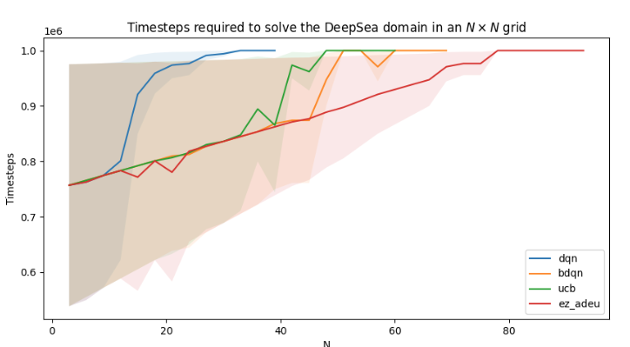
Results | Deep Sea
ez-ADEU emulates ez-greedy[3]
[3] Dabney et al. "Temporally-Extended ε-Greedy Exploration.
" International Conference on Learning Representations.
Notes:
[03:11:2026] We also created an adeu instance that emulates a previous adaptive exploration method, ez-greedy. As you can see, the ez-adeu agent outperforms the other algorithms in the DeepSea domain, a domain that tests an agent's ability to "explore deeply" until finding a delayed reward.
We emphasize that ADEU is a highly effective framework: it can produce instances that outperform other methods on robotic control tasks, as well as instances that outperform other methods on tasks requiring deep exploration. )

Slide 18
Conclusions and
Ongoing / Future Work

Slide 19
Summary
We created a Generic Adaptive Exploration Framework
Theoretical Guarantees in a general Class of Games
Decides in a principled way to alternate between exploration and exploitation and vice versa
We outperform other exploration methods

Slide 20
Agent self-evolution...
ADEU is extending its own knowledge
Exploration is decided per state, not globally
Policies it is confident on are replicated; novel states are explored
Knowledge is extended only when required

Slide 21
…and now…Safety

Slide 22


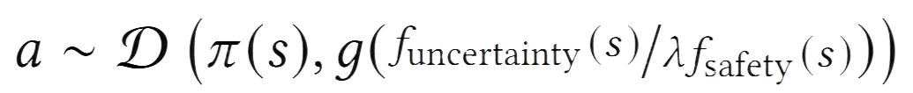
ADEU for Safe Exploration
From uncertainty to safety
Safety-aware action selection
Building on
we can create safety-aware instances,
by pretraining π(s) on a safe mentor,
and using the following f(s):
Standard Uncertainty? a pretrained, uncertainty-driven f(s)
Known cost function? explore inversely to it; i.e., use its inverse as f(s)
Unknown cost function? learn it online; explore inversely to it
Unknown cost: we create two new "safety-aware" ADEU instances:
( Eq. 2)
High expected cost → low variance → exploit π(s)
(Eq. 3)
Uncertainty-driven exploration when the expected cost is low; otherwise, safe
Eq 3: Best of both worlds;
safe where it matters, uncertainty-driven exploration everywhere else.
Notes:
by designing an 𝑓 (𝑠) that outputs low uncertainty
in these states, an ADEU agent can alternate between exploration
and exploitation proportionally to the safety of the current state.
Indeed, we pretrain the agent (only) in states neighboring unsafe ones (let us call them NUS), with a safe policy.
Hence, the agent has a "good" prior in these states. However, the agent does not know which states these are.
In other words, the agent has a partially pretrained network that outputs a random action when the agent is not in a NUS, and a safe action when it is in a NUS. Since the agent does not know a priori if it is in a NUS or not, it does not know whether to trust its network or not.
This is exactly what we are solving; by employing a "safety aware" uncertainty-measuring mechanism, we can learn when to trust the network, and when not to “listen to it” and search for something better.
BTW,
this is what we are also doing in our current work, but using a (slightly) different formulation that allows us to calculate bounds - and more!
where 𝑓safety (𝑠) is the expectation of the environment’s cost function
Learned via interactions assuming an initial safe policy
In Eq. 3 𝑓uncertainty (𝑠) is the aforementioned uncertainty-measuring mechanism and all other notation (except 𝜆) follows Eq. 2. Note
that 𝜆 generally acts as a term (or mechanism) that ensures the safety term “dominates” when safety is critical.

Slide 23
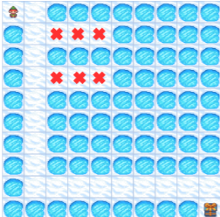
Safe Exploration: Results
Method | Mean ; Max reward | Violations
ε-greedy | 210 ; 739 | 0.34
IM | 267 ; 780 | 0.55
UCB | 12,605 ; 65,687 | 0.10
ADEU (Eq. 1, with pretraining) | 59,865 ; 104,487 | 0.01
ADEU (Eq. 2) | 7 ; 7 | 0.00
ADEU (Eq. 3) | 19,255 ; 85,087 | 0.00
Safety Frozen Lake
ADEU instances, pretrained with a safe policy near unsafe states:
Eq. 1: Standard ADEU using
f(s) = visitation freq.
Eq. 2, where f_{safety}(s) is a learned cost
Eq. 3, where f_{uncertainty} = visitation freq. and f_{safety} = learned cost
Eq. 1-pretr: highest reward (fastest to the goal), ~10× fewer violations than baselines
Eq. 2 alone: perfectly safe but too conservative.
Eq. 3: Best of both worlds
Notes:
Again, the reward measures the ability of the agent to find the treasure as fast as possible. Hence, lower reward corresponds to more time to find the goal.

Slide 24
Safe Exploration is
Adaptive (ADEU) Exploration
Safe exploration can be cast as ADEU exploration
Bounds, guarantees, good results

Slide 25
…moving to multiple agents…

Slide 26
Extension: Multiagent exploration
Example
THE LOCKED ROOM
All agents are trapped in a locked room.
Goal: at least one agent finds the key to unlock the door.
Shelf A
Cabinet B
Desk C
Checked: no key
Unexplored
Unexplored
The agents have a shared goal and shared memory.
Agent 1
Agent 2
Agent 3
Shared experience matters:
an unsuccessful search can prevent
another agent from repeating the same action
SHARED MEMORY
Shelf A checked → explore B or C
Notes:
[0./11/2026] Imagine a multiagent scenario where all the agents are trying to escape from a locked room. There are, for example, three agents (Agents A, B and C) and two distinct goals: Find the Key; and find the door. Since the agents are collaborating, it is fair to assume that they all share the same experience. From a technical point of view, they append their experience to the same buffer. Hence, the three agents share the same policy (of course with some differences, arising from the stochasticity of the learning procedure). Ideally, we would like each agent to explore a different part of the room. In that (let's say coordinated) way, they will be able to find the solution faster.

Slide 27
ADEU in a Multiagent Setting
Vanilla multiagent exploration
Proposed Multiagent ADEU
Independent exploration can produce duplicated/redundant experience.
Agents share a policy and a mechanism for estimating (collective) uncertainty.
Example: two agents search the same location for the key.
Exploration reflects what the whole team knows.
Individual uncertainty → Collective uncertainty → No redundant exploration
Notes:
In this centralized training and execution model, each agent might explore using the standard techniques: Noisy Based Exploration (or epsilon greedy in discrete action space), such as MADDPG, IDQN or Policy based Exploration, such as MAPPO. Using the standard methods, the agents do not harness the collective knowledge: Agent B might explore the same states where A has already explored.
But how would a Multiagent ADEU work in that scenario. Since the agents are sharing everything, we can also say that they share a common definition of uncertainty. In other words, when being in the same state, the two agents will calculate the same uncertainty. Hence, the agents will never re-explore something with low uncertainty, due to the definition of ADEU (recall that low uncertainty results in no exploration). Now, each agent explores, aiming to increase collective knowledge.

Slide 28
From Individual Experience to Organisational Knowledge
Generate experience
Agents act in the environment and record observations, including failed searches.
1
Build shared memory
Consolidate experiences into a common record of evidence (Replay Buffer).
2
3
Estimate collective uncertainty
Use shared knowledge to identify unresolved questions and gaps.
Coordinate exploration
Prioritise useful experiences rather than duplicating already reliable evidence.
4
Organisational knowledge: reusable evidence that improves the team’s next decisions.
Notes:
[0.:11:2026] To conclude, starting from individual exploration and uncertainty, each agent generates individual experience. Then, this individual experience is utilized to construct a collective buffer; all the agents are trained using that buffer, resulting in a common shared policy. They are also by default sharing the same uncertainty measuring mechanism. Hence, each agent explores to improve the collective knowledge, eliminating in that way the redundant exploration. Given all that, each agent can now explore given common knowledge. Using ADEU, it will avoid reexploring known states and increasing known knowledge. Hence, we achieve Organisational knowledge, in the sense that the agents are using previous knowledge, to avoid redundant exploration.

Slide 29

Future Directions
Test background knowledge
Escape suboptimal knowledge
Create novel uncertainty measuring mechanisms
Guide exploration via modifying higher moments of the distribution
Interpret safe exploration as an adaptive one

Slide 30
Uncertainty-Driven Adaptive Exploration
ADEU website
Thank you!
Any Questions?
{lbakopoulos, gchalkiadakis}@tuc.gr
Download published proceedings paper version at:
https://www.ifaamas.org/Proceedings/aamas2026/pdfs/HQII4250.pdf
Notes:
I should add affiliations etc

