Slide 1
OXHACK 2026
Farm equipment that makes its own decisions
Autonomous harvest planning for efficient farming at scale
01 Forecast
Met Office, 127 h
02 Value
£/ha per field, per hour
03 Plan
cooperative MPC, whole fleet
04 Replan
every 6 h
Notes:
Big farms run fleets over thousands of acres, but harvest is still planned by hand. We built equipment that decides for itself.

Slide 2
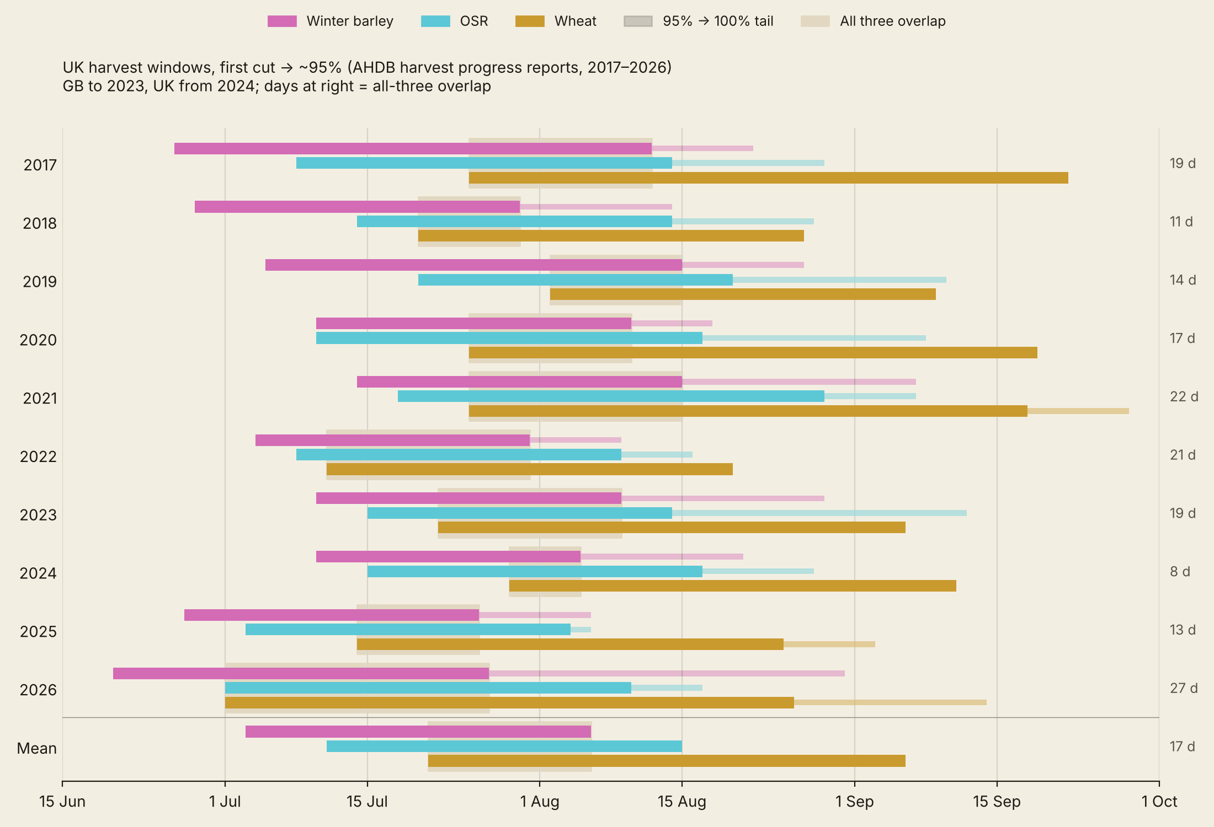
THE PROBLEM
Three crops, one short window, weather in charge
17 days
a year on average when winter barley, oilseed rape and wheat all need cutting at once (AHDB, 2017–2026)
0.5–2.5%
of wheat yield lost for each day harvest waits after the grain reaches 18% moisture (UMD Extension)
By hand
today: someone drives field to field with a moisture meter, and the fleet follows
Oxhack 2026 · autonomous harvest planning
2/5
Notes:
Barley, rape and wheat ripen together: 17 days a year all three need cutting at once, and wheat loses up to 2.5% a day waiting.

Slide 3
HOW IT WORKS
One plan for the whole fleet, redone every 6 hours
01
Forecast
Met Office ensemble, 127 h ahead
— Temperature, rain (mm), humidity
— Every field, every hour
02
Value
£/ha if cut in each hour
— Grain moisture model per crop
— Minus drying and fuel, at market prices
03
Plan
Cooperative MPC on a farm digital twin
— Most harvest profit, least driving
— Home to the depot rather than idle
— A cost on grain left standing
04
Replan
New forecast every 6 h
— Machines re-route themselves
— No one drives out to check
A planning layer above any autonomous harvester stack.
Oxhack 2026 · autonomous harvest planning
3/5
Notes:
Every six hours: the latest forecast, each field's grain moisture and value, then one plan for every machine.

Slide 4
DOES IT WORK
A farmer wants it, and a full season shows why
“Pay good money”
for a system that optimises and automates his harvest routes. A delay can cost “tens to hundreds of thousands of pounds”.
2024 season replay · 9 Jun – 10 Sep · 4,046 ha · real past forecasts and weather
ha cut
net £
Farmer rules
2,484
2.59M
Ed, Apsley Farms
9,000 acres arable · up to 300 acres a day at harvest
Our MPC planner
4,046
4.37M
+£1.79M
net over the season (+69%); the farmer's rules leave 1,562 ha standing
Oxhack 2026 · autonomous harvest planning
4/5
Notes:
A 9,000-acre farm would pay good money for this. Over the 2024 season our planner nets 1.8 million pounds more than farmer rules.

Slide 5
NEXT
From harvest to the whole farm
Other field work
— Ploughing, drilling, spraying
— Same fleet, same planner
Sensors in the fields
— Wind, rain, grain moisture
— GDD and NDVI for ripeness windows
— Early warning on pests and disease
Full farm digital twin
— Every field measured, not modelled
— Every machine planned together
Today the grain moisture is modelled from forecasts; field sensors would measure it.
Farm equipment that makes its own decisions.
Oxhack 2026 · autonomous harvest planning
5/5
Notes:
Next: ploughing and drilling, and sensors in the fields, towards a farm that runs itself.

