Slide 1
Is Genius Born or Made?
Refinements and Complications in the Nature-Nurture Controversy

Slide 2
The Nature-Nurture Controversy with Respect to Outstanding Achievement
Nature:
  Galton’s (1869) Hereditary Genius
  Galton’s (1874) English Men of Science

Slide 3
The Nature-Nurture Controversy with Respect to Outstanding Achievement
Nurture:
  Behaviorist Learning (e.g., Watson)

Slide 4
“Give me a dozen healthy infants, well formed, and my own specified world to bring them up in, and I’ll guarantee to take any one at random and train him to become any type of specialist I might select – a doctor, lawyer, artist, merchant chief, and yes, even a beggar-man and thief, regardless of his talents, penchants, tendencies, abilities, vocations and race of his ancestors.”

Slide 5
The Nature-Nurture Controversy with Respect to Outstanding Achievement
Nurture:
  Behaviorist Learning (e.g., Watson)
  Expertise Acquisition (e.g., Ericsson)
    Deliberate Practice
      The 10-year Rule
      The Monotonic Function

Slide 6
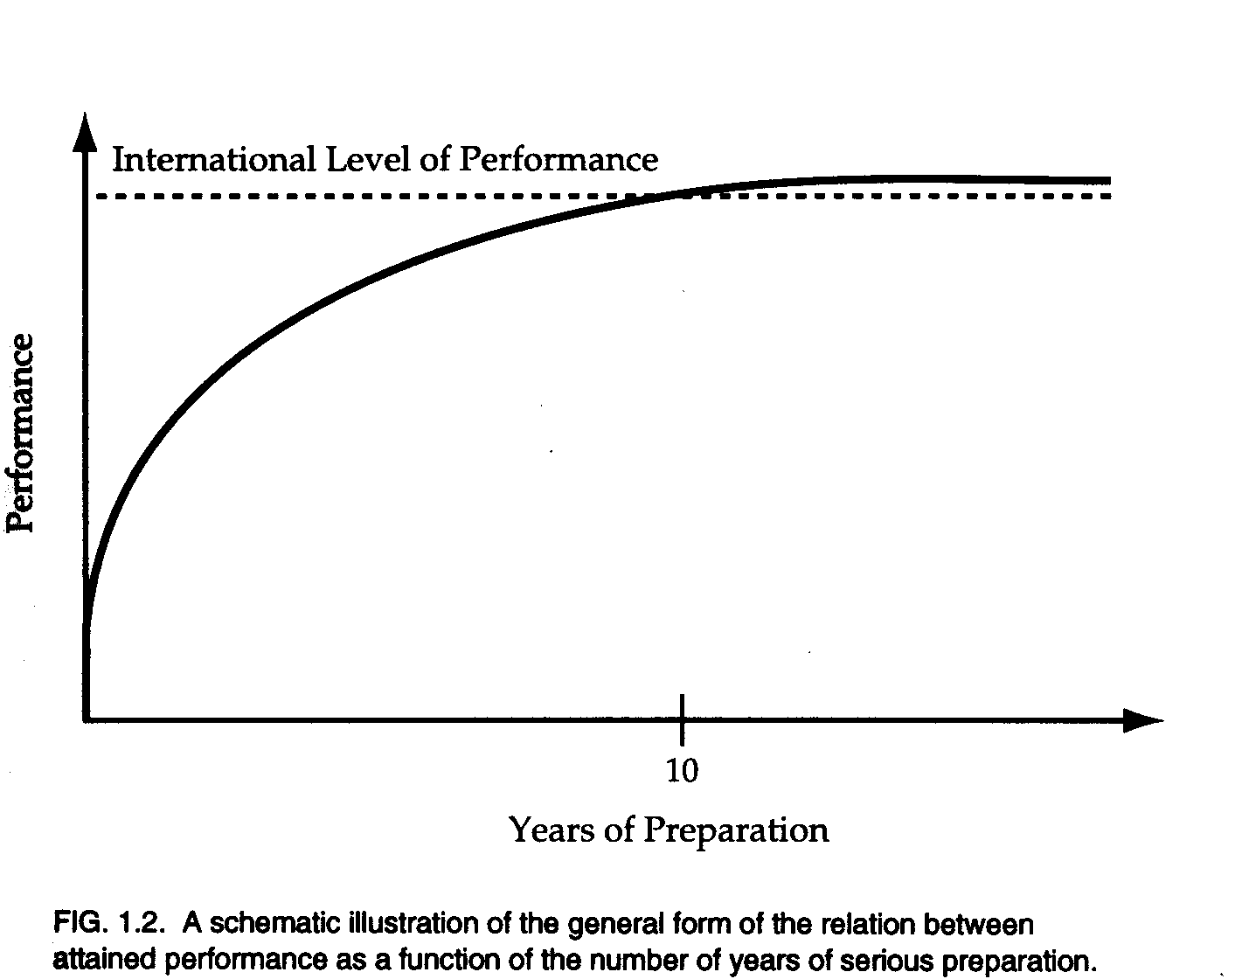

Slide 7
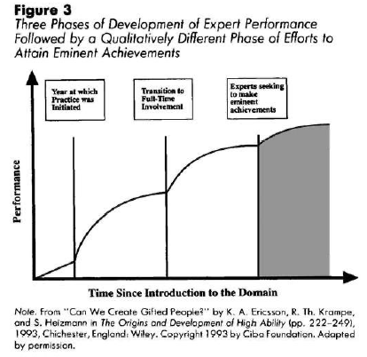

Slide 8
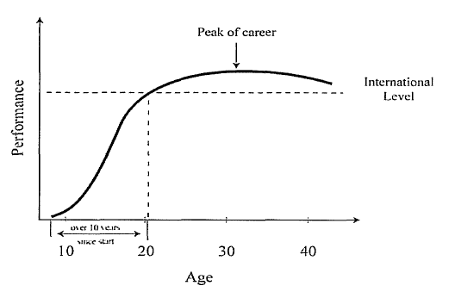

Slide 9
Nature Revisited:
Behavioral Genetics
Environmental Effects
  Shared (e.g., parental child-rearing practices)
  Nonshared (e.g., birth order)
Genetic Effects
  Numerous nontrivial heritability coefficients for both cognitive and dispositional correlates of achievement in various achievement domains

Slide 10
Nature Revisited:
Behavioral Genetics
However, two potential complications in biological inheritance that render it less simple than often conceived:
  Multiplicative rather than additive inheritance (emergenesis)
  Dynamic rather than static inheritance (epigenesis)
Hence, a more complex conception of talent and its development, as indicated in the following formal model

Slide 11
Definition: Potential Talent
Any genetic trait or set of traits that
  accelerates expertise acquisition and/or
  enhances expert performance
in a talent domain (e.g., creativity)
Traits may be
  cognitive (e.g. IQ) or dispositional (e.g., introversion),
  specific (e.g., perfect pitch) or general (e.g., g)

Slide 12
Two-Part Genetic Model
Emergenic Individual Differences
Epigenetic Development

Slide 13
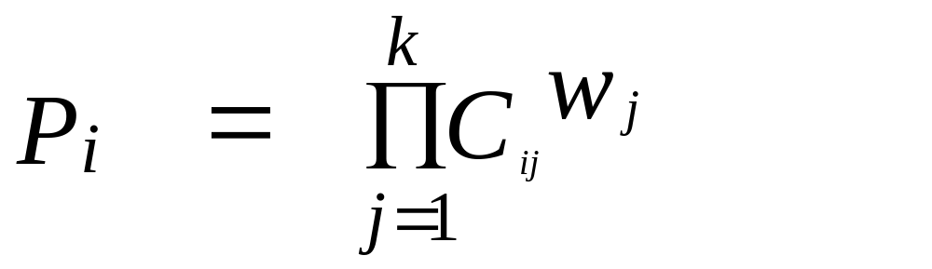
Emergenic Individual Differences: The Model

Slide 14
Emergenic Individual Differences: The Model
P_{i} is the potential talent for the ith individual
C_{ij} is the ith individual’s score on component trait j (i = 1, 2, 3, ... N)
w_{j} is the weight given to the jth component trait (w_{j} > 0)
П is the multiplication operator (cf. Σ)

Slide 15
Emergenic Individual Differences: The Model

Slide 16
Emergenic Individual Differences: The Implications
the domain specificity of talent
the heterogeneity of component profiles within a talent domain
the skewed frequency distribution of talent magnitude
the attenuated predictability of talent
the low familial inheritability of talent
the variable complexity of talent domains

Slide 17
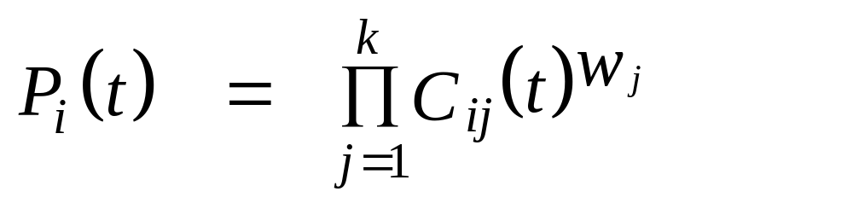
Epigenetic Development:
The Model
e.g.
C_{ij} (t) = 0, if t < s_{ij},
= a_{ij} + b_{ij} t, if s_{ij} < t < e_{ij}, and
= a_{ij} + b_{ij} e_{ij}, if t ≥ e_{ij}.

Slide 18
Epigenetic Development:
The Model
C_{ij} (t) = a_{ij} + b_{ij} e_{ij}
C_{ij} (t) = a_{ij} + b_{ij} t
C_{ij} (t) = 0
t < s_{ij}
s_{ij} < t < e_{ij}
t ≥ e_{ij}

Slide 19
Epigenetic Development:
The Implications
the occurrence of early- and late-bloomers
the potential absence of early talent indicators
the age-dependent cross-sectional distribution of talent
the possibility of talent loss (absolute vs. relative)
the possible age-dependence of a youth’s optimal talent domain
the increased obstacles to the prediction of talent

Slide 20
Conceptual Integration
Fourfold Typology of Genetic Gifts
Additive versus Multiplicative Models
Simple versus Complex Domains

Slide 21
Fourfold Typology of Genetic Gifts
 | Additive | Additive | Multiplicative | Multiplicative
Results | Simple | Complex | Simple | Complex
Trait profiles | Uniform | Diverse | Uniform | Diverse
Distribution | Normal | Normal | Skewed | Extremely skewed
Proportion ungifted | Small | Extremely small | Large | Extremely large
Familial inheritance | Highest | High | Low | Lowest
Growth trajectories | Few | Numerous | Few | Numerous
Growth onset | Early | Earliest | Later | Latest
Ease of Identification | Highest | High | Low | Lowest
Instruction / training strategies | Few | Numerous | Few | Numerous

Slide 22
Conclusion
Some forms of genius may be in part “born” - but not in a simplistic manner,
because genetic endowment can be multidimensional, multiplicative, and dynamic rather than unidimensional, additive, and static.
As a consequence, it can be inherited even when familial inheritance is low, in contrast Galton’s assumption in Hereditary Genius.

Slide 23
Nurture:
Empirical Studies of Exceptional Creators
There can be little doubt that certain forms of exceptional accomplishments closely fit the expertise-acquisition explanation
Examples include world-class achievements in individual sports, musical performance, and competitive games (e.g., chess)
Yet other forms of extraordinary achievement do not seem so compatible with this account
This is especially true for creative genius

Slide 24
Creative Genius:
The Originality Paradox:
  Creativity depends on originality, but originality may be undermined by excessive expertise
  Anecdotal evidence: Einstein vs. Grossman
  Experimental evidence: Insightful problem solving (e.g., “functional fixedness”)
  Historiometric evidence: Cox (1926) data

Slide 25
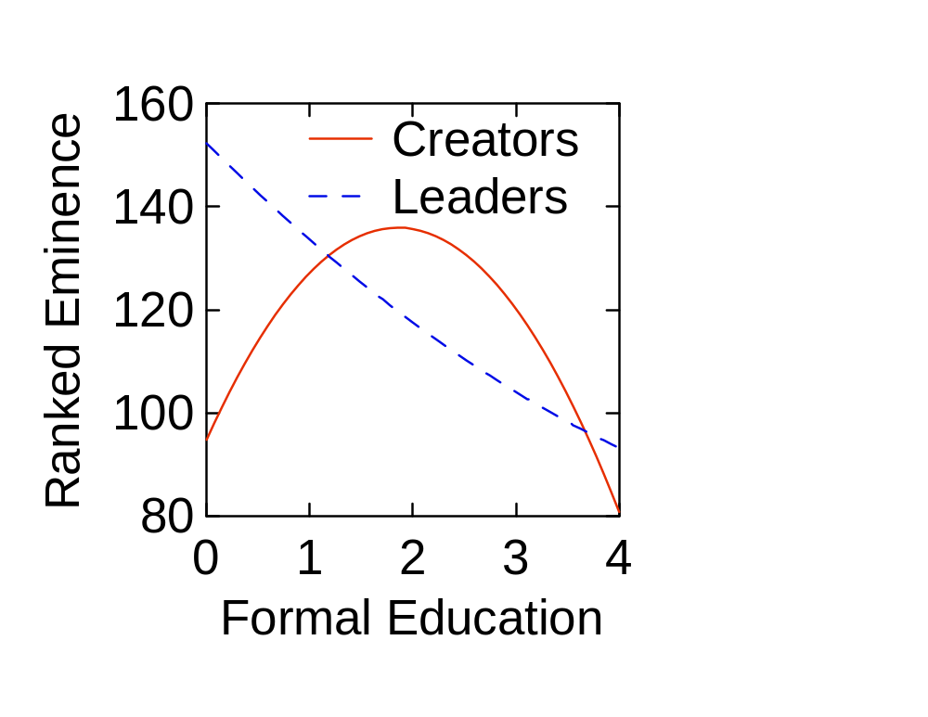

Slide 26
Creative Genius:
The Originality Paradox:
  Creativity depends on originality, but originality may be undermined by excessive expertise
  Anecdotal evidence: Einstein vs. Grossman
  Experimental evidence: Insightful problem solving (e.g., “functional fixedness”)
  Historiometric evidence: Cox (1926) data
  Hence, experts are not creators and vice versa
In support of this position can be cited several problematic findings regarding individual differences and longitudinal changes

Slide 27
Problematic Findings
Individual Differences
  The 10-Year Rule
    Substantial cross-sectional variation in the actual number of years prior to making a major contribution
    For example, in a sample of 120 composers two kinds of preparation measures were defined for both unweighted counts of themes and weighted counts of works:
      Musical preparation: year of first hit minus year of first formal lessons
      Compositional preparation: year of first hit minus year of first composition

Slide 28
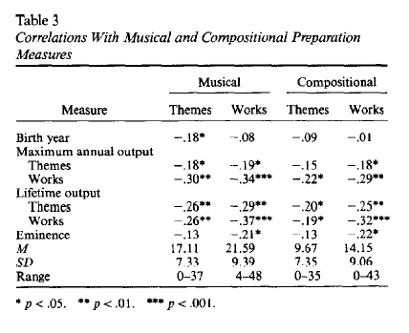

Slide 29
Problematic Findings
Individual Differences
  The 10-Year Rule
    Moreover, this variation correlates negatively with
      maximum annual output,
      lifetime output, and
      eminence
    In other words, the greatest creators require less time to acquire domain-specific expertise

Slide 31
Problematic Findings
Individual Differences
  The 10-Year Rule
    What renders these negative correlations all the more remarkable is that productivity and impact are also negatively correlated with
      age at first formal lessons and
      age at first composition
    That is, those who start earlier take less time: both onset and the rate of expertise acquisition are accelerated
    This pattern differs from what is normally expected of expertise acquisition (e.g., musical performance)

Slide 32
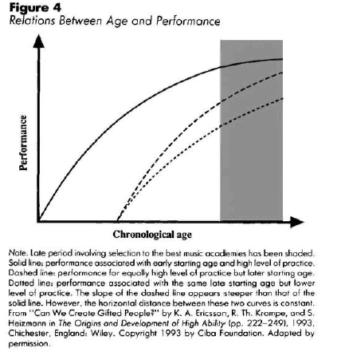

Slide 33
Problematic Findings
Individual Differences
  The 10-Year Rule
    Similar findings have been found for other samples (e.g., eminent scientists):
      Those with the highest output and impact begin expertise-acquisition earlier and complete it more rapidly
    This consistent empirical finding can be interpreted as support for the existence of creative talent
      That is, those individuals who are able to accelerate the onset and termination of expertise acquisition are also able to generate creative ideas at an accelerated rate

Slide 34
Problematic Findings
Individual Differences
  Personal Characteristics
    Creativity is
      negatively correlated with latent inhibition (and other cognitive filtering processes) and
      positively correlated with
        openness to experience (from the “Big Five”),
        breadth of interests (number of hobbies, omnivorous reading, etc.),
        versatility (both intra- and inter-domain)

Slide 35
Problematic Findings
Individual Differences
  Personal Characteristics
    Two difficulties regarding the above list:
    First, several of the traits appear to have a significant genetic basis (e.g., openness, latent inhibition).
    Second, these do not seem to be the individual attributes that would be expected if creative genius was made according to a standard expertise-acquisition model

Slide 36
Problematic Findings
Individual Differences
  Personal Characteristics
    According to the latter framework, expertise acquisition should require specialized concentration on a single domain that filters out all extraneous distractions
    It is especially difficult to explain how exceptional creativity in one domain would be positively correlated with expertise acquisition in multiple domains (particularly given that creativity is not positively correlated with sleep deprivation)
    However, these individual traits do make sense if originality is dependent on a breadth of knowledge and skills and on a receptiveness to serendipitous stimuli

Slide 37
Problematic Findings
Longitudinal Changes

Slide 38
Problematic Findings
Longitudinal Changes
  Total Productivity: A Non-Monotonic Function

Slide 39
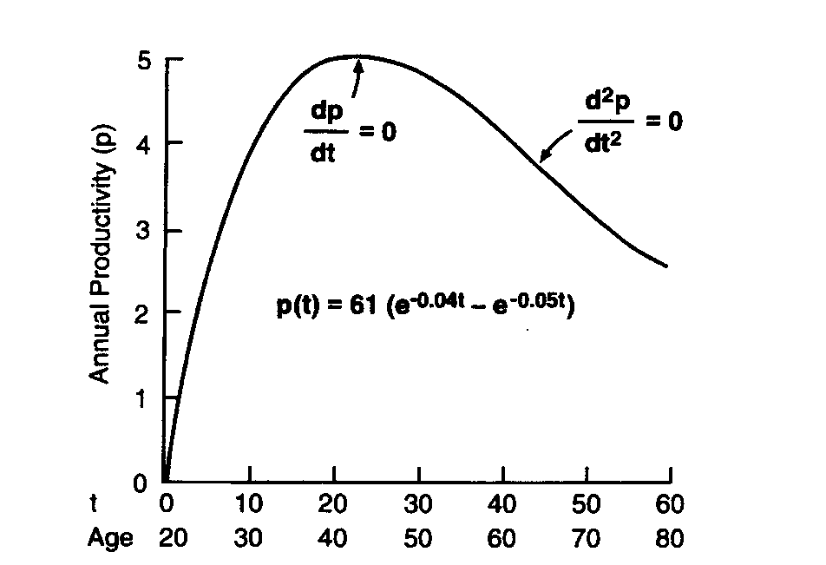

Slide 40
Problematic Findings
Longitudinal Changes
  Total Productivity
  Quantity-Quality Relation: The Equal-Odds Rule

Slide 41
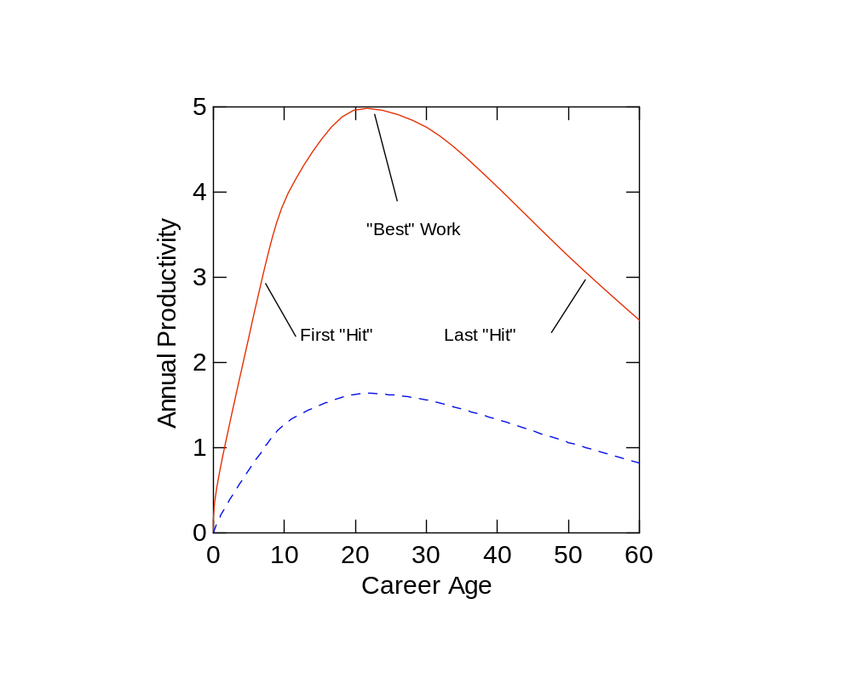

Slide 42
Problematic Findings
Longitudinal Changes
  Total Productivity
  Quantity-Quality Relation
  Career Landmarks: Best Work < Last Work

Slide 43
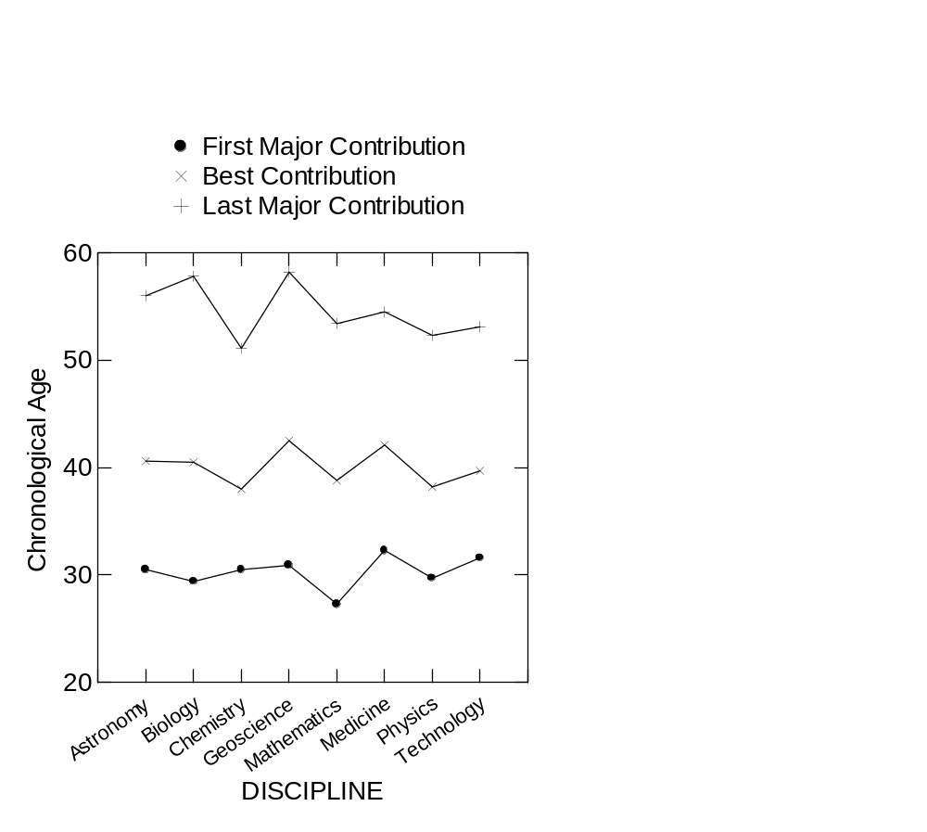

Slide 44
Problematic Findings
Longitudinal Changes
  Total Productivity
  Quantity-Quality Relation
  Career Landmarks
  Overtraining and Cross-training Effects
    Former: Within-domain expertise acquisition can eventually undermine creativity
    Latter: Cross-domain expertise acquisition can enhance creativity

Slide 45
Problematic Findings
Longitudinal Changes
  Total Productivity
  Quantity-Quality Relation
  Career Landmarks
  Overtraining and Cross-training Effects
    First example: Highly popular opera compositions
    Second example: High-impact research programs
      e.g., Charles Darwin when working on the Origin

Slide 46
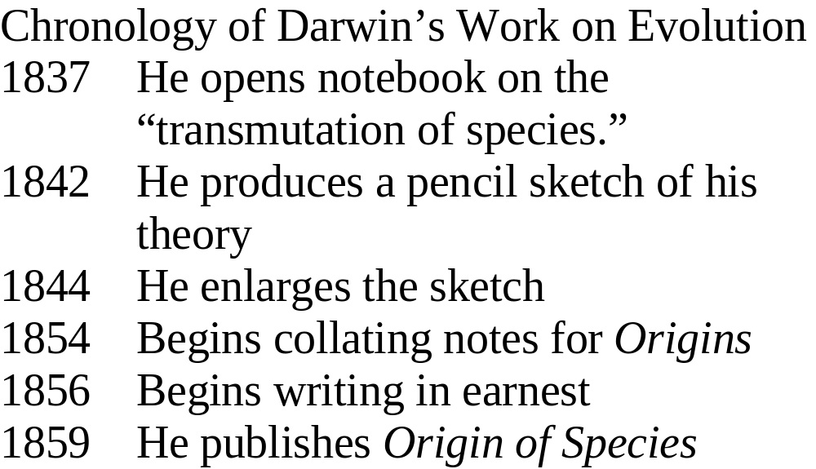

Slide 47
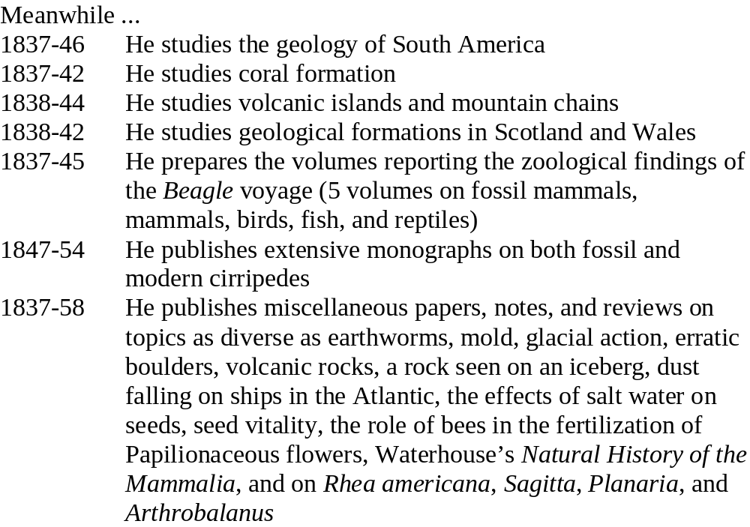

Slide 48
Nature-Nurture Integration
Environmental Effects on Phenotype
  e.g., contingency of heritability estimates on environmental variance
Genotypic Effects on Environment
  e.g., deliberate practice
Genetic-Environmental Multiplicative Effects
  e.g., practice effects moderated by genetic profile
Dynamic Longitudinal Interactions
  e.g., general intelligence

Slide 50
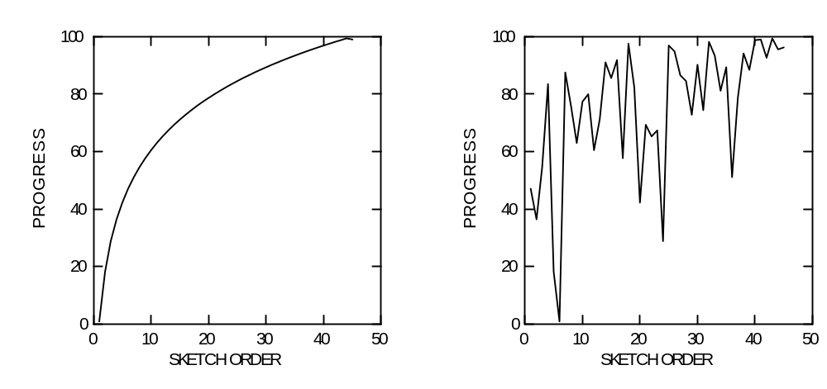

Slide 51
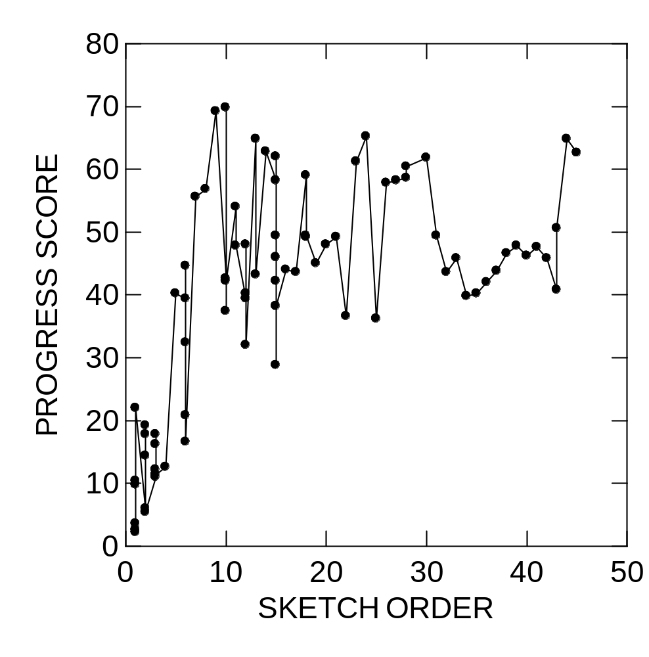

Slide 52
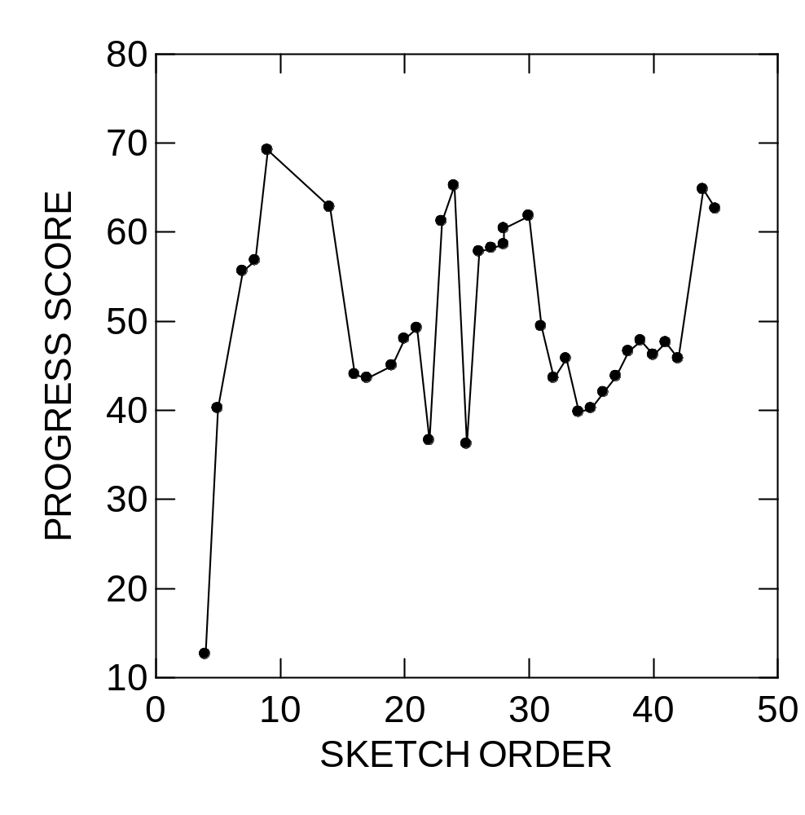

Slide 53
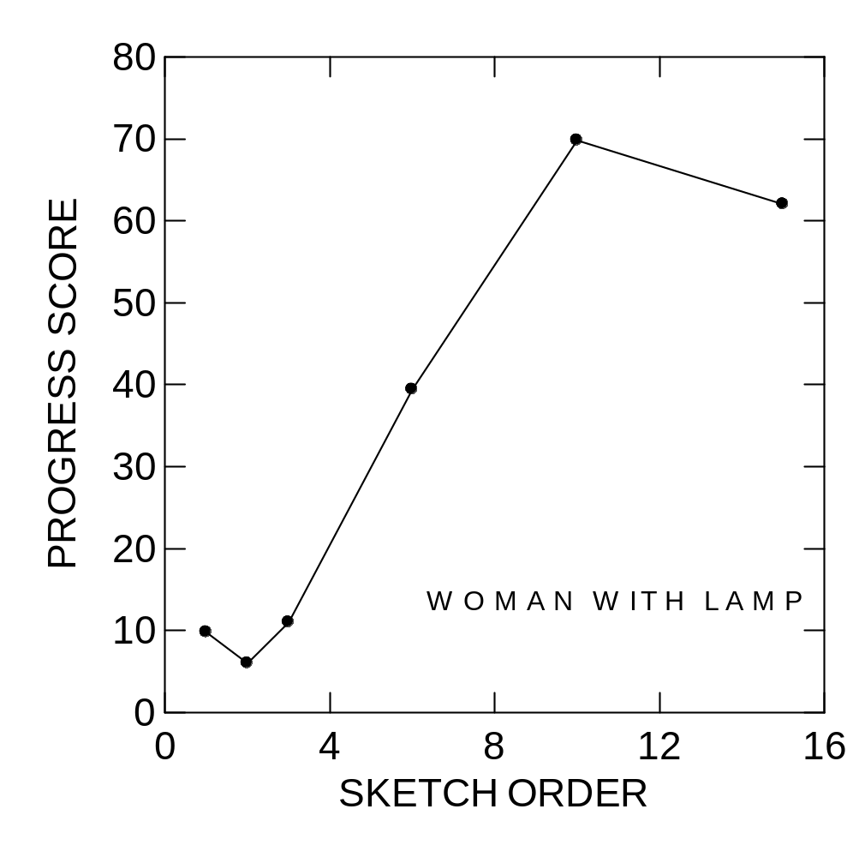

Slide 54
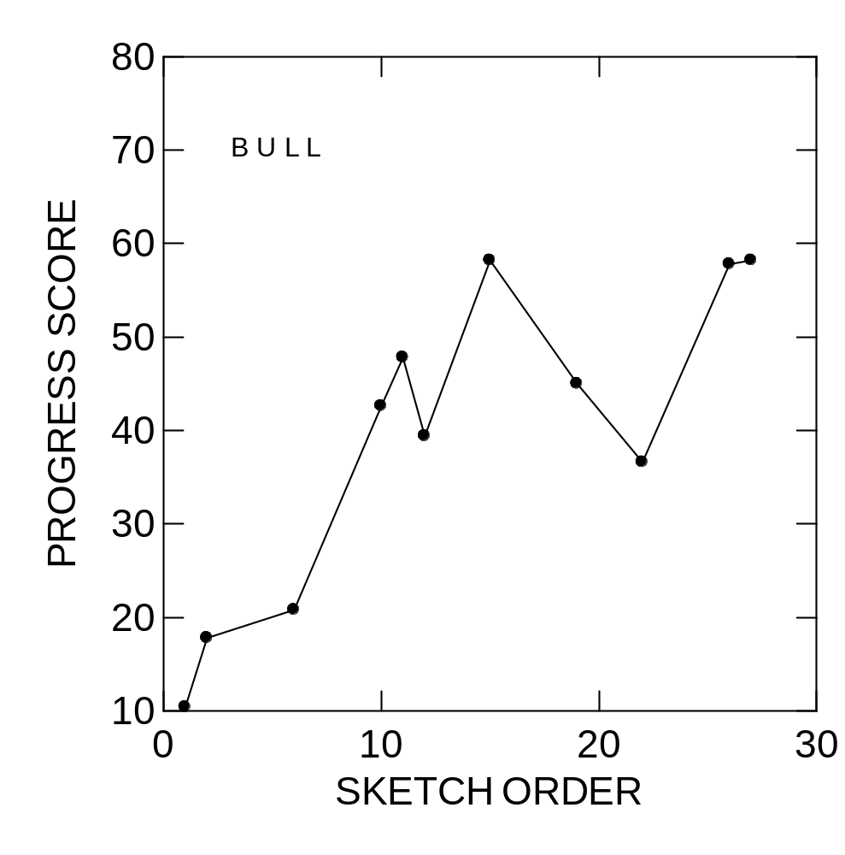

Slide 55
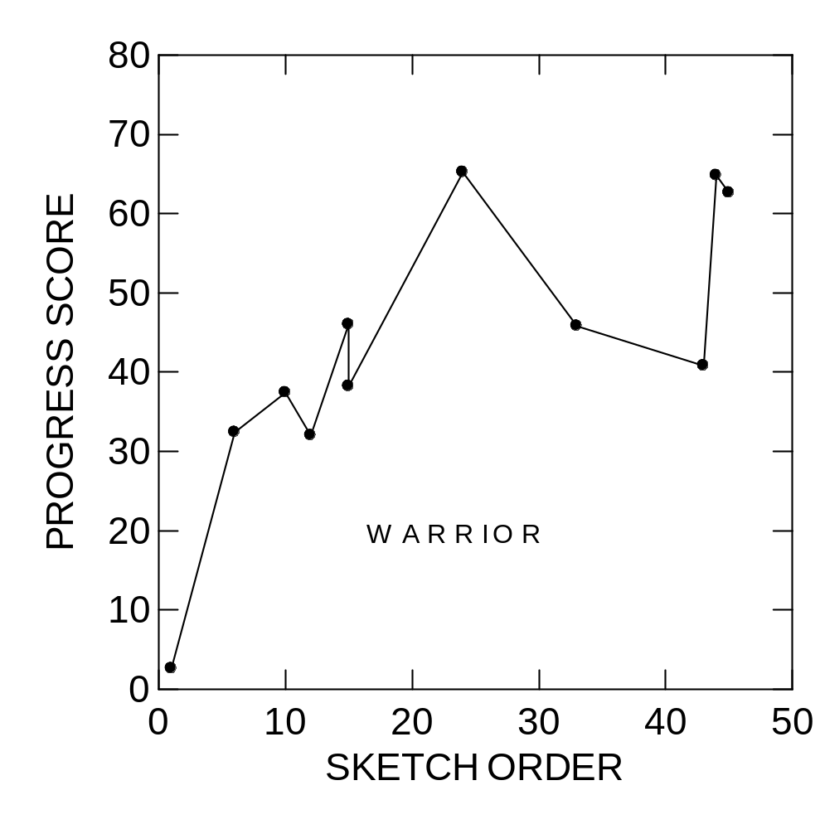

Slide 56
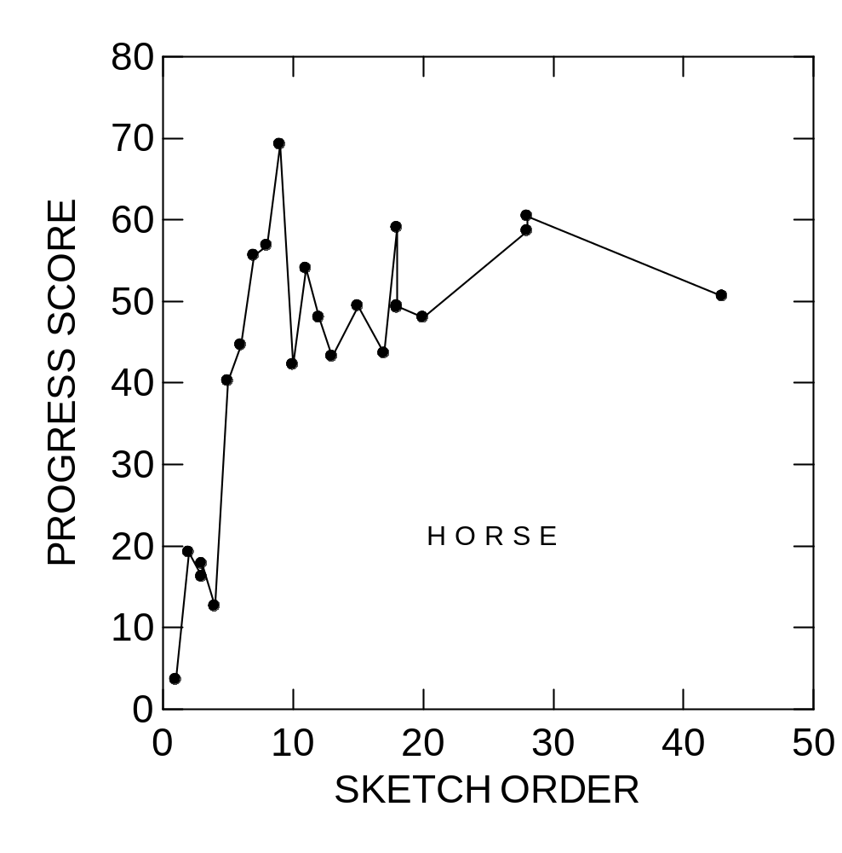

Slide 57
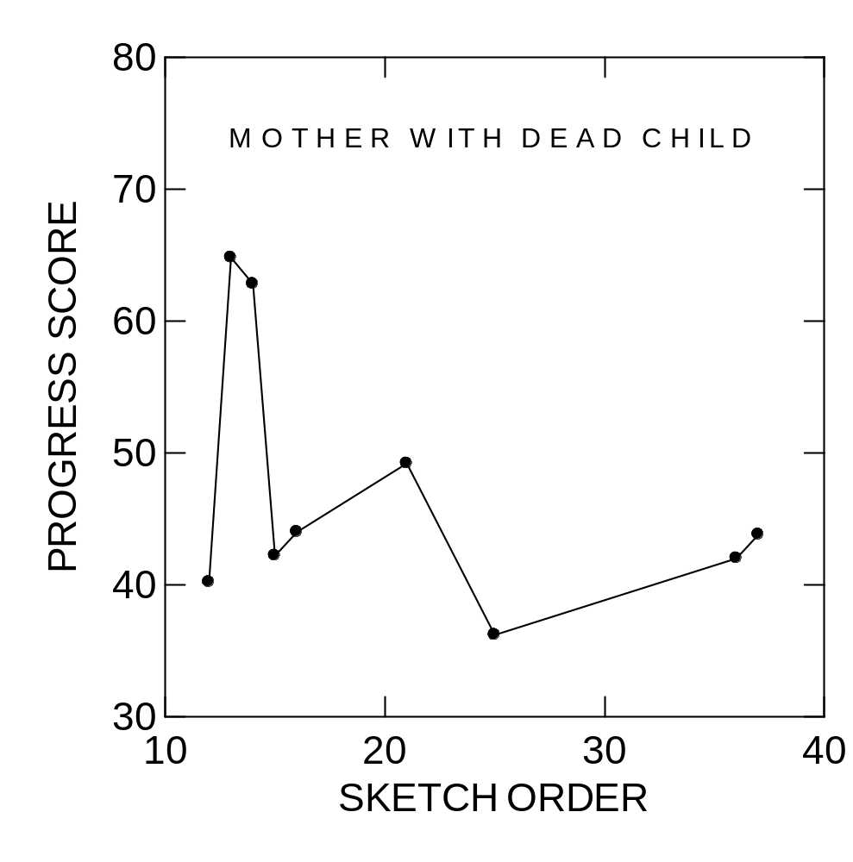

Slide 58
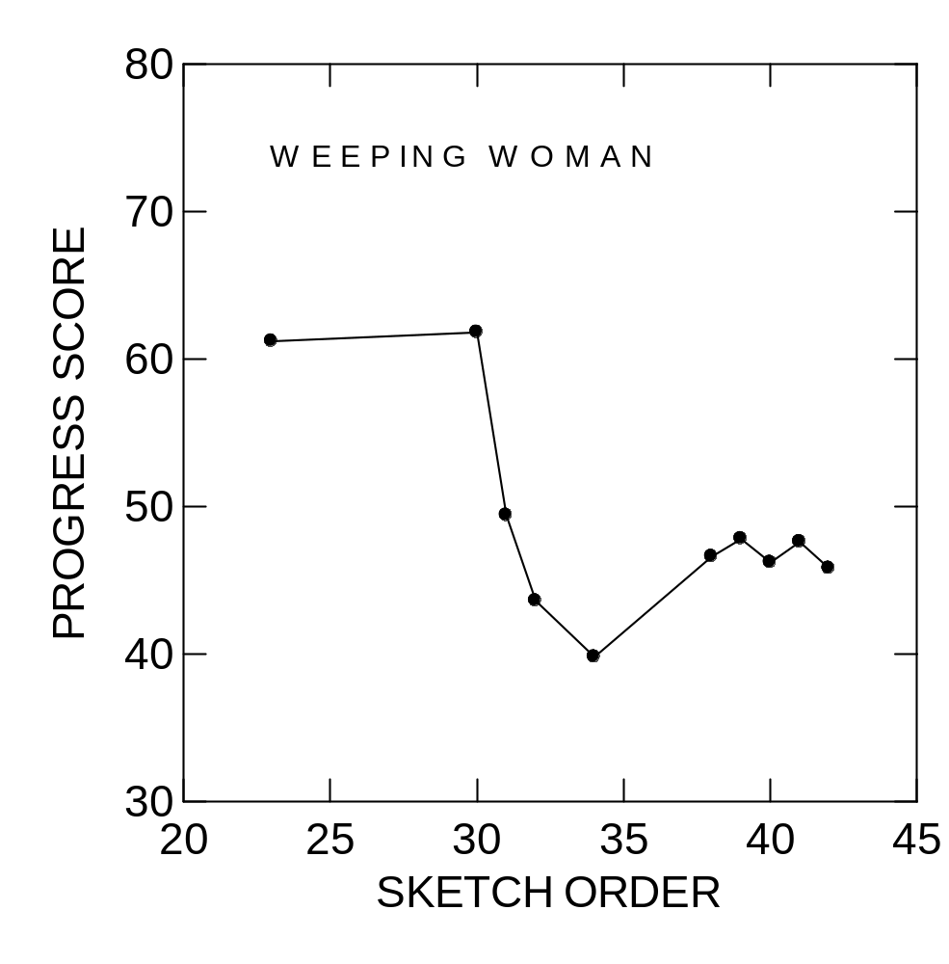

Slide 62
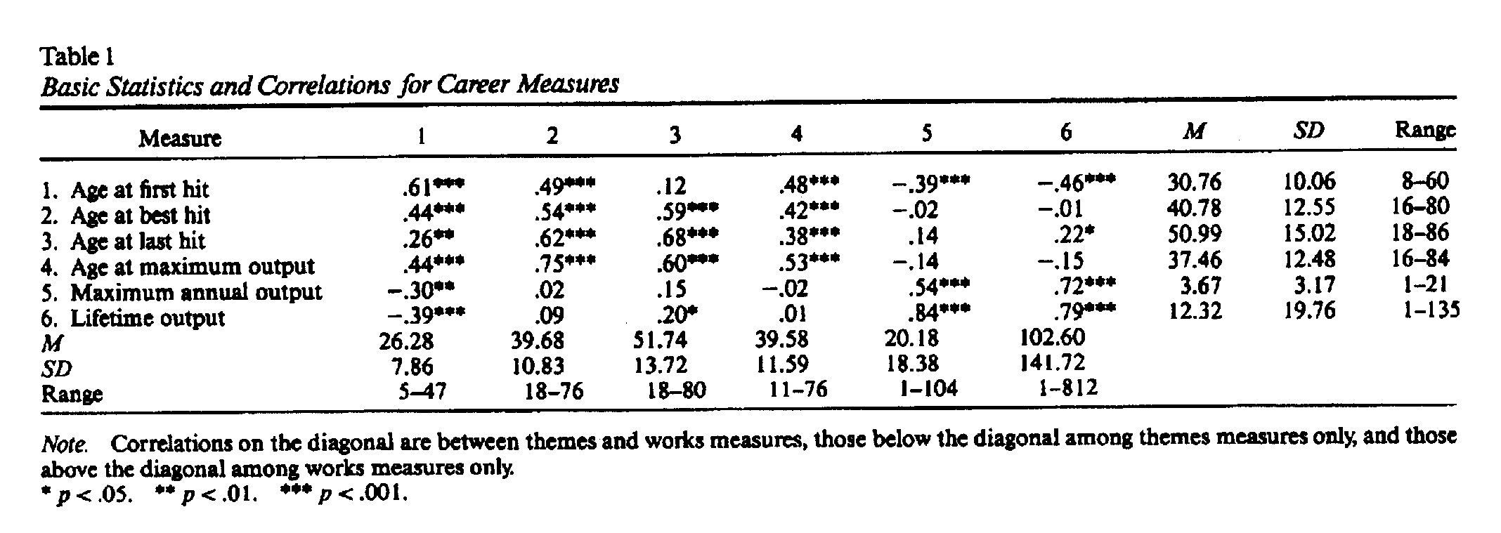

Slide 63
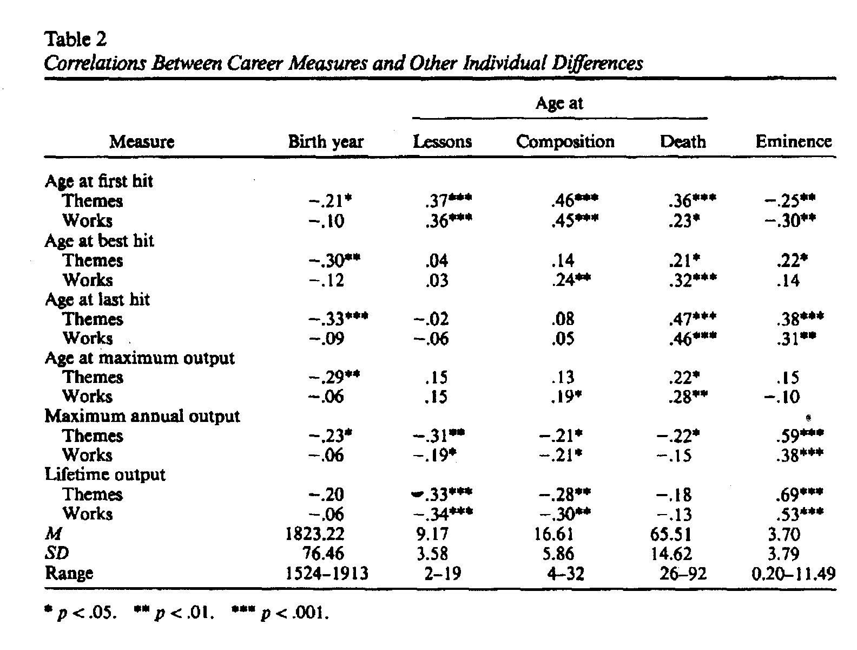

Slide 64
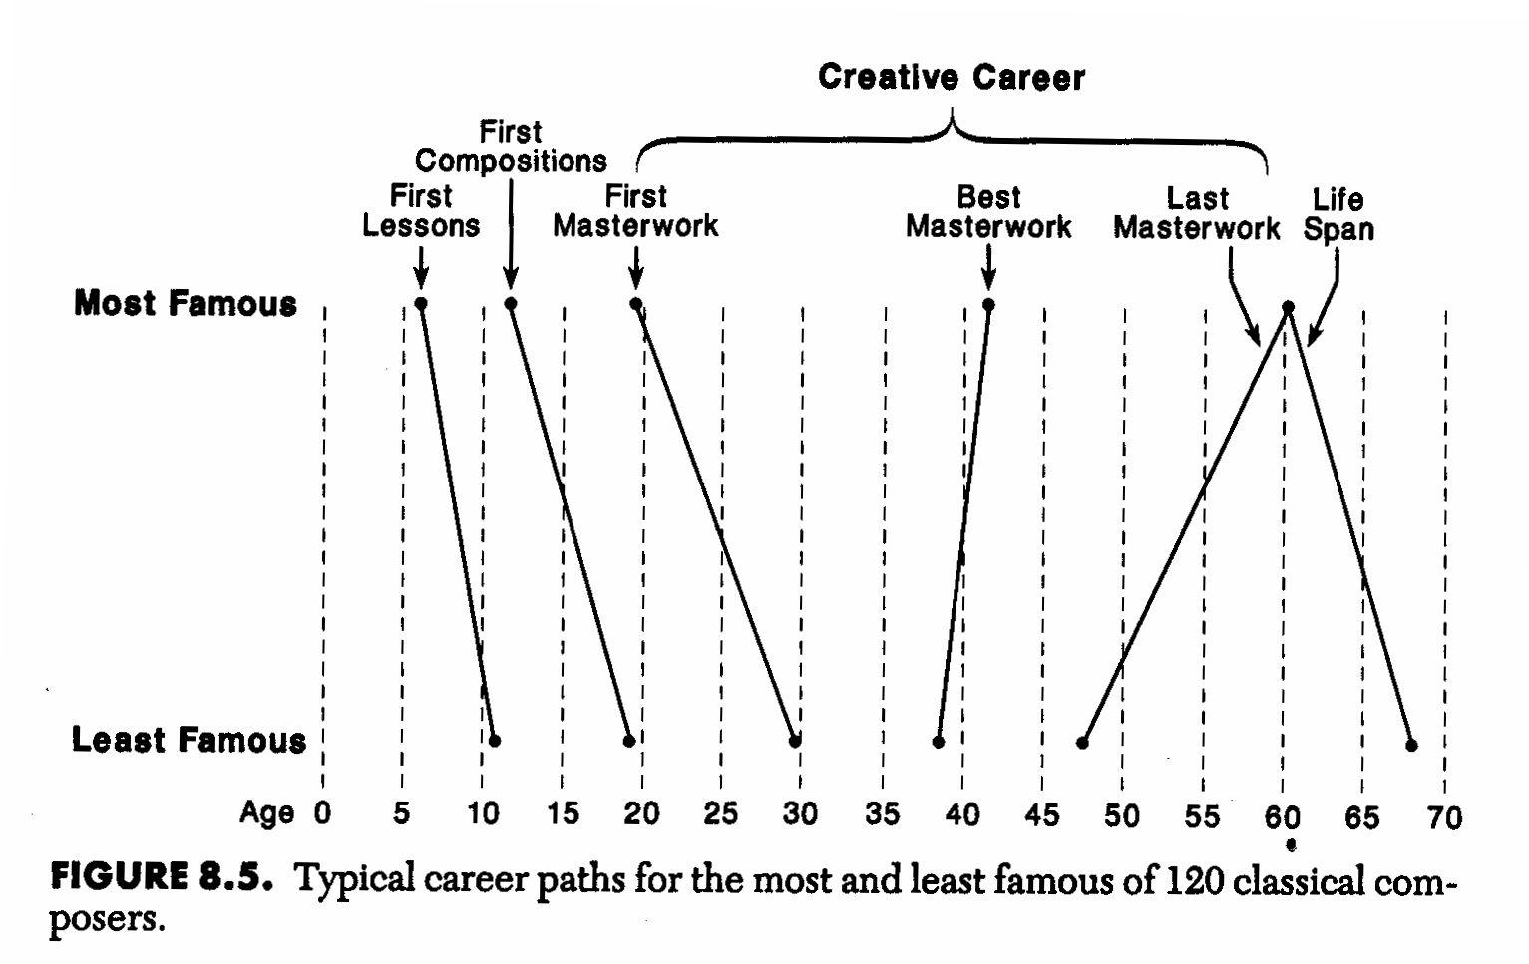

Slide 65
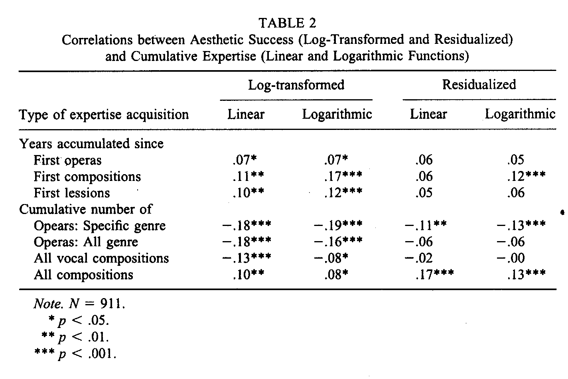

Slide 66
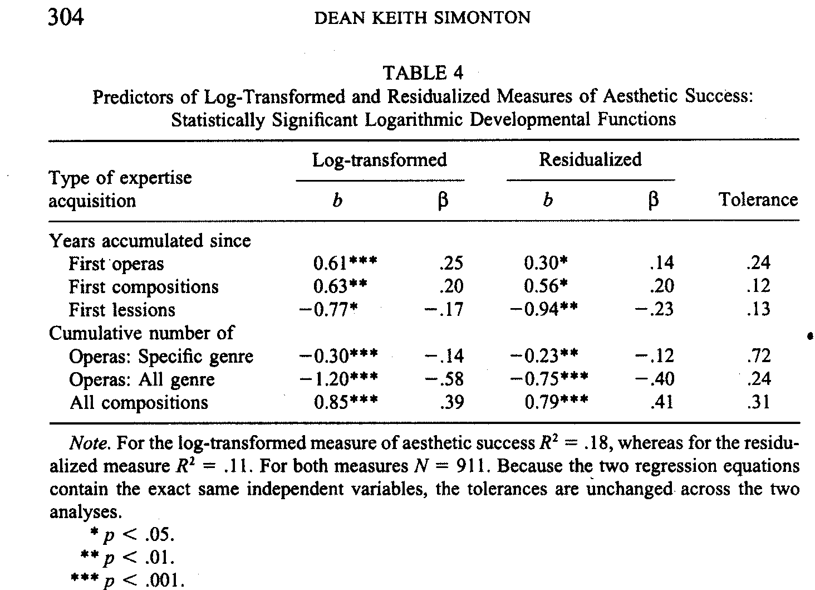

Slide 67
