Slide 1
Annual Review
Performance, outlook, next steps
WinBrow

Slide 2
What changed
Revenue grew 18%
Enterprise drove 70% of growth
Churn fell to 2.1%
Confidential
2
Notes:
Pause for questions.

Slide 3
Revenue by region
Region | Revenue | Growth
North | $4.2M | 18%
South | $3.1M | 12%
East | $2.8M | 8%
Confidential
3

Slide 4
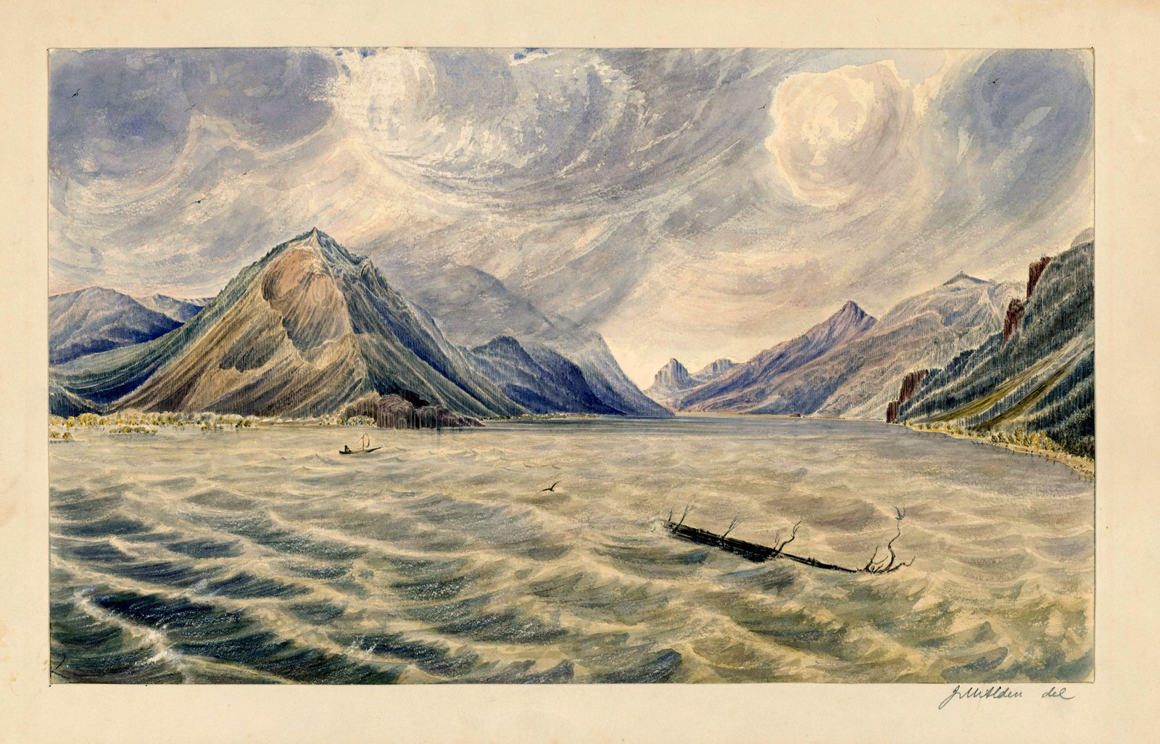
Where we operate
Regional landscape
"Wind Mountain" Columbia R - NARA - 102278851 (page 1).png — James Madison Alden (Public domain), Wikimedia Commons
Confidential
4

Slide 5
Quarterly growth
Confidential
5

Slide 6
Next year
Focus
Harden
Scale
Confidential
6

Slide 7
“Simplicity is the ultimate sophistication.”
— Leonardo da Vinci

Slide 8
Thank you
Questions?
WinBrow

