Slide 1

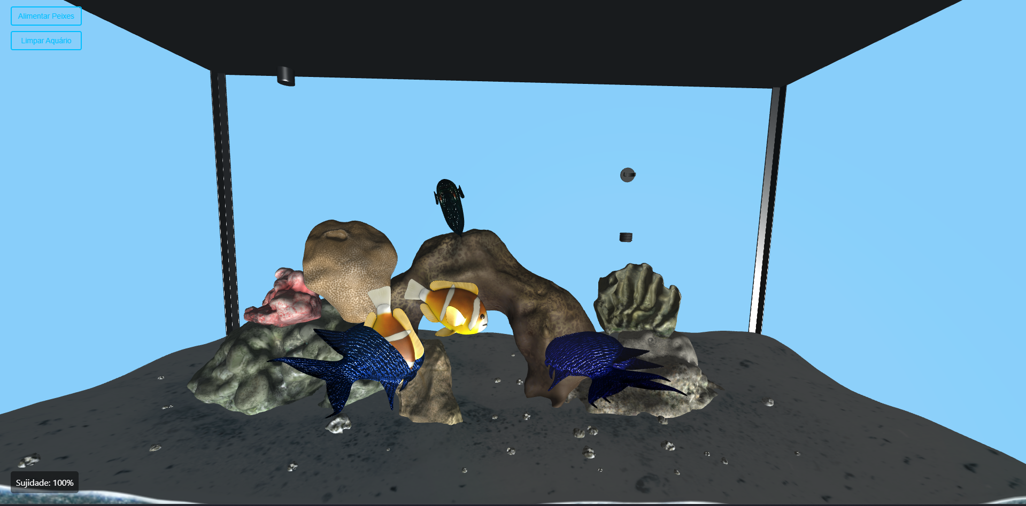
AQUARIUM
PROJECT
Presented by: Leonardo Luís, 114093
INTERACTIVE 3D AQUARIUM SIMULATION WITH THREE.JS

Slide 2




GOALS
GOALS
TECHNOLOGIES
To develop an interactive 3D aquarium simulation with both external and first-person perspectives, featuring water dirt accumulation, fish feeding, and dynamic fish behavior.
Three.js
Modular JavaScript
Legacy OBJ/MTL Loaders
HTML / CSS
NODE

Slide 3

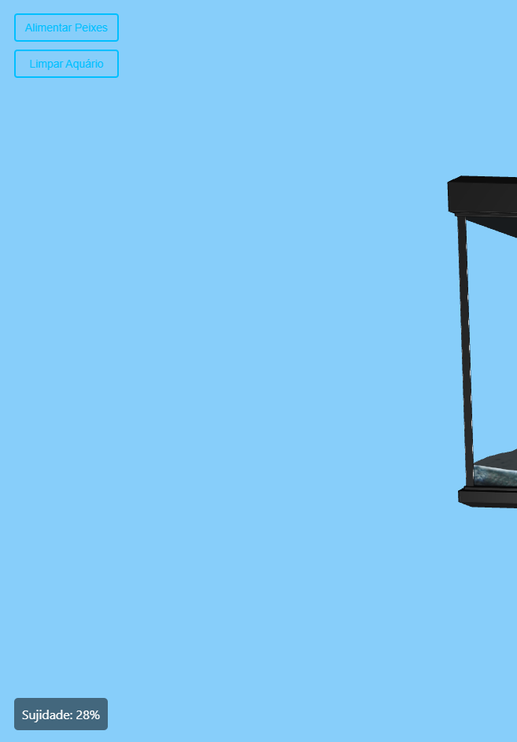
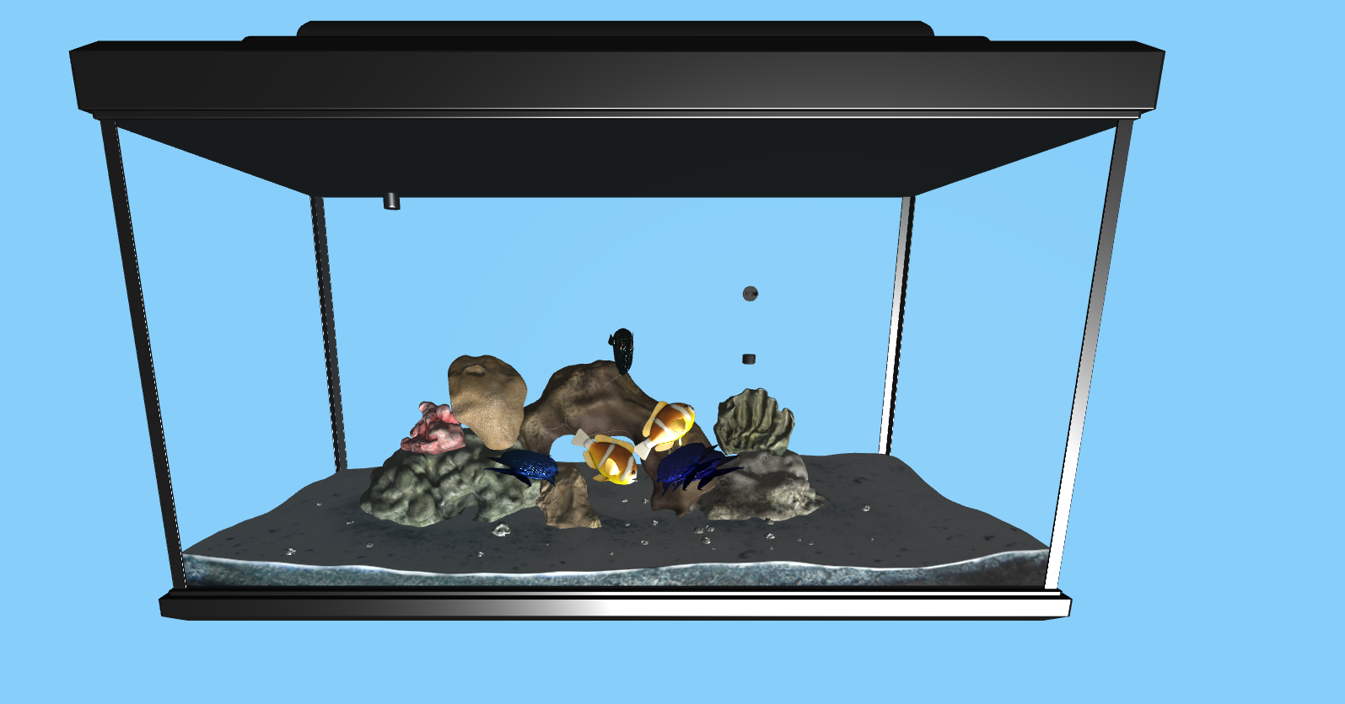



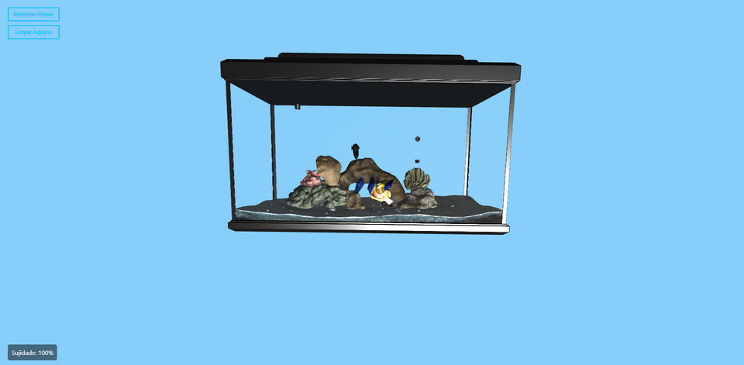
CURRENT PROGRESS & NEXT STEPS
✅ Implemented So Far:
Aquarium model loaded and positioned correctly
Animated fish swimming in circular patterns
Buttons to feed fish and clean the aquarium
Dirt increases gradually
External view supported via orbit controls
🛠️ Still to Implement:
First-person view with FPS-style navigation
Visual progression of dirt on aquarium glass over time
Adaptive fish behavior (fed vs. hungry)
Refraction shader to simulate underwater vision
Improved fish movement and lighting effects

Slide 4

End
ICG
Leonardo Luís
114093

