Slide 1
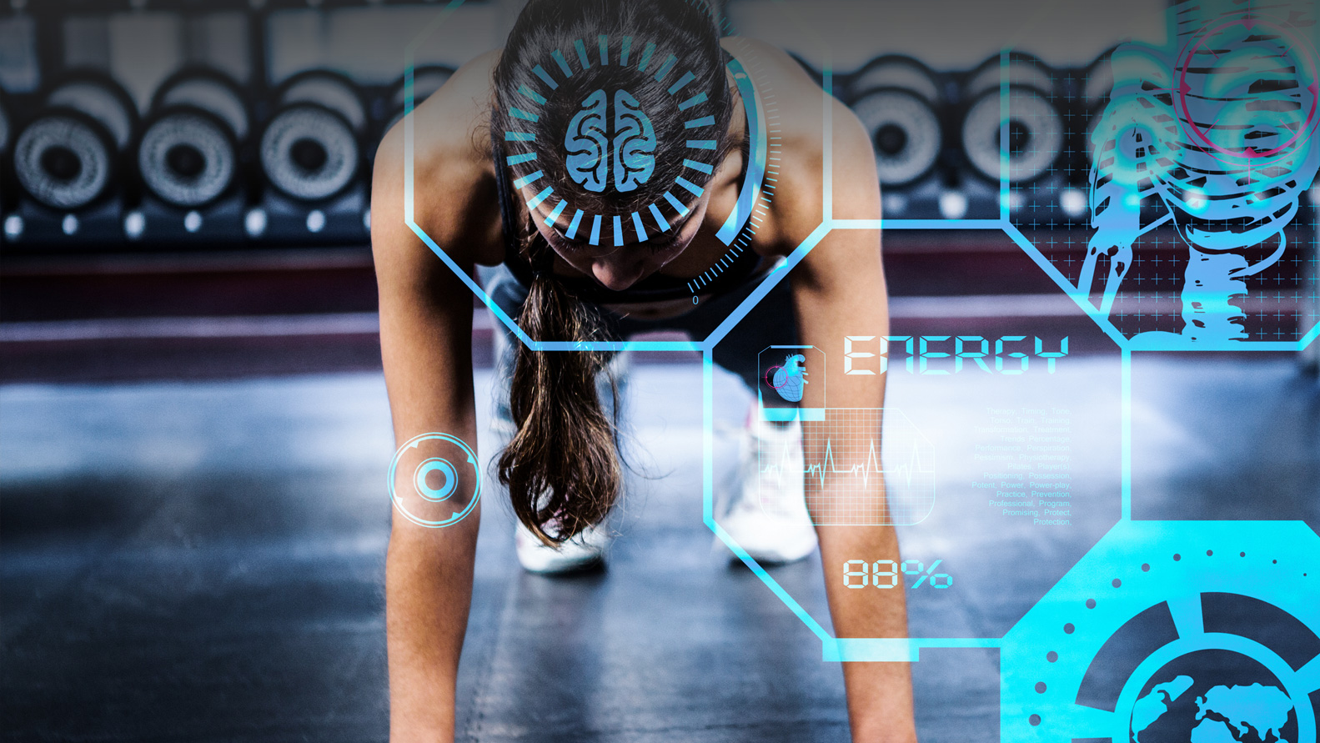
THE IMPACT OF TECHNOLOGY ON ELITE SPORTS
Leonardo Pedro

Slide 2
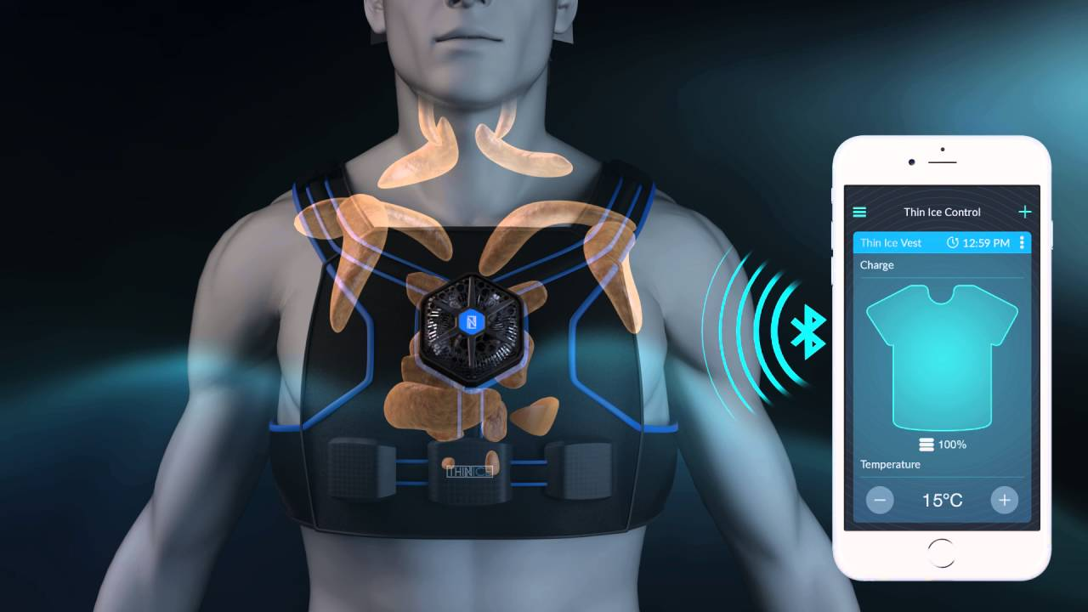
Use of biofeedback for motion corrections
Heart rate
Respiratory rate

Slide 3
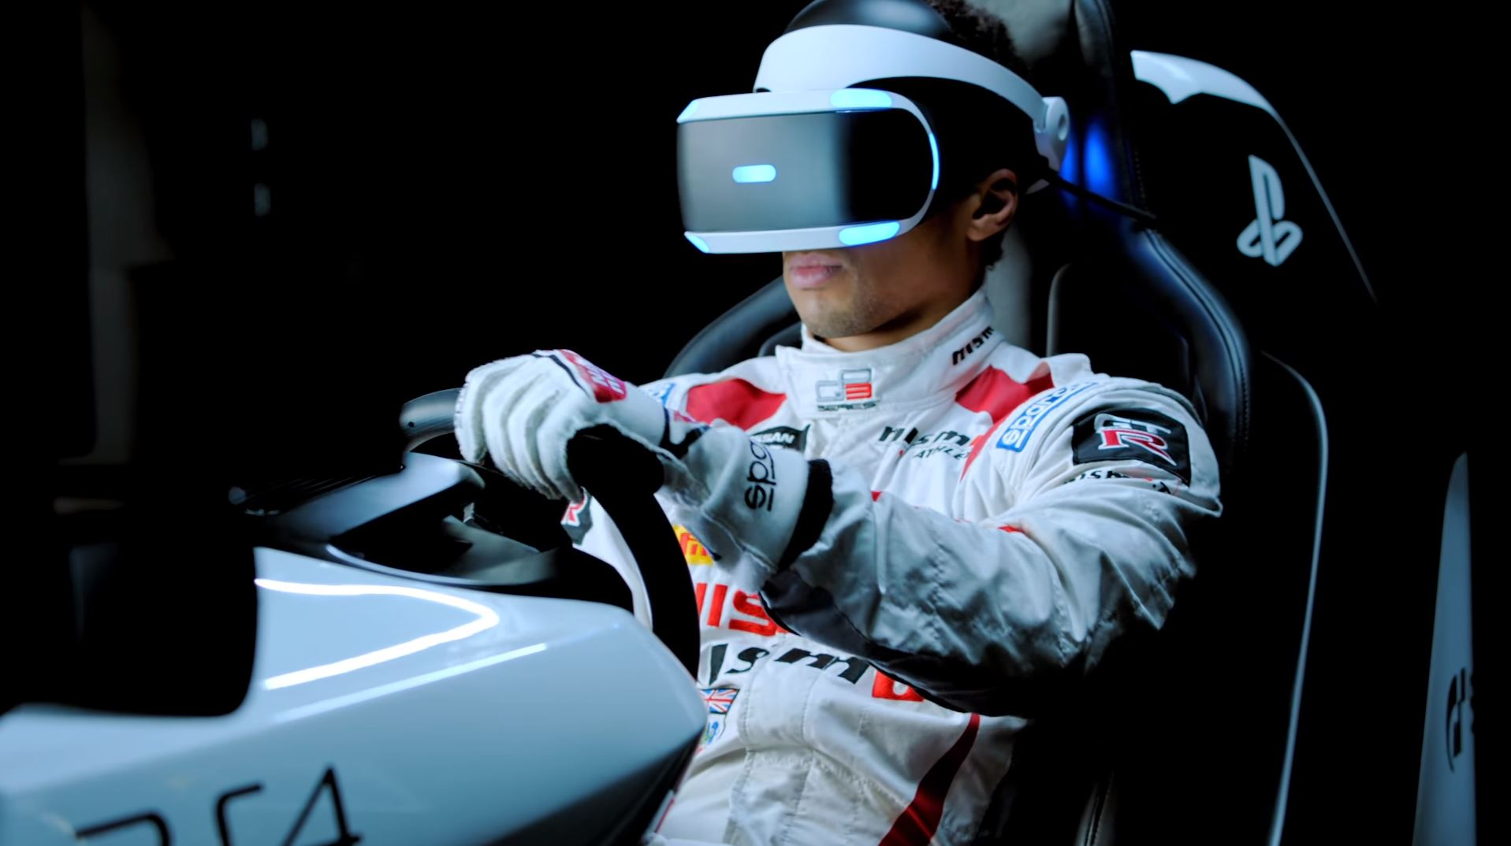
Virtual Reality
Simulation Reality
Artificial Reality

Slide 4
THE IMPACT OF TECHNOLOGY ON ELITE SPORTS
Leonardo Pedro

