Slide 1
Data-driven insights: identifying the best soccer players by position
Leo Fonseca
Jan 18th, 2024

Slide 2
About me
I'm Leonardo Fonseca, a dedicated software developer with a deep passion for soccer, embarking on an exciting journey into Data Science.
My goal is to explore soccer statistics, leveraging them to analyze players' performances and endeavour to establish a comprehensive ranking based on their statistical prowess.

Slide 3

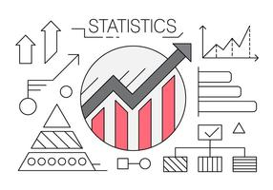

Inspiration
LOVE
INNOVATION
FUTURE

Slide 4
Project
DATA RESOURCE
FOTMOB
LEAGUE
CANADIAN PREMIER LEAGUE 2023
STATISTICS
ATTACK SKILLS
ALGORITHM
RANDOM FOREST CLASSIFIER (Python)
DASHBOARDS
TABLEAU

Slide 5
Collecting the stats
For each CPL game, from April to October, I collected the Attack stats.
It was 116 games generating a dataset with more than 3,500 rows.
And the league had 187 players.
So, I built two datasets: Players and Stats.

Slide 6

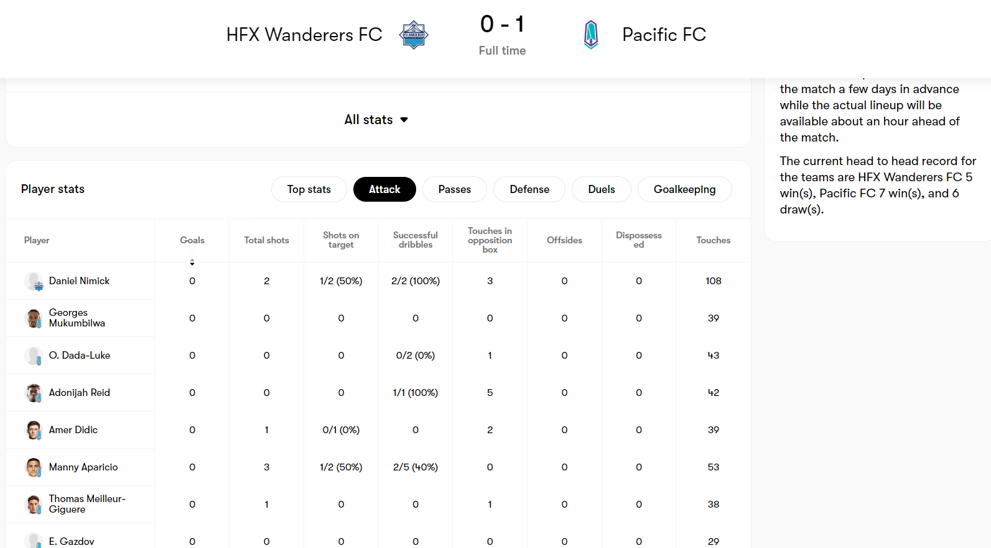


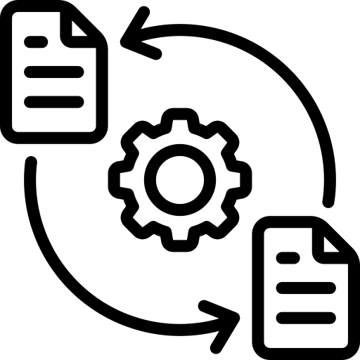
The process
Exclude Goalkeepers from the analysis.
Standardize player names and assign a unique identifier (ID) for each player.
Extract and separate concatenated statistics for clearer analysis.
Acknowledge the variability in stats across different games.
Fotmob
HTML
Files
Players
CSV
File

Slide 8


The process
Ignore Goalkeepers
Fix names and create an ID for each player
Extract concatenated stats
Stats are not the same for all games
RandomForestClassifier
Ranking players by month
Ranking the best players of the season
Fotmob
HTML
Files
Players
CSV
File

Slide 9
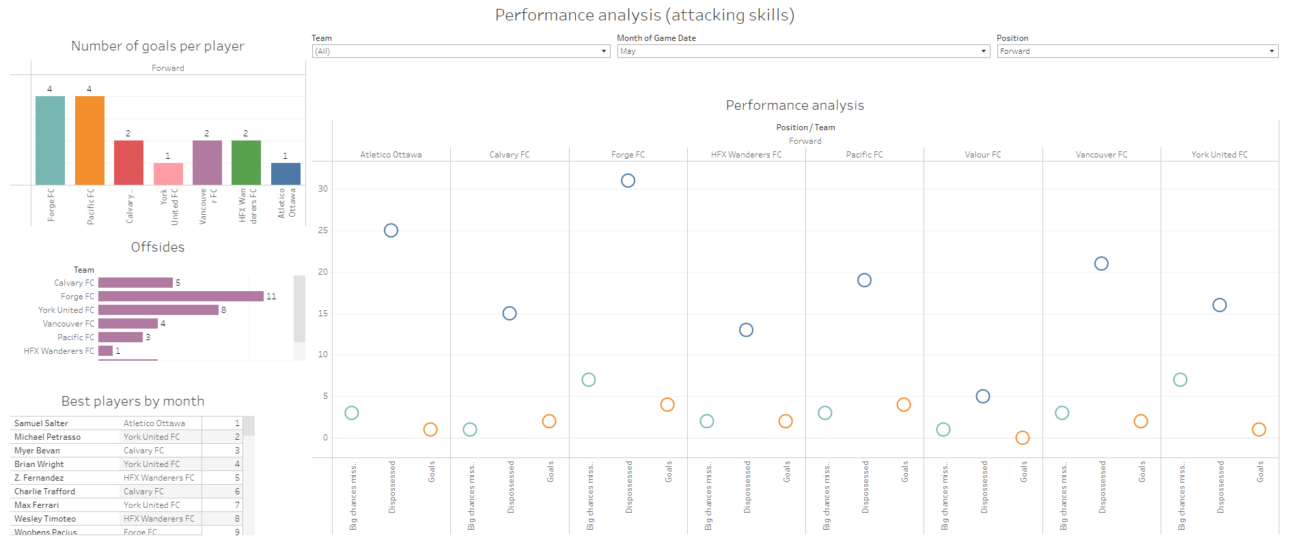
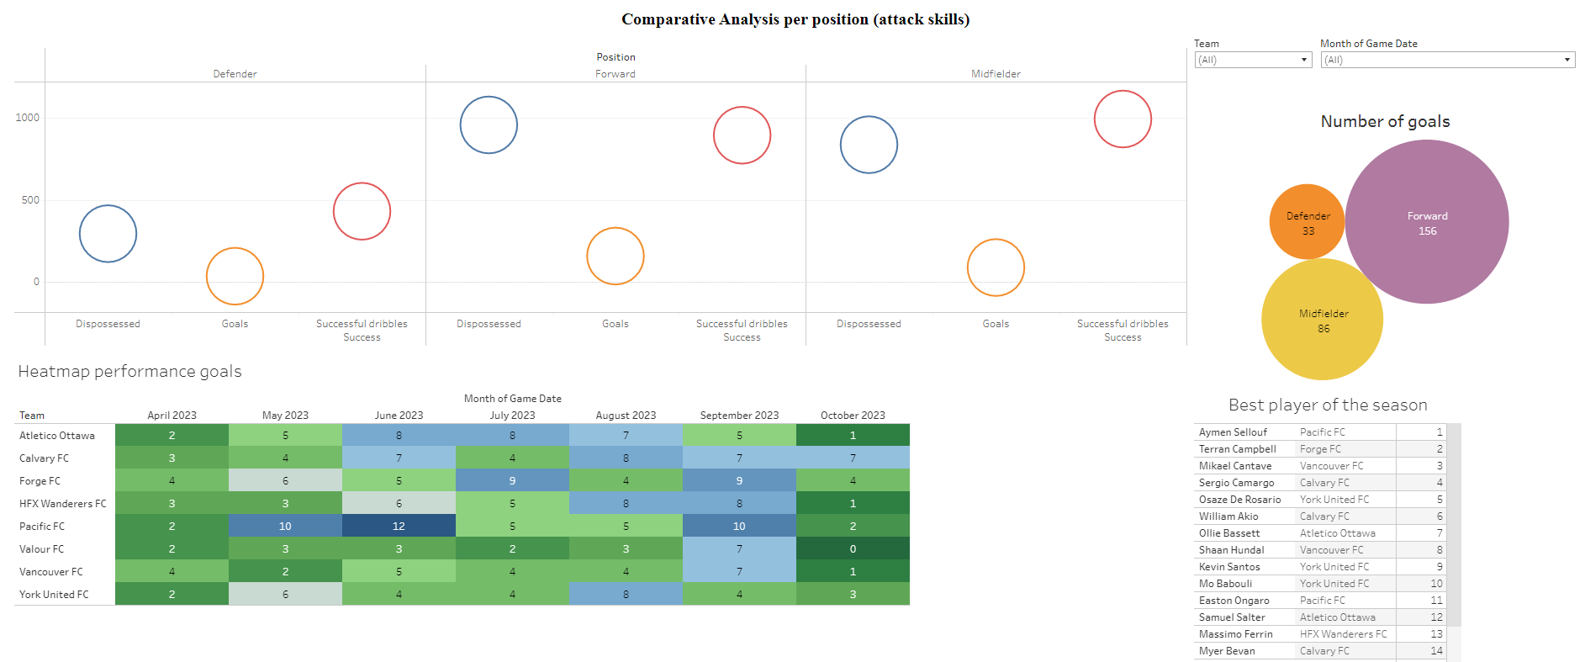
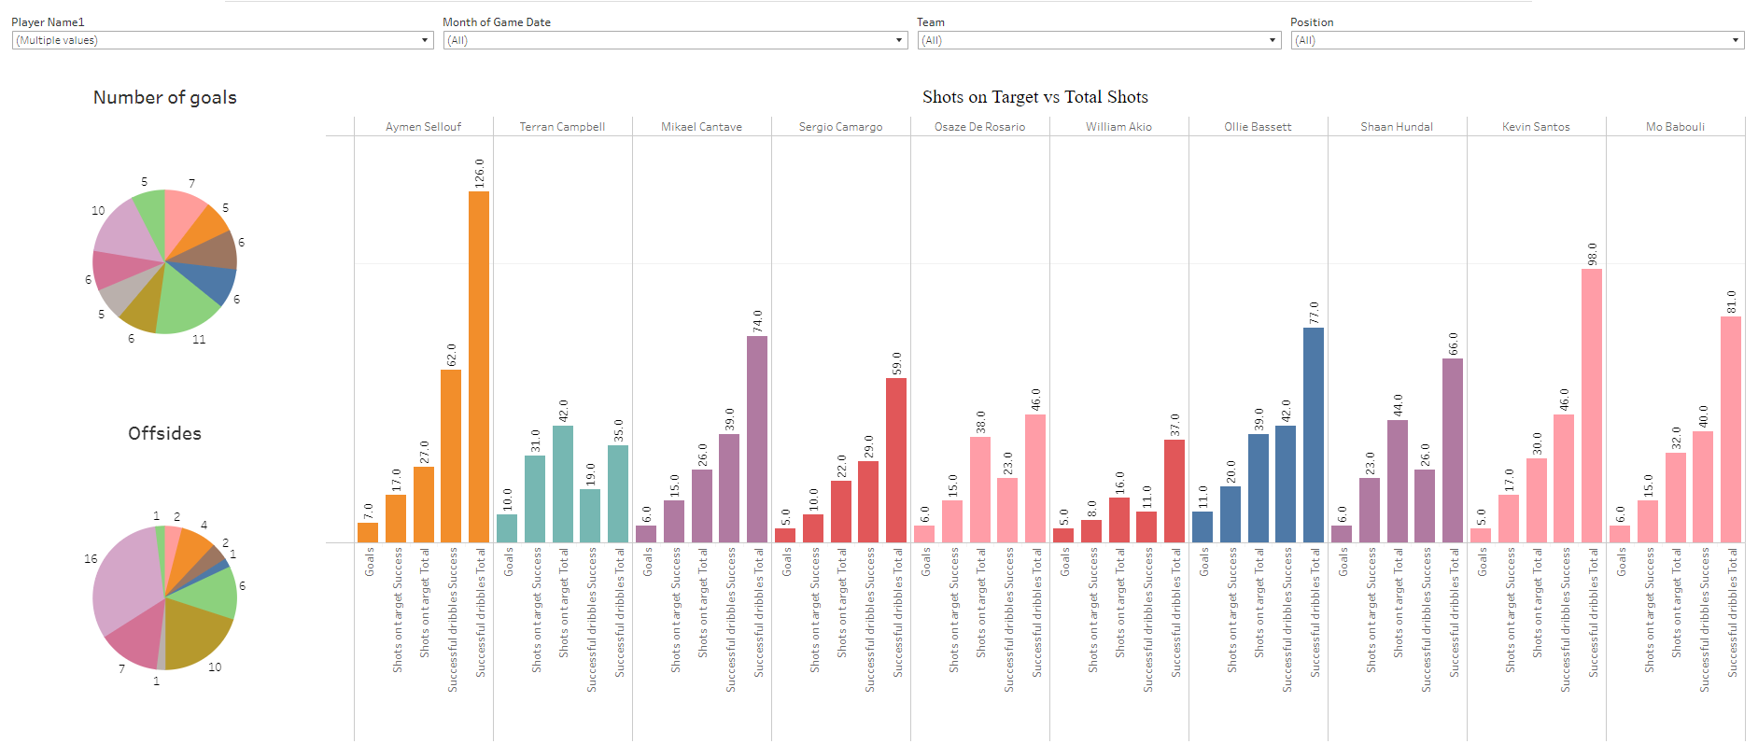
Dashboards
$3B
$2B
$1B
PERFORMANCE
ANALYSIS
COMPARATIVE ANALYSIS
PER POSITION
COMPARATIVE ANALYSIS
PER PLAYER

Slide 10
Future
Integration of Stats from Different Sites
Expansion of Classification for Other Skills
The potential to enhance data richness by incorporating statistics from additional websites, creating a more comprehensive dataset.
The concept applied to attacking skills can be extended to Defensive, Passing, and Goalkeeper skills, broadening the scope of player assessment.
Publication of Dashboards
Automation and League Expansion
Sharing the visually engaging dashboards on social media platforms to garner feedback and engage a broader audience.
Implementing automation to streamline the data collection and analysis process, with the prospect of incorporating data from other leagues, thereby expanding the project's scope.

Slide 11




Thank you
Leo Fonseca
leo.fonseca.canada@gmail.com
https://github.com/leoaugusto1976/lhl-final-project

