Slide 1
Quantitative Biological Research with Python (92847)
TA 12 – Modules, VCF & multivariate analysis

Slide 2
Modules

Slide 3
Organizing your code
When doing research, most of the time we just work interactively
With Jupyter we create a notebook with all our code and results
But even with Jupyter, our code is not really reusable
If we want to use the code somewhere else, we’ll have to copy-paste it (code duplication is bad!)
When writing generic code that can be reused (by ourselves or others), we may want to put it in a separate module

Slide 4
Modules
Like built-in or third-party libraries, we can write custom modules that can then be imported from anywhere
Modules are nothing but standard .py files (or directories); everything within these files can be imported from the module
Just need to make sure the module is in PYTHONPATH, by either:
Installing the module into a standard location (e.g. site-packages)
Temporary hack:
Modifying the PYTHONPATH environment variable
Changing sys.path
Relative import (should be done only within a module)

Slide 5
Example
Using genome_reader.py as a module

Slide 6
Reloading a module
While developing a module, sometimes you change it and want to reload it (if you work interactively)
Just running the import statement again won’t help
You can either restart your shell, or use the importlib.reload built-in function
Reloading is dangerous (it won’t update other references to that module)

Slide 7
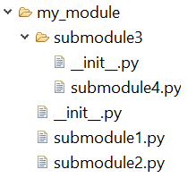
Modules with multiple files
It’s a good idea to spread big modules across multiple files (submodules)
You can create any directory structure that reflects your module structure
For example, given the shown tree, you can do the following:
from my_module.submodule1 import some_function
from my_module import some_function2
from my_module.submodule3 import submodule4
__init__.py files are important
They determine what the module exports
Must exist (even if you leave them empty)

Slide 8
Relative imports
When you need to import things from other submodules in the same module, you need to use relative imports
For example, your code in the A.B.C module can do:
from . import D # Imports A.B.D
from .. import E # Imports A.E
from ..F import G # Imports A.F.G

Slide 9
Cyclic imports can cause troubles
Example: A imports B, and B imports A
Cyclic imports usually indicate a bad design
If two modules are so interdependent, perhaps they should be merged into one module
If you insist keeping cyclic imports, you are exposed to some technical issues
It’s better to avoid the from module import something syntax and remain with import module
Behavior may vary between Python versions

Slide 10
__name__
__name__ is a variable that refers to the module name of the current code
It’s better not to use it (unless you really must hack something)
It’s conventionally used in scripts as:
if __name__ == ‘__main__’:
…

Slide 11
Open sourcing
If you are serious about turning your code into a package, use setuptools (setup.py)
Simple tutorial: https://python-packaging.readthedocs.io/en/latest/
It will also allow you to upload your module to PyPI (so others can just pip install it)
You can share code via GitHub (http://www.github.com/)
If you actually want other researchers to use your package, consider providing a command-line interface (e.g. using argparse)

Slide 12
VCF

Slide 13
Storing genetic data
Raw NGS data is usually encoded in the FASTQ format
[Turns into BAM files after alignment]
Just a pile of reads and scores
Can reach tens of gigabytes per sample
Mostly redundant (matches the reference genome)
Processing human genetic data usually involves mapping the reads to the reference genome, and storing only the differences (= variants)
Easier to work with (you get only the distinct elements of each genome)
Far less data to store
However, reflects the decisions of algorithms (not divine truth)

Slide 14
VCF format
Variant Call Format
A very common, textual format for storing genetic variants
The concept is very simple, the details are quite complex
The spec file of the current version (4.3) is 35 pages long: http://samtools.github.io/hts-specs/VCFv4.3.pdf
1000 Genomes Project uses a slightly different specification they developed

Slide 15
The body of VCF is comprised of tab-separated rows (each representing a variant) with at least 8 columns: CHROM, POS, ID, REF, ALT, QUAL, FILTER, INFO
Additional columns provide the actual genotype of each of the samples/individuals

Slide 16
CHROM: the name of the reference sequence (typically a chromosome) on which the variation is being called
POS: 1-based position of the variation on that sequence
ID: Name of the variation (e.g. dbSNP rs identifier) or “.” if unkown
REF: The reference bases on the reference sequence
ALT: List of alternative alleles at this position (that replace the REF sequence)
Together, REF & ALT can describe all simple variation types (SNPs, indels, etc.)
QUAL: Quality score
INFO: Extra fields given by key-value pairs (separated by semicolons)
Common INFO fields include:
AC/AF: allele count/frequency of each ALT allele, listed in the same order
AN: total number of alleles in the called genotypes

Slide 17
VCF files also contain header rows beginning with ## describing various general properties such as:
Used version of VCF format
Used reference genome
Creation date
Whether the data is phased
Descriptions of INFO fields

Slide 18
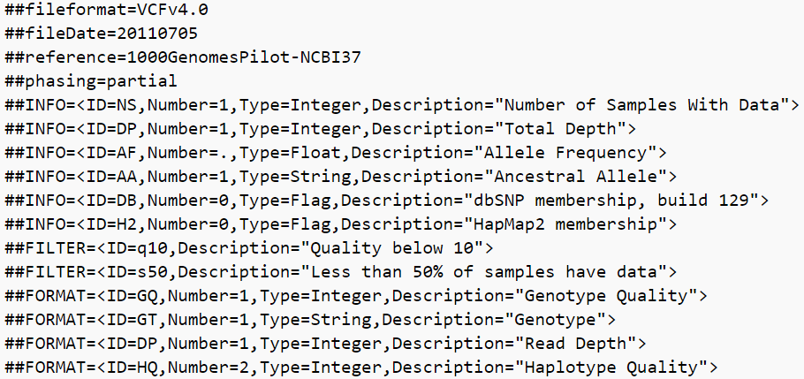
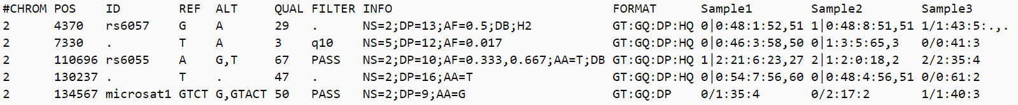
Example
Headers
Homozygous Reference (G|G)
Heterozygous (A|G)
Homozygous Alternative (A|A)
Genotypes

Slide 19
Limitations of VCF
No copy number variations (called separately)
In reality our genome can be better seen as comprised of haplotypes rather than individual, unrelated variants
Partially supported if the variants are phased
Somatic mutations are much more complex than germline variants (e.g. subclonal mutations)

Slide 20
Working with VCFs
There are some efficient open-source C/C++ implementations that provide a rich set of command-line tools for various manipulations (e.g. vcflib: https://github.com/vcflib/vcflib)
PyVCF is a simple (but very slow) Python parser (https://pyvcf.readthedocs.io/en/latest/)
Parsing by hand is not so difficult either

Slide 21
Multivariate analysis

Slide 22
The problem of confounding
Virtually all the statistical methods we have learned deal with just two variables (AKA bivariate analysis).
When there are confounders, we may end up with “spurious correlations”
Sex, income, etc.
Alcohol consumption
Mortality

Slide 23
Ways to control/adjust for confounders
Stratification: Perform the analysis within homogenous groups (with respect to the relevant confounders)
Can then report per-group p-values, or merge them (will be discussed in a bonus question)
Multivariate models
Either way, can only account for known & observed confounders.

Slide 24

Multivariate linear regression
The simple linear-regression model is: $y_{i}=β_{0}+βx_{i}+ε_{i}$
The null hypothesis is $H_{0}:β=0$ (i.e. just guessing a constant$β_{0}$ for all the samples is as good as making an $x$-dependent linear estimation).
We can generalize the model for any number of variables, obtaining: $y_{i}=β_{0}+β_{1}x_{i1}+…+β_{k}x_{ik}+ε_{i}$

Slide 25
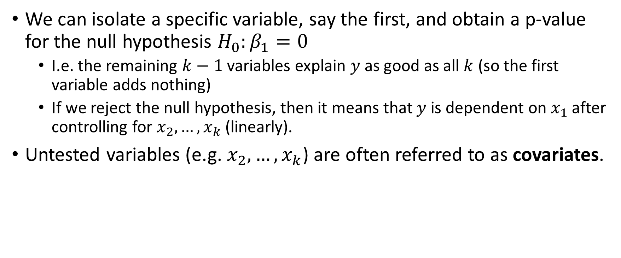
We can isolate a specific variable, say the first, and obtain a p-value for the null hypothesis $H_{0}:β_{1}=0$
I.e. the remaining $k−1$ variables explain $y$ as good as all $k$ (so the first variable adds nothing)
If we reject the null hypothesis, then it means that $y$ is dependent on $x_{1}$ after controlling for $x_{2},…,x_{k}$ (linearly).
Untested variables (e.g. $x_{2},…,x_{k}$) are often referred to as covariates.

Slide 26
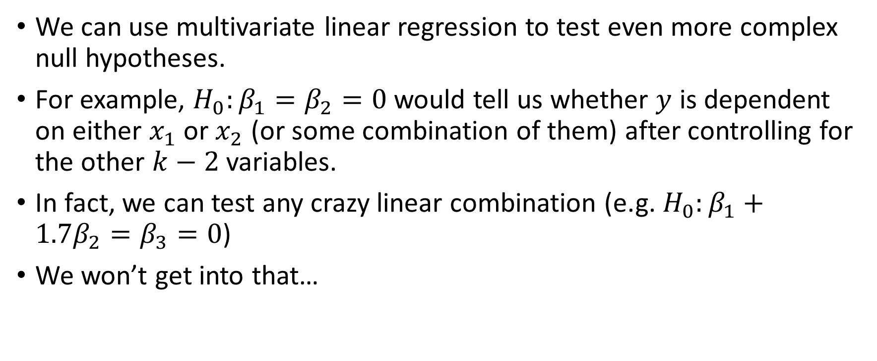
Contrasts
We can use multivariate linear regression to test even more complex null hypotheses.
For example, $H_{0}:β_{1}=β_{2}=0$ would tell us whether $y$ is dependent on either $x_{1}$ or $x_{2}$ (or some combination of them) after controlling for the other $k−2$ variables.
In fact, we can test any crazy linear combination (e.g. $H_{0}:β_{1}+1.7β_{2}=β_{3}=0$)
We won’t get into that…

Slide 27
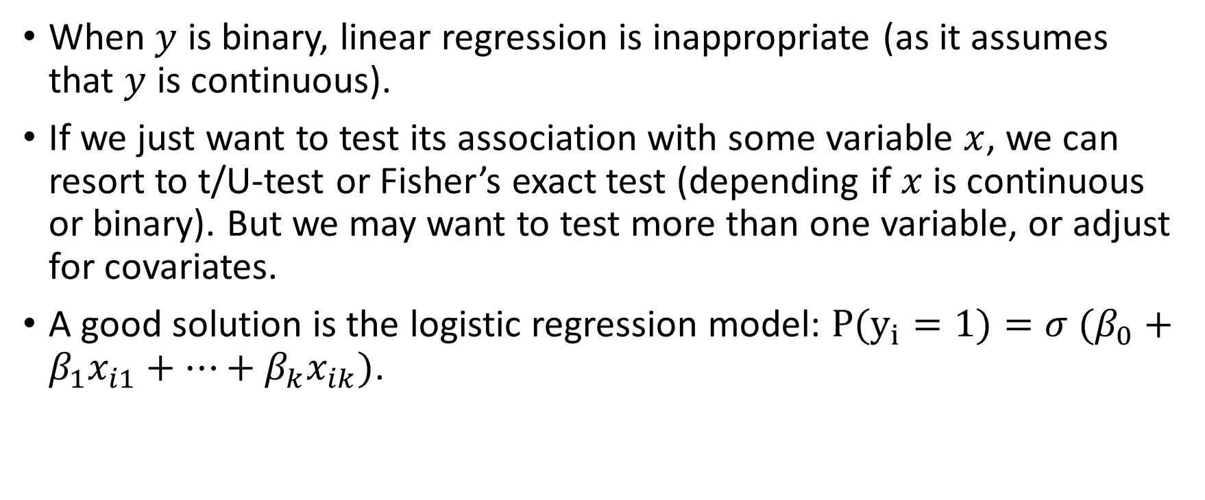
Logistic regression
When $y$ is binary, linear regression is inappropriate (as it assumes that $y$ is continuous).
If we just want to test its association with some variable $x$, we can resort to t/U-test or Fisher’s exact test (depending if $x$ is continuous or binary). But we may want to test more than one variable, or adjust for covariates.
A good solution is the logistic regression model: $P(y_{i}=1)=σ (β_{0}+β_{1}x_{i1}+…+β_{k}x_{ik})$.

Slide 28
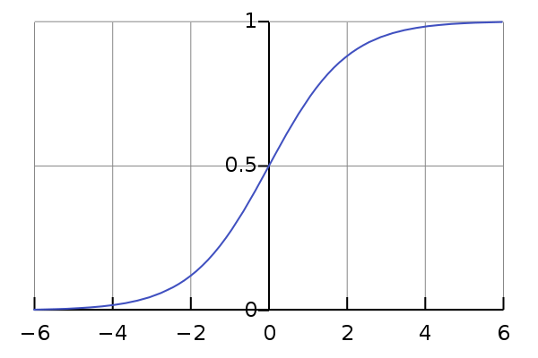

The (standard) logistic function
AKA sigmoid
$σ\left(x\right)≔\frac{e^{x}}{e^{x}+1}$
Output is in the range $(0,1)$
$σ\left(−∞\right)=0$
$σ\left(0\right)=\frac{1}{2}$
$σ\left(∞\right)=1$

Slide 29

The $y$ variable determines whether to use linear or logistic regression.
Both can handle $x$ variables that are either continuous or binary.

Slide 30
Sratification (vs. multivariate analysis) - pros & cons
Pros:
Can highlight associations that behave differently across different groups
Given the groups, it is model-free (no further assumptions)
Cons:
Group definition is arbitrary when dealing with continuous variables
Underpowered compared to multivariate analysis (especially with small groups)

Slide 31
Demonstration
Linear & logistic regression
Per-group analysis will be demonstrated in an upcoming bonus question.

